Slide 1
BMSW4003
Digital Skills and Research Methods
SEO
Skills for the Workplace Swansea

Slide 2
Session overview
In this session we will learn about SEO and strategies to get our business seen.

Slide 3
What is SEO????
It’s the art and science of matching your information—your webpages, products and services—with what people are searching for online.

Slide 4
SEO Framework
Understand
What is SEO
What tech do we need/use?
Evaluate
Benchmark
Gap analysis
Research
Keyword planner
Trends
Plan
Implement
Measure
Google analytics
Content creation
SEO campaigns
Adwords campaigns
Run Google ads
Schedule psting
Webmaster tools
Business case?
What are competitors doing?

Slide 5
4 forces of SEO
Algorithms
Technical
Seasonality
Competitive
Algorithms – Has Google updated how it reads info?
Technical – Have you updated content/ made changes to the site, creating errors?
Seasonality – Does the seasons impact SEO choices?
Competitive – A new competitor? Increased paid media?
Notes:
1. Algorithmic
Definition: Changes in search algorithms are affecting my organic performance.
Examples include:
Large or small-scale updates to Google algorithms.
Increases in featured snippets that impact the types of results that show up on a search engine results page (SERP).
Increases in the percentage of ads on a SERP for given topics.
2. Technical
Definition: Changes on my website are affecting my organic performance.
Examples include:
You added a new section of content.
You merged two websites into one domain.
You moved from non-secure to secure hosting.
3. Seasonality
Definition: Changes in time are affecting my organic performance.
Examples include:
Beginning of the fiscal year
Holidays
Literal season changes
Economic cycles (which can span for months or years)
4. Competitive
Definition: Competitive pressures are affecting my organic performance.
Examples include:
A new competitor entering the market, a merger, or an acquisition.
Non-competing sites competing for your keywords.
Increases in paid media cannibalizing a larger share of clicks for target keywords.

Slide 6
3 eras of SEO
Pre-Google
Google era (1990s – 2000s)
Quality strikes back (2011 – present)
Notes:
Era 1: The Pre-Google Era
In the late 1990s and early 2000s, SEO was simple for companies to manipulate. Just put your keywords all over your website again and again, and you’ll probably get traffic.
For end users, this era delivered search results of uneven quality. Fortunately, a new search engine would arrive and change everything.
Era 2: Google Era 1 (late 1990s – late 2000s)
As Google grew from a small project at Stanford, it quickly became the world’s most popular search engine. Google’s emphasis on citations—how many websites link to your website?—was a critical improvement.
While Google’s search engine model has never been disclosed in detail, SEO experts have found ways to optimize the system.
Two SEO methods stand out from this era. Some marketers published “spun articles” (i.e. computer-generated remixes of content) to gain Google’s favor. Next, we also saw the rise of content mills—companies that paid large numbers of writers small fees to churn out content. For a time, such methods worked.
Era 3: Quality Strikes Back (2011 – present)
Several major Google search engine changes starting in 2011 changed the SEO industry forever. In particular, Google updates started to target (and punish) spam and low-quality websites.
Here are some of the most important changes:
The Panda Update (February 2011). This update caused content mills and many other low-quality websites to disappear from the top ranking spots. Some businesses lost significant revenue as their traffic fell. Indirectly, this update rewarded higher-quality websites with a better user experience.
The Penguin Update (April 2012). The Penguin update continued the emphasis on quality. Further, this update began to penalize whole websites for spam techniques like keyword stuffing, rather than penalizing just the individual webpages. Google’s 2012 blog post announcing the change is also notable for distinguishing between “white hat” (e.g. high-quality SEO techniques) and “black hat” (i.e. low-quality SEO techniques reliant on spam).
The Fred Update (March 2017). This update focused on the tension between user experience and marketing. In brief, highly aggressive monetization methods—such as full-screen advertisements that obscure the underlying content—result in reduced traffic. In addition to excessive advertising, some SEO experts believe that low-quality links were also targeted in this update, such as a high volume of links that appear highly similar.
What does this mean for you as an SEO beginner?
First, exercise caution in using SEO methods and techniques that originated before these updates, because they may violate Google’s expectations.
Second, focus on the recurring themes in Google’s updates—publishing high-quality information and emphasizing the user experience.
Now that you know what SEO is and Google’s philosophy on quality, let’s get down to work on how to do SEO.

Slide 7
The Fundamentals of On-Page SEO (Can Google Read Your Website?)
ACTIVITY…

Slide 8
Go to a website you visit often and, Identify what you think are the keywords
You have 15mins to research and document.
Tell me the name of the website and the keywords you identified

Slide 9
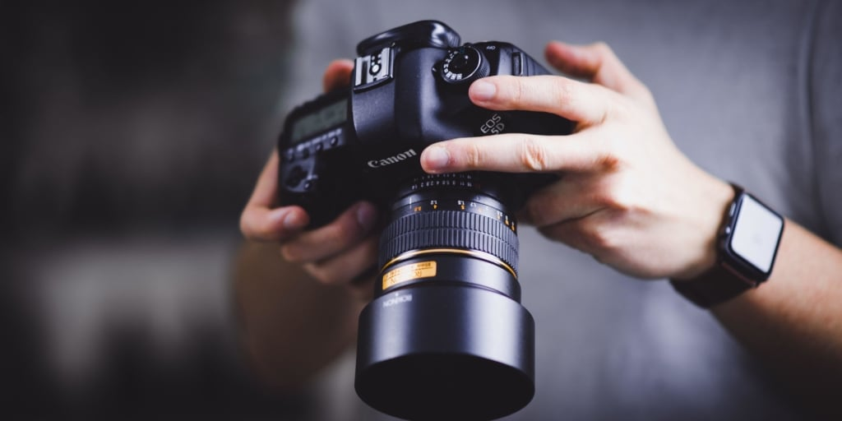
THE IMPORTANCE OF IMAGES…
65-85% of people describe themselves as visual learners
A study carried out by PR News found that online content with good images get 94% more views than those without

Slide 10
Activity 2….
Go back to the website you visited for activity 1: -
Identify trends and patterns in the visuals
How many pictures are present on the page?
Are they good quality?
Do they tell a story or is there a theme?
Is there video?
How do the images impact your connection with the website?
(You have 15mins)

Slide 11
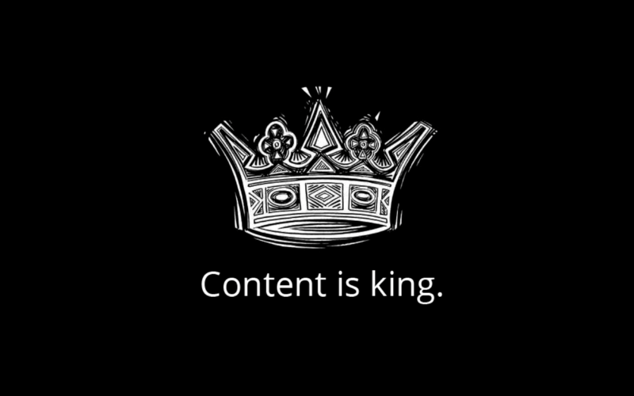

Slide 12
Content informs, entertains, educates and offers utility.

Slide 13
Activity 3….
Using the same website from the previous activities: -
  Does the website inform, entertain or educate?
  Does the website inspire trust?
  How ?
(You have 15mins)

Slide 14

We are all content creators

Slide 15
TUTORIAL….
Using your questionnaire data and analysis: -
Create an SEO strategy for your business:
        Identify keywords you can use
        What sort of images?
        Bullet point how you can inform, Educate or entertain

