Slide 1
International Marketing: Principles and Practices
LCMB 7026
WEEK 1

Slide 2
Week One
Part One: Module Introduction
Part Two: Growth of International Business

Slide 3
Module Introduction
Module Leader and Lecturer:
Dian Mayasari
d.mayasari@uwtsd.ac.uk

Slide 4
Over to you..
Introduce yourself:
(name, hobby, education/ work experience, etc)
Share your idea:
What makes this module a success?

Slide 5
Module Introduction
Professional Services/ Support:
IT service desk - BirminghamITServiceDesk@uwtsd.ac.uk
Student Engagement - birminghamstudentengagement@uwtsd.ac.uk
Wellbeing team - birminghamstudentengagement@uwtsd.ac.uk
Disability teams - disability.birmingham@uwtsd.ac.uk
Birmingham Assessment - birminghamassessments@uwtsd.ac.uk

Slide 6
Module Overview
Title:
International Marketing: Principles and Practices
Module Code: LCMB 7026
Credit: 20

Slide 7
Module Overview
AIMS
To support the development of a comprehensive understanding of contemporary marketing theories and practices in an international environment.
LEARNING OUTCOMES
Upon the successful completion of this module, the student should be able to demonstrate the ability to:
Critically compare and contrast the impact of cultural differences and similarities between nations in a marketing context;
Identify and critically reflect on the contemporary ethical and practical frameworks of marketing within a global context.

Slide 8
In the classroom
Respect fellow students.
Please keep your mobile phone in silent mode.
Participate in class discussion.
ASK!!! This is the ONLY way to learn.
Do not leave things to the last minute (assessments, etc.)
Always here to help- please ask if you need any support.
Bring your laptops to class!

Slide 9
Structure of weekly sessions
Morning classes start at 09:15 and afternoon classes start at 14:00. Please make sure you arrive in class on time.
Anyone who comes to class late, after 10 minutes, will be marked as late in the register
Lectures/ Module leaders/ Program managers are not allowed to authorise any absences. Only the Student Engagement Team can authorise absences.
The last 15 minutes are reserved for 1-to-1. (e.g. 13:00-13:15 or 17:45-18:00). Students leaving 10 min earlier than 17.45 (i.e., 17:35 or earlier) will be marked as late.
Academic staff members (Program managers, Module leaders or lecturers) cannot grant extensions, change the timetable or provide/discuss any wellbeing advice/issues, etc. Discuss any non-academic issues with the designated UWTSD staff members/teams.

Slide 10
Indicative Content covered each week
Week | Topic
1 | Module introduction
 | Growth of international business
2 | International marketing environment
3 | Sociocultural environment in international marketing
4 | Organisational structure and market entry
5 | STP strategies
6 | International product strategies and branding
7 | International pricing and promotional strategies
8 | International distribution and logistics
9 | Ethical issues in international marketing and assessment surgeries
10 | Research in international marketing and assessment surgeries

Slide 11
How this module be different to Marketing Management?
Advance module
(Students must know the basics of 4Ps and STDP)
More research
More applications
More critical analysis (asking ‘so what?’)
More comparative analysis
To set your mind as a global citizen

Slide 12
Assessment
Assessment 1-100% weighting of overall mark
Individual Essay(5000 words ±10%)
Let’s check together the assessment briefs in Moodle.
A step-by-step guide template is provided to support you writing the essay

Slide 13

Questions?
Do you have any questions relating the module……

Slide 14
Part Two
Introduction to International Marketing:
Growth of the International Business.

Slide 15
In today’s session….
After reading and studying this session, you will be able to:
Explain the meanings of the terms “international marketing,” “multinational corporation,” “born-global,” “home country,” and “host country”
Explore how the drivers of globalisation have influenced international marketing.
Discuss how the factors that create international marketing complexity are linked to creating a global mindset for marketing activities

Slide 16
Learning Objective1
What are the meanings of the terms “multinational corporation,” “born-global,” “home country,” and “host country”?

Slide 17
What is Marketing?

Slide 18
Marketing Defined
Marketing may be defined as “discovering consumer needs and wants, creating the goods and services products that meet those needs, and then pricing, promoting, and delivering those goods and services.” (Keegan, 2013)
The marketing mix consists of the major activities used to develop and sell goods and services.

Slide 19
What is International Marketing?

Slide 20
International Marketing
The utilization and adaptation of the best marketing practices for the purposes of conducting commerce in other countries (Baack, 2018)
The process of planning and conducting transactions across borders does create exchanges that satisfy the objectives of individuals and organisations (Czinkota, 2011).
It includes conducting commerce with customers, clients, partners, society at large, and the overall global community.
Also known as Global marketing (Zou & Cavusgil, 2002)
Notes:
The definition highlight the keywords such as Countries, borders, and global

Slide 21
What’s the difference between Marketing strategies and International marketing strategies?

Slide 22
Comparison of Single country marketing strategy and International marketing strategy
Single Country Marketing Strategy | International Marketing Strategy
Target market strategy | Global market participation
Marketing mix development | Marketing mix development
Product | Product standardization or adaptation
Price | Price standardization or adaptation
Promotion | Promotion standardization or adaptation
Place | Place standardization or adaptation
 | Concentration and coordination of marketing strategy
 | Integration of the competitive moves
Keegan and Green (2013)

Slide 23
Who does international marketing?
Multinational Corporations (MNCs)
  Businesses that conduct activities in at least one other country that differs from the home country in which the organisation is headquartered.
  Example?
Born-global firms
  Businesses that operate in two or more different countries from inception are born-global firms.
  Example?
Notes:
MNC examples can be: Unilever, Exxon, Coca-Cola, etc
Born Global can be: IT company, or other companies serve global market since established

Slide 24
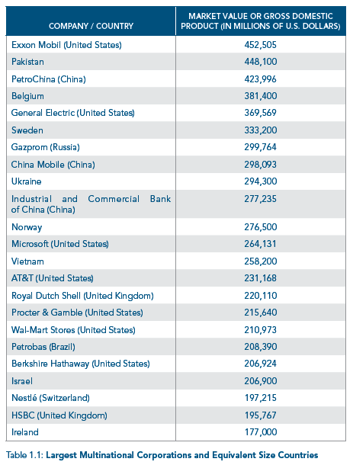
Largest MNC and Equivalent Size countries
  Exxon Mobil’s market value is almost as big as the GDP of Pakistan
  Microsoft’s market value is almost as big as the GDP of Vietnam
What can you conclude from the data in Table 1.1?
  (Baack, 2018)
Notes:
There is no right or wrong answer. The question is to highlight the importance/ significant of international business
Comparison:
Comparing a company's market cap to a country's GDP provides a way to gauge the relative size and economic influence of the company compared to the nation.
Implication:
If a company's market cap is as large as a country's GDP, it suggests that the company's economic impact and influence are comparable to that of the entire nation.

Slide 25
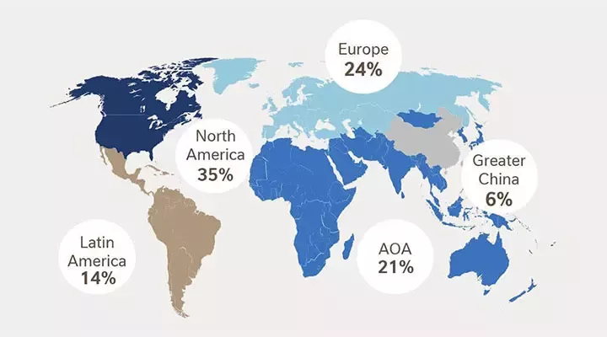
Home vs. Host Country
The home country is the nation in which the business is located or the country that houses the company’s main headquarters.
A host country is a nation being targeted for expansion. The country where the company wants to market its product.
Figure 1 – Nestle sales around the world (Nestle, 2024)
What are the home country and
the host country of NESTLE?
Notes:
Students can browse on their Laptop/Mobile phone about Nestle’s home country (Switzerland).
It’s also mentioned in Table 1.1. Slide 24

Slide 26
International Marketing Approach
Ethnocentric: Only considers the home/host country’s cultural ambience (one strategy for all) - Standardisation
Polycentric: Considers the cultural values of both the host and home countries (standardisation vs adaptation)
Region-centric: Considers the culture only of the region in which the company is operating - Standardisation
Geocentric: Takes the cultural ethos of the geographic coverage the company plans to have
Notes:
A different approach will determine whether the company adopts an adaptation or standardisation strategy in its marketing across countries.

Slide 27
Activity 1 - Home vs Host Country
Do it in pairs (e.g. with a person sitting next to you) – 20 min
Have a look at Table 1.1 (slide 21) – Use your laptop/ mobile phone to do the research:
Identify the home country of the MNC listed in Table 1.1
Identify if the host country(s) of the MNC listed in Table 1.1
Write your answer in a piece of paper

Slide 28
BREAK

Slide 29
Learning Objective 2
How have the drivers of globalisation influenced international marketing?

Slide 30
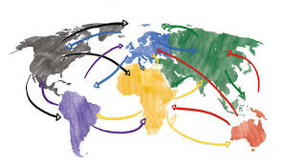
Globalization
The increased interconnectedness of consumers and businesses (Baack, D. G. 2018)
Globalization provides a key marketing opportunity
Globalization Drivers:
  Channels of Communication
  Lower Transportation Costs
  Immigration and Emigration Patterns
  Governmental Actions
  Multilateral Trade Agreement (further discussion in session 2 – next week)

Slide 31
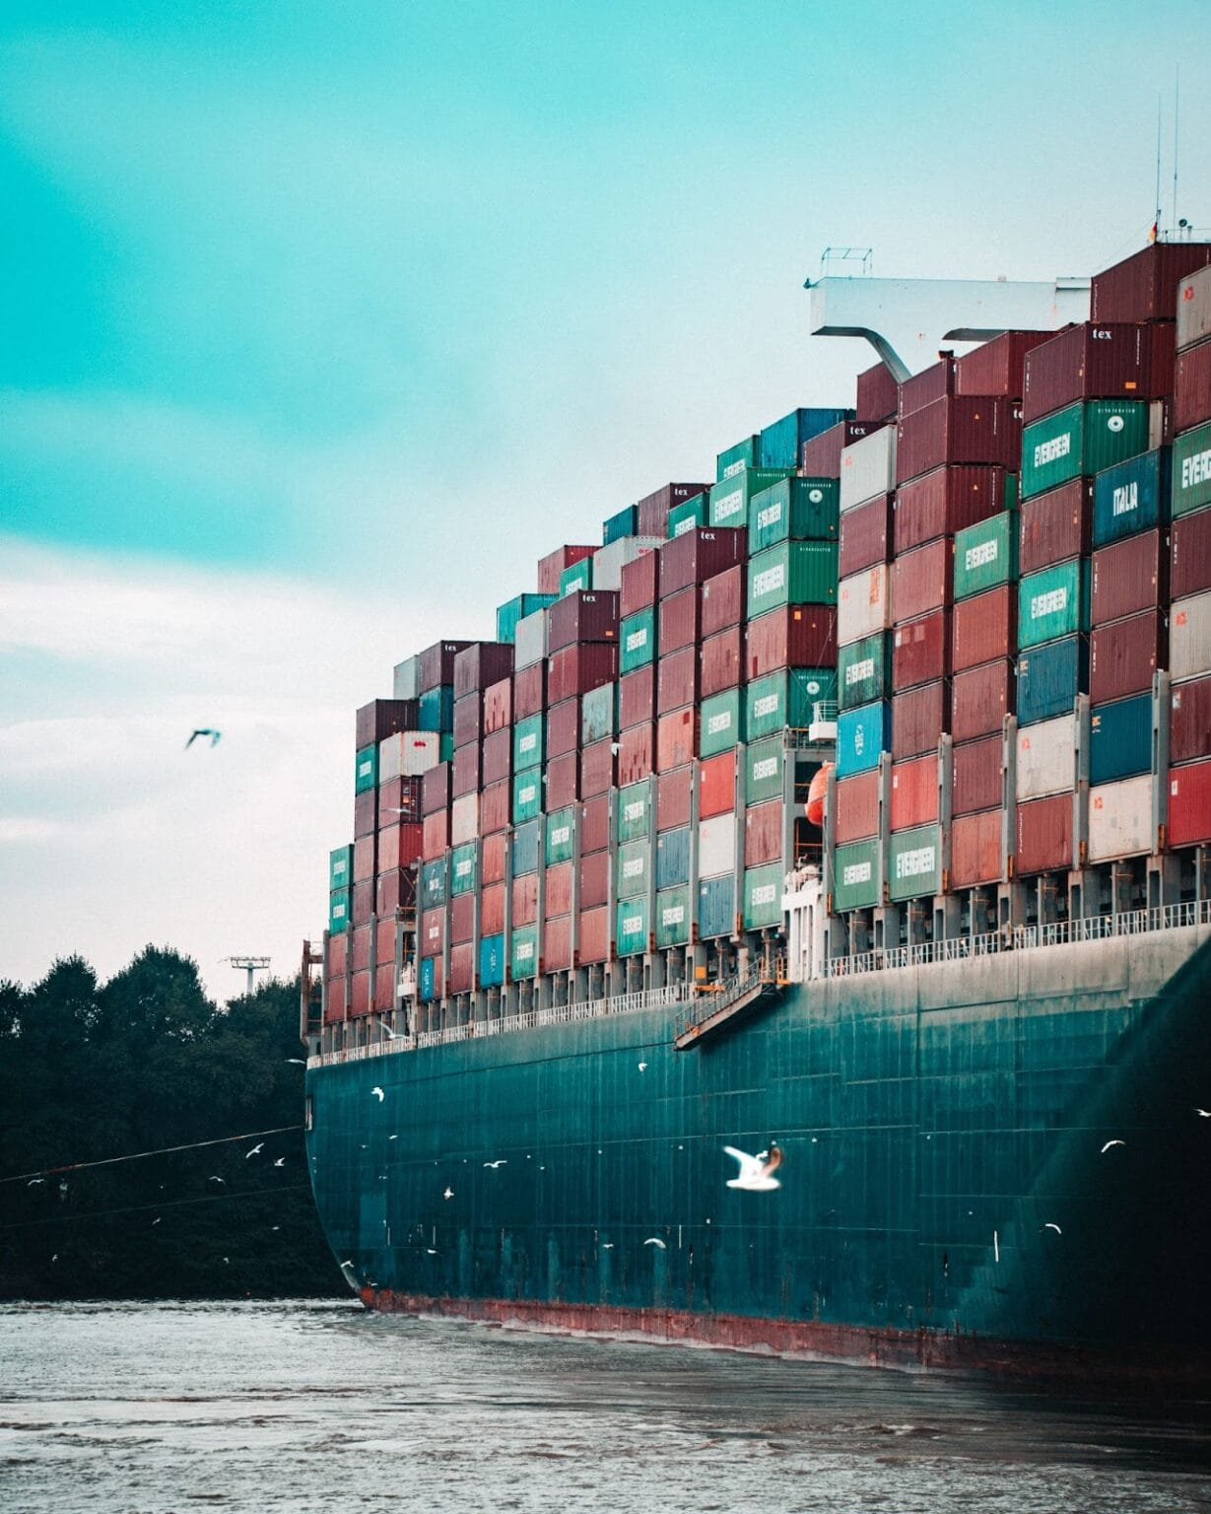
Globalization Drivers:
Channels of Communication
Technology alters communication patterns
Social Media
Outsourcing marketing activity to other countries
(British consumers calling the customer service in Lithuania)
Lower Transportation Costs
Technology decreases transportation costs
Technology enables the movement of people and products
  Containerization (Notteboom & Rodrigue, 2009)
  Reduction in air freight cost (Hummels, 2007)
Notes:
Containerization is a method of transporting freight by placing it in large, standardized containers without need for repacking or complex handling

Slide 32
Globalization Drivers:
Immigration and Emigration Patterns
The movement of people increases ties between countries
Widens exposure to different cultures and ideas
Desire product from former home
Governmental Actions
Government reduces barriers to commerce
Market liberalization (e.g., China)

Slide 33
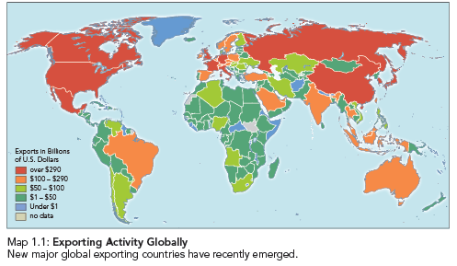
What is the largest exporting country?
Notes:
China in 2023 = 3.3 billion USS (Statista, 2023)

Slide 34
How do you see globalization?
If you are a marketing manager/ business owner of a local company
Is globalisation a threat/ opportunity to your company?
Will your answer be different if you are a marketing manager of a local company vs a multinational company?
Notes:
Give students 10 minutes to compose their thoughts

Slide 35
Learning Objective 3
How are the factors that create international marketing complexity linked to creating a global mind-set for marketing activities?

Slide 36



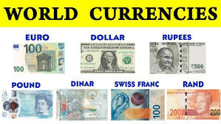

International Marketing Complexity
Culture
Language
Political and legal systems
Economic systems
Infrastructure

Slide 37

Culture
Beliefs, customs, and attitudes could be different in every country
Willingness to try new products
Strategic Implication?
  Find a local partner to navigate the differences.
  Think globally, act locally?
  Think locally, act globally?

Slide 38

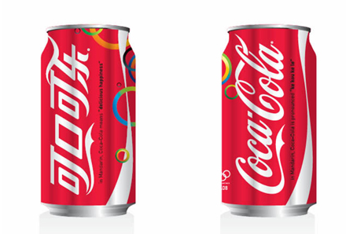

Language
Movement of product across boundaries may require translation
Strategic Implication?
  May need a cultural assimilator who is well-versed in both host and home countries’ languages and cultures

Slide 39
Political, Legal and Economic system
A further discussion about this in session two, next week
Different countries may have different political, legal and economic systems
The host country’s government may protect local economy and politics (see: TikTok and Douyin) – Why does ByteDance need to create a different platform in China?
Strategic Implication:
Local partner to navigate the host country’s political/ legal/ economic system

Slide 40
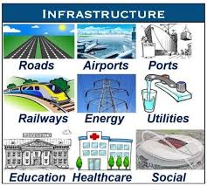
Infrastructure
Organisational infrastructure
Physical infrastructure
Poor infrastructure increases production and marketing costs
Strategic Implication:
See the business with a global mindset
  Could Uber succeed in a country without internet access?

Slide 41
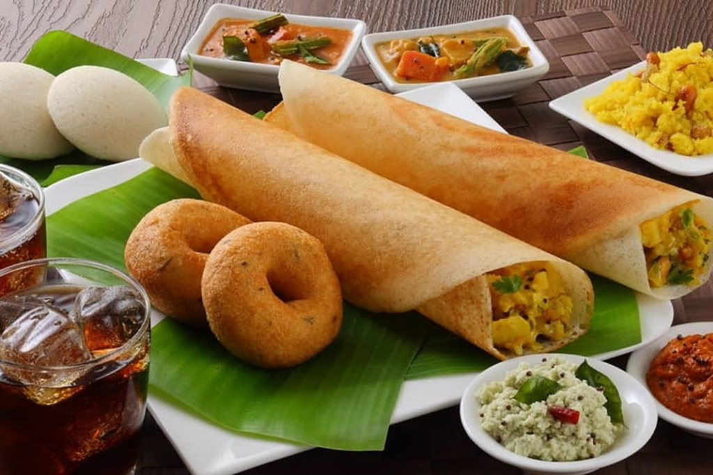
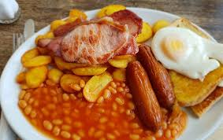
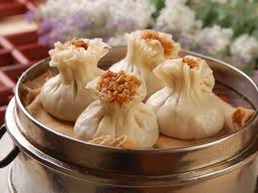
International Marketing in daily life
Marketing and international marketing are not always ‘glamorous’.
It’s not always about fancy sports car and luxury products
Think about bathing or breakfast, they are daily activities, basic human activities. The globalisation of business practices and international marketing also impacts these.

Slide 42
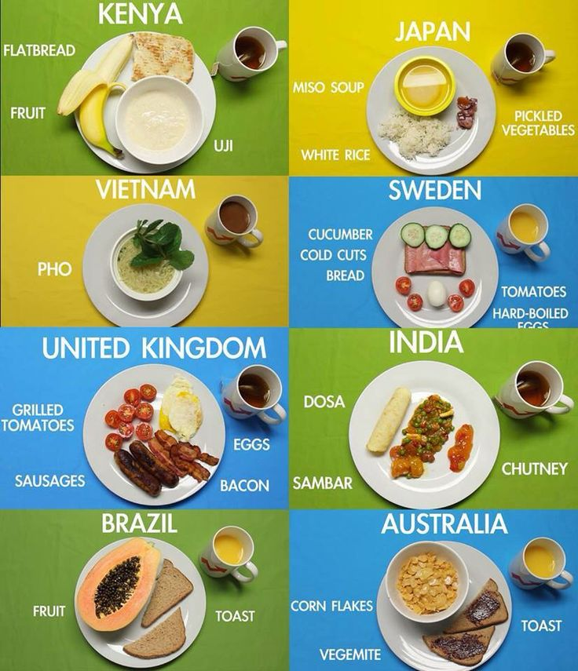
Group Activity (20 min) –
International marketing in daily life
Research breakfast in the UK and one other country (you choose), and answer this:
Compare how the international marketing of breakfast products in those two countries is impacted by culture, language, and infrastructure.
Write down your answer on a flipchart paper
Your group will be presenting your findings in front of the class

Slide 43
Template Idea for your group activity:
 | Country A | Country B | Marketing Impact
Culture: Breakfast time How to eat breakfast | Early morning Together with family | Mid day On the way to work | Light breakfast menu in Country A Meal deal or to-go breakfast for country B
Language:
Infrastructure: Raw materials availability | Corn is available | Abundance Wheat | Corn cereal in country A, Pastry/ bread in country B
Economic system | High Income country | High income country | Premium pricing

Slide 44
Template Idea for your group work:
Country A
Culture Religious Bath
Language
Economic High income, Premium pricing
Infrastructure
Country B
Culture Bath for hygiene
Language
Economic Low income – small size packaging
Infrastructure
Any other template ideas are welcome.
Creativity is a highly sought-after skill by employers

Slide 45
Today we covered
:
The terms “international marketing,” “multinational corporation,” “born-global,” “home country,” and “host country”
Explore how the drivers of globalisation have influenced international marketing.
Discuss how the factors that create international marketing complexity are linked to creating a global mindset for marketing activities

Slide 46
Any questions?
Next week we will study
International Marketing Environment

Slide 47
References
Baack, D. G. (2018). International marketing., 2nd edition. London: SAGE Publications.
Czinkota, M.R. (2011) International Marketing. Hampsire: Cengage Learning.
Hummels, D. (2007) ‘Transportation Costs and International Trade in the Second Era of Globalization’, The Journal of economic perspectives, 21(3), pp. 131–154.
Keegan, W.J. and Green, M.C. (2013) Global marketing. 7th ed., global ed. Boston, Mass. ; London: Pearson.
Notteboom, T. and Rodrigue, J.-P. (2009) ‘future of containerization: perspectives from maritime and inland freight distribution’, GeoJournal, 74(1), pp. 7–22
Zou, S. and Cavusgil, S.T. (2002) ‘The GMS: A Broad Conceptualization of Global Marketing Strategy and Its Effect on Firm Performance’, Journal of marketing, 66(4), pp. 40–56

