Slide 1
Management and Leadership
Wynne Jones

Slide 2
Exercise 15 mins – Write down a ‘great leader’ and 3 reasons why.

Slide 3
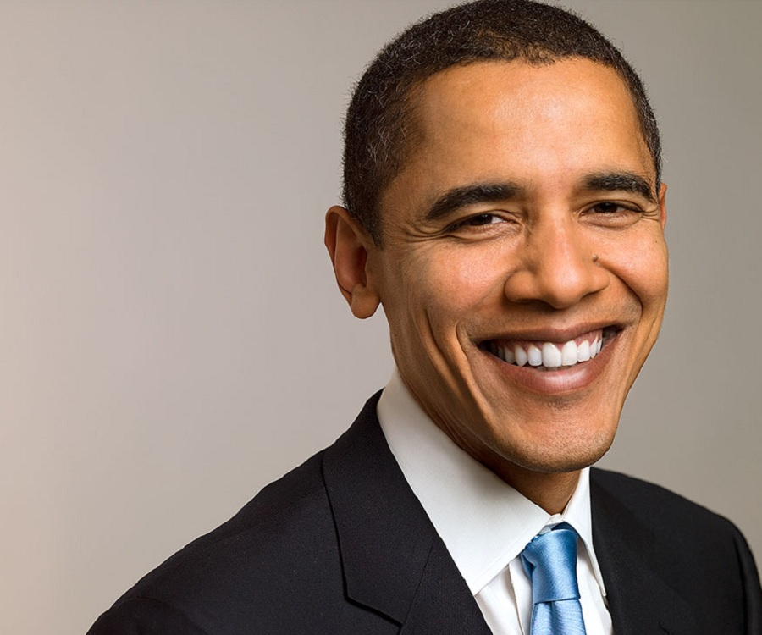
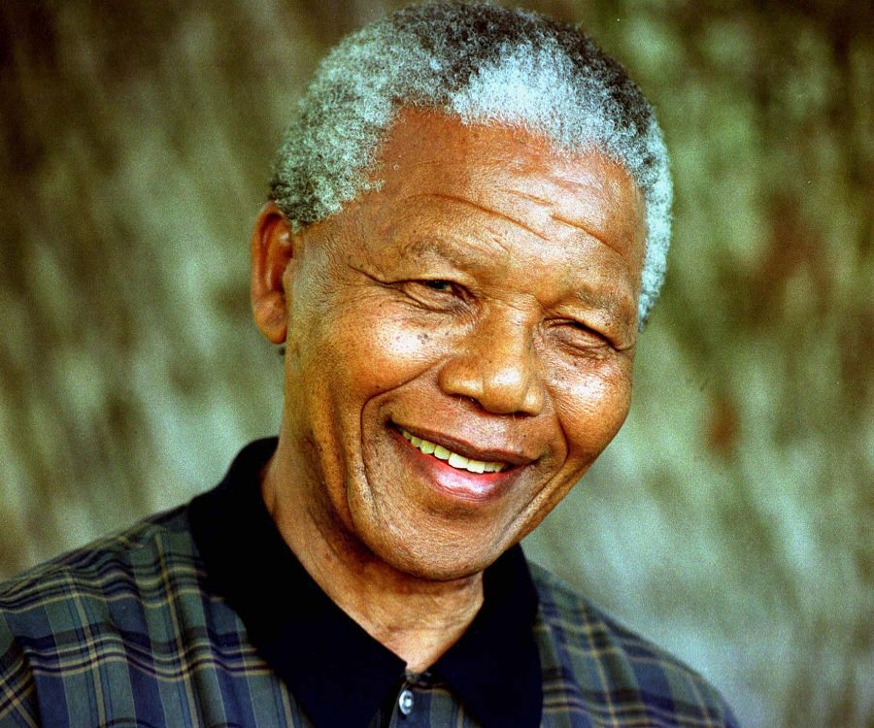
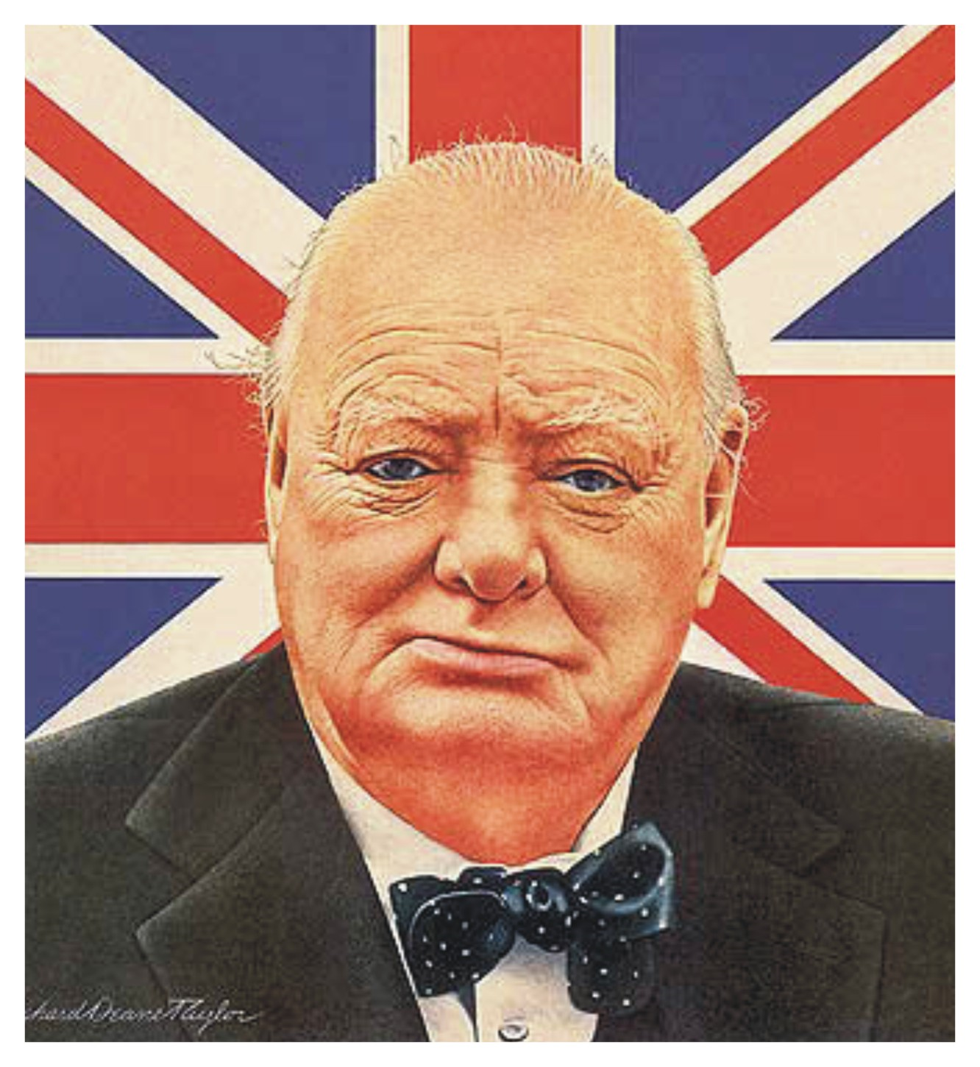
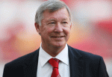
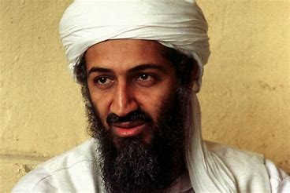
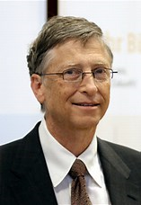
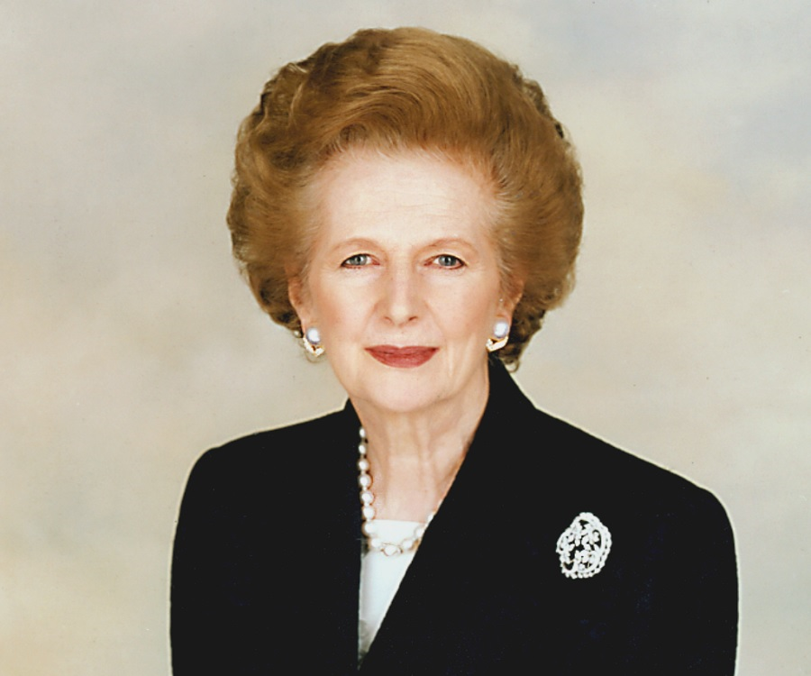
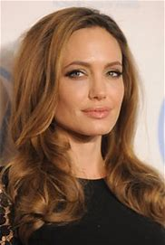
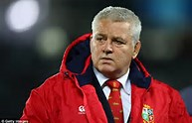
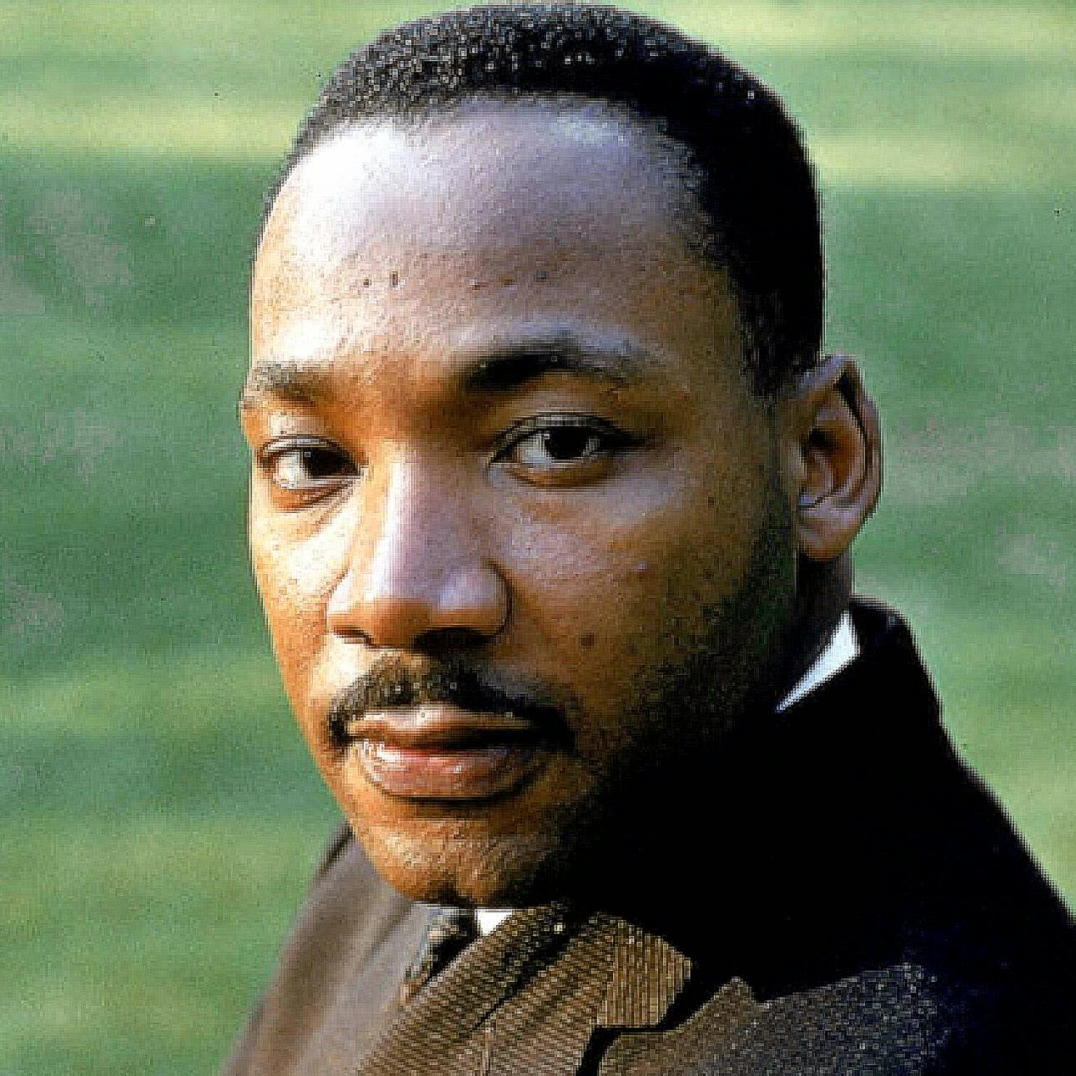
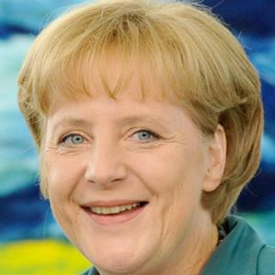

Slide 4
Leaders/Managers – Made or Trained?
According to Eden leadership training is unrealistic as some managers ‘have it’ naturally whilst others do not.
What do you think of this theory?

Slide 5
Providing Leadership to a Team
Are you a Manager or a Leader?
Or both?
What do the words mean and how do they impact on the way you perform?

Slide 6
The Differences between Management and Leadership
There is a lot of overlap,
Both incorporate organising, working with people, and achieving organisational goals,
Both are necessary for the successful running of any Organisation.

Slide 7
Managers | Leaders
Establish Strategy, Set Timetables/Rota’s Provide Structure, Allocate Resources, Rely on Authority to command respect, Instruct others, Are concerned with stability, Are concerned with processes and systems. | Create a vision, Have a long term view, Develop strategies, Inspire and empower others, Focus on shared goals and values, Embrace change, May not have managerial responsibility but still command respect, Create a positive team environment.

Slide 8
Modern day Leadership in PS
A more flattened approach to management and leadership where every one is expected to take more personal responsibility.

Slide 9
Task: Impact of Leaders and Managers
What would be the impact on an organisation if:
It had strong Management but a lack of Leadership?
Strong Leadership and a lack of Management?

Slide 10
A couple of examples of Leadership styles
Dominance
Submission
Authoritarian, Autocratic Making decisions without consultation or explanation
Laissez-faire, delegating power (and responsibility), fail to direct, everyone does his/her own thing.

Slide 11
Extremes of Leadership
Styles at the two extremes i.e. Dominance and Submission are likely to be unattractive and lead to demotivation.

Slide 12
Leadership Styles
Macgregor’s Theory X and Theory Y,
Action Centred Leadership,
Blake and Mouton Leadership (Managerial) Grid,
Tannenbaum and Schmidt Continuum,
Situational Leadership,
Transactional Leadership,
Transformational Leadership.

Slide 13
Management and Leadership
Wynne Jones

Slide 14
Task: Expectations from a ‘Leader’
5 mins

Slide 15
Expectations from a ‘Leader’
Integrity
Ethical leaders :
The manner in which a leader handles challenging situations or conflicts is one example of an opportunity for modelling strong integrity.
By dealing with a conflict directly and in a transparent manner, leaders prove themselves to be honest, forthright managers.
Goals
Leaders make their priorities for both themselves and their workers clear.
When a team fails to meet its goals, leaders are expected to provide constructional feedback and suggestions for improvement.
If goals are achieved, leaders should acknowledge this while simultaneously raising standards for the next project.
Motivational
Leaders must “inspire a high level of commitment and performance,”
Not be entirely negative or positive, but a mixture of both.
E.g. a leader might introduce initiatives that either reward employees based on outstanding performance or punish them for poor performance.

Slide 16
Expectations from a ‘Leader’
Innovation
Outstanding organisations are such thanks to workers who constantly strive to improve.
These organisations must have innovative leaders who can see past immediate projects, objectives and successes and develop new, original ideas to stay ahead of their competitors.
Leaders can inspire and draw out innovation in their employees by constantly asking questions and paying attention to any worker with valid concerns or solutions.
Collaborative
Leaders can encourage a collaborative spirit by demonstrating strong communications skills, not only with the employees they oversee but with their own employers, clients and customers.

Slide 17
Douglas McGregor
Douglas McGregor was born in 1906 and died at the comparatively young age of 58 in 1964, he was a professor of management at Massachusetts Institute of Technology .

Slide 18
Douglas McGregor
In his book ‘The Human Side of Enterprise’ McGregor identified an approach of creating an environment within which employees are motivated via authoritative, direction and control or integration and self-control, which he called theory X and theory Y.

Slide 19
McGregor’s Theory X and Theory Y
McGregor did not publish much but what he did publish had a great impact.
In 1993 he was listed as the most popular management writer of all time.

Slide 20
McGregor’s Theory X and Theory Y
McGregor’s Theory X and Theory Y was an early attempt to analyse leadership style,
It was based upon the underlying assumptions that leaders hold about employees.

Slide 21
Task: ‘Assumptions about employees’
If you were a manager what sort of traits (positive or negative) would you expect to find in your stasff?

Slide 22
Theory X
Theory X assumes that people would prefer to avoid work if they can,
They have to be coerced and threatened to get them to perform,
Employees need, and will respond to, close supervision and control.

Slide 23
Theory X
Leaders who take this view generally get a hostile reaction from employees, which acts to reinforce their original view and strengthen the behavioural cycle.

Slide 24
Theory X
McGregor proposed that the role for managers and or leaders was to change from Commanding and Controlling (Authoritarian) subordinates to one of assisting them to reach their full potential.

Slide 25
Theory Y
Assumes that humans naturally find work satisfying, will respond positively to objectives to which they are committed, and accept responsibility,
Individual satisfaction can be gained from the pursuit of organisational goals (Mission and Vision Statements).

Slide 26
Theory Y
Whilst this theory is more appealing to employees, not all people are self-motivated or willing to consistently align themselves to the objectives of the organisation.

Slide 27
Theory Y
So in contradiction to Theory X McGregor makes the assumption that employees are:
Not all inherently lazy,
Capable of self direction and self control, and
Capable of providing important suggestions and ideas that will improve organisational effectiveness.

Slide 28
Theory Y
These positive aspects of Theory Y when effectively managed by the use of a system of ‘Objectives and Rewards’ and the opportunity to participate in the decision making process can lead to the realisation of both personal and organisational goals.

Slide 29
What is the most effective X or Y?

Slide 30
Managing Using Theory X and Y
It would be over simplistic to suggest that managers have a ‘theory X’ or ‘theory Y’ mind-set (hopefully!),
Managers would usually have different types of relationship with different subordinates,
Perhaps they would adopt a theory X approach with some and a theory Y with others!

Slide 31
Leadership

Slide 32
Team Leadership Model
Designed to:
Monitor the Team
Diagnose Team Problems
Take Appropriate Action
Restore Effectiveness of Team

Slide 33
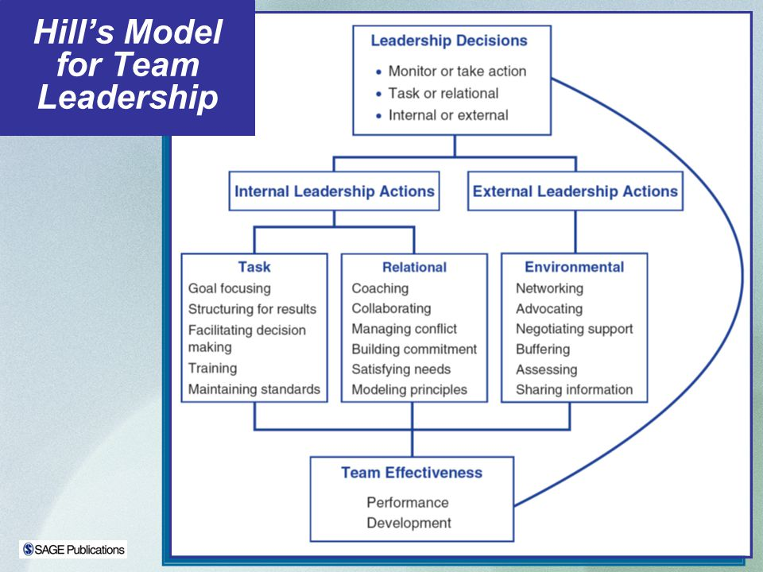

Slide 34
BOX 1 Leadership Decisions
These are the Big decisions for a leader:
Firstly, should the leader continue to observe the ‘team’ or Intervene and take some action?
Secondly, ‘Task or Relational Intervention’, does the team need help to achieve the task, or does it need help in maintaining relationships?
Thirdly, Internal or External, should the ‘intervention’ be within the team or in the teams environment?

Slide 36
Eden
At the start of the lecture we considered Eden’s theory that good leaders or managers were made rather than trained, next we will take a look at Adairs ‘Action Centred Leadership model’

Slide 37
Bibliography
Carson C. (2005) “A historical view of Douglas McGregor’s Theory Y”. Management Decision. (450 – 460).
Kopelman R.E. Prottas D.J. and Davis A.L. (2008) ‘Douglas McGregor’s Theory X and Y: Toward a Construct-valid Measure’. Journal of Managerial Issues. Vol XX. No.2. Summer 2008. 255-271.

Slide 38

Action Centred Leadership

Slide 39
Action Centred leadership (ACL) highlights the importance of leading a team, not just a group of individuals who make up the team.

Slide 40
The ‘three circle’ model was developed by John Adair whilst he was studying at Sandhurst military academy in the 1960’s and assumes that a team leader has three distinct functions to ensure successful leadership.

Slide 41
In conflict to Eden who we have discussed previously Adair argues that leadership is a trainable, transferable skill as opposed to an inborn trait.

Slide 42
Adair promotes a 50:50 rule – 50% of motivation comes from individual, and the other 50% comes from the leader.
You can apply this to the achievement of a task or the building of a team.

Slide 43
Group Exercise:
What ‘transferrable’ skills do leaders require?

Slide 44
Skills such as:
COMMUNICATION
MOTIVATION
DELEGATION
TIME MANAGEMENT
Used by all leaders to do their jobs can be trained thereby improving a persons leadership capability.

Slide 45
Adair’s ‘three circles’ theory focuses on the three following areas:
Achieving the Task,
Building the Team, and
Developing Individuals

Slide 46
Achieve
Task
Build
Team
Develop
Individuals
Notes:
3 areas identified by Adair
Discuss each area and get examples from students –
How are they going to achieve task / build team / develop individuals.

Slide 47
Achieve
Task
Build
Team
Develop
Individuals
Notes:
Where should the leader be?
In the middle?
Hovering above?
Demonstrate with group hug example – How many fingers am I holding up????
Discuss helicopter theory? You should be hovering above with the ability to land in whatever area you are required to land in.
What happens if you fail in a particular area – DISTORTIONS RESULT.

Slide 48
The effective leader is the one who keeps all three in balance;
That is who attends to all three at the same time,
If any one element is ignored, the others are unlikely to succeed.

Slide 49
ACL Distortions ‘Big T’
Task
Team
Individual
Notes:
BIG T – Too task orientated.
Does this relate to you. Do you know such a leader?
What effect could this have?
Pressure on staff / difficult to sustain / too much focus ,not aware of other issues.
Think about a murder enquiry – SIO’s now are better aware of the team rather than just focusing on the capture of the culprit.

Slide 50
‘Big T’
Pressure on time and resources often increases pressure on a group to concentrate on the task, possibly to the detriment of the people involved.
But if group and individual needs are forgotten, much of the effort spent may be misdirected.

Slide 51
ACL Distortions ‘Groupie’
Task
Individual
Team
Notes:
Groupie – really popular leader.
Is this you ,do you want to be, be honest.
What difficulties?? – Reluctant to criticise, standards fall, no standards are set.
Any experience of this? As previously said good to look at you leaders and identify good and bad aspects of their behaviour.

Slide 52
‘Groupie’
Taking time creating a good team spirit without applying effort to the task is likely to mean that the team will lose its focus through lack of achievement.

Slide 53
ACL Distortions
‘Blue Eyes’
Task
Team
Individual
Notes:
BLUE EYED SYNDROME
Facilitate – what do we mean here?
Concentrate on the more efficient – Why??
What effect will this have on the team? On the task?
Full team potential will not be realised.

Slide 54
‘Blue Eyes’
The focus here is on a specific individual or individuals,
This might be based upon a variety of ‘preferences’
Such as appearance, age, experience, or ‘group dynamics’ e.g.
Masonic connections, ‘drinking’ buddy, plays sport together, etc.

Slide 55
Action Centered Leadership.
Achieve the task
Build the team
Develop individuals
Notes:
This is the best model – fits in with Adair’s 50/50 idea.
What are the benefits of this position – Get feedback
Are we good at this
Any examples – mistakes made – de we have culture where we would accept a mistake – Should we????
Lets put this into practice.
Exercise - Playing cards
Hand out the aide memoir

Slide 56
The Skilled Leader
Identify and evaluate the requirements of the task,
Communicate these to the group and gain their commitment,
Plan the achievement of the task with the group,
Identify resources within the group and allocate responsibility to individuals,

Slide 57
The Skilled Leader
Monitor and evaluate progress of the whole group and of individual members,
Communicate feedback to the group and support, praise, encourage individuals,
Review plans, and make changes, with the group until the task is achieved.

Slide 58
Questions

