Slide 1
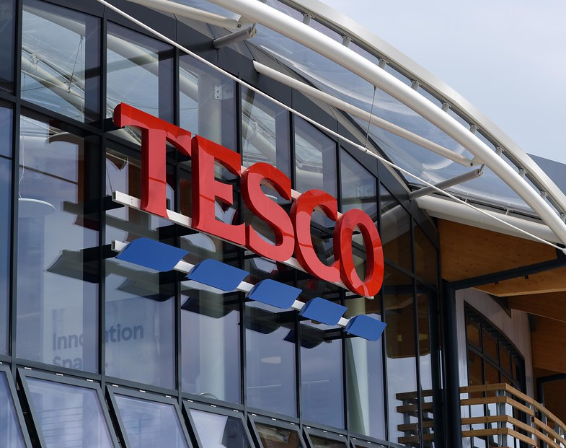
Building a sustainable marketing relationship
This Photo by Unknown Author is licensed under CC BY-SA-NC

Slide 2

Task 1- Slide 1
Digital marketing, also called online marketing,
This includes not only:
email
social media
web-based advertising
The company Tesco is not an exception in this case. The renowned and world-known retail. That is the reason, the company is intending to enhance digital marketing planning and also reduce the gaps in terms of the challenges identified in assignment.

Slide 3
Benefits of digital marketing
Disadvantages of digital marketing
Global reach
Lower cost
Trackable, measurable results
Personalization
Openness
Social currency
Skills and training
Time consuming
High competition
Complaints and feedback
Security and privacy issues

Slide 4

Disadvantages of Social Media
1. Spending a lot of time on social media.
2. Decrease in Communication skills.
3. Fake news.
4. Social media can cause sleeplessness
Advantages of social media
1. Useful for educational purposes:
2. Build your brand:
3. Stay up to date.
4. Get connected to new people.
This Photo by Unknown Author is licensed under CC BY-SA-NC

Slide 5

Reference List
Anon, (2023). Digital Marketing & Social Media Project | Free Essay Examples. [online] Available at: https://samples.freshessays.com/digital-marketing-social-media-project.html.
Mailchimp (2021). What is Digital Marketing? A Beginner’s Guide - Mailchimp. [online] Mailchimp. Available at: https://mailchimp.com/marketing-glossary/digital-marketing/.
muzameel, S. (2022). Top 10 most common advantages and disadvantages of social media. [online] Web Trainings. Available at: https://www.webtrainings.in/social-media-advantages-and-disadvantages/.
NI Business info (2019). Advantages and disadvantages of digital marketing. [online] nibusinessinfo.co.uk. Available at: https://www.nibusinessinfo.co.uk/content/advantages-and-disadvantages-digital-marketing.
www.google.com. (n.d.). digital marketing - Google Search. [online] Available at: https://www.google.com/search?client=avast-a-2&q=digital+marketing&oq=digital+&gs_lcrp=EgZjaHJvbWUqBggBEAAYQDIGCAAQRRg5MgYIARAAGEAyBggCEAAYQDIGCAMQABhAMgYIBBAAGEAyBggFEAAYQDIGCAYQABhAMgYIBxAAGEDSAQk5Mjg1ajBqMTWoAgCwAgA&ie=UTF-8 [Accessed 2 Dec. 2023].

