Slide 1

Software Applications for Business
Task 5. Communication, Collaboration & Project Management applications

Slide 2

Table of contents
Assignment: Task 5.
Communication Apps.
  Definition & Examples
Collaboration Apps.
  Definition & Examples
Project Management Apps.
  Definition & Examples.
Marketing Communication Apps.
  Definition & Examples.
This Photo by Unknown Author is licensed under CC BY-SA-NC

Slide 3
Assignment 1: TASK 5
Task 5. Communication, Collaboration & Project Management applications. (Approx. 250 words).
Analyse several contemporary Communication/Collaboration/Project Management applications and document a summary of their key features using written text with some images and relevant citations (approx. 2/3 sources).
Test some features of a freely available Communication/Collaboration/Project Management application of your choice and document several screenshots with brief accompanying description to provide evidence of practical use.
When complete, include your answer to this task on a page in your e-portfolio.

Slide 4

Introduction
This Photo by Unknown Author is licensed under CC BY-SA-NC

Slide 5

Communication software
Communication software is the loose category of systems and apps that allow users to communicate and exchange files and text, audio, and video messages synchronously (real-time) & asynchronously via the cloud or local network from various devices.
The most common tools are email, Video conference, chat, and messaging apps.

Slide 6


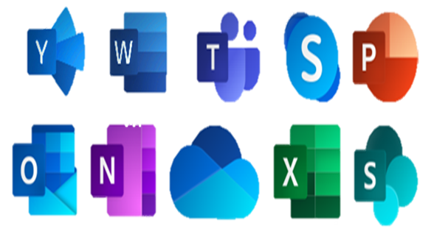




Example ICT software
Example Communication tools:
  Email
  Skype / Teams / Zoom
  Social media platforms
  DM Apps. E.g. Fb Messenger/WhatsApp.
Example File sharing tools:
  MS OneDrive
  Google drive
  Dropbox.
Example Marketing & communication tools:
  Hootsuite
  MailChimp.

Slide 7
Bg. Information communication technology
TechTarget.com define Telecommunication as the transmission of information over significant distances by electronic means and refers to all types of voice, data and video transmission. … that includes a wide range of information-transmitting technologies and communications infrastructures, such as wired phones; mobile devices, such as cellphones; microwave communications; fiber optics; satellites; radio and television broadcasting; the internet; and telegraphs. (r1)
Information technology aka Communication technology refers to all Telecommunication and Computer hardware and software that are used to process and communicate information.
According to the Oxford University Press “Information technology is the study or use of systems (especially computers and telecommunications) for storing, retrieving, and sending information.” (r2)
r1: What is Telecommunications (Telecom)? Definition from SearchNetworking? (techtarget.com) . Accessed 03/03/2022.
r2: https://languages.oup.com/. Accessed 03/03/2022.

Slide 8

Bg. Information communication technology
Author John Daintith expands on this and defines as Information technology (IT) as the use of computers to create, process, store, retrieve, and exchange all kinds of electronic data. (r3)
TechTarget.com define ICT, or Information Communication Technology as “all devices, networking components, applications and systems that combined allow people and organizations (i.e., businesses, nonprofit agencies, governments and criminal enterprises) to interact in the digital world.” (r4)
r3: Daintith, John, ed. (2009), "IT", A Dictionary of Physics, Oxford University Press, ISBN 9780199233991, retrieved 03/03/2022.
r4: What is ICT (Information and Communications Technology)? (techtarget.com). Accessed 0303/2022.
This Photo by Unknown Author is licensed under CC BY-NC

Slide 9


Bg. Synchronous & Asynchronous communication
Synchronous communication occurs in real time and can take place face-to-face, and as technology has evolved, can take place irrespective of distance eg. telephone conversations, Video conferencing and instant messaging).
Asynchronous communication is not immediately received or responded to by those involved eg. Emails, DMs Direct Messages, and forums which allow people to communicate on different schedules.

Slide 10

Example:
ICT & Collaboration software

Slide 11
Ms Outlook & GMAIL

Slide 12

Email communication
Microsoft Outlook is a popular email application, used in many businesses/Organisations across the world. It is part of O365 and is available as a desktop tool or Online as a Cloud tool.
In addition to sending and receiving emails, common features include:
  CC (copy in) & Bcc (blind copy) and pin emails
  Contact Management
  Calendar for scheduling meetings
  Task lists
  Automatic replies
  Signatures
  Automated junk mail and spam filters
Other email platforms e.g. Google’s Gmail which is part of Google’s Workspace. It is Google’s O365 alternative that include similar Software Apps for Business and collaboration.

Slide 13

Gmail
Gmail is a free email service provided by Google. In many ways, Gmail is like any other email service.
You can send and receive emails, block spam, create an address book, create calender and task items, and perform many other basic email functions.

Slide 14
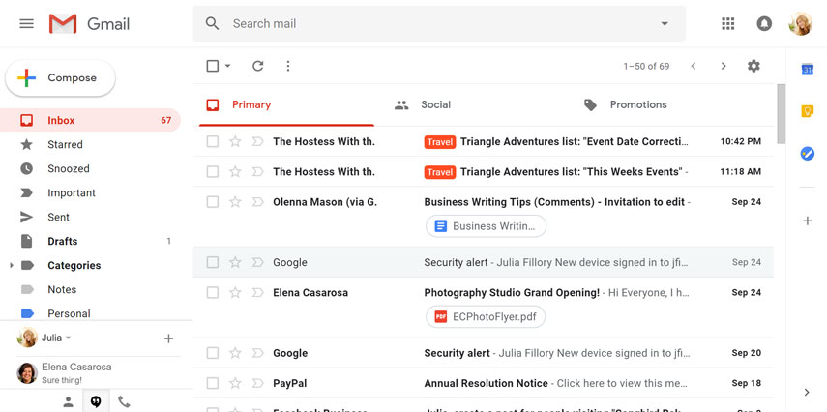
Gmail

Slide 15
skype

Slide 16

Skype
Skype, is a popular Internet calling app, has been around for quite some time.
The (mostly) free service launched in 2003, and has become one of the easiest and cheapest ways to stay in touch with others across the world.
Microsoft Teams has replaced Skype for Business, new Office 365 users can no longer download Skype for Business.
Skype will continue as a personal version alongside Microsoft Teams.

Slide 17
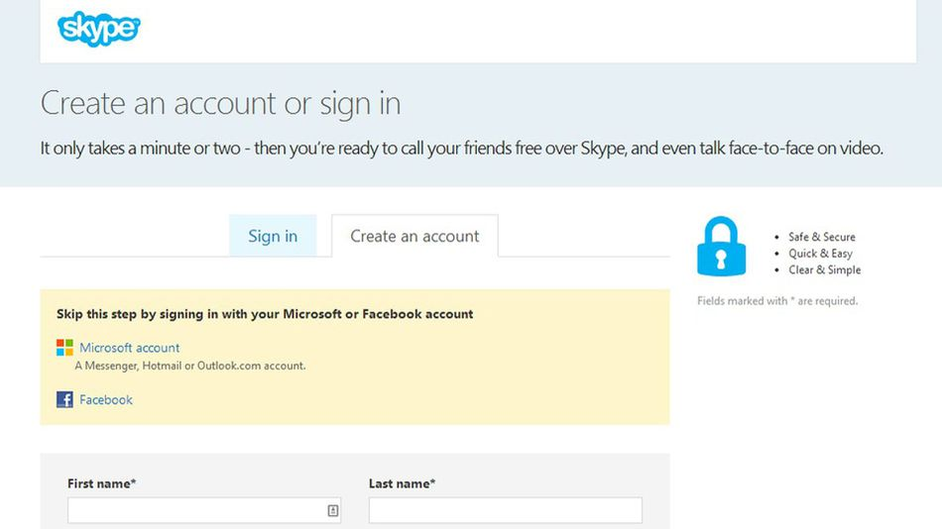
Skype personal
Skype is a great option because it's accessible through computers, phones, tablets, home phones, TVs and even devices such as the Xbox One.
If you choose to connect with your Facebook account, the benefit is that you’ll be able to view your Facebook News Feed and contact your Facebook friends in Skype.

Slide 18
Ms teams

Slide 19

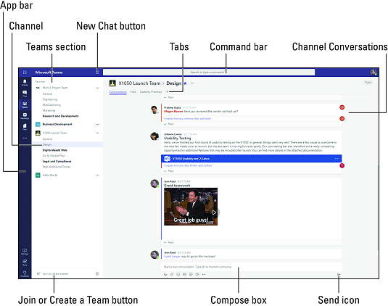
Microsoft Teams
Microsoft Teams is a collaboration app for personal, family and business use.
It enables people and teams to communicate via voice & video, instant messaging / DMs, chat, organise groups and provide file sharing all in one place.
Allows one-on-one or group/team audio and video calls.
You can share screens during web conferencing, schedule meetings, and record meetings.
Can be accessed easily via desktop, a mobile device or web browser

Slide 20
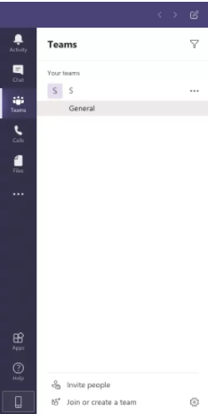
teams
Teams and Channels:
Each Team has subsections, which are called Channels, and a General Channel will automatically be created.
You can have multiple Channels within a Team for sub-teams / functional departments.
  For example, you could have a Marketing channel, a Finance channel, a HR channel that relate to different departments. And additional channels for sub-teams within different departments. We can choose whatever suits an organisation's way of working.
Channels are segregated conversations/meeting areas, where each one can be dedicated to a department, project or a task.

Slide 21
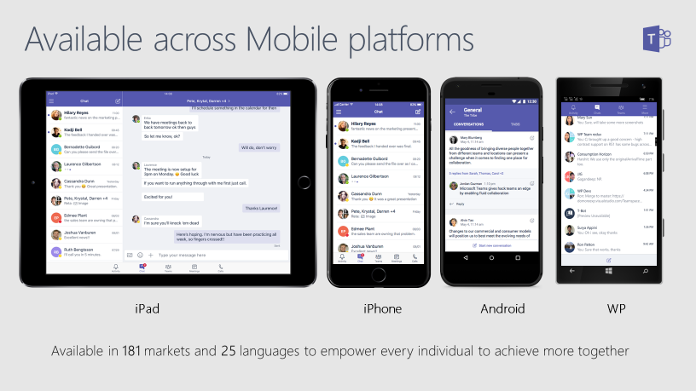
Ms teams

Slide 22
Bg. Ms Teams: conversations
Conversations are one of the key features of Teams, allowing each Team/channel to have a centralised discussion that is saved and easily searchable.
Conversations are the central component where all teamwork is recorded—from file sharing to video calls.
The use of the ‘at @’ symbol, @paul.jones allows you to tag participants or even whole teams to notify others.
The Teams app will notify you through an alert. As well as tagging, users can 'like' content and share emojis or GIFs.

Slide 23
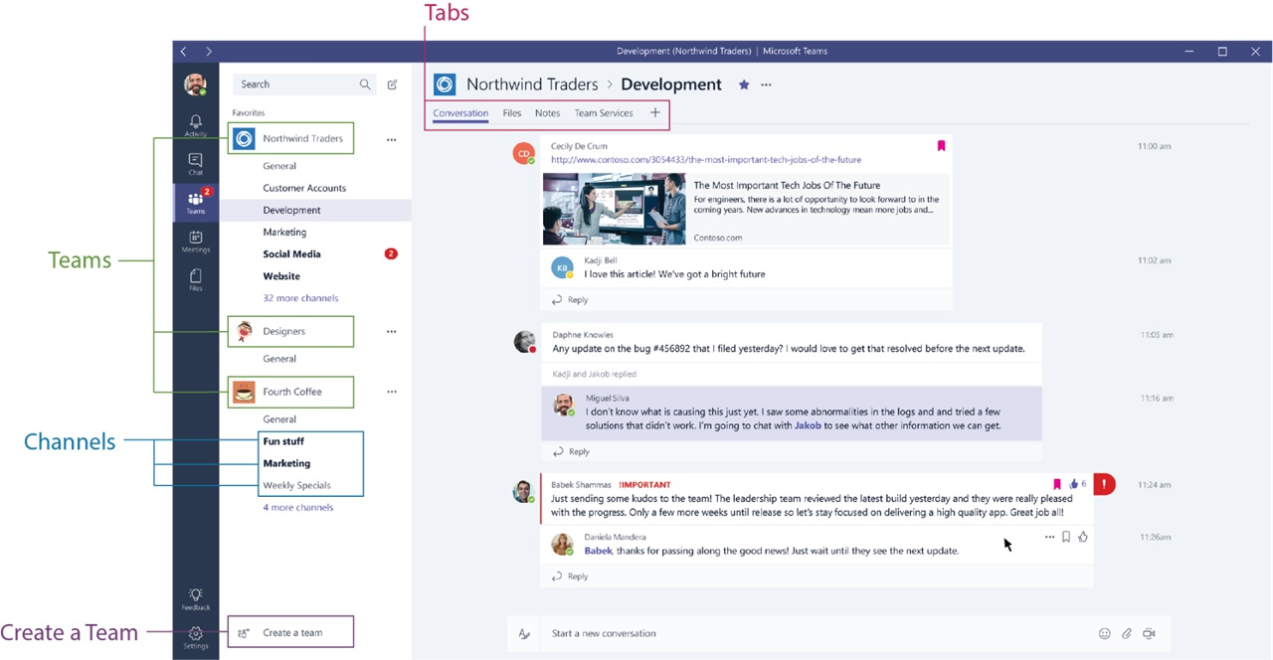
Bg. Conversation in a channel
Channel Tabs
Each Channel has their own tabs along the top. Conversation (group chat), Files (shared documents) and Notes (shared OneNote) are automatically created and you we can add our own additional tabs.

Slide 24
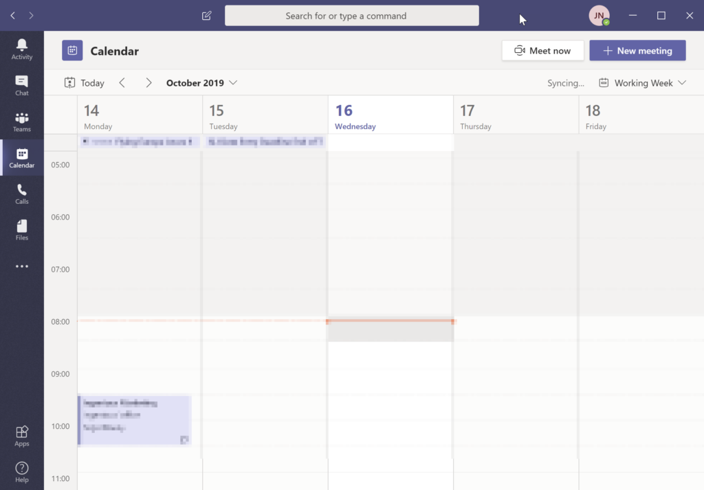
Calendar, Meetings & Video Conferencing
O365 Calendar is fully integrated into Teams.
This is where you can ‘Meet now’ or schedule a ‘New meeting’ to video conference with colleagues, friends or family.

Slide 25
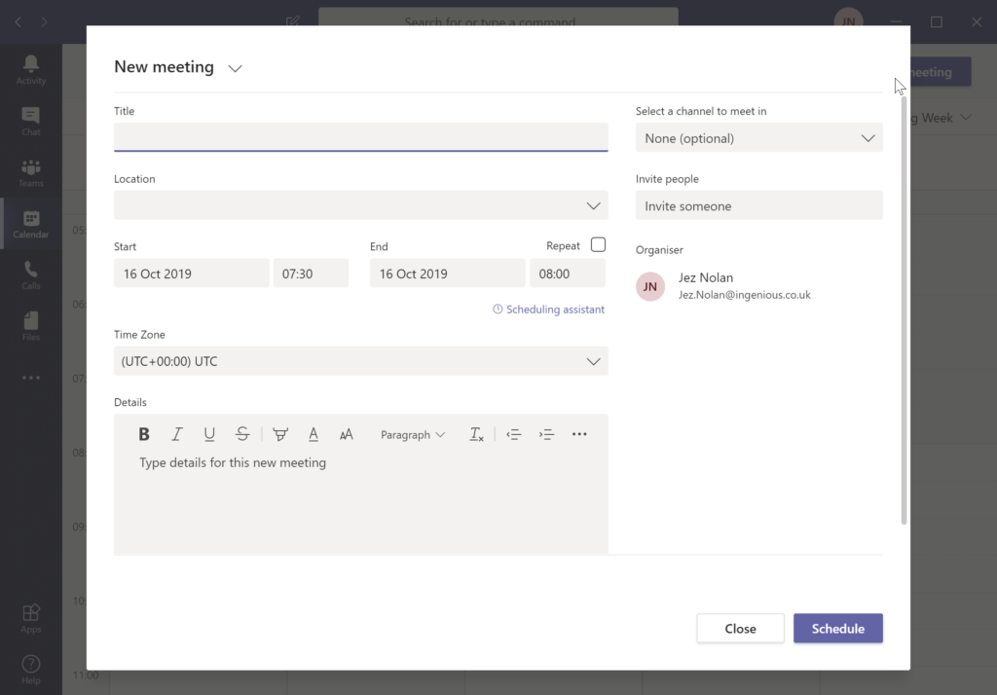
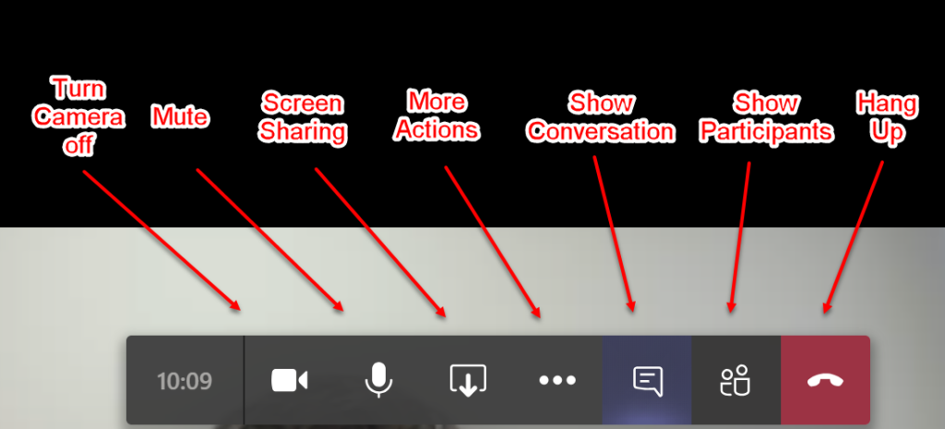
Bg. Teams meeting

Slide 26
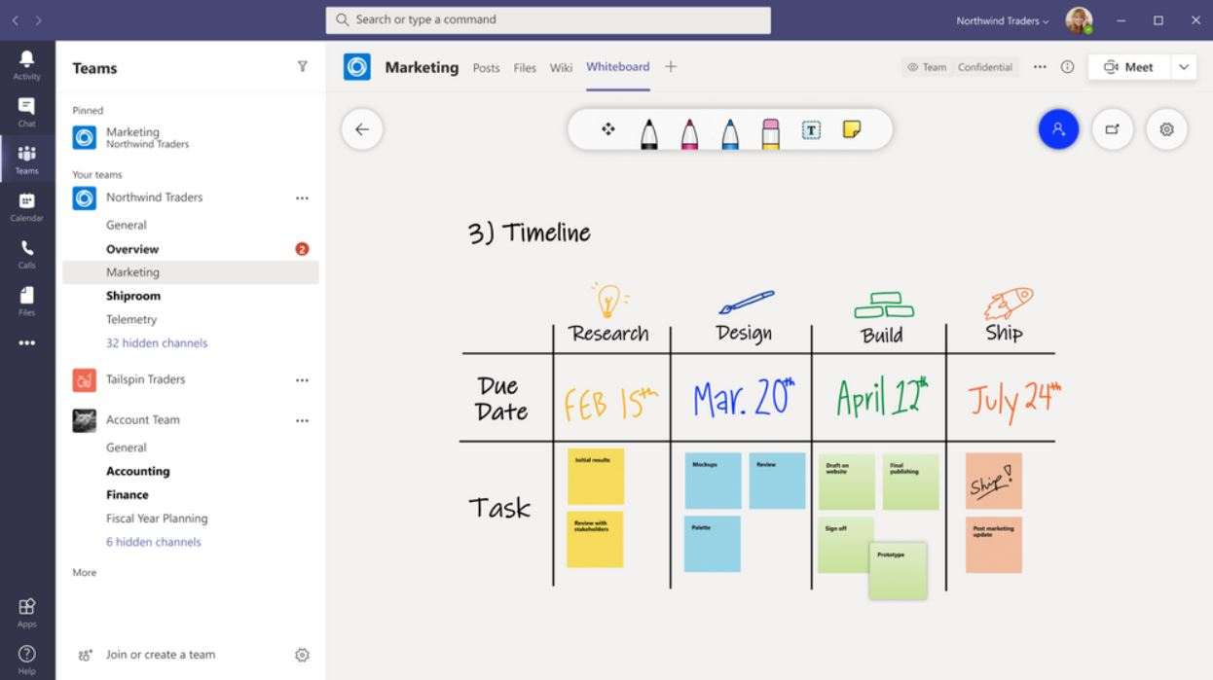
MS Whiteboard
Microsoft have integrated MS Whiteboard (which is free) into MS Teams.
It is a collaborate whiteboard, allowing meeting participants to work on the whiteboard at the same time.
To access during a call/meeting: Goto the ‘Share screen’ icon, and you will be able to click on MS Whiteboard.

Slide 27
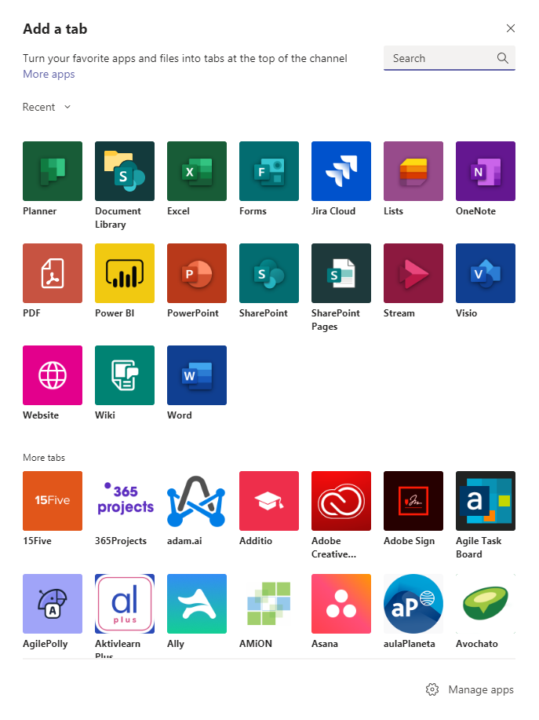
Ms teams: apps
We can easily add main different types of Apps in MS Teams to add additional functionality to enhance our work and collaboration with others while using Teams.
We can add an App. in 3 main areas in MS Teams:
  Directly in a real-time Meeting
  in a Chat directly in a conversation or
  in a Channel: to share with the whole team.
For example, we could add ‘a poll’ to allow live democratic decision making.
For more information & a video overview click-here.
Example apps: 9 Best Apps For Microsoft Teams To Make Your Communication Better.
This Photo by Unknown Author is licensed under CC BY-SA-NC

Slide 28
Teams (free)
Microsoft Teams is free for Unlimited group meetings for up to 60 minutes.
Up to 100 participants per meeting.
5 GB of cloud storage per user.
Unlimited chat with coworkers and customers.
File sharing, tasks, and polling etc..
If more than this is needed, MS offers a pricing structure.

Slide 29
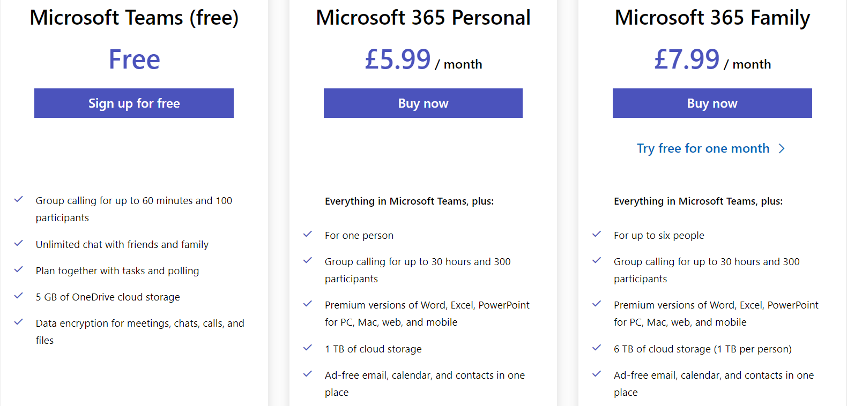
Bg. Teams – home pricing tiers
Link: Compare Microsoft Teams Pricing and Plan.

Slide 30
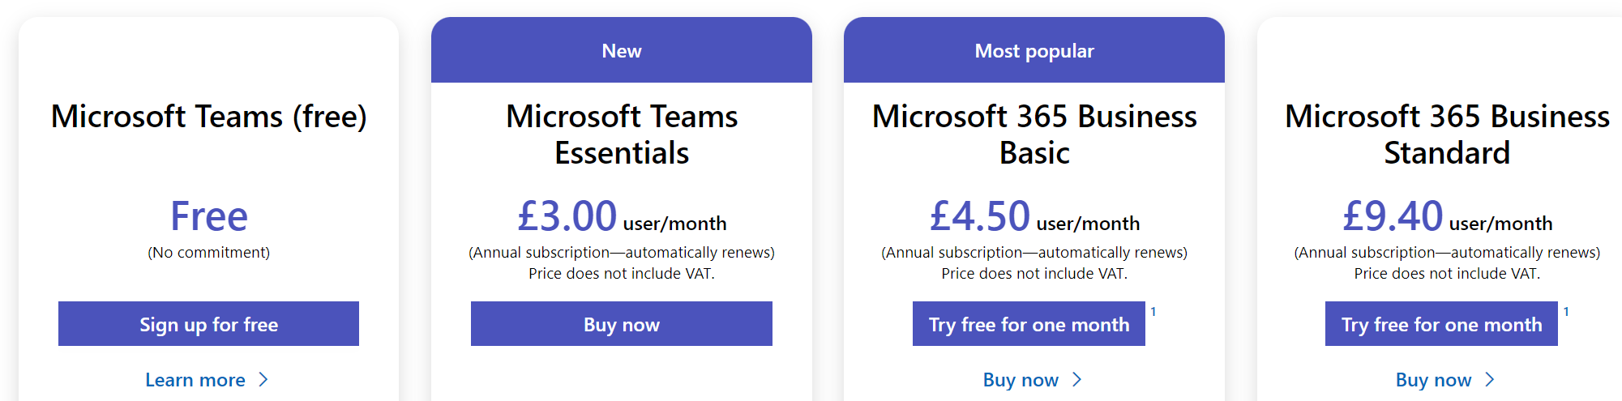
Bg. Teams – business pricing tiers
Link: Compare Microsoft Teams Pricing and Plans for Your Business.

Slide 31

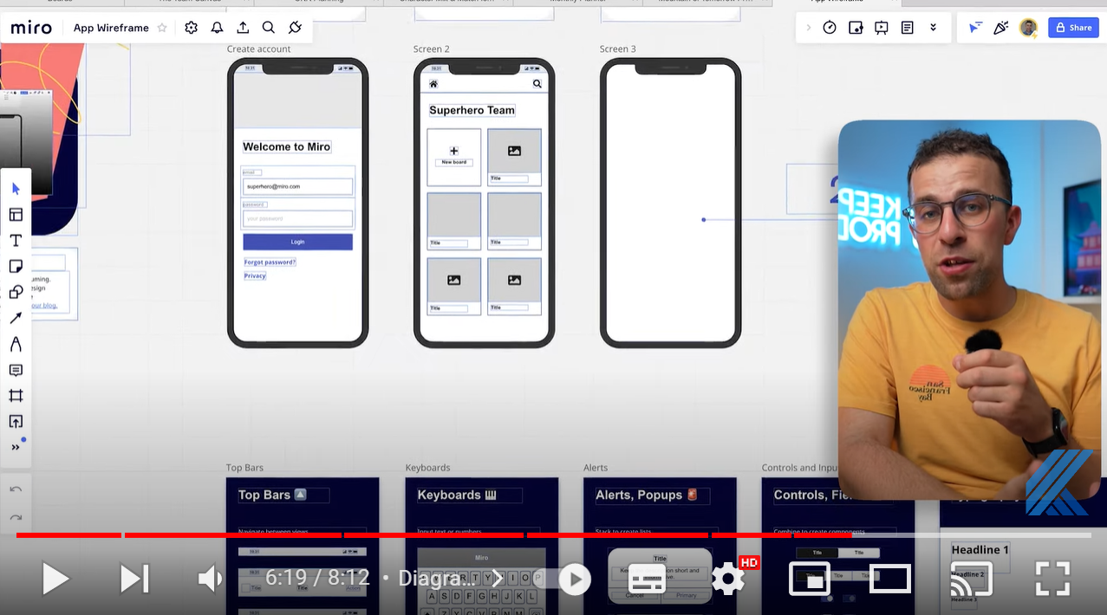

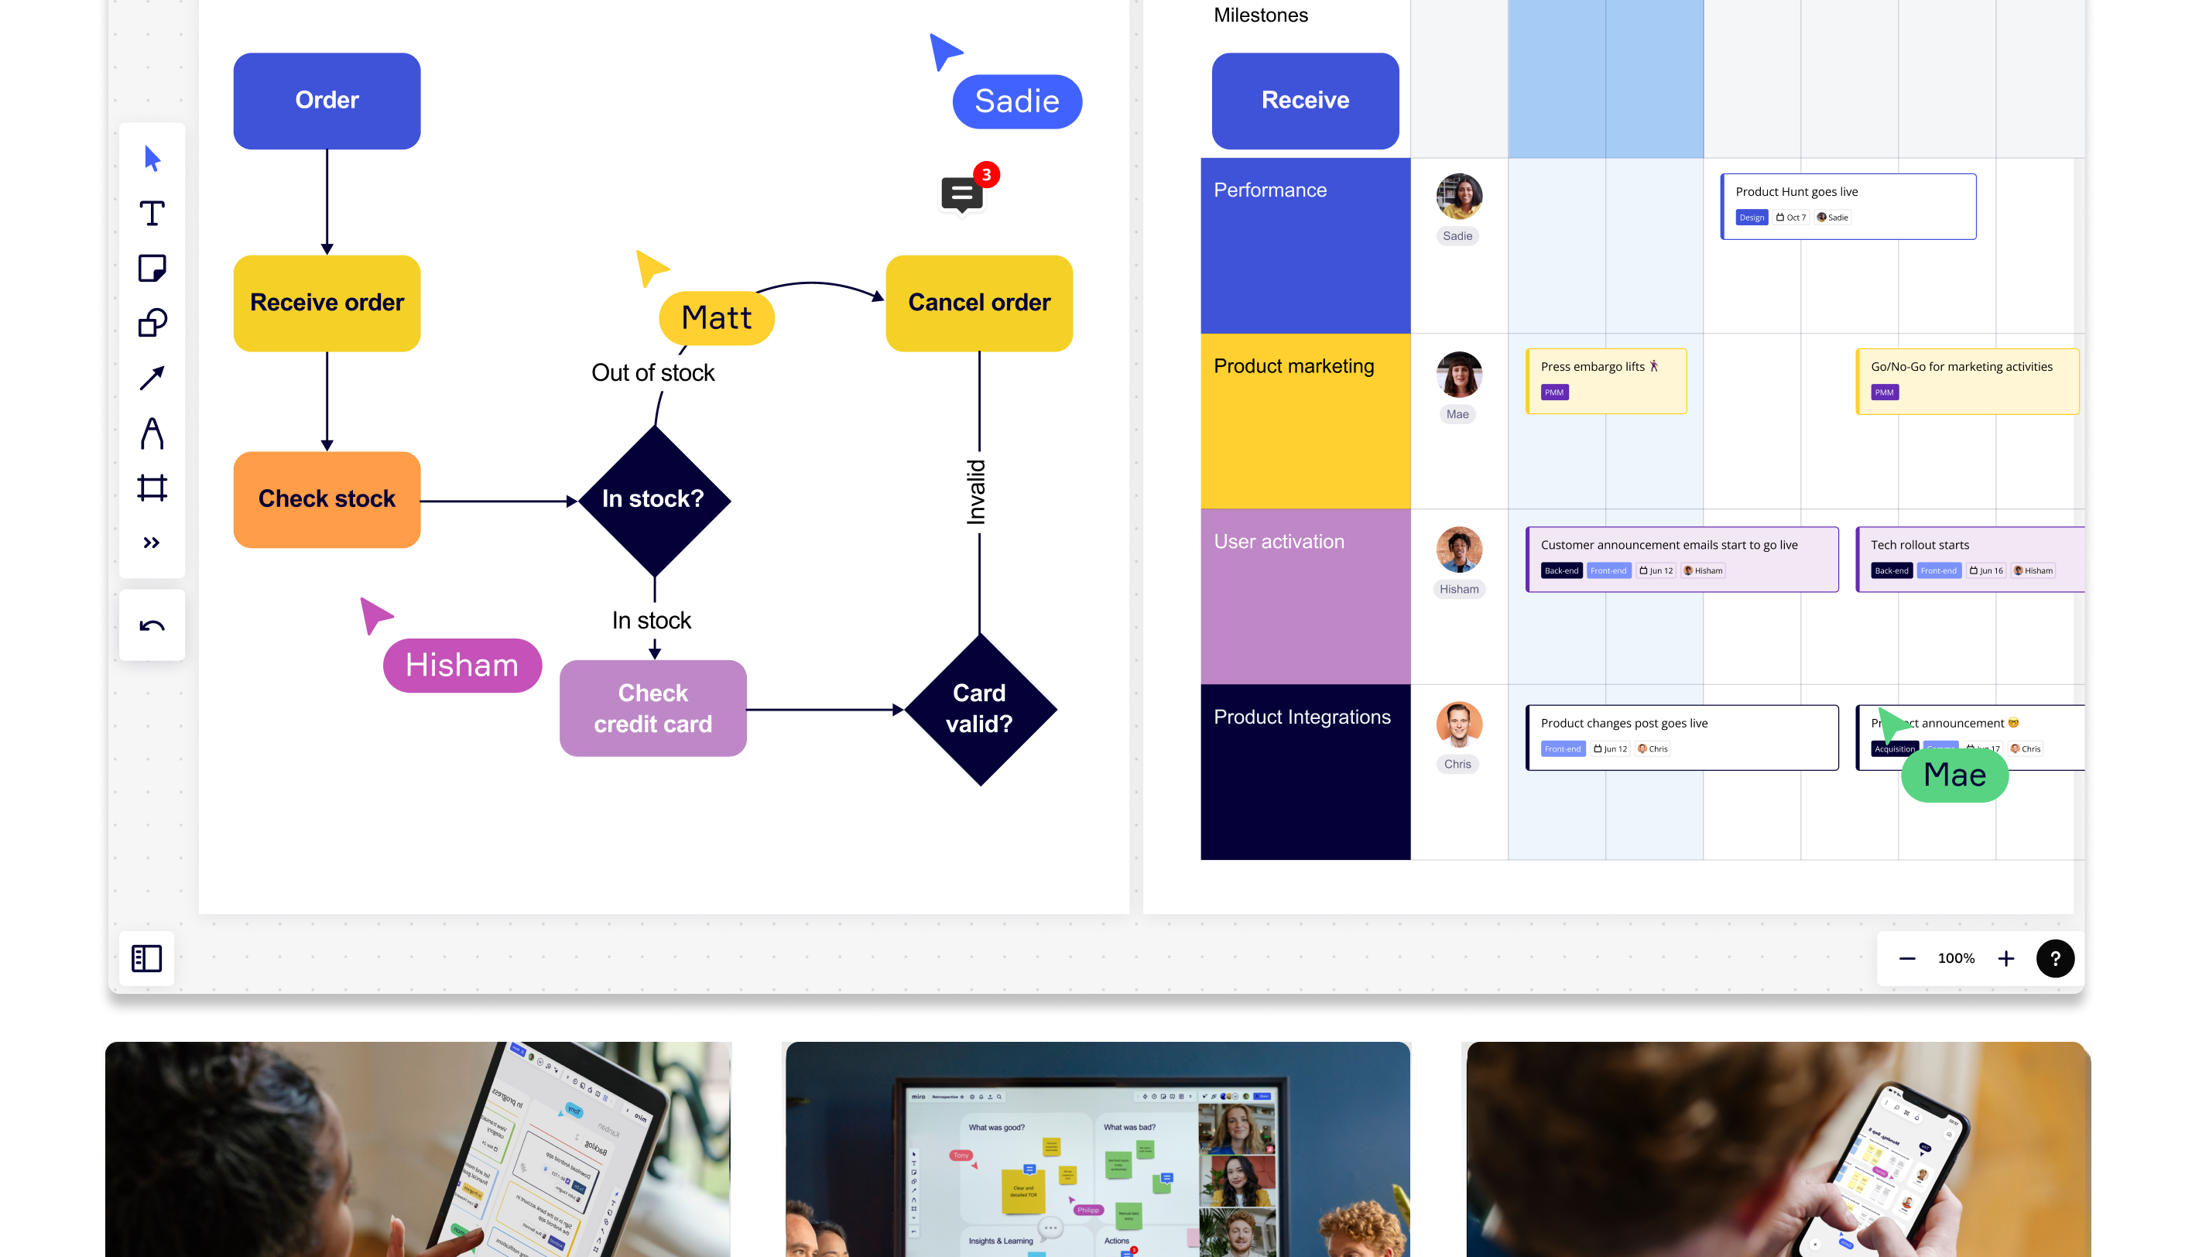
Miro.com
Miro is a web-based online collaborative whiteboard platform that allows teams to work together, from brainstorming with digital sticky notes to planning and managing agile workflows using flowcharts, Gantt schedules and wire-frame diagrams.
Play: Video Overview.
As with many other Apps, Miro can be added into MS Teams as an App.
Play

Slide 32
Other
Collaboration tools

Slide 33

Bg. zoom
There are four plans available.
The most popular being the free tier, in which virtual meetings can be held with up to 100 participants.
1-on-1 meetings without a time limit are possible, and meetings with multiple participants can be held for up to 40 minutes.
When your time is up, you can simply restart a meeting if need be.

Slide 34

Bg. zoom
The free option also allows users to conduct meetings in HD video and with audio, participants can join via their PC or a telephone line, and both desktops and apps can be shared.

Slide 35

Bg. zoom
Zoom's Pro, Business and Enterprise packages come with additional features, including an increase in meeting duration limits, cloud recording and storage, and company branding.
It is possible to join a meeting just from your browser, but to avoid browser limitations, it’s advisable download the application.

Slide 36
Bg. zoom
WEBINARS
If you have a Pro, Business, or Enterprise plan, you can take advantage of the webinars option. Webinars can be set up that broadcast to up to 10,000 view-only attendees at a time.
Screens, video, and audio can be shared; chat sessions between attendees and panelists can be hosted, and webinars can be run on either a pre-registration or open basis.

Slide 37
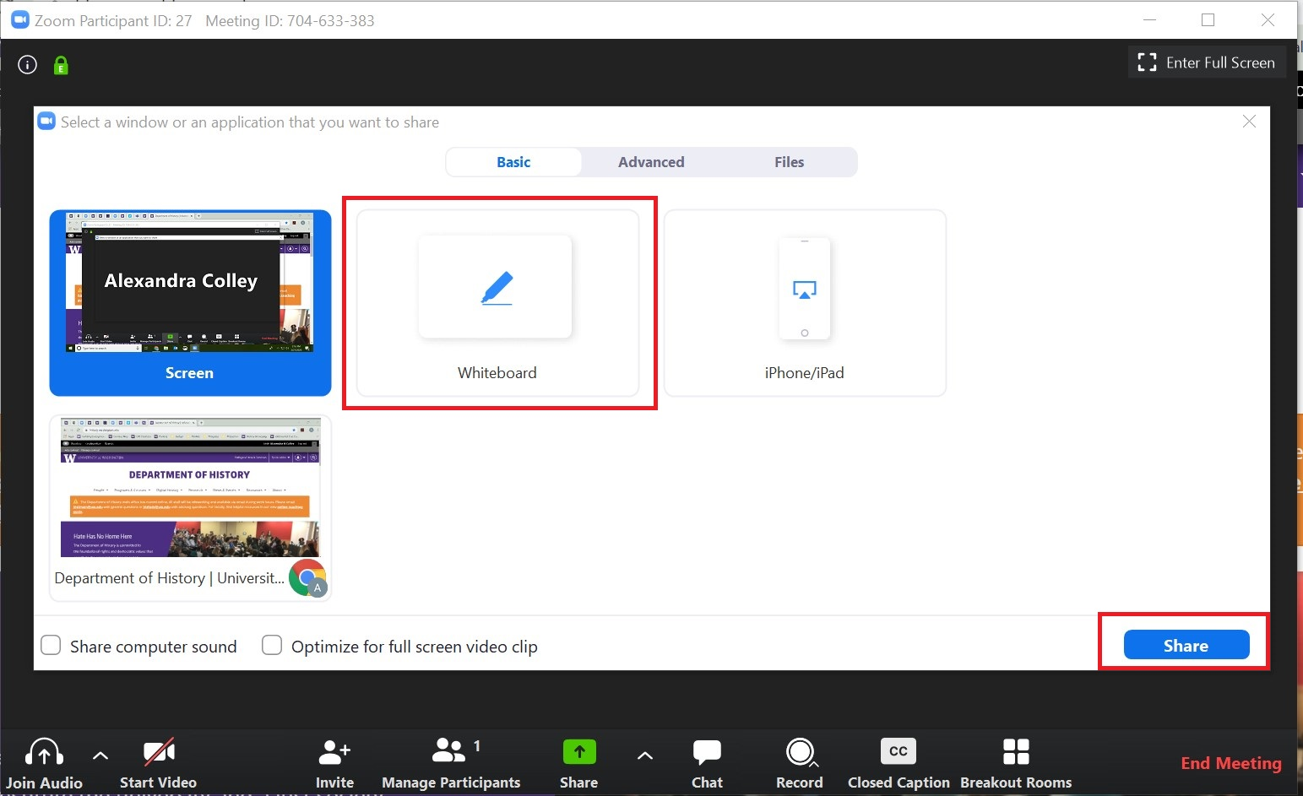
Bg. Zoom WHITEBOARDS
There is a "whiteboard" option under the "Share Screen" tab.
This is a useful option for drawing/canvassing ideas, brainstorming, or for acquiring feedback as it comes with different annotation options, including text boxes, arrows, and more.
The "spotlight" is a form of highlighter which can be used to bring user attention to a particular area or point.
Meeting participants can collaborate on the whiteboard.
A Whiteboard option is now also available in MS Teams.

Slide 38

Google meet
This Photo by Unknown Author is licensed under CC BY-NC-ND

Slide 39

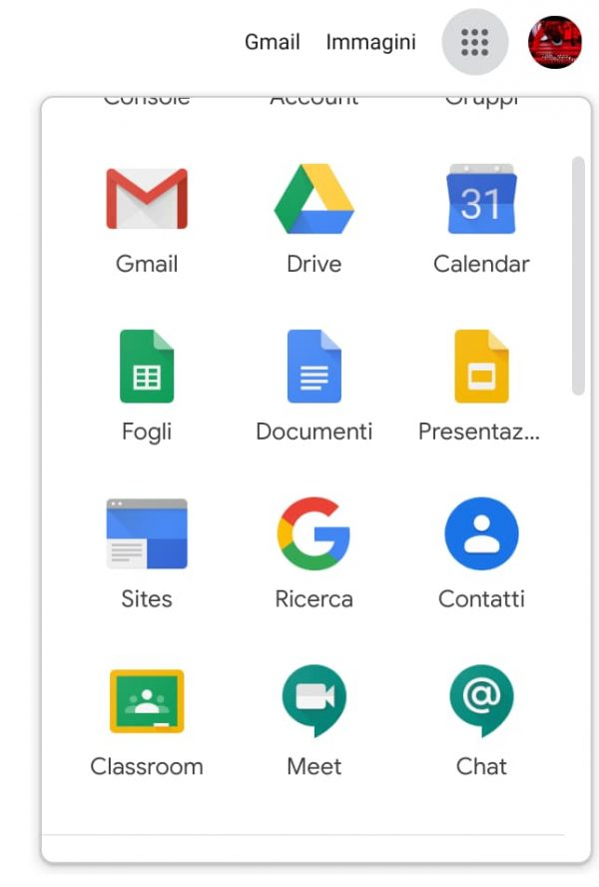
Google MEET
Google Meet is a Video Conferencing App like MS Teams & Zoom.
Google Meet & Google Chat have replaced Google Hangouts.
In includes a collaborative Whiteboard too (aka Google Jam).
Google has two Video calling Apps: Meet and Duo.
Google Meet (upto 250 people) allows business features and is more for professional use.
Google Duo (upto 32) more for informal hangouts/video calls
This Photo by Unknown Author is licensed under CC BY-NC

Slide 40
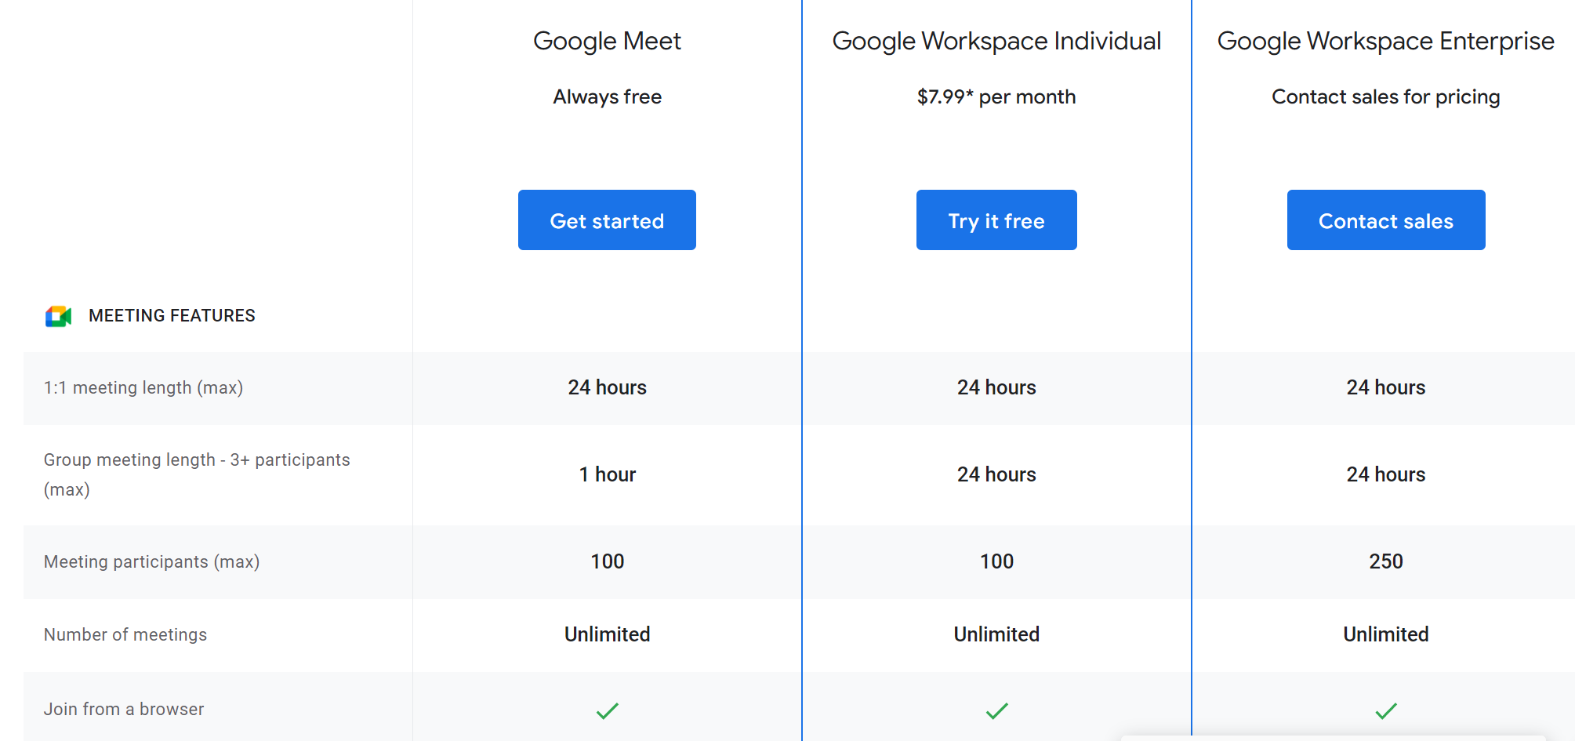
Google MEET
Bg. Google
MEET
For full pricing and feature list, please click-here.

Slide 41
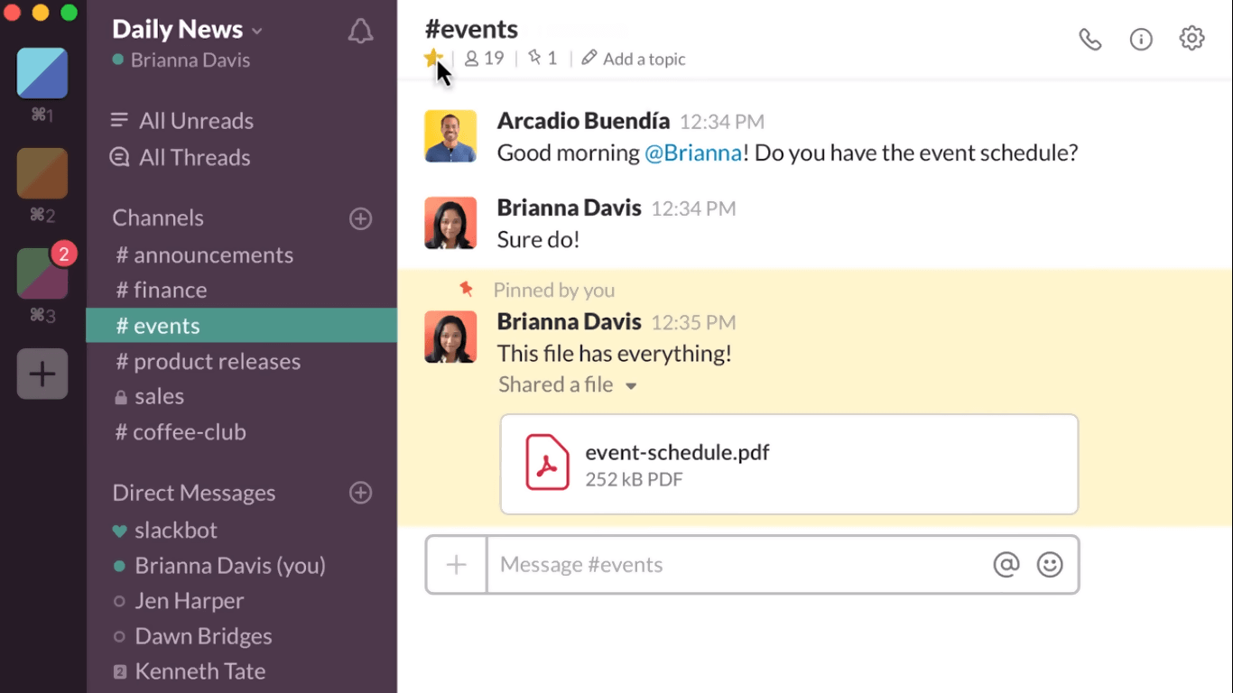
Slack
Slack is a collaboration tool.
It allows teams to collaborate via conversations using text, audio and video.
You can also organise conversations into various channels for specific initiatives or projects.
Slack integrates with many other Apps like Google Drive, Box and Dropbox and many others for a more holistic, unified and integrated collaboration.
  Bg. For a video overview, please click-here.
  Home: https://slack.com/.

Slide 42

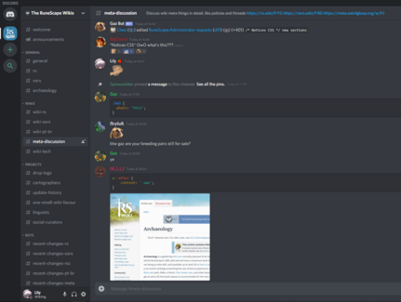
discord
It is a free voice, video, and text chat app that's used by millions of people for mainly social interaction, however many businesses use it too.
Discord is an online Voice over IP (VoIP) instant messaging platform where users communicate with voice calls, video calls, text messaging, and where they share media and files in private chats or as part of communities called ‘servers’.
A server consists of persistent chat rooms and voice chat channels which can be accessed via invite links.
Discord was made for online gamers to communicate and play together.
The Discord app is free to download, signing up for a Discord account is free, and anyone can create a Discord server for free.
  Bg. For a video overview, please click here.
This Photo by Unknown Author is licensed under CC BY-SA-NC

Slide 43
Project management apps.

Slide 44
Definition:
Project Management
According to the Project Management Institute (PMI): Project management is the discipline of planning, organising, motivating, and controlling resources to achieve specific goals. (ref)
Typically to bring about beneficial change or added value to the business/organisation , customrs and society.

Slide 45
Features of Project Management software
Some key features include of PM software include:
Timeline planning
Task scheduling
Team collaboration
Assigning tasks to team members
Time tracking (to see completion progress of tasks)
Project budgeting and resourcing: Assigning resources and costs to project tasks.

Slide 46
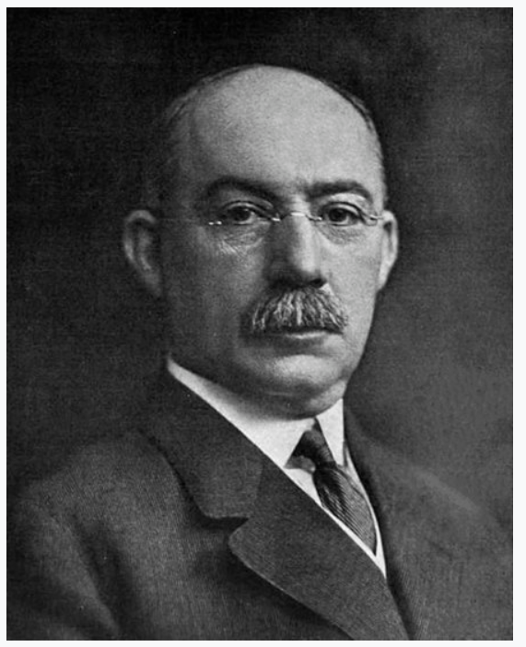

Gantt Charts
The Gantt Chart is named after US engineer and consultant Henry Gantt (1861-1919) who created the technique in the 1910s. He created this planning method to ensure good usage of staff and machine time at weaving mills around the time of WW1. You can see such looms at the Welsh Wool Museum in Carmarthenshire.
It is a very well-established method and is widely used in many industries today.
A Gantt chart shows the various activities which contribute to a project.
The activities/tasks are set out against a timeline and the duration of each task is visually depicted as a block making it easy to see the duration of each activity.
Technology allows for the use of Gantt charts in highly collaborative and interactive ways making it a very efficient and popular Project planning tool.

Slide 47
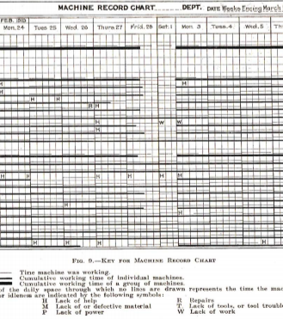
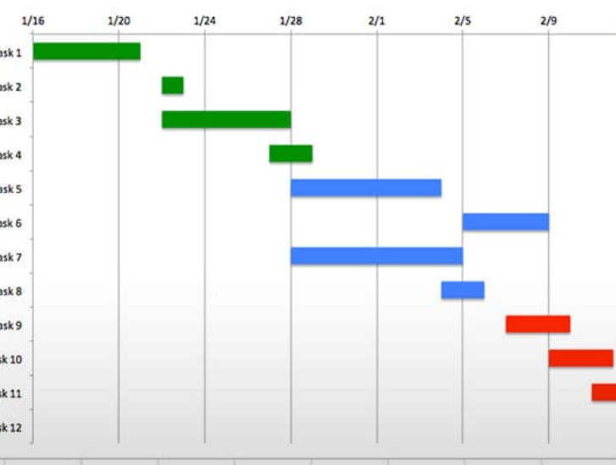





Over 100 years later Gantt charts are still an effective planning tool.

Slide 48

Project schedules & charts
  There are several common project scheduling methods that are used to schedule project tasks and to create project chart.
  These include the Gantt chart, Project timeline / Roadmap, PERT (Program Evaluation Review Technique) and CPA (Critical Path Analysis) diagrams.
  Timeline: The key focus is to create a ‘Project Schedule (task list) and Timeline’ to list your Project stages, tasks to complete, and when to complete them.
    Selection: It doesn’t really matter which method you use, as long as it helps you to plan and manage your project. For small project’s and due to their ease of use, common use in industry, we recommend using a Gantt chart for student projects/assignments.

Slide 49
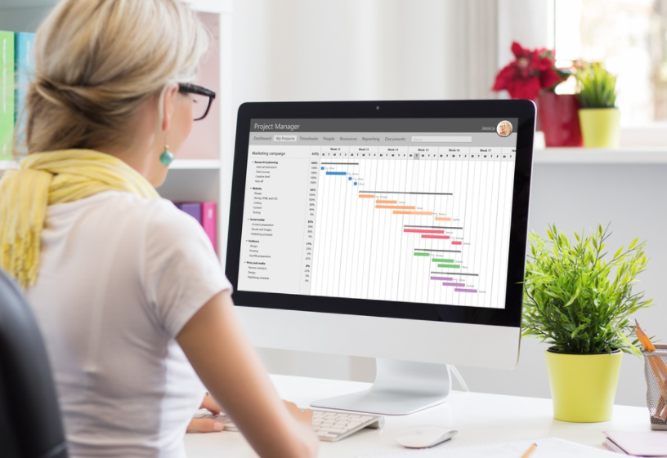
Benefits of Gantt Charts
On a Gantt chart you can easily see:
The start date of the project.
What the project tasks are.
Who is working on each task
When tasks start and finish
How long each task will take
How tasks group together, overlap and link with each other.
The finish date of the project

Slide 50
Bg. Gantt Chart: Example How to…
Many Gantt charting tools will allow you to complete the following process in an easy and often automated way. Here is an overview of how to create a Gantt chart.
  Document a Project start and end date.
  List your project tasks on a separate line/row. Start by listing your project’s tasks/activities using an appropriate tool of your choice e.g. you could start by creating a list in Excel, a table in Word or use an Online Gantt chart tool.
  Next assign completion time/duration for each task. You can add start and finish dates for each task.
  Create bars for each task (Visual timeline bars). Make a chart for the project based on the Start & End dates and Task list. The chart will display a duration block for each task. E.g. You can do this in excel by using a Bar graph and converting it into a an Excel Gantt chart (a stacked bar chart). Although we recommend using a specialised Gantt charting tool to make this process easier.
  You can add sub-tasks and task descriptions and other details to the Gantt chart.
    Group work / Project Teams: If the project is Team-based, the project manager can now start to assign tasks to individual team members and invite them to collaborate on the chart.
Note: You will find many easy-to-follow tutorials online that show you how to create a Gantt chart for your project in minutes. Search Google or YouTube to find useful examples.

Slide 51

Technology: Gantt Chart Apps
Microsoft provide many tools to create a Project Timeline/Gantt chart such
as Microsoft Excel, Microsoft Project or Microsoft Planner.
  Bg. Note: A Gantt chart can also be created with Microsoft Visio (a Design chart App.) but this is not recommended, as it is convoluted.
  Bg. Note: MS Apps such as MS Planner and MS Project can be integrated into MS Teams for collaborative project work.
Google Drive also provide tools such as Google Sheets that can be used to create a Project Timeline/Gantt chart.
Today, however you can easily create an online Gantt chart using specialised cloud Gantt Apps. Such as Tomsplanner.com, Asana.com, Wrike.com, Monday.com, Miro.com.
  Others: TeamGannt , SmartSheet , Zoho , Gantter , Ganttic, Creatly.
  Bg. Note: These oline Gannt chart Apps are very easy to use. If needed, you can find many easy-to-follow tutorials online that show you how to create a Gantt chart for your project in minutes. Search Google or YouTube to find useful examples.

Slide 52
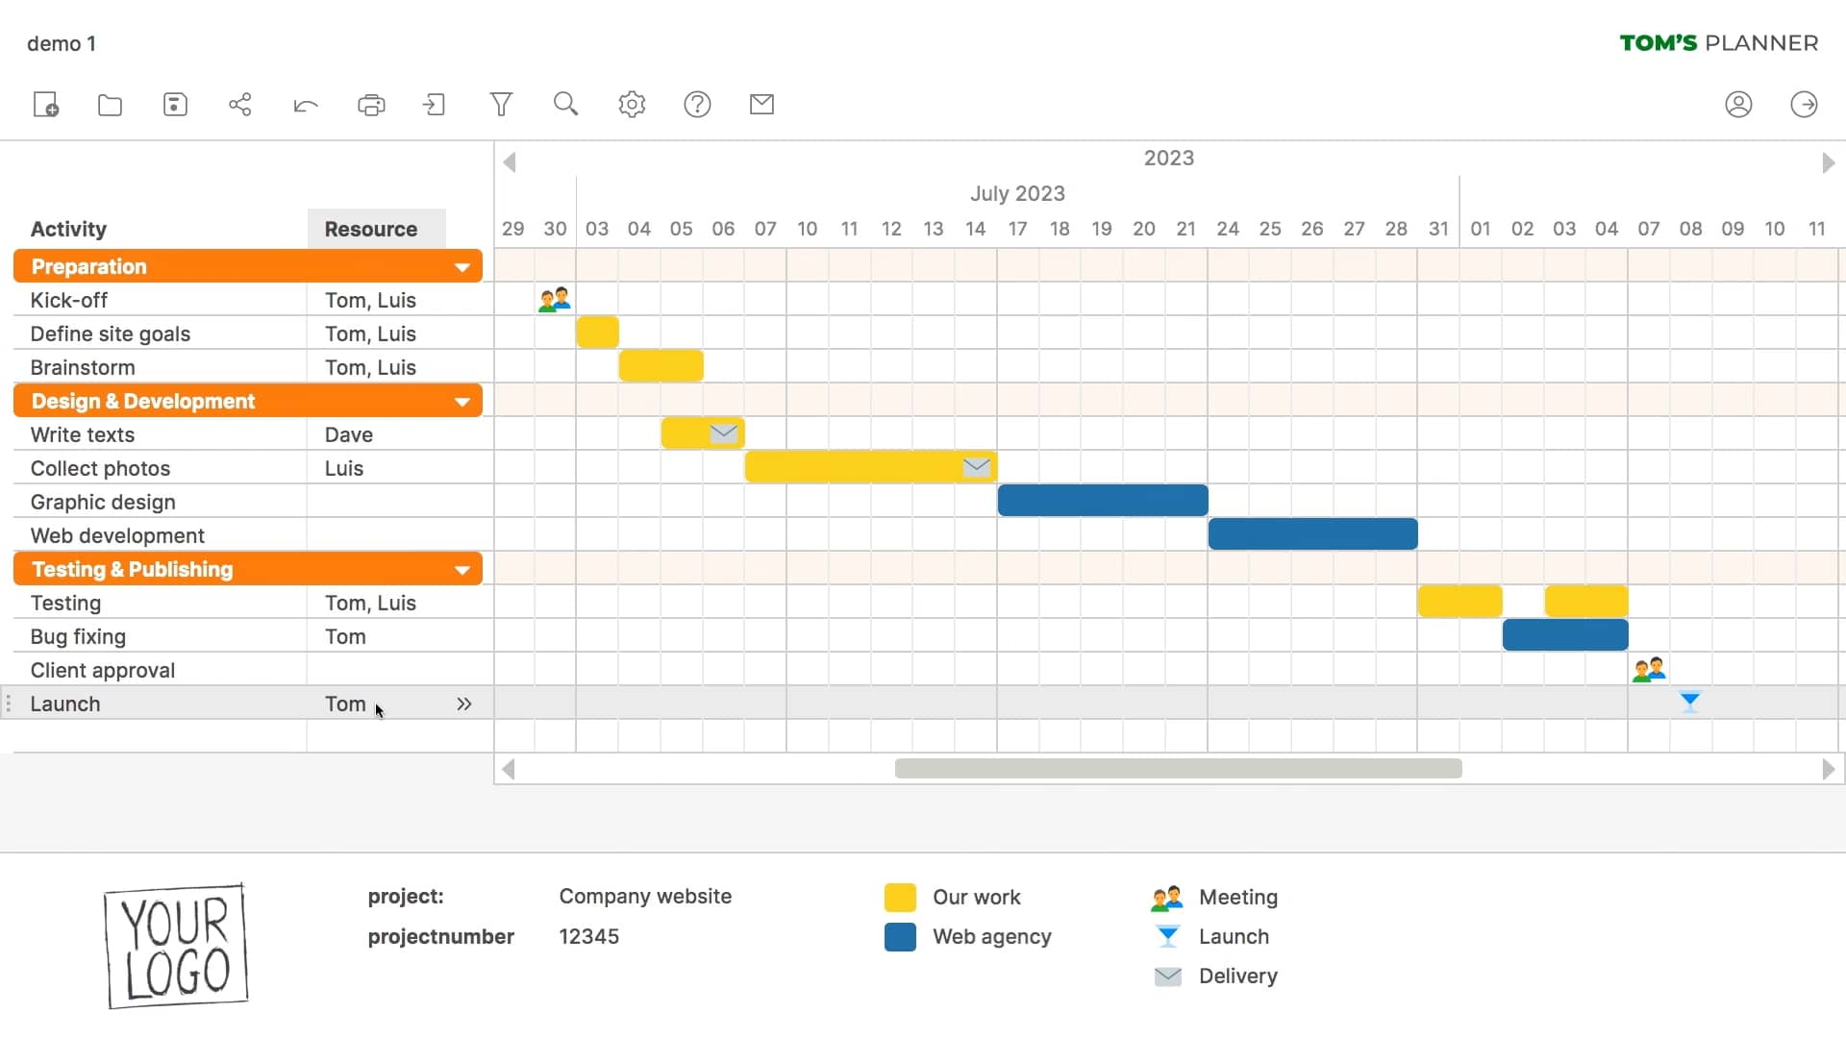
Video show: Tomsplanner.com (Scroll down)
This Photo by Unknown Author is licensed under CC BY-NC-ND

Slide 53
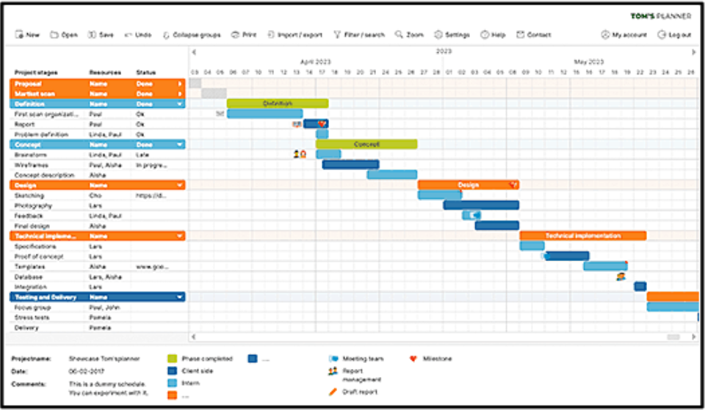
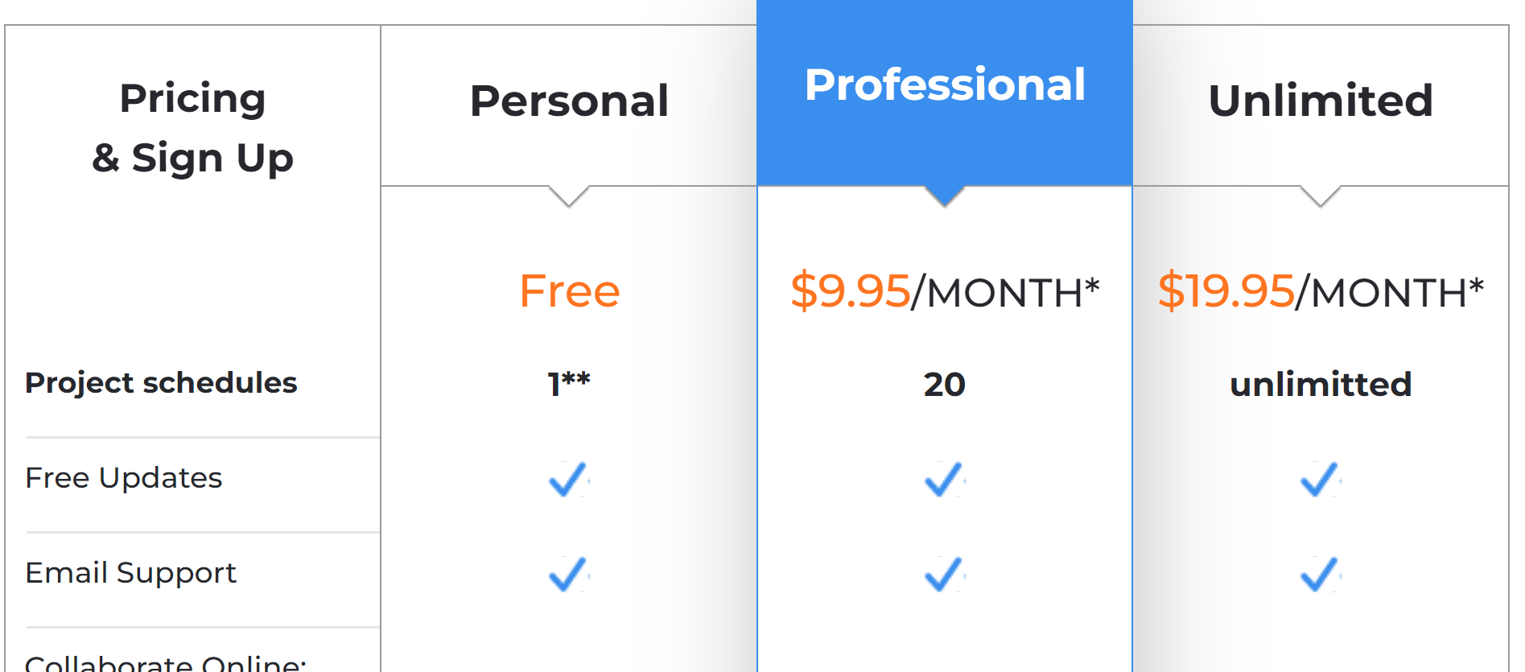
Bg. Feature: Tomsplanner.com
Tomsplanner.com is a web-based collaborative Gantt chart App that allows you to easily and quickly create professional Gantt charts for project planning, management and collaboration.

Slide 54
Bg. Cloud-based GANNT chart / Project Management Tools
Cloud-based Project Management Tools:
www.Gantter.com *****
BaseCamp.com.
Projectplace.com.
Wrike.com
Kona.com
Piematrix.com
Google Project Management Solution: *****
Google Drive for document creation storage and collaboration with team members.
Gantter integrates into Google Drive.
Google Hangouts for Team meetings.

Slide 55
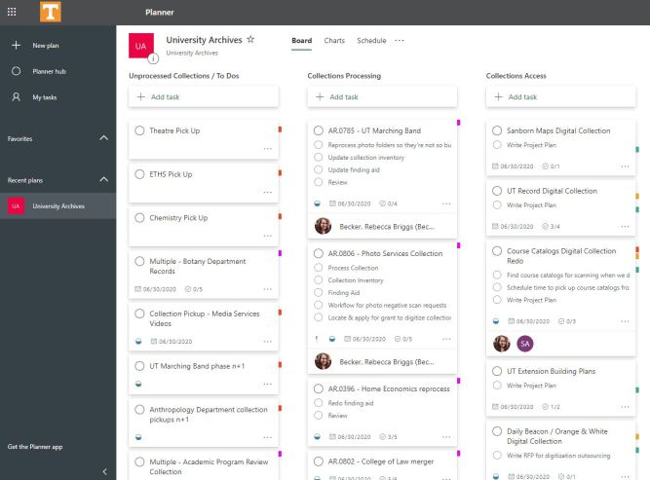
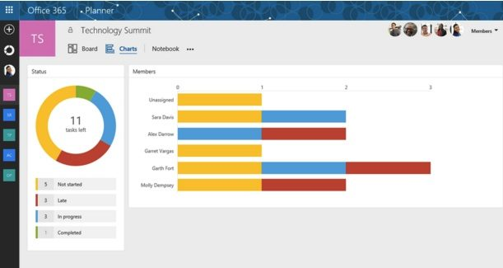
MS PLANNER
MS Office 365 Planner is a tool to organise project and teamwork tasks.
MS Planner provides a central point for individuals or teams to create plans, organise and assign tasks, and to check progress through dashboard charts.
Tutor show: 2min. Video: Microsoft Planner Overview.
  Bg. Tip: You can Add a MS Plan in MS Teams : Video - How to create a plan with Planner in MS Teams.
  Bg. MS Planner homepage: https://tasks.office.com.
This Photo by Unknown Author is licensed under CC BY-NC
This Photo by Unknown Author is licensed under CC BY-NC-ND

Slide 56
Marketing communication tools

Slide 57

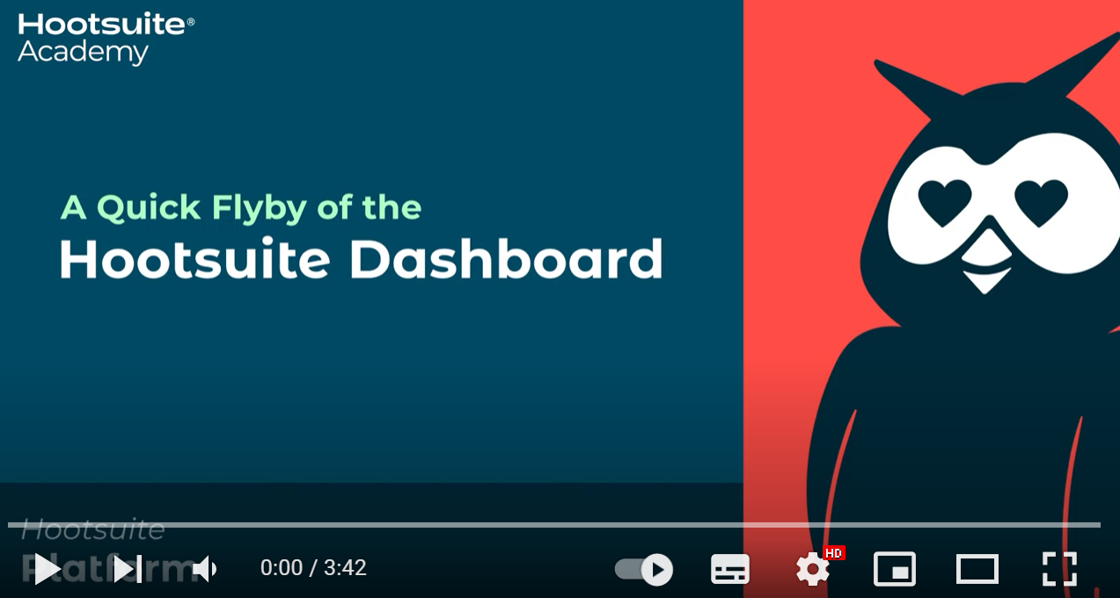
Social Media Management tools
Social Media Management tools allow you to create and schedule social media posts to run on multiple social media accounts from a single dashboard UI/interface.
They allow you to create and post across your SM channels (e.g. Twitter, Facebook, Instagram, LinkedIn, Pinterest, YouTube and TikTok) from one interface.
They are commonly used in business by Digital Marketing managers for effective Soical Media communication management. And are a type of CRM tool.
Example software tools include: Hootsuite.com & buffer.com. Video Show: Hootsuite overview.

Slide 58
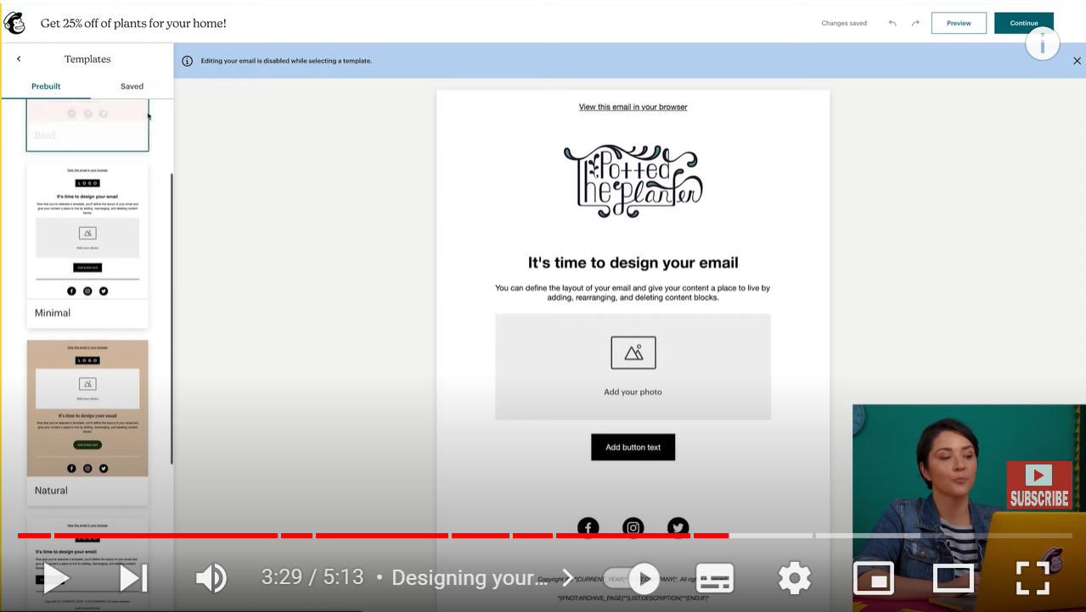
E-mail marketing management tools
E-mail marketing management tools allow you to create emails/digital newsletters, store and orgainse customer contact details, create newsletter campaigns and analyse their performance with data analytics.
Some popaulr tools include MailChimp, ZohoCampaigns, Drip, MailerLite, Campigner and ActiveCampaign and Moosend.
One of the oldest and best is MailChimp.com.
If-time: For a Video overview click here:
MailChimp Overview.

Slide 59
E-mail marketing management tools
For additional tutorial videos and information support, the following sites will be useful for you to research:
Youtube.com
Google.com
Linkedin learning
Microsoft Learn
Databases | UWTSD

Slide 60

ASSESSMENT Example
Tutor note: Show 1/2 Task 5 answer examples from previous assessment. Link in Moodle (for Tutor only).

Slide 61
Tutorial activity
Assignment: TASK 5
Task 5. Communication, Collaboration & Project Management applications. (Approx. 250 words).
Analyse several contemporary Communication/Collaboration/Project Management applications and document a summary of their key features using written text with some images and relevant citations (approx. 2/3 sources).
Test some features of a freely available Communication/Collaboration/Project Management application and document several screenshots with brief accompanying description to provide evidence of practical use.
When complete, include your answer to this task on a page in your e-portfolio.

Slide 62

Questions.
Q&A:
Please raise a hand if you have a question.

Slide 63




Reminder: stop recording
Stop video recording.
Add to Moodle.

Slide 64


Slide 65

Further reading: o365 software guides
Use the following sources for further information and tutorials:
UWTSD Tutorials:
  For Quick start guides to using Office365 tools please click here. For additional information please click here.
  Supporting slide deck on Moodle: Bg. 6. Collaboration tools.
Google search.
UWTSD Free software: Office365 Pro Plus is available to all students for free: Office 365 Pro Plus | UWTSD.

Slide 66
Archive slides

Slide 67
Bg. slides

Slide 68
Tasks

Slide 69
Tasks- work in pairs\small groups
One
Download and\or make accounts for each of the collaboration tools discussed in class, where multiple interfaces are available e.g., desktop, mobile or browser. Experiment with each
Two
Within your pairs or groups attempt the various functions of the application to meet and share information – collect screen-shots
Three
Construct a table for each application explored analysing the elements that were difficult and those that went well in your investigation for discussion in class

Slide 70
Email considerations

Slide 71
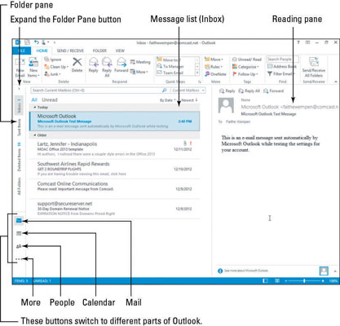
Bg. outlook
Outlook is an email software developed by Microsoft. Users can send, receive and read emails.
Packaged as part of Office 365 suite and as an Online free version – Outlook.com.
Outlook is more than just an email client. It is a suite of productivity tools – it includes calendar, and contacts
You can create events and meetings with its Calendar.

Slide 72
Bg. Email communication
CC: CC stands for Carbon copy. It includes those recipient addresses whom we want to keep informed of the email/conversation.
BCC: BCC stands for Black/Blind Carbon Copy. It is used when we do not want one or more of the recipients to know that someone else was copied on the message.

Slide 73

Bg. key Outlook features:
Outlook includes business productivity features such as:
eMail
Contacts + Different contact ‘Group’s can also be created which can be used for Depts., Teams, Projects or Task groups.
Calendar e.g. for scheduling meetings
Task creation and notification reminders.
Professional email Signatures.
Automatic replies – to set when away from / out of the office.

Slide 74

Email Security
Microsoft Outlook scans our emails and documents for spam and malicious software (malware) 24 hours a day, seven days a week.
Our email is on the same MS infrastructure that large corporations use to protect their networks, and we benefit from these security measures.
Microsoft data centers help safeguard our data and are certified to meet multiple industry-standard security certifications.

Slide 75
Unwanted Messages:
Types of Spam?
Phishing / Spoof emails: trick people into giving up sensitive information, e.g. website logins, and credit card info, by pretending to be a trusted website/person (a way of social engineering) also called email spoofing.
These emails contain familiar branding and content, and sound urgent. Common phishing ploys include:
  A request for payment of an outstanding invoice.
  A request to reset your password or verify your account.
  Verification of purchases you never made.
  A request for updated billing information.
By tricking people into giving up valuable information, cybercriminals are able to hack the online services we use without any real technological savvy. To put it another way, why pick the lock when you can just steal the key.

Slide 76
Bg. Email
“Phishing is the simplest kind of cyberattack and, at the same time, the most dangerous and effective. That is because it attacks the most vulnerable and powerful computer on the planet: the human mind,"
Adam Kujawa- Director of Malwarebytes Labs

Slide 77
Bg. Email Security
Malspam - is any kind of malware spread via spam. Much like phishing emails, malspam relies on social engineering to trick recipients into taking some kind of action, often against our better judgment, like clicking a download link, or opening an attachment contained in the email that infects your computer with malware.
In either case, these downloads and attachments often come in the form of Word, Powerpoint or PDF files with malicious code hidden inside i.e. scripts/macros that perform automated tasks.
When the document is opened the script runs, retrieving the malware program aka payload from the command and control (C&C) servers run by the cybercriminals that can damage or scan and retrieve information from your system.

Slide 78
Bg. Email threats
Malware payloads vary greatly. The malware payload may enslave your computer into a botnet for the purposes of sending out more spam.
More often than not the payload will be a Trojan. Banking Trojans, for example, are designed to steal sensitive financial information off your computer. And in an interesting twist, some Trojans, e.g. Emotet and TrickBot, are now being used as a delivery mechanism for other malware, like, adware and spyware.

Slide 79

Email
SMTP stands for Simple Mail Transfer Protocol.
It was first proposed in 1982.
It is a standard protocol used for sending e-mail efficiently and reliably over the internet.

Slide 80

Email
Key Points:
SMTP is application level protocol.
SMTP is connection oriented protocol.
SMTP is text based protocol.
It handles exchange of messages between e-mail servers over TCP/IP network.
Apart from transferring e-mail, SMPT also provides notification regarding incoming mail.
When you send e-mail, your e-mail client sends it to your e-mail server which further contacts the recipient mail server using SMTP client.
These SMTP commands specify the sender’s and receiver’s e-mail address, along with the message to be send.
The exchange of commands between servers is carried out without intervention of any user.
In case, message cannot be delivered, an error report is sent to the sender which makes SMTP a reliable protocol.

Slide 81

Email
IMAP stands for Internet Message Access Protocol.
It was first proposed in 1986.
1986. There exist five versions of IMAP.

Slide 82
Email
Key Points:
IMAP allows the client program to manipulate the e-mail message on the server without downloading them on the local computer.
The e-mail is hold and maintained by the remote server.
It enables us to take any action such as downloading, delete the mail without reading the mail.It enables us to create, manipulate and delete remote message folders called mail boxes.
IMAP enables the users to search the e-mails.
It allows concurrent access to multiple mailboxes on multiple mail servers.

Slide 83

Email
POP stands for Post Office Protocol.
It is generally used to support a single client.
There are several versions of POP but the POP 3 is the current standard.

Slide 84

Email
Key Points
POP is an application layer internet standard protocol.
Since POP supports offline access to the messages, thus requires less internet usage time.
POP does not allow search facility.
In order to access the messaged, it is necessary to download them.
It allows only one mailbox to be created on server.
It is not suitable for accessing non mail data.
POP commands are generally abbreviated into codes of three or four letters. Eg. STAT.

Slide 85
Email
Comparison between POP and IMAP
S.N | POP | IMAP
1 | Generally used to support single client. | Designed to handle multiple clients.
2 | Messages are accessed offline. | Messages are accessed online although it also supports offline mode.
3 | POP does not allow search facility. | It offers ability to search emails.
4 | All the messages have to be downloaded. | It allows selective transfer of messages to the client.
5 | Only one mailbox can be created on the server. | Multiple mailboxes can be created on the server.
6 | Not suitable for accessing non-mail data. | Suitable for accessing non-mail data i.e. attachment.
7 | POP commands are generally abbreviated into codes of three or four letters. Eg. STAT. | IMAP commands are not abbreviated, they are full. Eg. STATUS.
8 | It requires minimum use of server resources. | Clients are totally dependent on server.
9 | Mails once downloaded cannot be accessed from some other location. | Allows mails to be accessed from multiple locations.
10 | The e-mails are not downloaded automatically. | Users can view the headings and sender of e-mails and then decide to download.
11 | POP requires less internet usage time. | IMAP requires more internet usage time.

Slide 86

Email
E-mail system comprises of the following three components:
Mailer
Mail Server
Mailbox

Slide 87
Email
Mailer
It is also called mail program, mail application or mail client. It allows us to manage, read and compose e-mail.
Mail Server
The function of mail server is to receive, store and deliver the email. It is must for mail servers to be Running all the time because if it crashes or is down, email can be lost.
Mailboxes
Mailbox is generally a folder that contains emails and information about them.

Slide 88
Email
Working of E-mail
Email working follows the client server approach. In this client is the mailer i.e. the mail application or mail program and server is a device that manages emails.
Following example will take you through the basic steps involved in sending and receiving emails and will give you a better understanding of working of email system:
Suppose person A wants to send an email message to person B.
Person A composes the messages using a mailer program i.e. mail client and then select Send option.
The message is routed to Simple Mail Transfer Protocol to person B’s mail server.
The mail server stores the email message on disk in an area designated for person B.

Slide 89
Email
The disk space area on mail server is called mail spool.
Now, suppose person B is running a POP client and knows how to communicate with B’s mail server.
It will periodically poll the POP server to check if any new email has arrived for B.As in this case, person B has sent an email for person B, so email is forwarded over the network to B’s PC. This is message is now stored on person B’s PC.

Slide 90
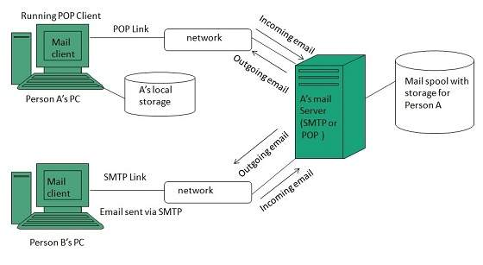
Email

Slide 91

Email
Etiquette
The term etiquette refers to conventional rules of personal behaviour. But while communicating via email, we cannot know about the body language and tone of voice etc. Therefore a set of guidelines for acceptable behaviour on email that have been evolved is known as Email Netiquette.
Here are set of guidelines that should be followed while working with email:
Try to make your message as short as possible. It will make your message easy to read and understood.
Be careful about spelling and grammar while typing a message.
Use emoticons, smiles when required.
Email address entered must be correct.
The subject heading of a message should be clear and descriptive.

Slide 92
Email
Etiquette
The term etiquette refers to conventional rules of personal behaviour. But while communicating via email, we cannot know about the body language and tone of voice etc. Therefore a set of guidelines for acceptable behaviour on email that have been evolved is known as Email Netiquette.
Follow the same rules as if you are writing a letter or a memo.
Sending a message that has already been forwarded or replied many times may contain many angled brackets. It is better to remove the angled brackets from the message.
While sending mails to multiple persons, specify their email addresses in the BCC: field so that the spammers cannot come to know about addresses of other recipients to whom you have sent a copy.
Keep size of attachment as small as possible.
Always add your signature at the end of email.
Before you send, make it sure everything is fine because you cannot call back a sent mail.

Slide 93
tasks
If you have not yet got a UWTSD account create a free Microsoft account with outlook online
If 365 is installed Link your mail account to the desktop application
Explore both the web and desktop interface and Complete the following –
Create a signature
Create an out of office message (ensure this is disabled when not needed)
Complete the following –
Create a folder for coursework emails
Send an email (complete with signature) to a classmate
forward, cc, bcc this message to further classmates or your tutor
Create a calendar meeting and invite a classmate

Slide 94
Microsoft sharepoint

Slide 95


Ms sharepoint
This Photo by Unknown Author is licensed under CC BY
SharePoint (launched in 2001) is a web-based collaborative platform that integrates with Office 365.
Primarily used within Organisations as an intranet document management and storage system.
It is a cloud-based service that help Teams within organizations share, collaborate, work on, find and organise/manage files and also applications.
It’s key purpose is to enable employees to collaborate across an organisation.
SharePoint has security features (credentials & permissions) and has the ability to allow users to set access control to files and folders.
It seamlessly integrates with Office365.

Slide 96
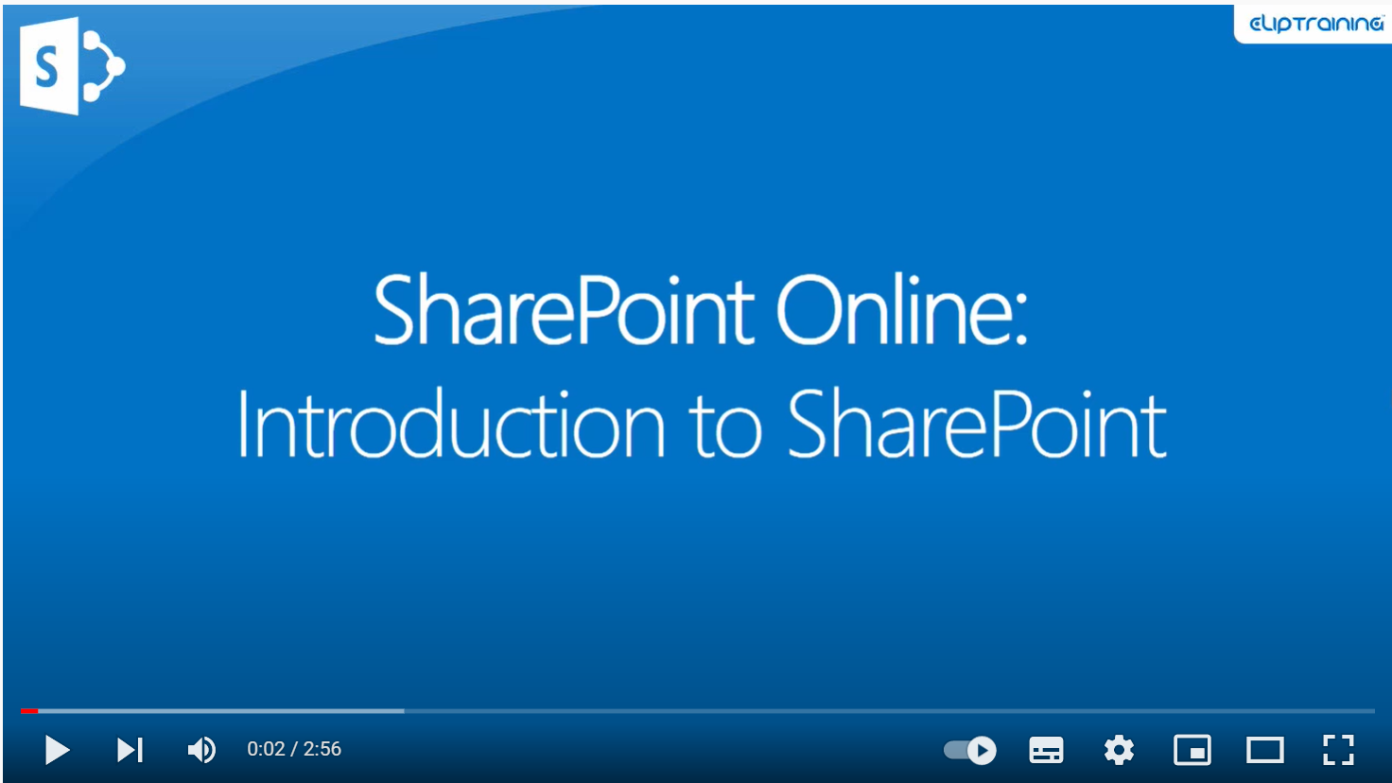
Bg. Video: Introduction to SharePoint Online

Slide 97
Social media platforms

Slide 98
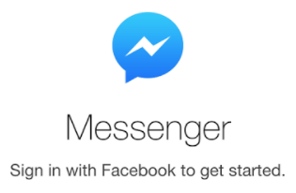
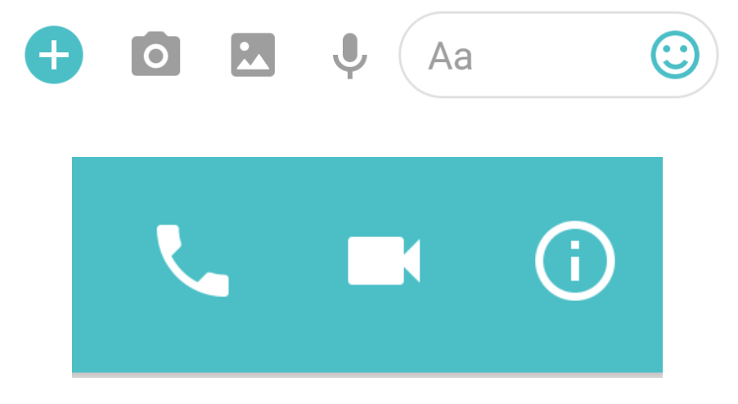
Social media platforms
Messenger (By Facebook) and WhatsApp (bought by Facebook) are common social communication apps to talk to family and friends.
These tools are very useful to stay in touch with friends and family and for fun and other social purposes. But can cause problems when used in the workplace.
Messages received for personal reasons can be distracting by nature, as can some of the features and functions of theses Apps.
Because the interface mixes all conversations into one place, using them for work causes boundary crossing and inefficiencies in communications.
It can create inefficiency in communication as users sift through chat topics from both your personal and professional contacts.
Although they allow video and udio capability, predominantly they are an instant message or chat application, who’s main purpose is to facilitate private conversations between users.
Because of this, other platforms are more appropriate for work purposes.

