Slide 1
Evaluation of Classifier Performance

Slide 2
Let’s define a few terms before we explore the confusion matrix and ROC curves
Given a classifier and an instance:
If the instance is really positive and it is classified as positive, it is counted as a true positive; if it is classified as negative, it is counted as a false negative.
If the instance is really negative and it is classified as negative, it is counted as a true negative; if it is classified as positive, it is counted as a false positive.

Slide 3
The Confusion Matrix
Given a trained classifier and a set of correct instances (the test set), a two-by-two confusion matrix (also called a contingency table) can be constructed.

Slide 4
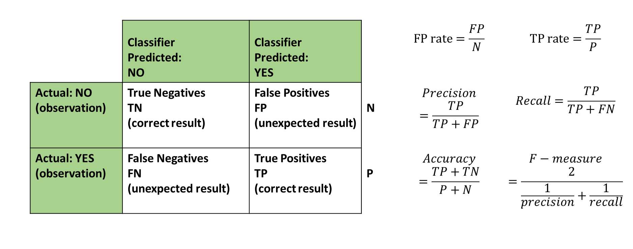
The Confusion Matrix
Common performance metrics calculated from it
 |  | Classifier Predicted: NO | Classifier Predicted: YES |  | $$FP rate=\frac{FP}{N}$$ | $$TP rate=\frac{TP}{P}$$
 | Actual: NO (observation) | True Negatives TN (correct result) | False Positives FP (unexpected result) | N | $$Precision=\frac{TP}{TP+FP}$$ | $$Recall=\frac{TP}{TP+FN}$$
 | Actual: YES (observation) | False Negatives FN (unexpected result) | True Positives TP (correct result) | P | $$Accuracy$$ $$=\frac{TP+TN}{P+N}$$ | $$F−measure$$ $$=\frac{2}{\frac{1}{precision}+\frac{1}{recall}}$$
The terms “Positive” and “Negative” refer to the classifier’s prediction.
The terms “true” and “false” refer to whether the prediction corresponds to the actual observation- what it really is.

Slide 5
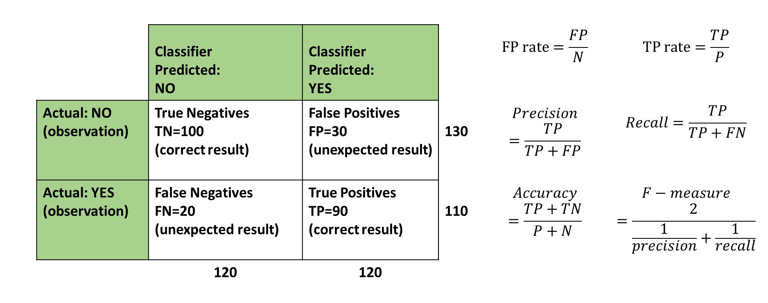
The Confusion Matrix
Common performance metrics calculated from it
 |  | Classifier Predicted: NO | Classifier Predicted: YES |  | $$FP rate=\frac{FP}{N}$$ | $$TP rate=\frac{TP}{P}$$
 | Actual: NO (observation) | True Negatives TN=100 (correct result) | False Positives FP=30 (unexpected result) | 130 | $$Precision=\frac{TP}{TP+FP}$$ | $$Recall=\frac{TP}{TP+FN}$$
 | Actual: YES (observation) | False Negatives FN=20 (unexpected result) | True Positives TP=90 (correct result) | 110 | $$Accuracy$$ $$=\frac{TP+TN}{P+N}$$ | $$F−measure$$ $$=\frac{2}{\frac{1}{precision}+\frac{1}{recall}}$$
 |  | 120 | 120
The terms “Positive” and “Negative” refer to the classifier’s prediction.
The terms “true” and “false” refer to whether the prediction corresponds to the actual observation- what it really is.

Slide 6

The Confusion Matrix
Common performance metrics calculated from it
 |  | Classifier Predicted: NO | Classifier Predicted: YES |  | $$FP rate=\frac{FP}{N}$$ = 30/130 | $$TP rate=\frac{TP}{P}$$ = 90/110
 | Actual: NO (observation) | True Negatives TN=100 (correct result) | False Positives FP=30 (unexpected result) | 130 | $$Precision=\frac{TP}{TP+FP}$$ = 90/120 | $$Recall=\frac{TP}{TP+FN}$$ = 90/110
 | Actual: YES (observation) | False Negatives FN=20 (unexpected result) | True Positives TP=90 (correct result) | 110 | $$Accuracy$$ $$=\frac{TP+TN}{P+N}$$ =190/240 | $$F−measure$$ $$=\frac{2}{\frac{1}{precision}+\frac{1}{recall}}$$
 |  | 120 | 120 |  |  | = 2((120/90)+(110/90))
The terms “Positive” and “Negative” refer to the classifier’s prediction.
The terms “true” and “false” refer to whether the prediction corresponds to the actual observation- what it really is.

Slide 7
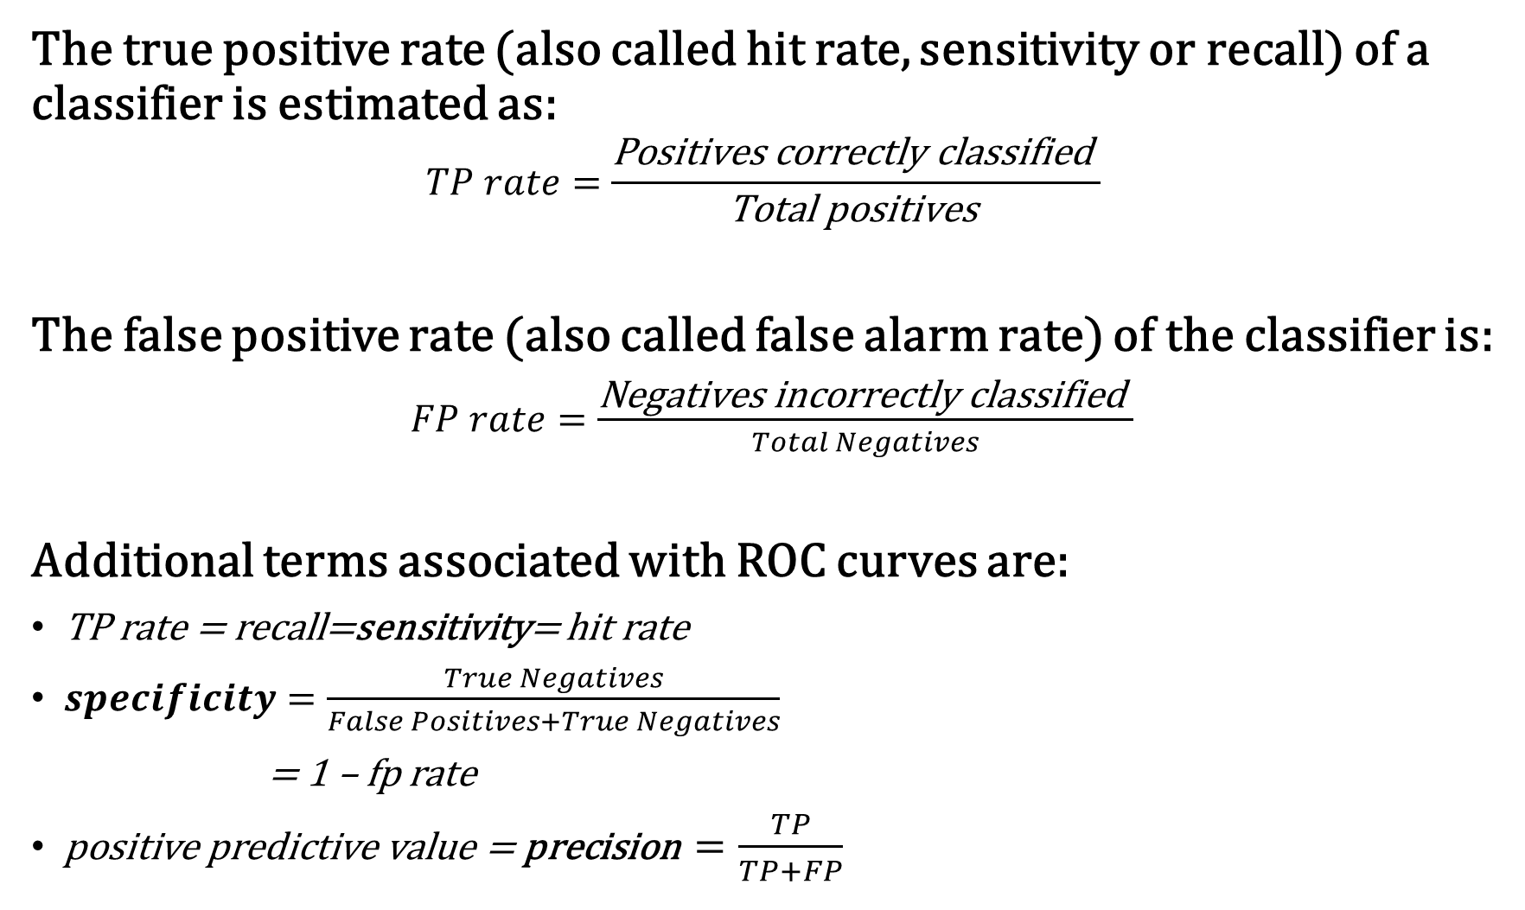
The true positive rate (also called hit rate, sensitivity or recall) of a classifier is estimated as:
$$TP rate=\frac{\text{Positives} \text{correctly} \text{classified} }{\text{Total} \text{positives} }$$
The false positive rate (also called false alarm rate) of the classifier is:
$FP rate=\frac{\text{Negatives} \text{incorrectly} \text{classified} }{Total Negatives}$
Additional terms associated with ROC curves are:
TP rate = recall=sensitivity= hit rate
$specificity=\frac{True Negatives}{False Positives+True Negatives}$
= 1 – fp rate
positive predictive value = precision $=\frac{TP}{TP+FP}$

Slide 8
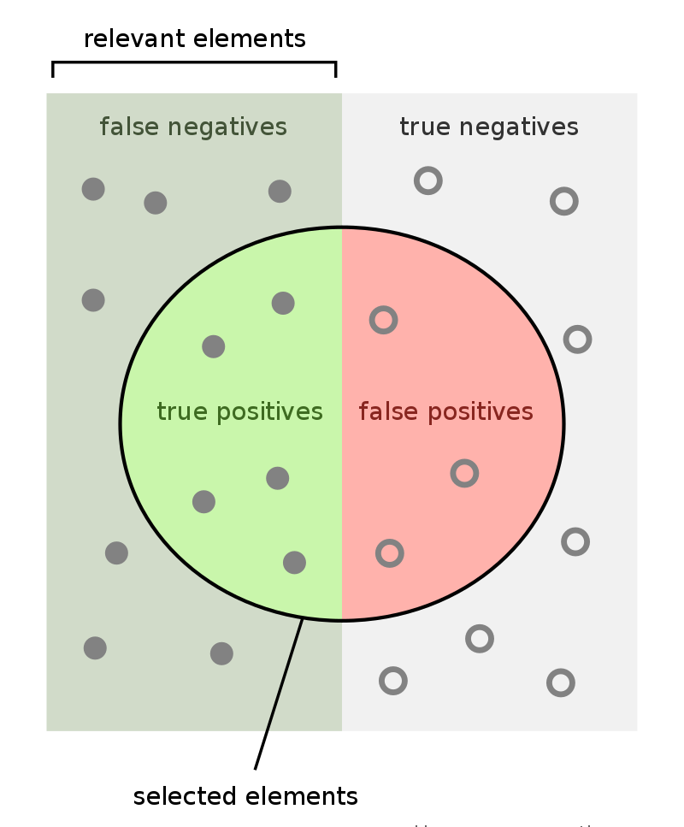
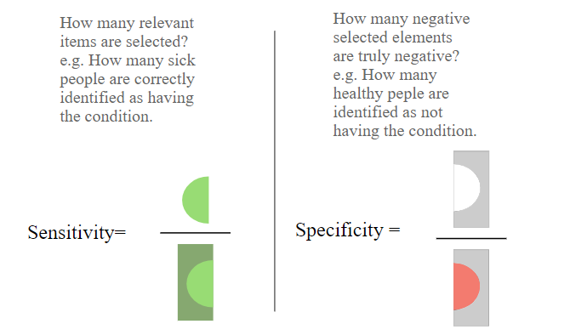
FeanDoe - Modified version from Walber's Precision and Recall https://commons.wikimedia.org/wik

Slide 9
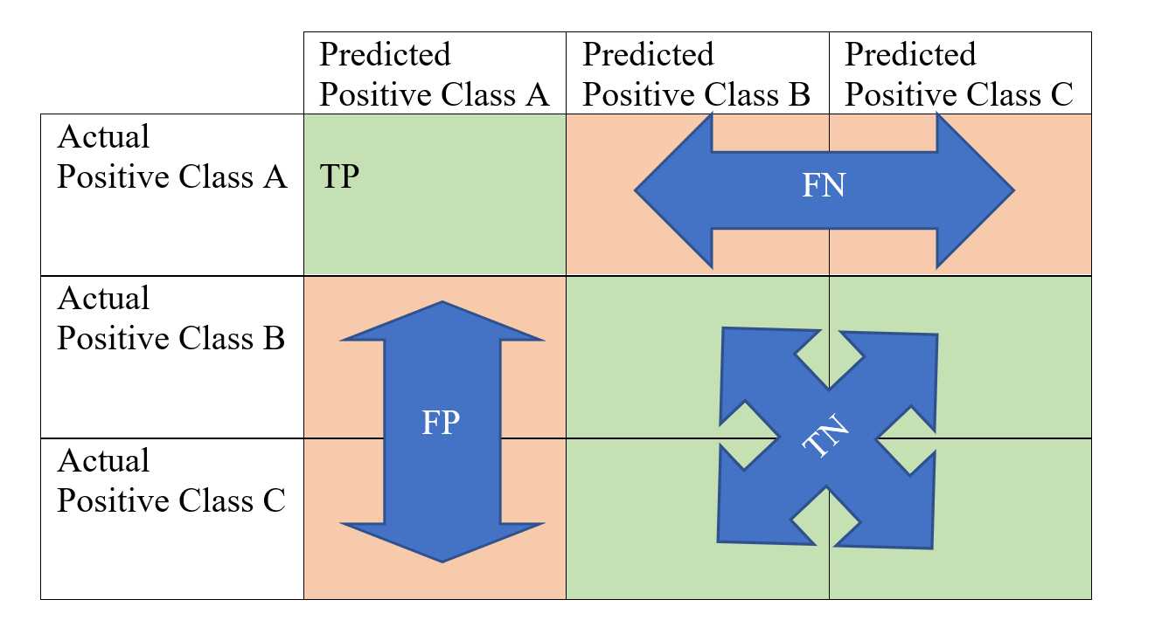
The Multiclass Confusion Matrix

Slide 10
The Multiclass Confusion Matrix
An Example
 | A | B | C | D | E | Support (TP+FN)
A | 5939 | 165 | 0 | 8 | 0 | 6112
B | 266 | 3144 | 13 | 0 | 436 | 3859
C | 0 | 7 | 2928 | 0 | 93 | 3028
D | 0 | 0 | 0 | 2716 | 0 | 2716
E | 49 | 692 | 58 | 0 | 3499 | 4298
TP+FP | 6254 | 4008 | 2999 | 2724 | 4028 | 20013
Profile Class | Recall | Precision | F1 | Support
A | 97.17 | 94.96 | 96.05 | 6112
B | 81.47 | 78.44 | 79.93 | 3859
C | 96.70 | 97.63 | 97.16 | 3028
D | 100.0 | 99.71 | 99.85 | 2716
E | 81.41 | 86.87 | 84.05 | 4298
 |  |  |  | 20013
Overall Acc. | 91.07 |  | Macro F1 | 91.41

Slide 11
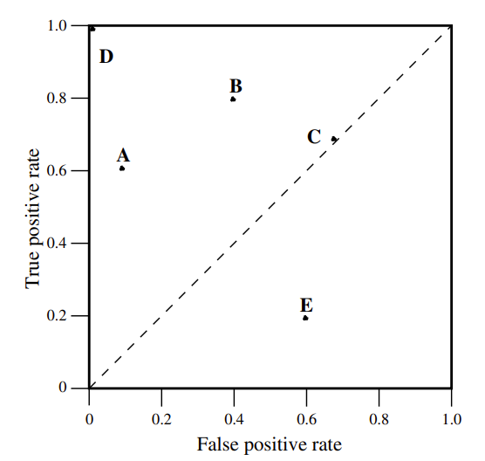
3. ROC space
ROC graphs are two-dimensional graphs in which TP rate is plotted on the Y axis and the FP rate is plotted on the X axis.
A ROC graph depicts relative trade offs between benefits (true positives) and costs (false positives).
Fig. 1 shows a ROC graph with five classifiers labelled A through E.
The closer we come to the top left (north-west) of the diagram, the better the classifier may be.
Fig. 1. Roc graph for 5 discrete classifiers, A to E

Slide 12
Decision Boundaries and ROC Curves
Recall Logistic Regression gave a probability of a class being correct. We set the decision boundary to be 0.5. If probability is estimated to be >=0.5 then it belongs to one class else it belongs to the other class.
If we vary the threshold from zero to one and calculate the TP rate and FN rate as we vary the threshold the we can plot the ROC curve.
To understand the usefulness of this let’s examine some examples.

Slide 13
Decision Boundaries and ROC Curves
Recall Logistic Regression gave a probability of a class being correct. We set the decision boundary to be 0.5. If probability is estimated to be >=0.5 then it belongs to one class else it belongs to the other class.
What happens when we move the decision boundary for a given classifier? Let’s explore this.
This ROC visualizer by Navan is very helpful. http://www.navan.name/roc/
The area under the red probability distribution curve is the total number of true positive classifications (think of each red pixel as being a single instance of the test set).
Similarly the area under the blue distribution is the number of negative classifications – true negatives.

Slide 14
If we can separate both classes by placing a threshold (vertical black line) between them then we have a zero false positives and 100% true positives.
Point D in ROC graph
0 0.1 0.2 0.3 0.4 0.5 0.6 0.7 0.8 0.9 1.0

Slide 15
If 10% (0.1) of our actual False observations are classified as False Positives and 60% (0.6) of our actual True observations are True Positives the we plot point A in the ROC graph
0 0.1 0.2 0.3 0.4 0.5 0.6 0.7 0.8 0.9 1.0

Slide 16
Point C in ROC graph
Both class distributions overlap each other fully so there FP rate is always equal to the TP rate, whatever the threshold.
0 0.1 0.2 0.3 0.4 0.5 0.6 0.7 0.8 0.9 1.0

Slide 17
If 60% (0.6) of our actual False observations are classified as False Positives and 20% (0.2) of our actual True observations are True Positives then we plot point E in the ROC graph.
0 0.1 0.2 0.3 0.4 0.5 0.6 0.7 0.8 0.9 1.0

Slide 18
To get a ROC curve we slide the decision threshold from 0 to 1.0 and plot (FPR,TPR) at each point.
0 0.1 0.2 0.3 0.4 0.5 0.6 0.7 0.8 0.9 1.0

Slide 19
The Area Under the Curve (AUC)
This gives a sense of the quality of the classifier.
Random guessing produces a diagonal line between (0,0) and (1,1) so we look for a AUC value greater than 0.5.
A perfect classifier will have a AUC of 1.0.
AUC is used when a general measure of predictiveness is required.

Slide 20
Cross Validation
Recall we can split our data into:
a training set
A validation set
A test set
We use the validation set to tune our model’s hyper parameters without using the test set.
Scikit Learn has a K-fold cross validation function that can do useful things.
It can split your training data into multiple subsets (say 10 of them).
Each is called a fold.
It trains on 9 folds and tests it against one fold.
It does this for each of the ten folds.
You can choose the number of folds.
This can be useful for creating ROC curves. See the Jupyter example notebook on Moodle to see this in action.

