Slide 1

Social & Ethical Marketing
Sara John-Davies (1910200)

Slide 2


Slide 3

Aims and Objectives

Slide 4
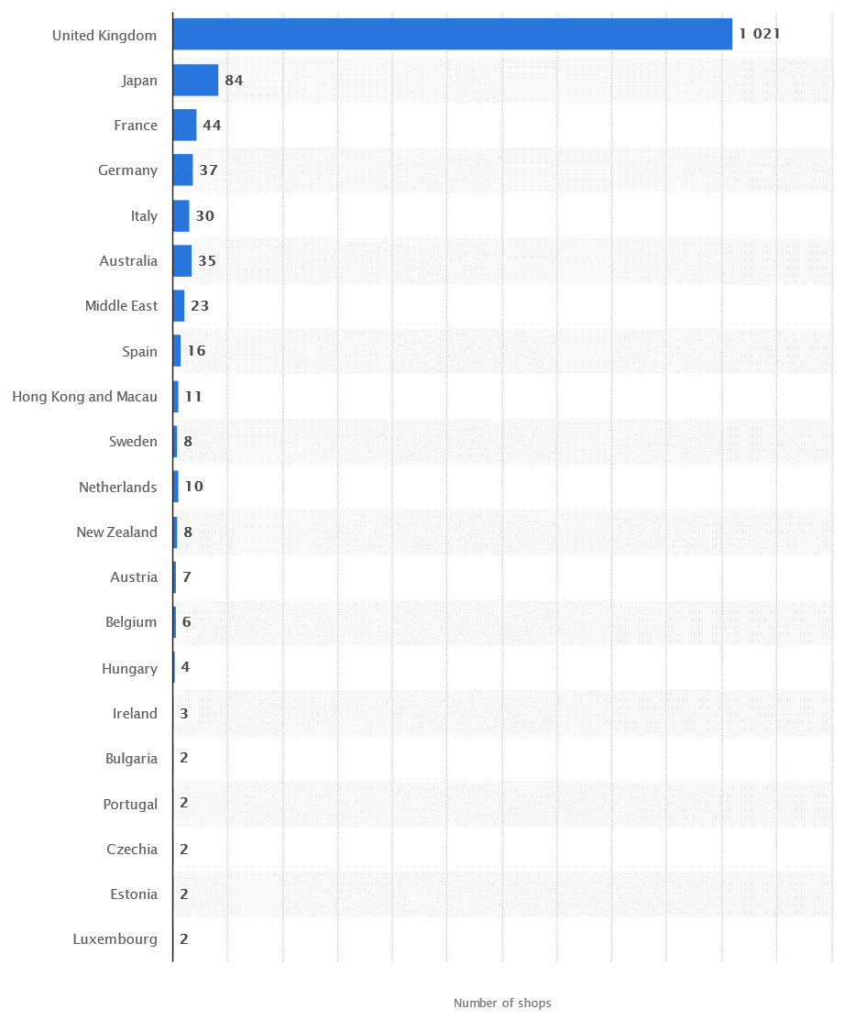

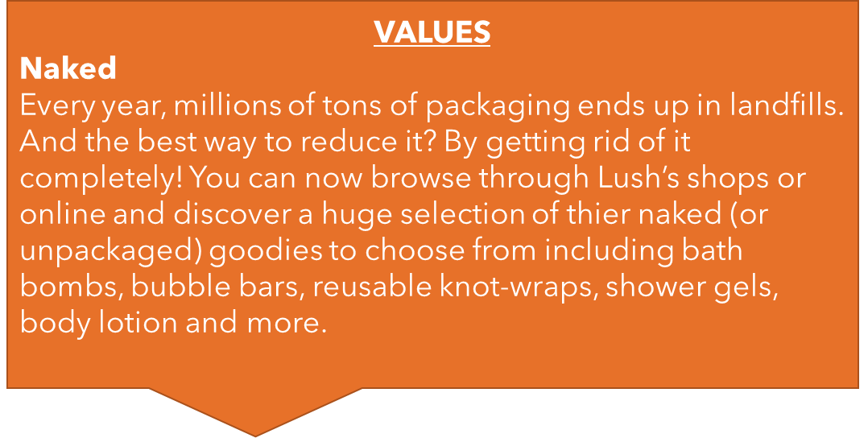
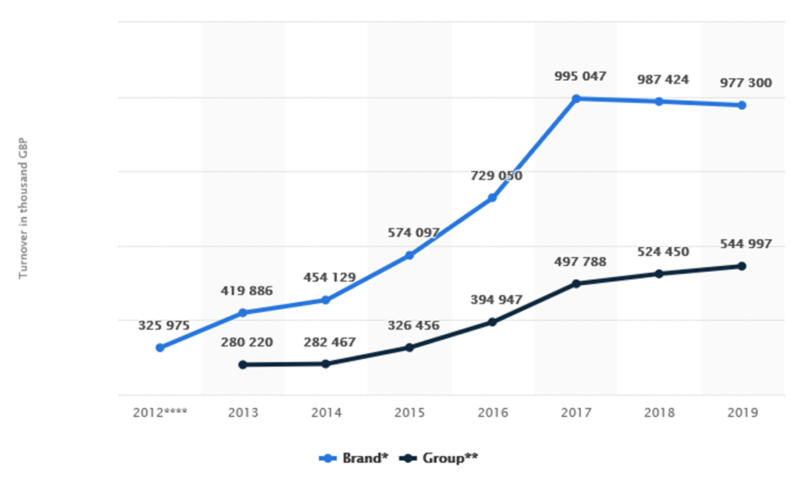
GEOGRAPHIC
PHYSCOGRAPHIC
Marketing Segmentation
DEMOGRAPHIC
BEHAVIOURAL

Slide 5


Slide 6
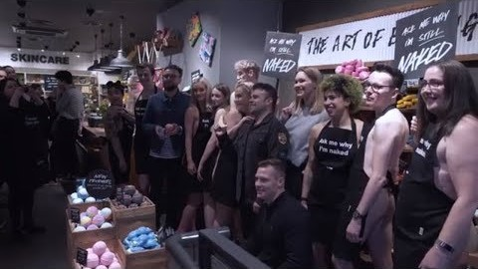

Slide 7


Slide 8


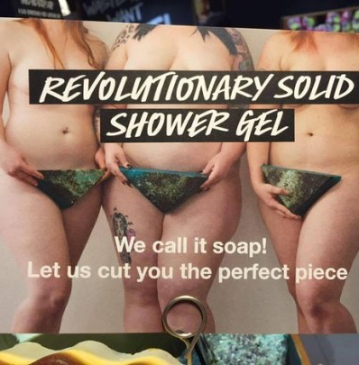
#LUSHNAKED Campaign
Do you think these look like ‘Porn’ to you?

Slide 9
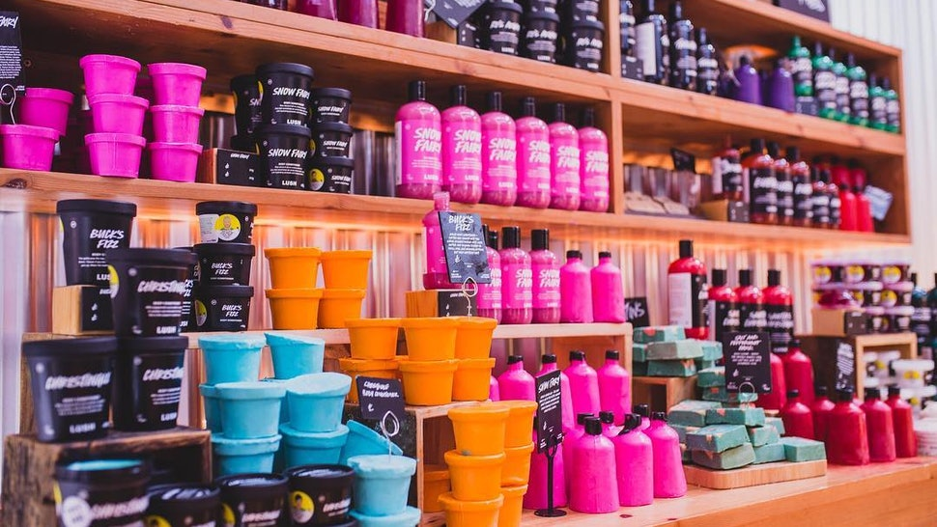
Justifaction

