Slide 1

Problem Solving and Decision Making (BMSW4004)
Student Name: Silverio de Oliveira da Cruz Guimaraes
Student ID number: 2026915
Module Coordinator: Ernest Ovia

Slide 2

Introduction
Company: Amazon
Industry: Online Retailer
Costumer Type: Business to Costumer
Organization Size: MNE
Problem Statement: Work Relates Stress .
Hard place to work due to the excessive workload pressure
Lack of support from managers and poor organization.
Notes:
Introduction
Amazon is a multinational technology company that is focusing on e-commerce. This is the online retail company that is under the industry of e-commerce, artificial intelligence, cloud computing as well as consumer electronics. The presentation is focusing on the stress regarding the work. Identifying the problems, it can be said that Amazon is the worst place to work due to the excessive workload pressure and Amazon is getting high quotes of the production for the warehouse workers that is creating the stress constantly.

Slide 3
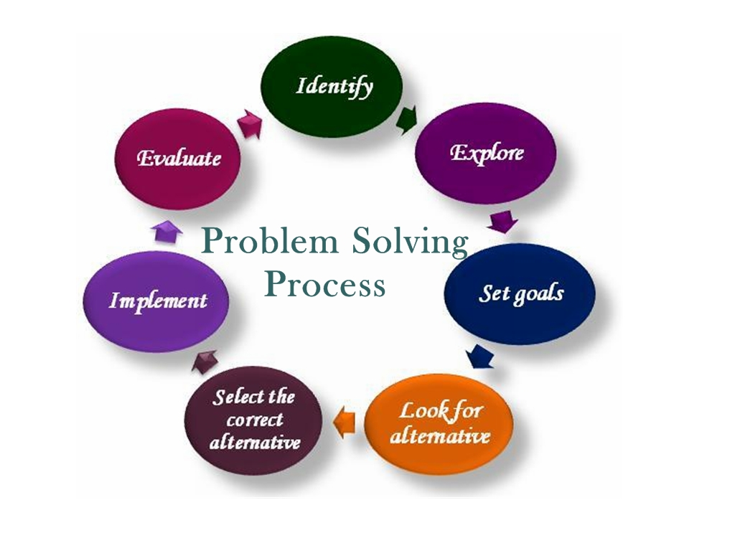
Problem Description
Definition of problem: a matter or situation regarded as unwelcome or harmful and needing to be dealt with and overcome.
Workload pressure is making a stressful situation
The people in the organization think that their work can kill them
Problem solving process:
Defining the problem - stressful situation among the employees
Clarifying the problem - employees said they are working like a robot.
Defining the goals - to reduce the stress in the workplace.
Root cause to the problems - High percentage of the work and working hours.
Developing action plan - maintain the flexibility in the working hour.
Executing the action plan - satisfy the employees and the employees can work happily than before.
Results - predict to get more percentage of the customers and development of business opportunities.
Continuous improvement - satisfaction from the employees and reducing the unhappiness among the employees for long time.
Source: (Kantor and Streitfeld, 2015)
Notes:
Problem description
Workload pressure is making a stressful situation for the employees in the organization. The staff in the organization are working like robots. Constant stress in the workplace of the organization is leading to the sickness of the workers. The people in the organization think that their work can kill them. Grueling conditions in the workplace in the Amazon is making difficulties for the employeesSource: (Kantor and Streitfeld, 2015).
Problem solving process -
Defining the problem - The stressful situation among the employees is the major problem.
Clarifying the problem - The employees said they are working like a robot.
Defining the goals - The organization has the goal to reduce the stress in the workplace.
Root cause to the problems - High percentage of the workload is the main cause of the problem.
Developing action plan - The organization will maintain the flexibility in the working hiur to reduce the stress.
Executing the action plan - Implementing the action plan the organization will satisfy the employees and the employees can work happily than before.
Results - Implementing the solution the organization will see more percentage of the customers and they will give better feedback and this will also develop more business opportunities.
Continuous improvement - Implementing the solution the organization can get the satisfaction from the employees and it leads to reducing the unhappiness among the employees.

Slide 4
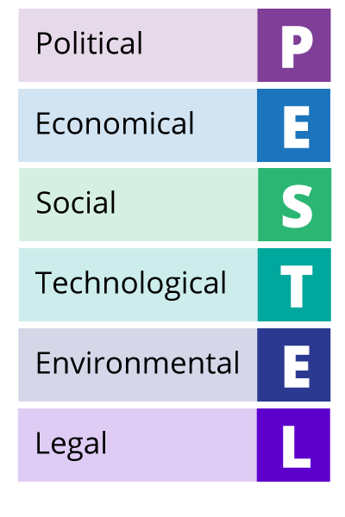
Environmental analysis (External)
Political - negotiations of Brexit
Economic - Amazon activity’s total revenue all over the UK were 20.63 billion
Social - avoiding social-interaction and online shopping trend
Technology – Implementation of the technological innovation
Environment - questions regarding the impact of the environment
Legal - commissions of the federal trade
Notes:
PESTEL analysis
Political - In light of the negotiations of Brexit, the USA and UK government hold the discussion about their deals of potential trade among the two countries. This is making it easy to operate in the UK and this leading to the reduction of the import tax as well as the less regulations (Gilchrist, 2017)
Economical - In 2020, Amazon activity’s total revenue all over the UK were 20.63 billion of the pound. On the other hand, 2019 showed 13.73 billion of the pound. So, it can be said that the business has increased due to the growth of online shopping. So, the people's trend with online shopping is leading to the stress of the employees because the company is creating pressure on the employees for more work.
Social - In the pandemic, there was a huge impact on the company because the people in the UK are avoiding social-interaction. So, thi8s is also affecting the business. So, the employees are also stressed with the low percentage of the business. Additionally, it can also be mentioned that the people’s trend of online shopping has also increased, which makes a more stressful situation ibn delivering the products.
Technological - In 2018, for expanding the workforce iofg the UK Amazon announced that they can double the staff’s amount that they are employing the centre of the development and research in London and the company is focusing on the proposition of the technology that is helping in reducing the stress because the technological implementation doesn’t want too much labour (Ruddick, 2017). However, innovation through technology can be effective in the workload situation.
Environmental - Till 2016, Amazon didn't publish their report of sustainability and this led to the questions regarding the impact of the environment on the environment with a wide range.
Legal - Increasing pressure on the multinational companies for risking assessing the clients. Amazon is under federal investigation to sell the goods. Amazon is coming under the commissions of the federal trade to produce the misleading claims regarding the pricing discounts around approximately 1000 numbers of the products (Bartz, 2017).

Slide 5

Environmental analysis (Internal)
Strengths
strong position in the market
a successful brand image
Weaknesses
Unsafe conditions in the workplace
Avoidance of the tax in the US, UK and Japan
Opportunities
expanding the operations of it in the developed market
planning of electric rickshaws by 2025
Threats
Economic recession
The fake reviews
Source: (Gupta, 2021)
Notes:
SWOT
Strengths - Amazon has a strong position as well as they have a successful brand image in the market. As per 2020 in the ranking of the global brand, Amazon ranked two with the brand value. The company is bringing innovative additions and creative ideas (Gupta, 2021).
Weaknesses - Launch of the Fire Phone in the US is making the failure when the fire devices did not go well. Avoidance of the tax in the US, UK as well as Japan spreaded the negative publicity for Amazon. Unsafe conditions in the workplace is le3adi\ing to the major weakness for the organization (Gupta, 2021).
Opportunities - The company can gain opportunity for expanding the operations of it in the developed market. Amazon pledges are making a positive impact on the environment. They are planning for electric rickshaws by 2025 (Gupta, 2021).
Threats - Regulations of the government are making threats to the proceedings of the business for Amazon in some complex countries. Economic recession is also mentioned as the threat for the organization. The fake reviews from the people makes the major threat and also the unhappiness of the employees (Gupta, 2021).

Slide 6
Cause & Effect Analysis
{Fishbone diagram}
4 main causes of work-related stress
Working environment
Process
Work equipment
Employes mental health (anxiety)
Poor scheduling process
Lack of model organization
Work related stress
Recruitment
Management
Not skilled people
Reduced staff
Leadership style
Lack development opportunities
Source: Foong et al. 2020,

Slide 7
Aspects of workplace stress
Source: Silverman, et al. (2010) (17)
Source: (Akinsanya & Oludeyi, 2013 : 65)
Working Environment
Stress
External Environment
Individual Behavior
Source: (Mack & Putzschel, 2014)
Source: (Cartwright and Cooper, 1997).

Slide 8
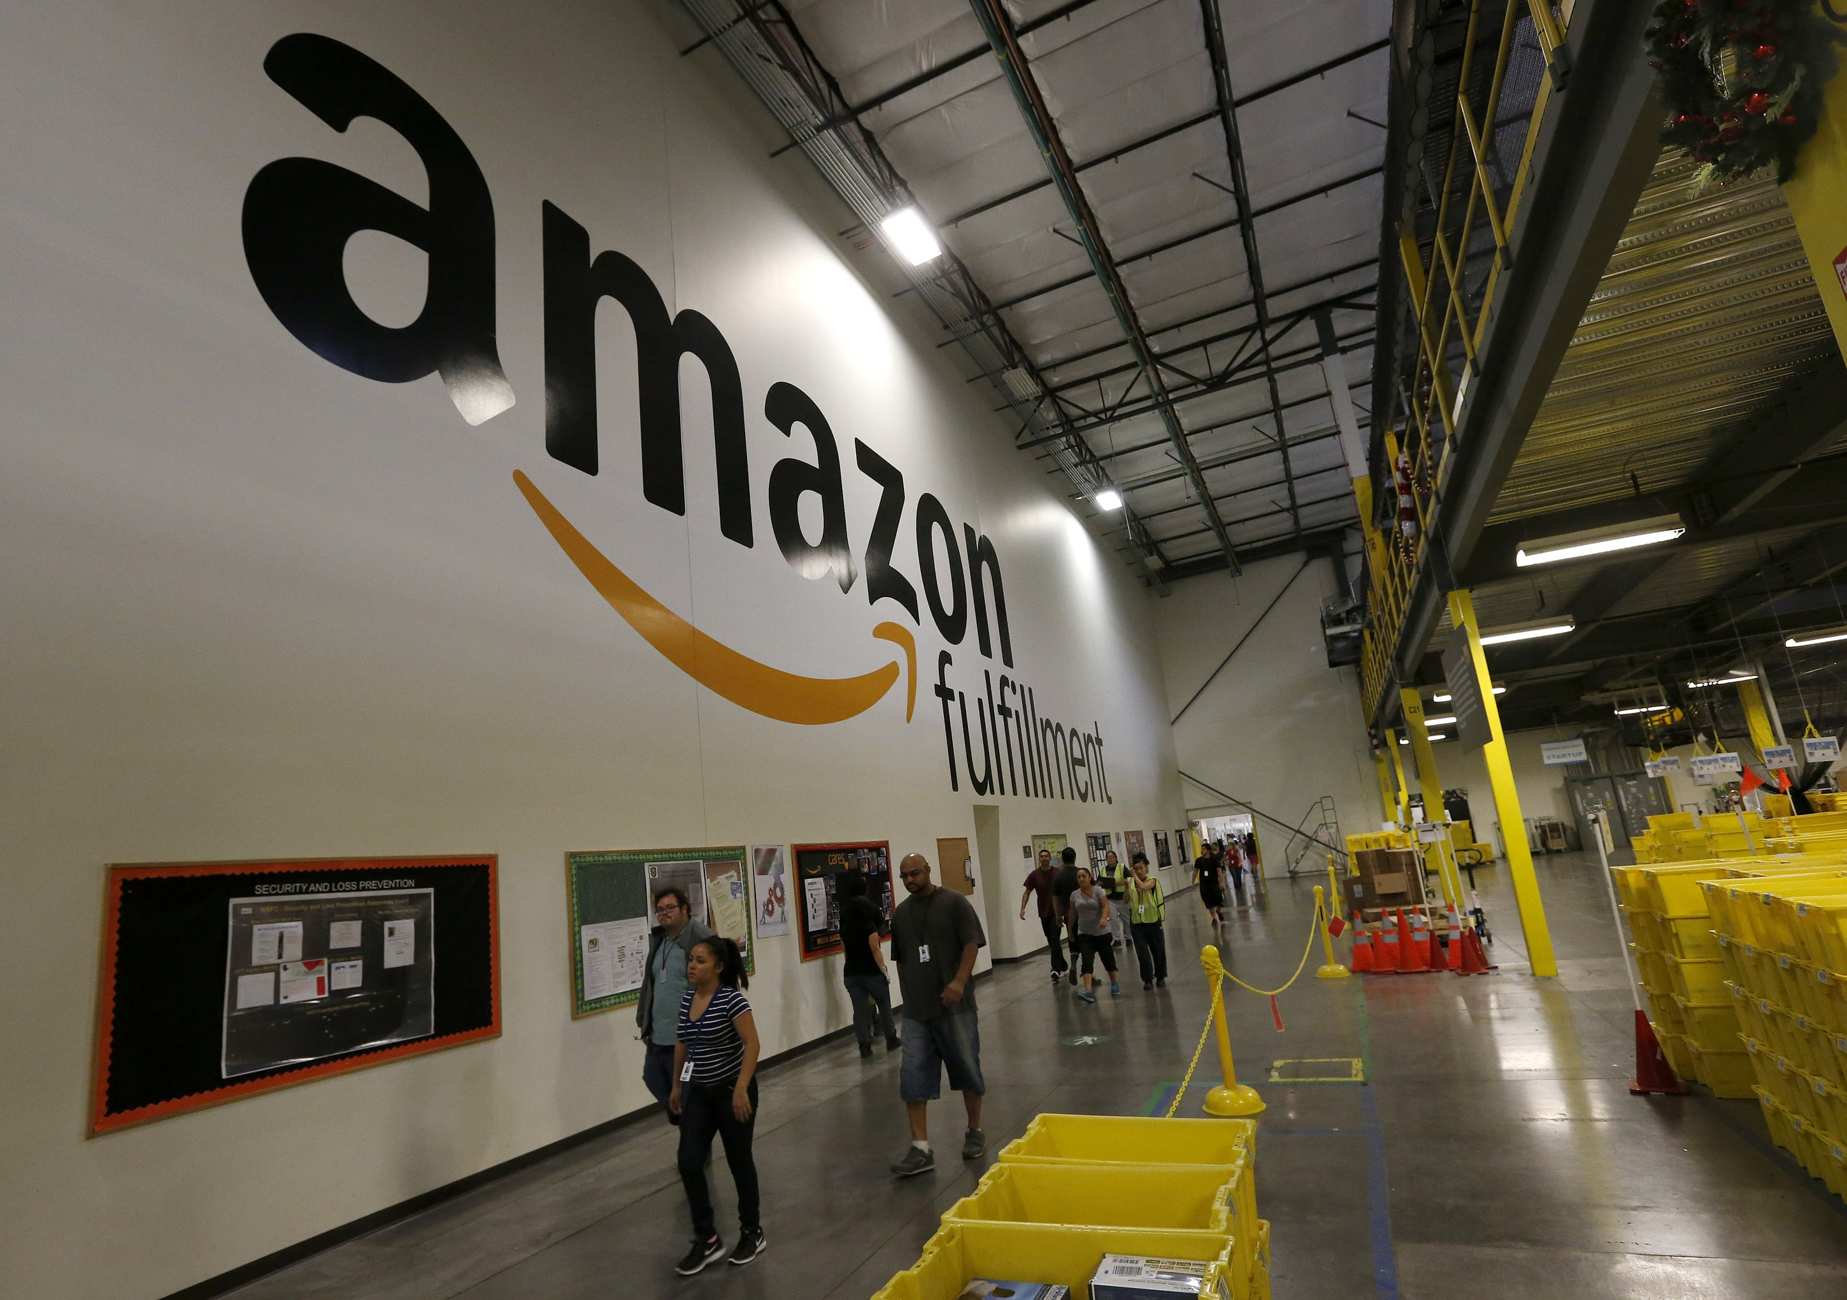
Suggested Solution
Suggested Causes:
Working environment (Main)
Process
Recruitment
Management
Suggested Solution:
Establish a maintenance schedule, job rotation.
More benefits and opportunities for the staff, to develop their career and recognize the employee`s work.
Positive relationship between employer and employee`s will definitively reduce stress at workplace, all parts counts.
Notes:
Suggested causes
The long hours can be the issues for the stressful situation
Heavy workload in the organization is leading to the pressurized situation for the employees.
Changes in the warehouse management system in Amazon is leading to too much stressfulness among the staff of the organization.
The close deadlines can also create pressures among the employees.
Suggested solution
Amazon can reduce the long hours working that will be beneficial for the organization as well as the employees. So, the company can allow flexible hours for the employees.
The company can encourage the wellness of the workplace like the company can encourage the employees to go on the walk in the time of launch breaks.
The company should recognize the employees that will encourage them.
The company should provide a proper deadline to the worker that will help in getting the better output of the work as well as the organizational benefit.

Slide 9
References:
Cartwright, S. and Cooper, C.L., 1997. Managing workplace stress (Vol. 1). Sage.
Foong, T.W., Tiong, H.F., Ong, S.Y. and Chen, F.G., 2020. Using quality improvement tools to enhance workplace learning in an anaesthesia unit. Medical Teacher, 42(11), pp.1228-1233.
Gupta, S.K., 2021. Amazon SWOT 2021: SWOT analysis of Amazon. Available at: https://bstrategyhub.com/swot-analysis-of-amazon-amazon-swot/amp/ [Accessed October 30, 2021].
Bartz, D., 2017. Probe opened up on deceptive Amazon discounts. The Independent. Available at: https://www.independent.co.uk/news/business/news/amazon-discounts-deceptive-federal-trade-commission-whole-foods-buy-out-prices-online-a7852516.html [Accessed October 30, 2021].
Ruddick, G., 2017. Amazon to double number of R&D staff in London. The Guardian. Available at: https://www.theguardian.com/technology/2017/jul/25/amazon-double-number-research-development-staff-london [Accessed October 30, 2021].
Gilchrist, K., 2017. Here's what could come out of the UK trade secretary's meeting with Wilbur Ross. CNBC. Available at: https://www.cnbc.com/2017/07/21/wilbur-ross-liam-fox-trade-us-uk-deal-brexit.html [Accessed October 30, 2021].
Kantor, J. and Streitfeld, D., 2015. Inside Amazon: Wrestling Big Ideas in a Bruising Workplace (Published 2015). [online] Nytimes.com. Available at: <https://www.nytimes.com/2015/08/16/technology/inside-amazon-wrestling-big-ideas-in-a-bruising-workplace.html> [Accessed 1 November 2021].

