Slide 1
ECES6009/C
MAKING A DIFFERENCE
Session 5

Slide 2
Overview
Empowerment
Choice
Features and Role of Person Centred Planning

Slide 3
Thompson’s 1992 model of inequalities and discrimination : PCS ( 2006)
Structural / social divisions
Cultural / Common-alities
Personal / Psych-ological
Notes:
Neil Thompson (1997, 2006) designed a model that has been influential in both social work and education contexts to enable practitioners to understand the need to address inequalities:
“Thompson suggests that individuals are affected by what he calls personal, cultural and structural influences that come together to impact on how we fit into the social world. What Thompson calls ‘cultural’ influences encompass broader shared approaches – such as what is seen as acceptable behaviour. Structural issues refer to the ‘bigger picture’ of how society is organised and include aspects such as government policy and the shape of the welfare state. Thompson calls his PCS model an ‘analysis’ because it is a way of examining different aspects of situations that [practitioners] come across. However, he emphasises that it is about action as well as thought. [Practitioners] (…) need to do more than understand how individuals are affected by social and other factors; they need to act on this understanding to challenge disadvantage and prejudice. The PCS analysis could be set out in a diagrammatic form (below), showing how the individual or personal experience is surrounded by cultural and structural influences.”

Slide 4
Inequalities and discrimination
Helpful to analyse situation in terms of 3 levels
The 3 levels (PCS) are interlinked and interact constantly
P- personal – thoughts, feelings, attitudes
C- cultural, consensus, conformity, unwritten rules
S- structural, social divisions, oppression & discrimination are institutionalised, ‘sewn in’
Thompson, 2006

Slide 5
Inequalities and discrimination
PCS analysis shows the different levels at which discrimination operates
Inadequacy of explanations that stop at the individual level
Oppression does not derive from individual actions
Can be and is often institutional
Thompson 2006

Slide 6

Task - Power / Empowerment
Individually: identify 3 times in your life when you felt powerful and 3 times in your life when you have felt powerless
What was the nature of the power?

Slide 7
Nature of power
Power can be:
  Emotional
  Political
  Economic
  Cultural
  Physical……..

Slide 8

Empowerment
The process by which individuals who lack power can become more powerful
Began to be embraced by policy makers in 1980’s through initiatives such as advocacy and user and carer involvement
Realisation that ‘top down’ may not be the most effective way of challenging disadvantage
(Booth, 2014)

Slide 9
Empowerment
Gaining more control over your own life
Being able to use your own resources to meet your own needs
Overcoming obstacles to meet your needs and aspirations
Having your voice heard in decision-making
Being able to challenge inequality, inequity and oppression in yours/others lives
(Dalrymple and Burke, 2001 cited in Booth, 2014)

Slide 10
Empowerment
Health and social care practitioners do not instantly give people power
They aim to reduce the powerlessness that individuals and groups experience
(Dalrymple & Burke 1995)
An empowerment perspective enables us to move away from a medical model to a social model

Slide 11

choice
Choice is the most powerful word and the most abused word in the current lexicon of the disabilities services system (Smull in O’Brien & O’Brien, 2000)
Preferences- what someone likes, and their desires and dreams
Opportunities- what is available
Control- the authority to make use of an opportunity to satisfy a preference

Slide 12
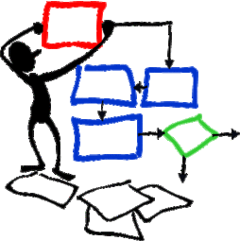
Control
Control is a complex concept
Having control means having to make decisions
Most of us do not want absolute control
How much control we have and what we have a control over should be a function of desire and capacity
However, our stereotypes of people with significant learning disabilities cause us to overlook capacities
(Smull in O’Brien & O’Brien, 2000)

Slide 13
Control
Important to differentiate between giving control and sharing control
We need to recognise that all people want and needs control over some aspects of their lives
(Smull in O’Brien & O’Brien, 2000)

Slide 14
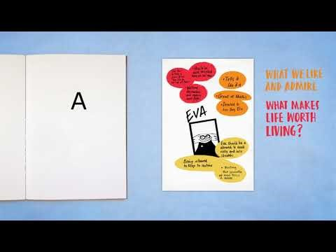
What is PCP?

Slide 15
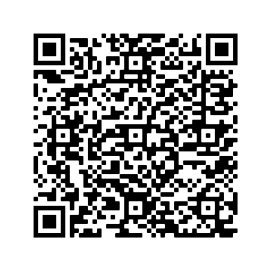
What is PCP?
What is PCP? Council for Disable Children
Discuss as a group
Feedback on benefits and challenges of employing this approach
(Video= 5 mins, Discussion 10mins)

Slide 16

Values of PCP
Community presence
Choice / control
Competence
Reputation / respect
Relationships
(Mercer, 2003)

Slide 17
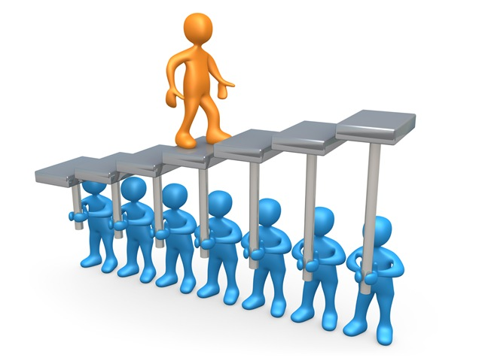
Values of PCP
Community presence
Sharing ordinary places and valued activities with others
(Mercer, 2003)

Slide 18

Values of PCP
Choice / control
Freedom to make decisions, both in everyday matters and large, life-defining matters
(Mercer, 2003)

Slide 19
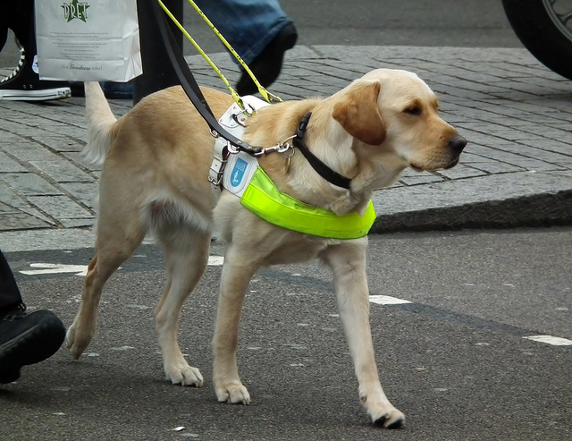
Values of PCP
Competence
Opportunities to engage in meaningful, functional activities with whatever level of assistance is required
(Mercer, 2003)

Slide 20

Values of PCP
Reputation / respect
Having a valued place or role in one’s community and being seen by others in positive ways
(Mercer, 2003)

Slide 21
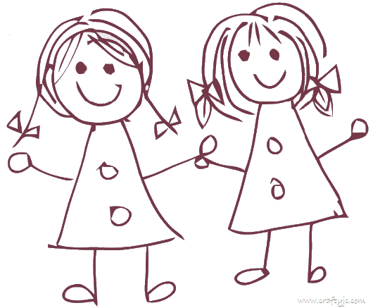
Values of PCP
Relationships
Development of a network of personal relationships and friendships, which in turn provides the context and the support for a person to engage in self chosen activities
(Mercer, 2003)

Slide 22
Reference list
Booth , J. (2014) Lecture 6 - Empowerment and Social Change SJSI6017. University of Wales Trinity Saint David. Unpublished.
Dalrymple, J. & Burke, B. (1995). Anti-oppressive practice: social care and the law. Buckingham, Open University Press.
Mercer, M. ( 2003) Person Centered Planning. Helping People with Disabilities Achieve Personal Outcomes. Illinois: High Tide Press
O’Brien.J. & O’Brien, C.L ( 2000) A Little Book About Person Centred Planning. Ontario: Inclusion Press
Thompson, N. ( 2006) Anti-discriminatory practice. ( 4th edn) Basingstoke: Palgrave Macmillan

