Slide 1
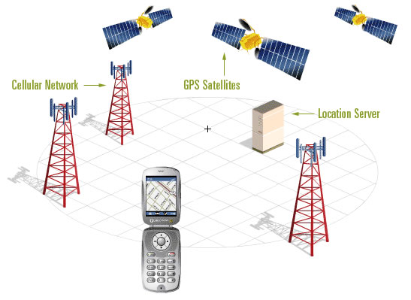
Location Based Services

Slide 2
What are Location Based Services
Location based services present a compelling new business opportunity for application developers, operators, and content producers. Location awareness differentiates mobile applications from traditional PC and wired Internet services.
Location based services are applications that make use of the users physical location in order to provide an enhanced service or experience.
Location acquisition interface is a middleware technology which simplifies location based applications and service development by giving developers an instant compatibility with any supported positioning method available in the mobile device.

Slide 3
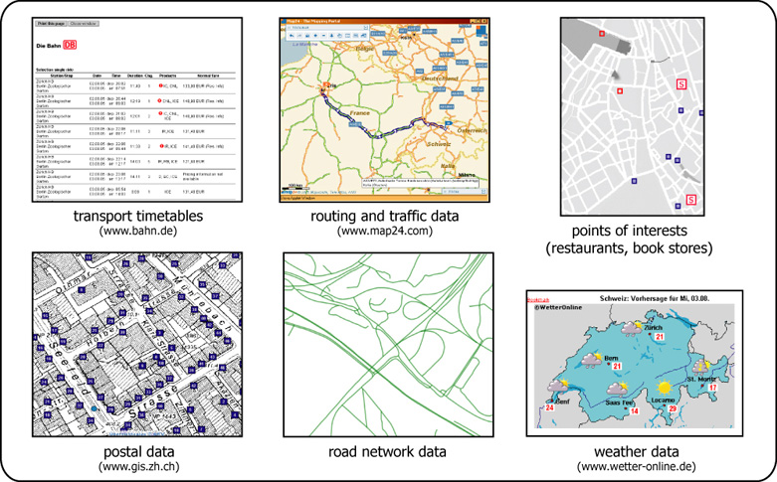
Images of where Location Based Services are used

Slide 4
Where are Location Based Services used?
Location Based Services can be used in many different ways, some examples are below -
  Location Based Services can be used to find Businesses, Restaurants and ATM’s.
  They also provide the user with alerts or notifications for e.g. A Traffic Jam.
  They can be used to find someone or something, like a doctor or hospital.
Location awareness can be used for navigation, mapping, workforce tracking, finding points of interest and getting weather information.

Slide 5
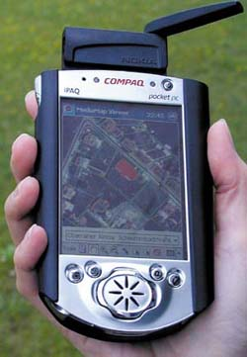
Location Based Services
The use of geographic data in the field on mobile devices like networked Personal Digital Assistant (PDA)
The main components for LBS are
Mobile device i.e. PDA's
Global positioning system (GPS)
Communication network
GIS
Typical Queries for LBS Applications
  Where am I?
  Where is the nearest…?
  How do I get To…?

Slide 6
Companies Using Location Based Services
There are many companies in which use location based services, in both the retail and tourism industry. These include –
  In the retail industry of many companies in which uses GIS and location based services is T-Mobile. T-Mobile use a variety of mapinfo products, which it is therefore able to effectively and cost efficiently determine potential new locations to develop a site, locate possible new customer populations and furthermore expand the company infrastructure.

Slide 7
Types of LBS
Triggered
  Emergency Services
  Fleet Tracking
  Navigation Services
User- requested
  Information Services (weather forecasts etc)
  Service Location (finding nearest)

Slide 8
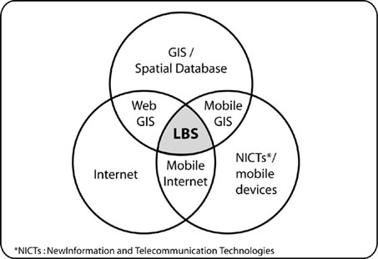
Where Location Based Services are used
LBS as an intersection of technologies
used within the Web, Mobile Devices and the Internet:

Slide 9
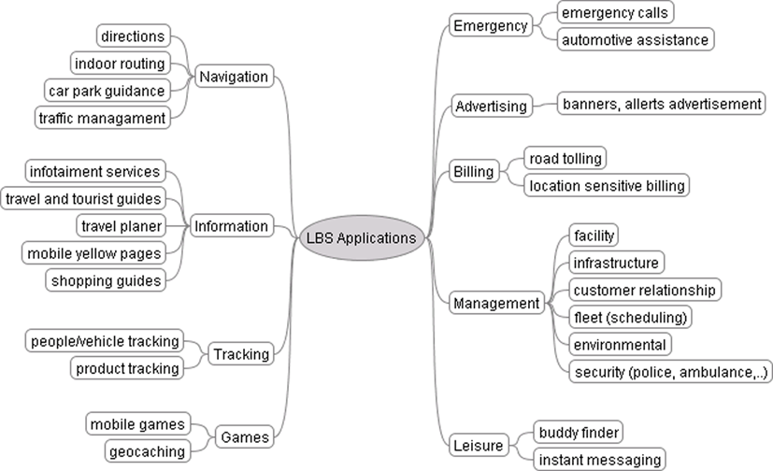
Categories of Location Service Applications
LBS application categories

Slide 10
Why are Location Based Services useful?
Navigation – planning a route
Orientation and Localisation - locating
Search – search for people and objects
Identification - identifying and recognising
persons or objects
Event Check – checking for events

Slide 11
How important is Galileo? Investigate.
http://www.gsa.europa.eu/
http://www.galileo-services.org/index.html

Slide 12
Summary
Location-based services are different from more conventional paper and internet based media (guides, directories, maps etc.) because they are aware of the context in which they are being used and can adapt their contents and presentation accordingly.

