Slide 1
Microdysgu

Slide 2
Targedau Iaith Personol:
Pronounciation (ynganu‘ei’)
Gorchmynion
Hyder (confidence)
​
Enw: Annabel Thomas ​
Teitl y wers: Eisiau, Eisiau Eisiau! ​
Nod y wers: deall, siarad ac ysgrifennu am eisiau
Blwyddyn: 4
Ffocws Iaith / Patrymau:​
Cwestiynau: Beth rwyt ti eisiau? / Beth rwyt ti eisiau brynu? / (os oes amser - beth rwyt ti eisiau fywd?)
Beth mae e eisiau?
Beth mae hi eisiau?
​Ateb:
Rydw i eisiau…
Rydw i eisiau bwyta..
Rydw i eisiau prynu..
Mae e eisiau..
Mae hi eisiau…
Gwybodaeth flaenorol:​
Eisiau (on its own) / DIM cwestiynau
Bwyd neu bwyta
​
Gweithgareddau:​
Drillo / cyflwyno iath
Gem GBBO
Tasg tâten boeth
Tasg cyfatebol (os oes amser)
Tasg glo
Geirfa:​
Eisiau
Beth + TM
Rywd i / mae e / mae hi
References: all resources have been created by myself from my university notes. See ‘Referencing’ slide.

Slide 3











Eisiau, Eisiau, Eisiau!
Rhestr o fwyd
Patrwn Brawddeg
Cwestiynau:
Beth rwyt ti eisiau?
Beth rwyt ti eisiau brynu?
Beth mae e eisiau?
Beth mae hi eisiau?
(Beth rwyt ti eisiau fwyd? Os oes amser)
Atebion:
Rydw i eisiau…
Rydw i eisiau bwyta..
Rydw i eisiau prynu..
Mae e eisiau..
Mae hi eisiau…
Pwy
Afal
Siocled
Mefys/
Mefusen
Sglodion
Uwd
Grawnwin
(Fi) Rydw i
(hi) Mae hi
(e) Mae e

Slide 4
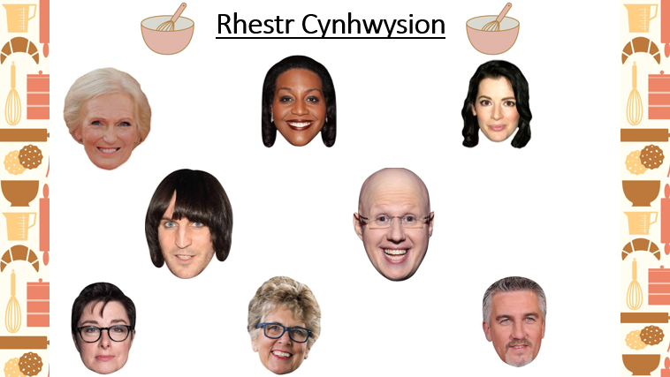

Grawnin !
Tomato!
Banana!
Sglodion!
Oren!
Salad!
Creision!
Cacen!

Slide 5

Brawddeg
1. ___________________________________________________________
2.____________________________________________________________
3.____________________________________________________________
4.____________________________________________________________
5.____________________________________________________________
6.____________________________________________________________
7.____________________________________________________________
8.____________________________________________________________

Slide 6

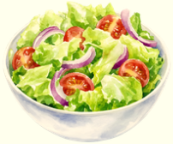

Adnoddau

Slide 7




Slide 8



Slide 9
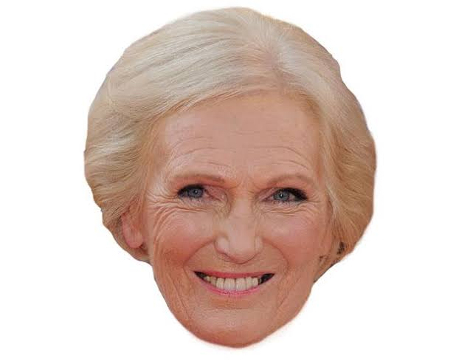
Gêm adnoddau

Slide 10
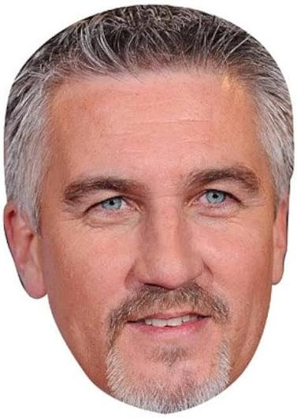

Slide 11


Slide 12

Cardiau Iath

Slide 13

Beth rywt ti eisiau?

Slide 14
Beth rywt ti eisiau brynu?

Slide 15
Rydw i eisiau…

Slide 16
Rydw i eisiau prynu…

Slide 17
Beth mae e eisiau?

Slide 18
Beth mae hi eisiau?

Slide 19
Mae e eisiau…

Slide 20
Mae hi eisiau….

Slide 21
(os oes amser)
Beth mae hi eisiau fwydd?

Slide 23
Referencing
All information used in PowerPoint and teaching has come from my university notes, some individual words were checked through Ap Geiriaduron.
Photo Referencing
Slide 3, 6, 7, 8 Canva – ‘elements’ (date accessed: 13/10/26) https://www.canva.com/
Slide 4
‘Mary Berry Mask’ – Celebrity Cut-Outs UK(date accessed: 12/10/26) https://www.celebrity-cutouts.co.uk/shop/celebrity-mask/tv-stars-celebrity-mask/mary-berry-celebrity-mask/
‘Alison Hammond Mask’ – FunkyBunky (date accessed 12/10/26) https://funkybunky.co.uk/Item/Alison_Hammond
Nigella Lawson Cut Out’ VIPCutOuts.Com – (date accessed 12/10/26) https://www.vipcutouts.com/new-celebrity-vip-cardboard-cutouts/product/3482-nigella-lawson-face-mask
‘Noel Fielding (fringe) Celebrity Mask’ - CelebrityCut-Outs.co.uk(date accessed: 12/10/26) https://www.celebrity-cutouts.co.uk/shop/celebrity-mask/comedians-celebrity-mask/noel-fielding-fringe-celebrity-mask/
‘Matt Lucas Celebrity Party Face Mask’ – CelebrityFaceMasks.com (date accessed 12/10/26) https://celebrity-facemasks.com/products/matt-lucas-face-mask.html
‘Sue Perkins Celebrity Party Face Mask’ CelebrityFaceMasks.com (date accessed 12/10/26) https://celebrity-facemasks.com/products/sue-perkins-face-mask.html
Prue Leith Celebrity Mask - CelebrityCut-Outs.co.uk (date accessed: 12/10/26) https://www.celebrity-cutouts.co.uk/shop/celebrity-mask/tv-stars-celebrity-mask/prue-leith-celebrity-mask/
FoxyPrinting Paul Hollywood Celebrity Face - FoxyPrinting-Hollywood-Celebrity-Party-Fancy – Amazon (date accessed 12/10/26) https://www.amazon.co.uk/FoxyPrinting-Hollywood-Celebrity-Party-Fancy/dp/B089657G5K
Slide 9 ‘Mary Berry Mask’ – Celebrity Cut-Outs UK(date accessed: 12/10/26) https://www.celebrity-cutouts.co.uk/shop/celebrity-mask/tv-stars-celebrity-mask/mary-berry-celebrity-mask/
Slide 10 FoxyPrinting Paul Hollywood Celebrity Face - FoxyPrinting-Hollywood-Celebrity-Party-Fancy – Amazon (date accessed 12/10/26) https://www.amazon.co.uk/FoxyPrinting-Hollywood-Celebrity-Party-Fancy/dp/B089657G5K
Slide 11 Prue Leith Celebrity Mask - CelebrityCut-Outs.co.uk (date accessed: 12/10/26) https://www.celebrity-cutouts.co.uk/shop/celebrity-mask/tv-stars-celebrity-mask/prue-leith-celebrity-mask/

Slide 24





(os oes amser) Tasg Cyfatebol
Beth rwyt ti eisiau afal?
Beth rwyt ti eisiau oren?
Beth mae hi eisiau siocled?
Beth mae hi eisiau frechdan ham?
Beth rwyt ti eisiau daten bôb?

Slide 25
(os oes amser)
Banana
Flour
Siocled
Siwgr

Slide 26
Burgyr
Sglodion
Letys
Halen (salt)

Slide 27
Wy
Tost
Cig moch
Tomato

Slide 28
Granwyn
Afal
Oren
Peren

