Slide 1
Assignment Title: Self-Awareness Presentation
Module: Professional Development within Health and Social Care (LCHS4009)
Lecturer : Dr KAL ALNANBABTAH
STUDENT NAME :LUMINITA IANCU
AD STUDENT:2525260

Slide 2
Future Career Choice: SEN Teaching Assistant (UK Health & Social Care Sector)
Essential Skills:
Communication and interpersonal skills
Patience, empathy and adaptability
Teamwork and behaviour support skills
Ability to provide individualised learning support
(National Careers Service, 2026)
Why This Career?
SEN Teaching Assistants play an important role in helping pupils overcome learning barriers and access education effectively.
(Department for Education, 2024)
Role Focus: Supporting pupils with special educational needs and promoting inclusive learning environments.
Key Requirements:
Experience supporting children or young people
Understanding of safeguarding responsibilities
Ability to work collaboratively with teachers and support staff (Jardi et al., 2022)
Commitment to supporting pupils’ academic, social and emotional development
(Department for Education, 2024)
Notes:
My future career would be a SEN Teaching Assistant as this role is a combination of education, care and inclusion. Support for teachers by providing additional provision to support pupils with a variety of learning needs and contribute to an inclusive learning environment (National Careers Service, 2026). Communication, patience, team-work and safeguarding awareness are key components of the role. I am developing skills which are relevant to my career goals as part of this training and I have undertaken practical volunteering skills as part of this.

Slide 3
Career Choice & Job Advertisement
Special Educational Needs (SEN) Teaching Assistant
Live Job Advertisement : TES (2026) ‘SEN Teaching Assistant, Dudley. Available at: https://www.tes.com/jobs/search?keywords=SEN+Teaching+Assistant&location=Dudley (Accessed: 4 October 2026)
Main Responsibilities:
Provide one-to-one and small-group support for pupils with additional learning needs.
Assist teachers in delivering inclusive classroom activities.
Support pupils’ academic, social and emotional development.
Promote safeguarding and positive learning environments.
(Department for Education, 2024)
Required Skills & Qualifications:
Level 2/3 Teaching Assistant or SEN qualification preferred.
Understanding of SEND needs and inclusive practice.
Strong communication, patience and teamwork skills.
Ability to build positive relationships with pupils.
(National Careers Service, 2026)
Career Alignment:
This career aligns with my goal of working in education and supporting children with additional needs.
My SEN Teaching Assistant Level 3 training and school volunteering experience support my progression towards this role.
Notes:
I have selected the career of Special Educational Needs Teaching Assistant as it is a career that entails 'Education, Care and Inclusion'. SEN Teaching Assistants support pupils who need extra help by working with teachers and making adjustments to support as needed (National Careers Service, 2026). Requires communication, empathy, patience and safeguarding awareness. My career is going to suit my long term aim, of becoming an education professional, and my SEN qualification, and volunteering experience are also helping me to build up skills. Tes { times educational supplement]

Slide 4
Understanding the Role: SEN Teaching Assistant
Responsibilities
Support pupils with SEND needs
Assist teachers in classroom activities
Provide individual learning and behavioural support
(National Careers Service, 2026)
Professional Skills
Communication and teamwork
Patience and empathy
Safeguarding awareness
(National Education Union, 2019)
Importance in Health & Social Care
Promotes inclusion and wellbeing
Supports children’s development and independence
(Department for Education, 2024)
Link to Job Advert
Requires classroom support skills, SEN understanding and collaborative working
Notes:
The role of the SEN Teaching Assistant is to support SEN children and to assist teachers to provide a welcoming environment where children with additional needs are included. The National Careers Service (2026) states that SEN Teaching Assistants are an essential resource to help enhance a pupil's learning and development. Effective communication, empathy and team working skills are essential as the professionals work with teachers, families and other support staff. My chosen job advert shows this and emphasises the knowledge of SEN and safeguarding skills, alongside classroom support skills.

Slide 5
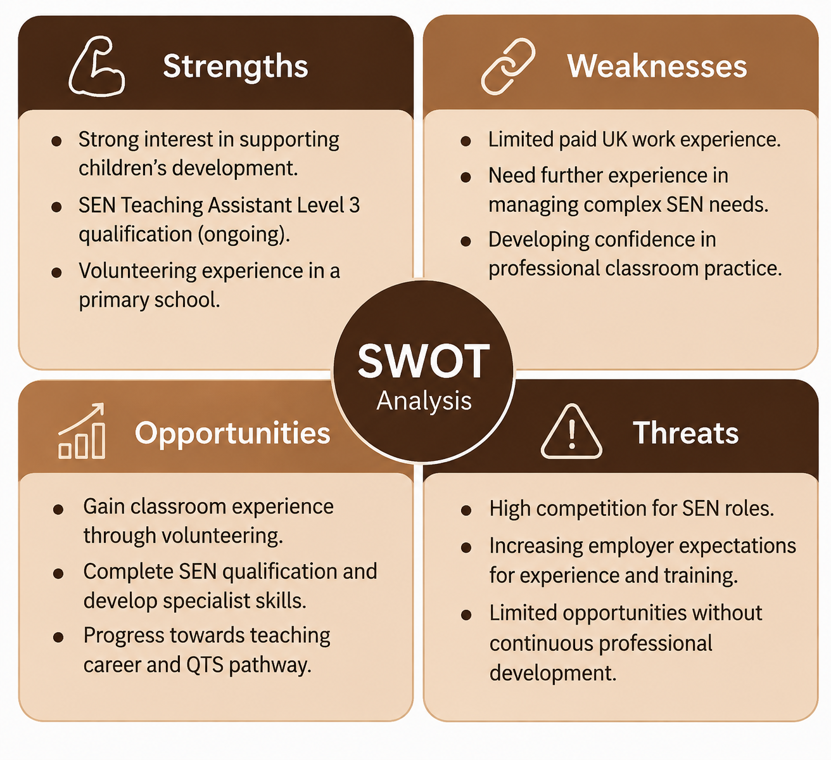
SWOT Analysis
(Tang et al., 2025; Jardi et al., 2022)
Notes:
My SWOT analysis illustrates the strengths and weaknesses of my current capabilities and skills in relation to the SEN Teaching Assistant role. I have worked in a primary school as a volunteer and I also have an interest in supporting children, I have completed SEN Level 3 training. I am aware, however, that there are aspects within the school's experience and exposure to complex SEN cases that need to be developed, particularly paid experience in the UK. I can overcome these weaknesses by gaining more classroom experience, training, and feedback from professionals with experience. Career opportunities like continuing to work towards teaching qualifications and professional development can help with my long term career goals. But competition for roles in SEN and evolving employer expectations are potential challenges that can be addressed through ongoing learning and skill development.

Slide 6
Applying Strengths to Career Development
Using My Strengths to Overcome Challenges
Strengths → Career Progression
✅ SEN Training & Knowledge
→ Develop confidence in supporting pupils with different needs.
✅ Primary School Volunteering Experience
→ Improve classroom skills and reduce limited UK work experience.
✅ Communication & Empathy Skills
→ Build positive relationships with pupils, teachers and families.
Development Action Plan
Complete Level 3 SEN Teaching Assistant qualification.
Gain further classroom experience.
Undertake continuous professional development (CPD).
Progress towards long-term teaching career goals.
(Department for Education, 2024; National Careers Service, 2026)
Notes:
My positive attributes will assist me with my identified weaknesses in my SWOT analysis . My SWOT analysis identified my weaknesses which I will be able to overcome by using my strengths. I am currently undertaking a qualification as a SEN Teaching Assistant to gain theoretical knowledge and volunteering in a primary school to gain practical experience. I can communicate effectively and be empathetic towards pupils and staff, developing positive relationships. I will ensure I carry on my professional development, seek more experience and build up specialist SEN skills to ensure my progression towards a career in teaching is minimised by counterbalancing these threats.

Slide 7
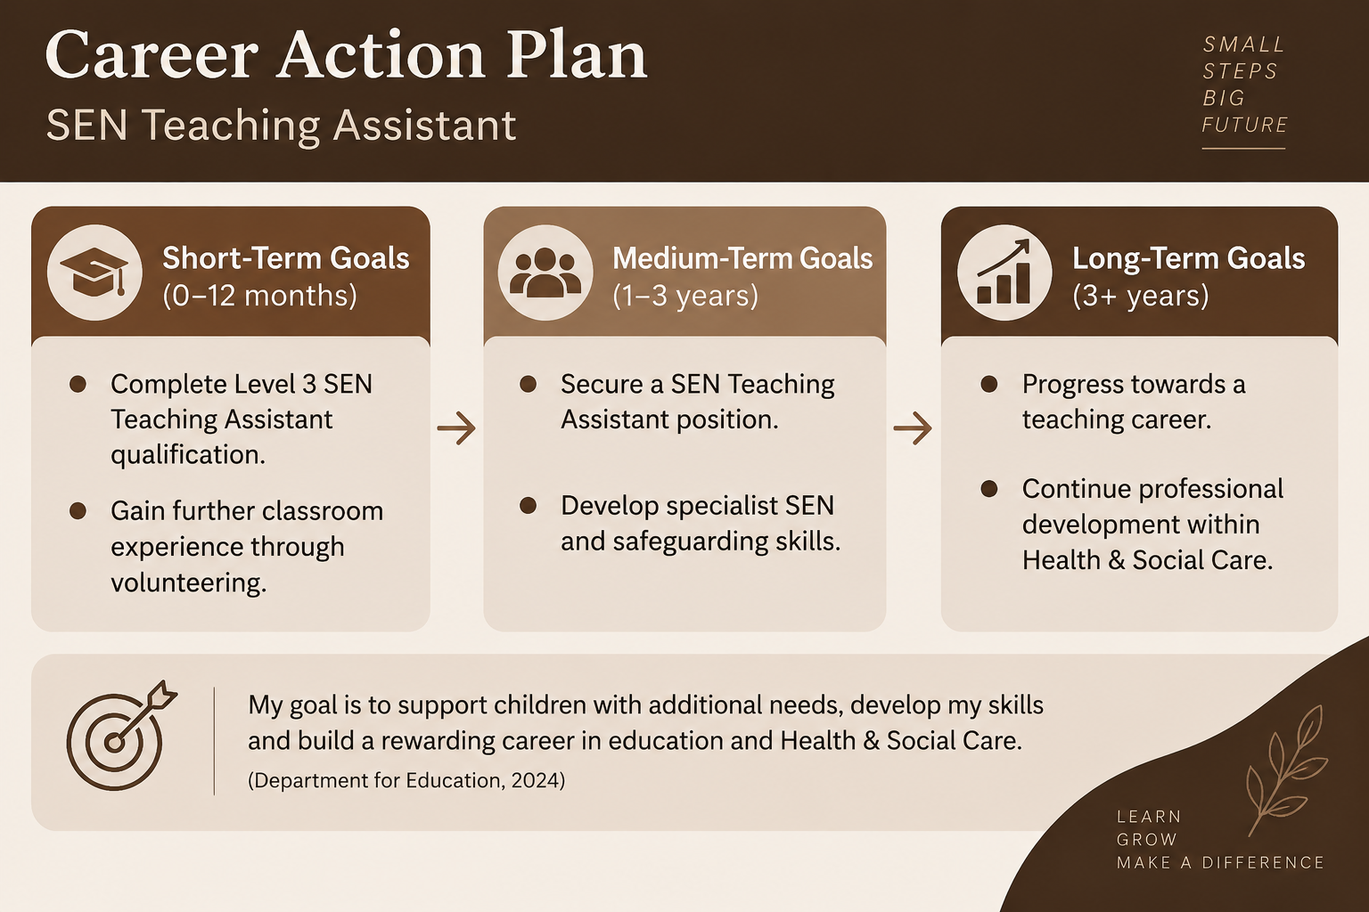
Career Action Plan
Notes:
My career action plan is listing the actions I will take to become an SEN Teaching Assistant. I'm going to finish up my training and get hands on experience in the short term. Over the medium term I will look for work and gain special skills. In the longer term I would like to develop my career further in education and Health & Social Care via Continuous Professional Development. (Department for Education, 2024)

Slide 8
Conclusion
Personal strengths support my career development
Continuous learning will improve my professional skills
My goal is to support children with additional needs
Commitment to growth within Health & Social Care
Notes:
This self-awareness analysis is helping me to understand my strengths and areas for development and career pathway as an SEN Teaching Assistant. My qualification, volunteering and commitment to lifelong learning can help me to rise to the challenge and continuously improve my skills. I want to help children who may have additional needs and have a positive impact in the Health & Social Care setting. (Department for Education, 2024)

Slide 9
References
Department for Education (2024) Special educational needs and disability code of practice: 0 to 25 years. Available at:
https://www.gov.uk/government/publications/send-code-of-practice-0-to-25
(Accessed: 23 September 2026).
National Careers Service (2026) Special educational needs (SEN) teaching assistant: Job profile. Available at: https://nationalcareers.service.gov.uk/job-profiles/special-educational-needs-sen-teaching-assistant?utm
National Careers Service (2026) Teaching Assistant: Job Profile. Available at:
https://nationalcareers.service.gov.uk/job-profiles/teaching-assistant
(Accessed: 23 September 2026).
National Education Union (2019) Professional standards for teaching assistants. Available at: https://neu.org.uk/latest/library/professional-standards-teaching-assistants?utm
Tang, Q., Deng, W., Huang, Y., Wang, S. and Zhang, H. (2025) Can generative artificial intelligence be a good teaching assistant?—An empirical analysis based on generative AI‐assisted teaching. Journal of Computer Assisted Learning, 41(3), p.e70027. https://onlinelibrary.wiley.com/doi/abs/10.1111/jcal.70027
Jardí, A., Webster, R., Petreñas, C. and Puigdellívol, I. (2022) Building successful partnerships between teaching assistants and teachers: Which interpersonal factors matter?. Teaching and Teacher Education, 109, p.103523. https://www.sciencedirect.com/science/article/pii/S0742051X21002481

