Slide 1
Scheduling / Modern Planning
Rhodri Thomas

Slide 2
Modern planning can be attributed to the movement toward what was called the “scientific” process of factory production management that came about during the industrial revolution. The pioneer of this approach was Fredrick Taylor.

Slide 3
There are several methods used today to evaluate the success of projects.
Gantt or Bar Chart,
Critical Path Method (CPM),
Arrow and Precedence Diagramming,
Fenced-Bar Charts,
Line-of-Balance scheduling,
Earned Value Management.

Slide 4
While there are significant differences between these methods, they all include the answers to three critical questions.
#What is to be done?
#How long will it take?
#What is to be done next?
The answers to these questions are often described in a listing of activities, their durations, and prior activities. The following table shows one such listing.

Slide 5
Activity | Duration (work-weeks) | Prior Activity
1 | 3 | None
2 | 5 | 1
3 | 2 | 2
4 | 3 | 1
5 | 2 | 4

Slide 6
The first column lists the activities that we think we will need to complete the project. With any project planning model the idea of flexibility is important since activities may need to be changed, added, or deleted as the project progresses.
The second column lists the durations of each activity. When reviewing the durations, it is important to clearly communicate the units associated with the durations. In this example we have used working weeks. A standard working week is five, eight-hour days. Often, translating between working days or weeks and calendar days is needed so it is crucial to always indicate the units used.
The third column lists the activities that must be completed prior to starting the given activity. For example, prior to starting activity 4, activity 1 must be completed.

Slide 7
Bar Charts
Henry Gantt, was responsible for the creation of the chart that still bears his name. The Gantt chart or bar chart used today was developed in the early 1900’s from a several different charts used by Mr. Gantt to communicate between management and employees about what work was to be accomplished on a given day.

Slide 8
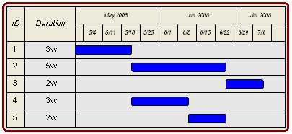
Chart filled with our information

Slide 9
This time line must always have specific units of time designated. Clearly designating the units on a bar chart is very important since the use of "weeks" for project duration does not typically refer to calendar weeks but 5-day working weeks. Notes accompanying the Visio Bar Chart must clearly indicate to all team members that crews will not be expected to work 7-day weeks. To help visually separate the time line, larger breaks are shown on the x-axis to show the working weeks and months.

Slide 10
The difficultly with the bar chart lies in the sequence that is implied in the chart layout. Without explicit designation of the sequence there could be confusion. In the example Bar Chart above, for example, there is nothing keeping someone from moving activities 2 and 4 to the start of the project. Since the last activity in the project is not last activity in the Bar Chart, there may be additional confusion.
While there are difficulties with the Bar Chart, it remains a commonly used project planning tool today. In recognition of his achievements, the American Society of Mechanical Engineers awards a "Henry Laurence Gantt Medal" for achievements in management sciences.

Slide 11

Fenced bar charts
To create the Fenced Bar Chart, draw a vertical line between the activities to show the sequence. In the chart below, the line from the end of Activity 1 to the start of Activity 2 illustrates the sequence constraint that Activity 1 must be completed before Activity 2 can start.

Slide 12
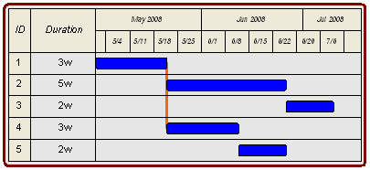
In the previous table you can see also that Activity 1 also precedes Activity 4. To show this, extend the line connecting Activity 1 and Activity 2 down to the start of Activity 4. The resulting Fence shows that Activity 1 precedes both Activity 2 and Activity 4.

Slide 13
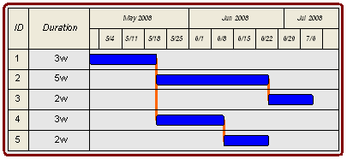
The final two sequences in our example projects are between Activity 2 and Activity 3 and Activity 4 and Activity 5. The figure below shows the fences that show the relationships between these Activities.

Slide 14
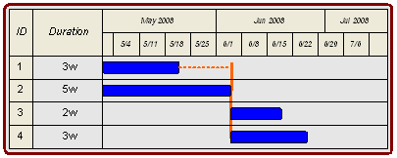
Activity | Duration (work-weeks) | Prior Activity
1 | 3 | None
2 | 5 | None
3 | 2 | 1,2
4 | 3 | 1,2
In this example several activities share multiple prior activities

Slide 15
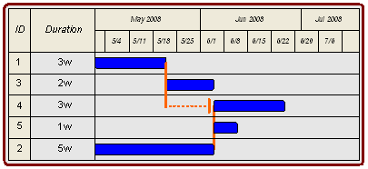
Activity | Duration (work-weeks) | Prior Activity
1 | 3 | None
2 | 5 | None
3 | 2 | 1
4 | 3 | 1,2
5 | 1 | 2
Here is an even more complex type of project plan that can be simply and clearly communicated with a fenced bar chart.

Slide 16
As work begins and the Fenced Bar Chart is updated, you can immediately see the impact of the job status on the project, and see how that impacts other activities in on the Fenced Bar Chart.
See if you can answer the following questions using the Fenced Bar Chart above:
#What if Activity 1 takes an additional week to complete?
#What if Activity 3 took an additional 2 weeks to finish?
#What if Activity 2 took one week less to complete?

Slide 17
Computer applications
Microsoft Project
Oracle Primavera Project Plan
Mindview Business Edition
Asta Powerproject
CS Project
Improvement
Larger capacity for programming
Cost analysis
Reports
Subcontractors management
Resources management
Monitoring and control

Slide 18
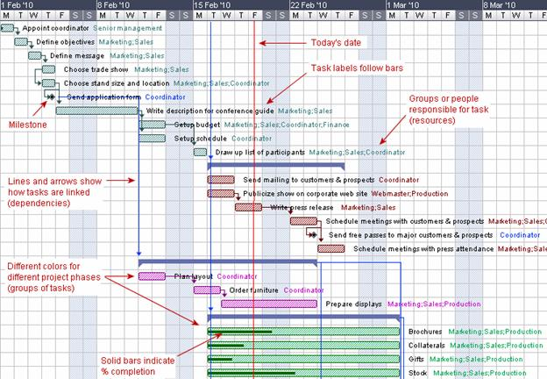

Slide 19
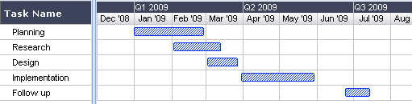
Num | Activity | Duration | 1 | 2 | 3 | 4 | 5 | 6 | 7 | 8 | 9 | 0 | 1 | 2 | 3 | 4 | 5 | 6 | 7 | 8 | 9 | 0 | 1 | 2 | 3 | 4 | 5 | 6 | 7
1 | General conditions | 4w
2 | Site layout | 1w
3 | Foundations | 6w
4 | Framing | 4w
5 | Building envelope | 4w
6 | Exterior finishes | 2w
7 | Services | 4w
8 | Interior finishes | 5w
9 | Landscaping | 2w
10 | Final acceptance | 1w

Slide 20
Arrow diagramming
Arrow Diagramming, AKA Arrow Diagram Method is one of the two versions of the Critical Path Method.
Arrow Diagramming provides model of project that combines the representation of sequence and duration. The Arrow Diagramming is useful because there is a clear link between the work to be accomplished and the diagram that represents that work. In addition, arrows are a common metaphor for time lines. Thus, Arrow Diagramming is, initially, very intuitive.

Slide 21
The two elements of Arrow Diagramming are arrows and nodes. One arrow is created for each activity to be accomplished. The tail of the arrow is the start of the activity. The head of the arrow is the end of the activity.
While there is no requirement to do so, the length of the arrow is often scaled to be proportional to the duration of the activity.

Slide 22
Nodes
At the tail, or start, and head, or end, of the activity arrows are nodes. Nodes are used to graphically show where activities end and begin in sequence.
The starting node for a given activity is referred to as the activity’s “i-node.” The ending node for a given activity is called the activity’s “j-node.”

Slide 23

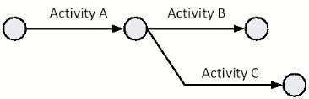
Activity | Prior Activity
A | None
B | A
Activity | Prior Activity
A | None
B | A
C | A

Slide 24
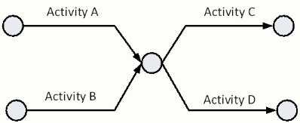
Activity | Prior Activity
A | None
B | None
C | A, B
D | A, B

Slide 25
Examples for you to try
Activity | Prior Activity
A | None
B | A
C | A
D | B, C
Activity | Prior Activity
A | None
B | None
C | A
D | A, B

Slide 26
Precedence Diagramming
Precedence Diagramming, or the Precedence Diagram Method, alleviates the difficulties of combining the representation of sequence and duration. Precedence Diagramming was originally referred to as “activity on node.”
In Precedence Diagramming the activities are identified by “nodes” or blocks. The sequence between activities is shown by arrows. The example below shows the schedule fragments previously shown for Arrow Diagrams.

Slide 27

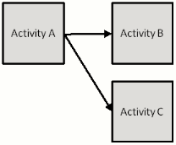
Activity | Prior Activity
A | None
B | A
Activity | Prior Activity
A | None
B | A
C | A

Slide 28
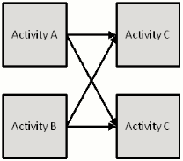
Activity | Prior Activity
A | None
B | None
C | A, B
D | A, B

Slide 29
A precedence diagram without any network calculations, such as that shown in the figures above, may be called "layout" diagrams. The layout diagram is a simple drawing that allows you to quickly sketch the sequence of activities in a network. Once the network has been sketched, then you can identify and correct lines that cross over and aesthetically organize the position of each.
While scheduling software is able to produce diagrams showing the activities and sequence, projects with complex sequence will require significant “tinkering” with the ordering of activities to generate a computer-generated printout that clearly communicates the sequence of the project.

Slide 30
Examples for you to try
Activity | Prior Activity
A | None
B | A
C | A
D | B, C
Activity | Prior Activity
A | None
B | None
C | A
D | A, B

Slide 31
Any questions?

