Slide 1
A qualitative study exploring the digital therapeutic alliance with fully automated smartphone apps
Rebecca Brotherdale, Katherine Berry, Sandra Bucci, Digital Health. Jack Thumwood

Slide 2
A brief Introduction
What is it?
Why is it important?

Slide 3
Method
17 participants (3 male 14 female) (age 21-52) (76% diagnosed)
Qualitative semi structured interviews were conducted with the participants using these apps
Materials used where the apps themselves and was then analysed eith thematic analysis

Slide 4
Findings
Connection with another
User friendly
Choice and empowerment
Goals and expectations
Safe place (No judgment)

Slide 5
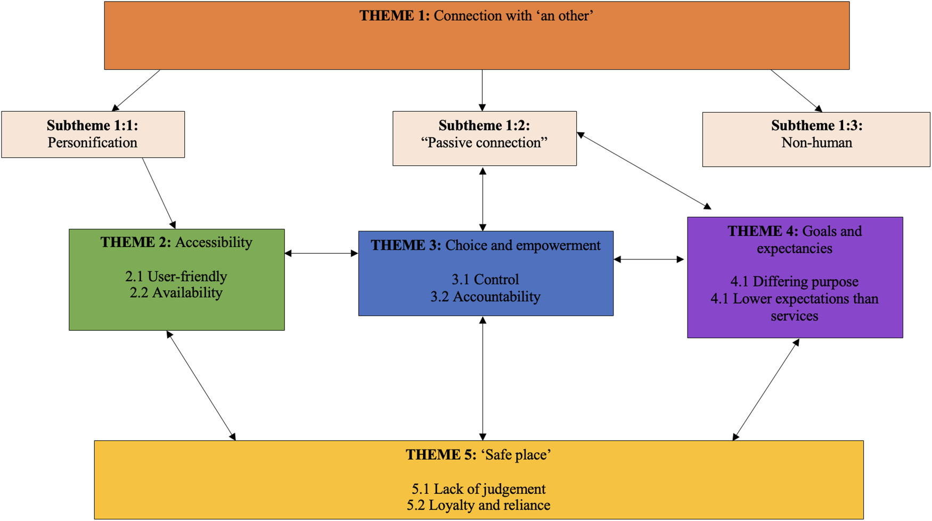

Slide 6
Discussion
Overview
Apps in terms of counselling practices
Pros and cons (technology)

Slide 7
Conclusion
Recap
Better apps (AI)

