Slide 1


Slide 1
Starbucks
Starbucks, an American company, is the world's largest coffee chain.Starbucks, founded by Jerry Baldwin, Gordon Bowker and Zev Siegel, opened its first store across the street from Seattle's historic Pike Place Market in 1971.

Slide 2


Objective
The main problem Starbucks faces is a lack of innovation to meet consumer demand.These two main problems have led to Starbucks' current situation.Every company needs to keep innovating to maintain its competitiveness.However, the innovation of Starbucks failed to meet the needs of customers, leading to a decline in turnover.
Therefore, the purpose of the research project is to identify the needs of customers and make corresponding innovations to change the problem of declining turnover.

Slide 3

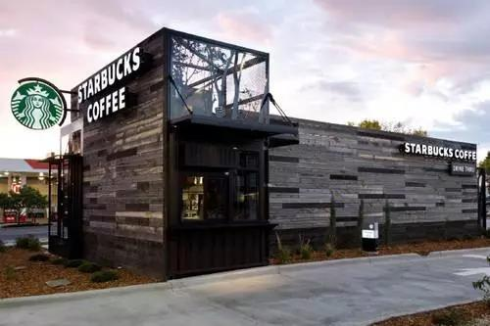
Starbucks
Strengths
Weakness
Starbuck
Threats
Opportunities

Slide 4

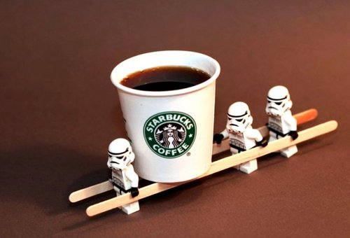
literature
  High price point: Although the high price of Starbucks is the advantage of the previous paragraph, it is also a weakness. The high price of some Starbucks products is unacceptable to some customers, otherwise Starbucks will become a part of their daily life. Although Starbucks' quality and good moral values may be attractive, some people just can't afford a cup of coffee.
  Lack of too unique products: while Starbucks may be famous for its Mexican Coffee, pumpkin flavored lattes and big chocolate cookies, they are not the most unique market. Many other coffee shops and chains offer similar products.

Slide 5


Conclusion
This report shows that Starbucks needs to meet customer needs through innovation.This broadens the market and increases revenue.Exceed customer expectations and retain the Starbucks experience. The difference between Starbucks and its competitors is its relationship with customers. In Starbucks' own research, the experience between customers and baristas is the biggest reason why customers keep coming back. In some cases, experience is more important than actual drinks.Increase the time spent in the training of new baristas. The new Starbucks partner has gone through the test of adding fuel to the fire. They know little about the company's history, even coffee and espresso drinks. It's important to remember the drink recipe, but more is needed.Take time for coffee education, including coffee workshops with customers. There is not enough time for coffee education, and most customers have never tasted coffee in the store. One way to spread the passion for the whole coffee bean wall is to share the love for coffee with customers.

Slide 6

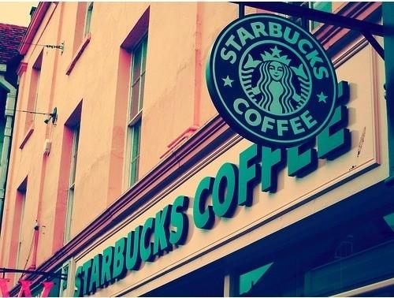
References
Encyclopedia Britannica. (2020). Starbucks | American company. [online] Available at: https://www.britannica.com/topic/Starbucks [Accessed 28 Feb. 2020].
Encyclopedia Britannica. (2020). Starbucks | American company. [online] Available at: https://www.britannica.com/topic/Starbucks [Accessed 28 Feb. 2020].
It, S. (2020). SWOT Analysis: What It Is and When to Use It. [online] Business News Daily. Available at: https://www.businessnewsdaily.com/4245-swot-analysis.html [Accessed 28 Feb. 2020].
Guiso, L., Sapienza, P., & Zingales, L. (2015). The value of corporate culture. Journal of Financial Economics, 117(1), 60-76.
Gordienko, V., Shevchenko, N. and Shevchenko, D. (2019). SWOT-ANALYSIS OF THE PROSPECTS FOR AGRICULTURAL DEVELOPMENT IN UKRAINE. Scientific opinion: Economics and Management, (1(63).

Slide 7

Thank you

