Slide 1
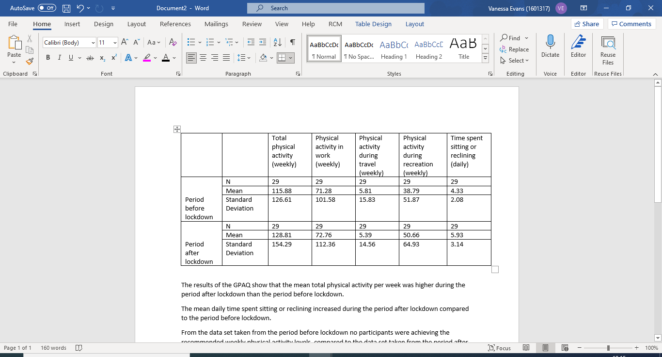
Outdoor Recreation During A National Lockdown: A Case Study
Rationale
Results
Taking part in outdoor recreation; ‘physical activities which take place in the natural environment’ (Comley and Mackintosh’s, 2015, p, 7) has positive effects on health and well being (Rogerson et al, 2020; Petty et al, 2007). However, the COVID-19 pandemic meant that from 23rd March 2020 the UK entered a national lockdown which restricted the ability to take part in outdoor recreation (GOV.UK, 2020). Current research has shown that lockdown and quarantine has negative effects on mental health (Brookes et al, 2020) but that outdoor recreation could be used to combat the effects of COVID-19 lockdown (Soga et al, 2020) and may even ‘outweigh the risk of infection’ (Dominski and Brandt, 2020, p.585).
This case study aims to explore the effects of a national lockdown on individuals outdoor recreation. Specifically the case study examines changes in physical activity levels, changes in outdoor recreation activity and begins to explore why individuals choose to take part in outdoor recreation during a COVID-19 lockdown.
0
Table 1. GPAQ results before and during COVID-19 lockdown.
Figure 1. Outdoor recreation activity choice before and during COVID-19 lockdown.
Research questions
Was there a difference in physical activity levels before and during the COVID-19 lockdown?
Was there a difference in the choice of outdoor recreation before and during COVID-19 lockdown?
Why did individuals choose to take part in outdoor recreation during COVID-19 lockdown?
Methods
00
Thematic analysis: ‘Why did you choose to take part in outdoor recreation during COVID-19 lockdown (23/03/2020- ?
The research method used was a mixed method questionnaire with 3 parts. Part 1 was an adaption of the Global Physical Activity Questionnaire (GPAQ) (WHO,2014) for before and during lockdown to assess physical activity changes. Part 2 assess outdoor recreation choices before and during COVID-19 lockdown. Part 3 was a qualitative open ended question to assess why individuals chose to take part in outdoor recreation.
The sample included 29 adults; 16 male and 13 female aged 18-64.
The data analysis consisted of data analysis to produce descriptive statistics and thematic analysis to generate global themes.
Health and lifestyle
‘I believe an active life is important’ ,‘ to improve my mental and physical health’
Nature connection
‘nice to be around nature’ ‘to get some fresh air’ ‘being outdoors is freeing and peaceful’
COVID-19 Lockdown
‘combating boredom’ ‘ to make the most of it (lockdown)’ ‘because gym was closed’
Findings
1
Physical activity increased during lockdown, despite physical activity decreasing in work and travel, more people were physically active during their recreation.
2
The choice of outdoor recreation changed during lockdown; more people cycled and walked for leisure during lockdown than before lockdown.
3
People chose to take part in outdoor recreation during COVID-19 lockdown because of: health and lifestyle; nature connection; COVID-19 lockdown and social connection.

Slide 2
References
Comely, V., and Mackintosh, C. (2015) The Economic Impact of Outdoor Recreation in the UK: The Evidence, SRA/Liverpool John Moores University.
Dominski, F.H. and Brandt, R., (2020). ‘Do the benefits of exercise in indoor and outdoor environments during the COVID-19 pandemic outweigh the risks of infection?’. Sport sciences for health, 16(3), pp.583-588.
GOV.UK (2020) ‘Prime Minister's Boris Johnson addressed the nation on coronavirus’ Available at: Prime Minister's statement on coronavirus (COVID-19): 23 March 2020 - GOV.UK (www.gov.uk) (accessed: March 2021)
Pretty, J., Peacock, J., Hine, R. Sellens, M., South, N., Griffin, M. (2007), ‘Green Exercise in the UK Countryside: Effects on Health and Psychological Wellbeing, and Implications for Policy & Planning.’ Journal of Environmental Planning Management. 50, 2, pp. 211-31.
Rogerson, M., Wood, C., Pretty, J., Schoenmakers, P., Bloomfield, D. and Barton, J., (2020). ‘Regular doses of nature: The efficacy of green exercise interventions for mental wellbeing’. International Journal of Environmental Research and Public Health, 17(5), p.1526.
Soga, M., Evans, M.J., Tsuchiya, K. and Fukano, Y., (2021). ‘A room with a green view: the importance of nearby nature for mental health during the COVID‐19 pandemic’. Ecological Applications, 31(2), p.1-13
World Health Organization (2014). Global Strategy on Diet, Physical Activity and Health. WHA57.17. In Proceedings of the 57th World Health Assembly. Geneva, Switzerland: World Health Organization. 2004:2-18.

