Slide 1

Analysis of interview data
ASD
2022

Slide 2
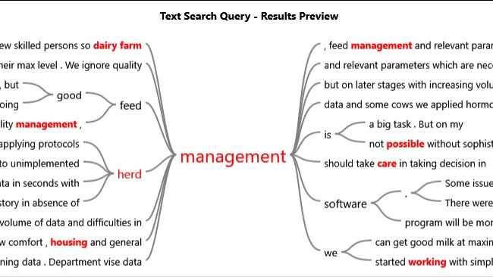

Slide 3
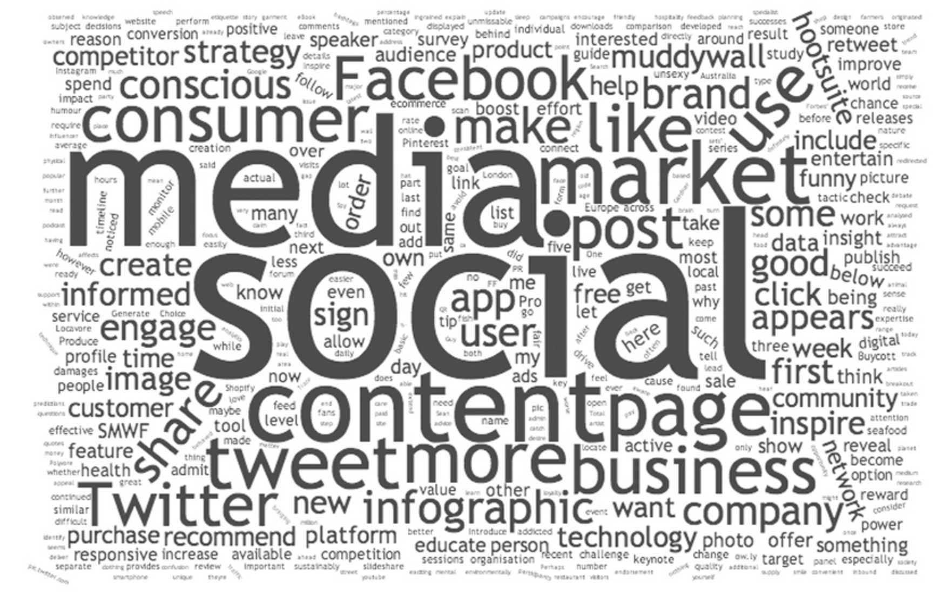

Slide 4
USING MATRIX ANALYSIS
Qualitative data

