Slide 1
BA Business Management
Leadership and management, theory and practice
Modul number: LCBB6003
Lecturer: Dr Mushfiqur Rahman
Group Presentation
by
Team leader: Aniko Pongo (2010922)
Anita Varga (2012895)
Renata Szabo (200964)

Slide 2
Table of content
Slide 3 - 4: Introduction
Slide 5 - 9: Effectiveness of Leadership
Slide 10 - 14: Application of theories and models
Slide 15 – 16: Recommendation
Slide 17: Conclusion
Slide 18: Reference List

Slide 3
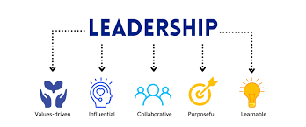
Introduction
In this presentation, a detailed discussion about the complexities and challenges comprised of leading and supervising people within the organisations will be demonstrated.
The chosen organisation for this presentation is General Electric and its most effective chief executive officer (CEO) was Jack Welch, who served the organisation within the duration of 1981 to 2001.
Notes:
This slide demonstrates that the leadership of a business organisation deals with designing and moving toward specific goals and objectives across the operating environment. Leadership involves significant value for any organisation as it deals with performance and productivity enhancement. The role and responsibility of leadership and management within the chosen organisation will be demonstrated with the evaluation of their leader’s style and approach. Challenges and complexities comprised with the organisational leadership are discussed. Moreover, relevant theories and models are included to identify leadership and management concepts with the identification of their benefits and limitations. However, ineffective management of leadership can create disruption within the workflow of the organisation and create dissatisfaction within the internal environment.

Slide 4

Effectiveness of leadership
Various effective leadership qualities comprised within the Jack Welch management approach that assisted the organisation to integrate its market capitalisation.
It not only improved the performance and productivity of the company but also ensure subtle motivation for organisational employees across the working ecosystem.
The ideal trait of Jack Welch’s leadership is an association with the charismatic leadership approach, which allows them to inspire people within the organisational culture (Taken from the case study).
However, the limitation of the charismatic leadership approach within the firm will include the emergence of narcissism and focus shifting from people toward themselves.
Notes:
The leadership approach of Jack Welch led to the enhancement of the market capitalisation for the organisation and it creates effective growth and development environment. It elevated staff motivation, which allowed an increase in the overall performance, productivity and efficiency of the company. However, the limitation of the charismatic leadership style of Welch includes focus shifting, which can entail adverse impacts. Overall, the quality of Welch’s leadership was effective as it helped General Electric to attain significant growth and development in the existing marketplace. The inclusion of a charismatic leadership style enhances the management effectiveness of Jack Welch and it ensures proper employee motivation within the working ecosystem of the company. Jack Welch’s leadership approach limitation also includes the risk of emerging narcissism throughout the organisational culture.

Slide 5

Effectiveness of leadership
The charismatic authority of the organisation’s management leads to the establishment of compassion, confidence and appropriate communication throughout the internal environment (Novitasari et al., 2021).
Demanding leadership approach is involved the key quality of Jack Welch as it encouraged the employee to reach a higher potential, which helped in enhancing the operational efficiency of the organisation.
Another key aspect of Jack Welch’s leadership is the encouragement of power decentralisation, which promoted the emergence of creativity and innovation among the organisational members.
The advantage of power decentralisation in the organisation’s workplace includes minimisation of job load and facilitation of diversification for the organisation (Indeed, 2022).
Notes:
One of the key leadership qualities and traits of Jack Welch involves their demanding nature, which encourages organisational members to increase their input within the working ecosystem. However, this increases the concern of working pressure and load for the employees, which can entail a negative impact on the company. Power decentralisation is comprised of the most effective leadership quality of Jack Welch that advance the innovation and creativity aspect of General Electric. Moreover, the inclusion of manager autonomy is associated with leadership traits that improved the decision-making capability of the company. Power decentralisation within the company can help in the minimisation of workload and promote diversification across the internal environment.

Slide 6

Effectiveness of leadership
Significant autonomy for managers is also provided by the organisational CEO, which helped in the attainment of active decision-making capability that enhanced the success rate extensively.
Power decentralisation also advances supervision and control for the company but it can lead to conflict development and problems within the co-coordinative progression.
Workplace autonomy increase the value perception for employee and support the establishment of work-life balance for organisational members.
However, the limitation of this strategy of Jack Welch can lead to the creation of difficulty in information centralisation, which can disrupt the performance and productivity of the company.
Notes:
The provision of autonomy to managers and the organisational members is encompassed in the most effective leadership quality of Jack Welch, which led General Electric to the success pathways. Organisational support increases the concern for innovation and creativity throughout the working ecosystem, which improved the organisational decision-making that assisted in increasing market capitalisation (Volery and Tarabashkina, 2021). However, the power decentralisation strategy can encompass a negative impact in terms of a higher risk of conflict emergence, which can disrupt the coordinated progression of the company. On the other hand, workplace autonomy can influence the employee perceived value and support in the attainment of work-life balance for employees and managers. However, the limitation of this approach is difficulty in the establishing information centralisation and it can disrupt organisational productivity.

Slide 7

Effectiveness of leadership
Welch also incorporated effective management philosophies such as boundaryless organisation with the reducing the bureaucratic and hierarchal structure within the firm.
This is one of the most beneficial approaches of the organisational leader because it helped in fostering creativity and innovation by the annihilation of the silos across the various business units.
Overall, the leadership quality of Jack Welch was significant and the inclusion of the Rank and Yank system within its management practice improve their leadership effectiveness significantly.
Notes:
Jack Welch entailed management philosophies like boundaryless progression and minimisation of hierarchal and bureaucratic management structure within the organisation. It is included in the most effective approach as it assisted in promoting innovation and creativity. However, it can lead to the emergence of confusion across the internal environment.

Slide 8

Effectiveness of leadership
Another effective leadership tactic of Jack Welch was leveraging the performance management system, which assisted in nurturing the best talents for General Electric.
This strategy consented to the integration of market capitalisation and enhanced the progression rate towards the specified objectives and goals.
However, the limitation is ineffective consideration of personalised objectives and the risk of leading to unfair reward provisions for employees.
It assisted in better employee ranking and letting go of individuals present within the bottom 10% of the ranking system, which supported the integration of the workforce (Taken from the case study).
This system was considered highly controversial for the organisation but it helped in promoting the high-performing employee and negating the management concern of underperformers.
Notes:
The inclusion of a performance management system is involved in the most effective leadership quality, which can help in the integration of the workforce for the organisation (Holzer et al., 2019). However, it incorporates the risk of unfair rewards and ineffective consideration of personalised objectives within the organisational culture. Other successful and controversial leadership tactics of Jack Welch include the ranking and yanking system as it assisted in higher focus on well-performing employees. However, it can create a negative image of the firm due to the elimination of the underperformers in the marketplace.

Slide 9
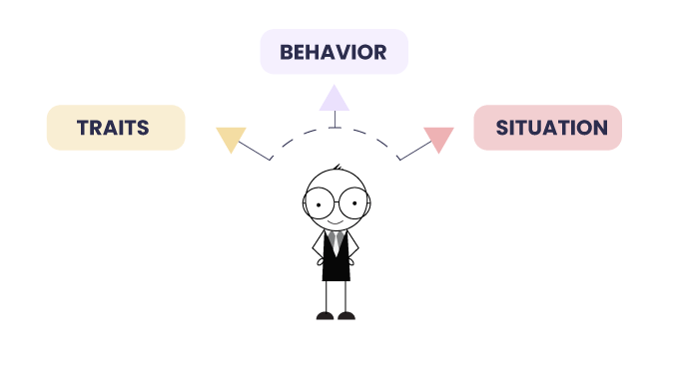
Application of theories and models
Contingency theories allow leaders to work according to the need of the situation rather than depending on a specific leadership style.
This theory helps leaders by providing an appropriate sense of behaviour, as there is not any finest way to lead an organisation (Lawton-Misra and Pretorius, 2021).
Having a well-documented contingency plan can improve employee morale and push their fear out however; leaders need to set some alternative plans before taking any specific action.
The idea of a boundaryless organisational structure of General Electric developed by Jack Welch is efficiently maintained by the appropriate use of contingency theory (as per the case study). It helps the organisation to maintain its structure and improve its performance.
Notes:
Contingency theory can also work as situational leadership as the leaders prefer to make a decision or implement strategy according to the preference of the business (Lawton-Misra and Pretorius, 2021). Depending on a single strategy reduces the agile nature of the workplace and restricts the potential growth of the business. Leading the operation of any business becomes easier with workplace agility and teams can easily adapt to any changes according to the situation efficiently. General Electric considers its culture as one of the key aspects of its success. Thus, they value boundaryless organisation structure for better management of the employees and boosting the morale of the employees.

Slide 10
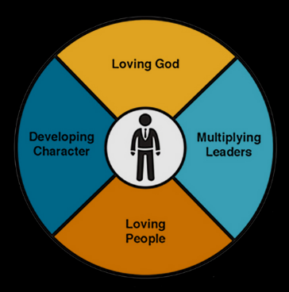
Application of theories and models
Transformational leadership theory encompasses the involvement of other people in the organisation's process and activities for motivating them to work with more productivity (Nawaz and Khan, 2016).
This theory allows for making positive changes in the business organisation and its culture by encouraging the staff to ensure lower employee turnover.
Transformational leaders provide better opportunities to the firms for formulating a new vision and achieving challenging goals. However, the lack of focus of the leaders can reduce the quality of workplace performance.
The CEO of GE, Jack Welch pushes their employee to make decisions and encourage them to involve in the business independently (Harvard Business Review, 2020).
Notes:
Transformational leadership theory refers to providing value to the decisions made by the employees of the organisation. It promotes valuable changes to inspire the followers for completing the goal and transforming the followers into leaders. As motivating plays a major role in business development, this specific leadership style allows the company and the leaders to ensure better engagement with the business process. It can make positive changes in the business development process as staff of organisations can improve their performance by getting recognition. Thus, these leaders have less focus on the individual performance of the employees. It increases the business risks and hampers the growth of the business culture. Employees in General Electric are valued as they can manage operations of their own.

Slide 11

Application of theories and models
The transactional leadership style considers three different facts as management by expectation (passive), management by expectation (active) and contingent reward (Saeed and Mughal, 2019).
Managing competitive tasks becomes easier with the use of rewards thus, the leaders set goals with the reward system for getting more benefits to form the organisation. The CEO of GE implemented different management performance management systems for better performance.
As employees can easily impact the business directly, this sense of fairness in the work culture enhances the productivity of the firm also learning becomes easier for the employees adopting this leadership style.
However, this leadership style does not focus on building a relationship with others and finding the best rewards according to the preference of the staff becomes difficult.
Notes:
The transactional leadership style promotes contingent rewards to ensure better business performance in a competitive situation (Saeed and Mughal, 2019). This reward system motivates people positively to boost their productivity and quality at the same time to be recognised by the company. Understanding the reward and punishment system is an easier strategy for employees. Also, the leaders are continuously monitoring the employees and their performance and productivity if they are able to achieve the set goal or not. However, the driving factors are varying depending on the preference of the employees. Thus, finding a common reward becomes challenging for managers and requires huge time.

Slide 12
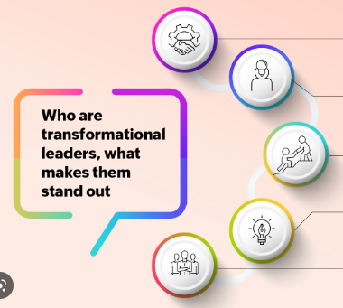
Application of theories and models
A transformational leadership style is an approach that allows individuals to adopt a positive change to develop the culture of the workplace (Northouse, 2021).
This leadership style encourages the employees of the organisation by fulfilling higher-order needs like self-esteem and self-actualisation.
It defines a clear vision for the end goal of the company by maintaining workplace integrity and motivating the staff for ensuring business development Welch achieved employee motivation by flattening the hierarchy.
As it promotes people to make their decisions, misusing this power can hamper the operations and development of the business.
Notes:
On the other hand, the transformational leadership style allows the leaders to make positive changes inside the organisation for getting a more competitive advantage and boost the morale of the staff. All the higher-order needs of the staff can be fulfilled by adopting this specific leadership style. Workplace integrity allows the people of the firm to do the right thing to enhance the image of the brand. However, if people are not aware of their responsibilities and inappropriately use the power given by the company, the organisation may face issues in managing the business operations.

Slide 13
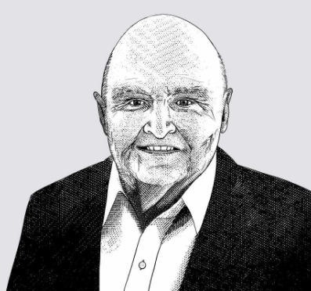

Application of theories and models
Jack Welch, CEO of GE is regarded as one of the best business leaders as the capitalisation of General Electric grew up by more than 4000% during his serving period (according to the case study).
Promoting the best talent, Welch implemented performance management systems as he believed that the right people can drive the organisation in the right direction, which promotes his transactional leadership style (Slater and Prichard, 1998).
Flattening the hierarchy for better employee performance and breaking down silos to encourage people in the organisation helps Mr Welch to promote motivation through his transformational leadership style.
Notes:
The CEO of General Electric always pushed the staff of the company to develop skills and make independent decisions by taking risks. Implementing a different management system shows the transactional leadership nature of Jack Welch (Slater and Prichard, 1998). He decentralised the power of power and gave autonomy to the managers for taking ownership of the business by making their own decisions. Thus, it can be identified that Jack Welch majorly follows the transformational leadership style to handle the business efficiently.

Slide 14

Recommendation
One of the most effective recommendations associated with improving leadership quality and effectiveness includes the establishment of an effective communication system.
Implementation of the open communication system can help in increasing employee happiness and engagement within the workplace.
It will also enhance inter-departmental transparency for employees (Pongton and Suntrayuth, 2019).
Another relevant strategy that can allow the organisational CEO to integrate their leadership and management effectiveness is the inclusion of a feedback system as it will consent to develop an understanding of employees’ issues.
It will not only help in the advancement of the overall organisational culture but it can also influence the perceived behaviour of employees with the provision of sheer focus on the individual’s problems.
Notes:
Implementation of the relevant communication systems can be included in the most effective recommendation for the company as it can help in enhancing employee engagement (Mazzei et al., 2019). It will assist in the creation of a collaborative working environment and integrate inter-departmental transparency. The inclusion of a feedback system within the leadership approach can be incorporated in the relevant recommendation as it can increase the focus on employee problems and challenges. However, it will consume significant working time for the organisation.

Slide 15

Recommendation
Inspiring personal and professional growth throughout the working ecosystem can also be involved in the most effective recommendation for improving the leadership effectiveness of the organisation.
Employee training will elevate the value proposition for the organisational employee with the attainment of valuable skills and knowledge throughout their career graph (Khaliq et al., 2020).
Implementation of an appropriate leadership style within the organisational culture can also be included in the appropriate recommendation that can help in integrating management effectiveness.
Leadership style can assist in boosting employee morale and empower employees to elevate their performance and productivity, which can be highly valuable for the organisation (Sari et al., 2021).
Notes:
Emphasising personal and professional employee growth is also included in the effective recommendation as it can enhance the value proposition for employees and ensure the attainment of relevant skills. However, this will require significant monetary investment for the company. Leveraging appropriate leadership style is included in appropriate strategy as it can ensure the creation of positive organisational culture (Tran, 2021). However, it will entail shifting within the existing management and decision-making approach of the company throughout the domestic environment.

Slide 16

Conclusion
From the above discussion, it can be concluded that the overall quality of Jack Welch’s leadership was effective as it helped in the elevation of the market capitalisation of the company up to 4,000% across the operating market.
One of the major findings of the above discussion includes that Jack Welch incorporates a charismatic leadership approach that encourages organisational members to reach their highest potential.
The inclusion of performance management in the system is also comprised of the effective leadership tactics of Jack Welch throughout the existing marketplace.
Transformational theory can be comprised in the most effective model as it involves the consideration of common goals, values and beliefs to integrate the performance.
Notes:
Overall, it can be said that Welch’s leadership was astounding and entailed significant value for General Electric by driving them to a successful pathway. It consented to the firms to integrate their market capitalisation of around 4,000% in the domestic market. Jack Welch’s key traits involve demanding and charismatic leadership. Transformational theory can also help the organisation to increase performance with higher consideration of values and beliefs.

Slide 17
Reference List
Harvard Business Review (2020) The Jack Welch Era at GE. Available at: https://hbr.org/1989/09/speed-simplicity-self-confidence-an-interview-with-jack-welch (Accessed: 03 March 2023)
Holzer, M., Ballard, A., Kim, M., Peng, S. and Deat, F. (2019) Obstacles and opportunities for sustaining performance management systems. International Journal of Public Administration, 42(2), pp.132-143.
Indeed (2022) Decentralization in Organizations. Available at: https://ca.indeed.com/career-advice/career-development/decentralization-in-organizations (Accessed: 03 March 2023)
Khaliq, A., Kayani, U.S. and Mir, G.M. (2020) Relationship of employee training, employee empowerment, team work with job satisfaction. Journal of Arts & Social Sciences, 7(2), pp.185-198.
Notes:
Lawton-Misra, N. and Pretorius, T. (2021) Leading with heart: academic leadership during the COVID-19 crisis. South African Journal of Psychology, 51(2), pp.205-214.
Mazzei, A., Butera, A. and Quaratino, L. (2019) Employee communication for engaging workplaces. Journal of Business Strategy, 40(6), pp.23-32.
Men, L.R., Qin, Y.S. and Mitson, R. (2021) Engaging startup employees via charismatic leadership communication: The importance of communicating “vision, passion, and care”. International Journal of Business Communication, p.23294884211020488.
Nawaz, Z.A.K.D.A. and Khan, I. (2016) Leadership theories and styles: A literature review. Leadership, 16(1), pp.1-7.
Northouse, P.G. (2021) Leadership: Theory and practice. Sage publications.
Novitasari, D., Haque, M.G., Supriatna, H., Asbari, M. and Purwanto, A. (2021) Understanding the Links between Charismatic Leadership, Intrinsic Motivation and Tacit Knowledge Sharing among MSME Employees. International Journal of Social and Management Studies, 2(3), pp.1-13.
Pongton, P. and Suntrayuth, S. (2019) Communication satisfaction, employee engagement, job satisfaction, and job performance in higher education institutions. Abac Journal, 39(3), pp.90-110.
Saeed, M. and Mughal, Y.H. (2019) Role of transactional leadership style upon performance: Mediating role of culture. Journal of Managerial Sciences, 13(1), pp.47-57.
Sari, F., Sudiarditha, I.K.R. and Susita, D. (2021) Organizational culture and leadership style on employee performance: Its effect through job satisfaction. The International Journal of Social Sciences World (TIJOSSW), 3(2), pp.98-113.
Slater, R. and Prichard, M.J. (1998) Jack Welch and the GE way (pp. 52-53). New York: McGraw-Hill.
Tran, Q.H. (2021) Organisational culture, leadership behaviour and job satisfaction in the Vietnam context. International Journal of Organizational Analysis, 29(1), pp.136-154.
Volery, T. and Tarabashkina, L. (2021) The impact of organisational support, employee creativity and work centrality on innovative work behaviour. Journal of Business Research, 129(1), pp.295-303.
Waldman, D. C. and O’Reilly, C. (2019) Leadership for Organizations. 1st edn. California: Sage

Slide 18


