Slide 1
Sales & Marketing plus
Pitching/presentation
Chris Thomas

Slide 2
Selecting a Market and Establishing a Position in the Market
Important Questions That All Start-ups Must Ask
  Who are our customers and how will we appeal to them?
  A well-managed start-up approaches this query by following a three-step process:
    Segmenting the market
    Selecting a target market
    Establishing a unique position

Slide 3
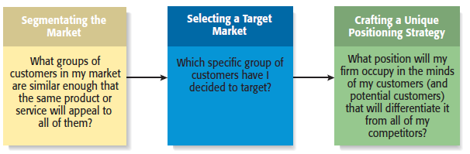
The Process of Selecting a Target Market and Positioning Strategy

Slide 4
Market Segmentation
Involves studying a firm’s
industry and determining the
different target markets in that
industry.
Markets can be segmented in
a number of different ways,
including
- Product type
- Geography (city, state, region)
- Demographic variables
Segmenting the Market

Slide 5
Example: Segmenting the Dance Studio Market by Customers Served
Professional Dancing
Adult Dancing
Youth Dancing
Serious
dancers who aspire
to make a living
dancing in Broadway
plays
Ballroom and other
types of dancing
for adults who want
to learn dance for
recreation and fun
Ballet and other types of dancing for young girls who want to learn to dance to develop poise and grace

Slide 6
Selecting a Target Market
Once a firm has segmented
the market, a target market
must be chosen.
The market must be sufficiently
attractive and the firm must have
the capability to serve it.
By focusing on a clearly defined
market, a firm can become an
expert in that market and then
be able to provide customers a
high level of service.
Target Market

Slide 7
Establishing a Unique Position
1 of 2
After selecting a target market, the
firm’s next step is to establish a
“position” within the market that
differentiates it from its rivals.
A “position” is the part of a market
that the firm is claiming as its own.
A firm establishes a unique
position in its customers’ minds
by drawing attention to two or
three of the product’s attributes.
Positioning

Slide 8
Establishing a Unique Position
2 of 2
Positioning (continued)
  Firms often develop a “tagline” to reinforce the position they have staked out in their market, or a phrase that is used consistently in a company’s literature and thus becomes associated with the company.
  An example is Nike’s familiar tagline, “Just do it.”
    The beauty of this simple three-word expression is that it applies equally to a 21-year-old triathlete and a 65-year-old mall walker.

Slide 9
Branding
1 of 4
Establishing a Brand
  A brand is the set of attributes—positive or negative—that people associate with a company.
    These attributes can be positive, such as trustworthy, dependable, or easy to deal with.
    Or they can be negative, such as cheap, unreliable, or difficult to deal with.
  The customer loyalty a company creates through its brand is one of its most valuable assets.
Brand Management
  Some companies monitor the integrity of their brands through a program called “brand management.”

Slide 10
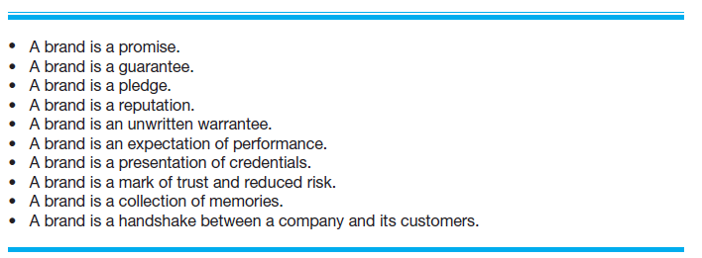
Branding
2 of 4
What’s a Brand?

Slide 11
Branding
3 of 4
Establishing a Brand
  So how does a firm establish a brand?
    On a philosophical level, a firm must have meaning in its customers’ lives. It must create value—something for which customers are willing to pay.
    On a more practical level, brands are built through a number of techniques, including advertising, public relations, sponsorships, support of social causes, and good performance.
    A firm’s name, logo, Web site design, Facebook page, and even its letterhead are part of its brand.

Slide 12
Branding
4 of 4
Power of a Strong Brand
  Ultimately, a strong brand can be a very powerful asset for a firm.
  Over 50% of consumers say that a known and trusted brand is a reason to buy a product.
  A brand allows a company to charge a price for its products or services that is consistent with its image.
  A successful brand can increase the market value of a company by 50% to 75%.

Slide 13
Marketing strategies
How do you decide on which of the generic strategies to adopt?

Slide 14
Marketing strategies
How do you decide on which of the generic strategies to adopt?
Cost Leadership
Differentiation
Focus

Slide 15
Depends of thorough understanding of:
  Customers (what they want)
  Competitors (how their product or service compares)
  Degree of competition (Porter’s Five Forces)

Slide 16
Features v Benefits
Why does someone by a drill?
Why does someone buy a pen?

Slide 17
People buy the benefits the product brings to them.
They do not buy the features e.g. you do not buy oil for your car because of its colour or smell, you buy it because it makes the engine run smoothly.
Different people may look for different benefits in a pen – it must write – but if this were the only benefit only the cheapest pens would be sold.
Why would you buy an expensive pen?

Slide 18
Example:
Feature: “Our widgets are manufactured locally”
Benefit: “So you can be assured of an immediate supply.”
But this only comes from knowing what the customer wants…
  Does he want immediate supply?
  Is he concerned about carbon footprints?

Slide 19
Five P’s
One technique that is widely used to describe the features of a product or service is called the marketing mix or the 4/5 P’s:
Product (or service)
Price
Promotion
Place: channels of distribution
People: service, support (5th ‘p’)

Slide 20
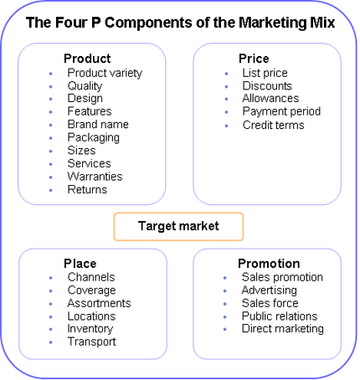

Slide 21
The customer buys the marketing mix as a package, and the mix must be consistent with the benefits the customer is looking for.

Slide 22

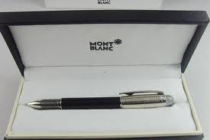
Think of the marketing mix for:
  Bic Biro
  Mont Blanc Pen

Slide 24
Marketing on a Shoestring
You’ve designed a new pen.
Ergonomically shaped – eliminates writers cramp – ideal for heavy users of pens.
How could you market this pen with £50 budget?

Slide 25
Marketing on a Shoestring
Website
Create Facebook group
List on other websites
Networking
PR

Slide 26
Get a list of potential customers
Write to them
Email and phone
Arrange a meeting

Slide 27
Write a press release
Host an event
Join a local group or club
Attend a trade show
Make a video

Slide 28
The Four Ps of Marketing for New Ventures
Product
Price
Marketing Mix
Promotion
Place (or distribution)

Slide 29
Product
Product
  Is the good or service a firm offers to its target market.
  The initial rollout is one of the most critical times in the marketing of a new product.
  All firms face the challenge that they are unknown and that it takes a leap of faith for the first customers to buy their products.
    Some start-ups meet this challenge by using reference accounts.

Slide 30
Core Product vs. Actual Product
Core Product
Actual Product
The product itself, such as an antivirus software program.
The product plus all the attributes that come with it such as quality level, features, design, packaging, and warranty.

Slide 31
Price
Price
  Price is the amount of money consumers pay to buy a product.
  The price a company charges for its products sends an important message to its target market.
    For example, Oakley positions its sunglasses as innovative, state-of-the-art products that are both high quality and visually appealing.
    This position in the market suggests a premium price that Oakley charges.
  Most entrepreneurs use one of two methods to set the price for their products, as shown on the next slide.

Slide 32
Core Product vs. Actual Product
Cost-Based Pricing
Value-Based Pricing
The list price is determined by adding a markup percentage to a product’s cost.
The list price is determined by estimating what consumers are willing to pay for a product.

Slide 33
Promotion
Promotion
  Refers to the activities the firm takes to communicate the merits of its product to its target market.
  There are several common activities that entrepreneurs use to promote their products and services.
Advertising
  Advertising is making people aware of a product or service in hopes of persuading them to buy it.

Slide 34
Pluses and Minuses of Advertising
Pluses
Raise customer awareness of a product.
Explain a product’s comparative features and benefits.
Create associations between a product and a certain lifestyle.
Minuses
Low credibility.
The possibility that a high percentage of people who see the ad
will not be interested.
Message clutter.
Relative costliness compared to other forms of promotion.
Intrusiveness.

Slide 35
Steps Involved in Putting
Together an Advertisement

Slide 36
Public Relations
Public Relations
  One of the most cost effective ways to increase the awareness of the products of a company is through public relations.
  Public relations refer to efforts to establish and maintain a company’s image with the public.
  The major difference between public relations and advertising is that public relations is not paid for—directly.

Slide 37
Public Relations Techniques
Press release
Traditional media
coverage
Social media
coverage
Articles in industry
press and periodicals
Blogging
Monthly newsletter
Civic, social, and community
involvement

Slide 38
Social Media
Social Media
  Consists primarily of blogging and connecting with customers and others through social networking sites like Facebook and Twitter.
Blogging
  The idea behind blogs is that they familiarize people with a business and help build an emotional bond between a business and its customers.
Facebook and Twitter
  Businesses establish a presence on Facebook and Twitter to build a community around their products and services.

Slide 39
Other Promotions Techniques
Viral Marketing
Guerrilla Marketing
Facilitates and encourages people to pass along a marketing message about a particular product or service
A low-budget approach to marketing that relies on ingenuity, cleverness, and surprise rather than traditional techniques
http://www.mediagang.co.uk/portfolio/reverse-graffiti-advertising/

Slide 40
Place (or Distribution)
Place
  Encompasses all the activities that move a firm’s product from its place of origin to the consumer.
  The first choice a firm has to make regarding distribution is whether to sell its products directly to consumers or through intermediaries (such as wholesalers and retailers).
  Within most industries, both choices are available, so the decision typically depends on how a firm believes its target market wants to buy its product.

Slide 41
Selling Direct Vs. Selling Through an Intermediary
1 of 2
Approach to Distribution
Description
Selling Direct
Many firms sell direct to the customer, maintaining control of the distribution and sales process.
Selling Through Intermediaries
Other firms sell through intermediaries and pass off their products to wholesalers who place them in retail outlets to be sold.

Slide 42
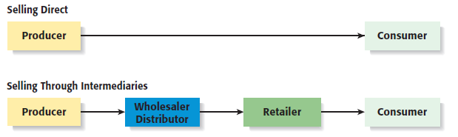
Selling Direct Vs. Selling Through an Intermediary
2 of 2

Slide 43
Sales Process
1 of 3
Sales Process
  A firm’s sales process (or sales funnel) depicts the steps it goes through to identify prospects and close sales.
  A formal sales process involves a number of identifiable steps.
Importance of Process
  Some companies simply wing it when it comes to sales, which isn’t recommended.
  It’s much better to have a well thought-out approach to prospecting customers and closing sales.

Slide 44
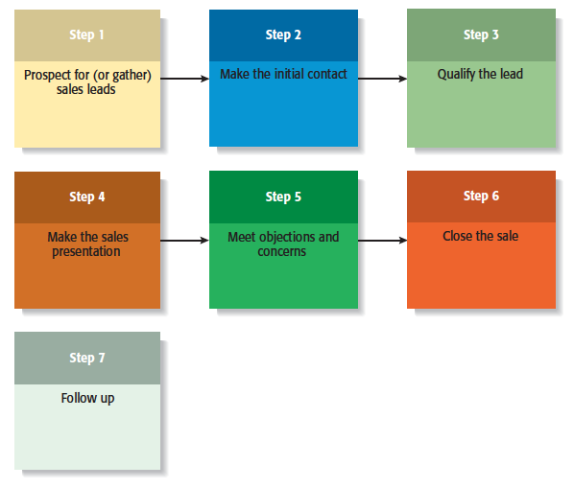
Sales Process
2 of 3

Slide 45
Sales Process
3 of 3
Usefulness of Sales Process
  Mapping the sales process in the manner shown on the previous slide provides a standard method for a firm’s employees to use, and provides a starting point for careful analysis and continuous improvement.
  Often, when companies lose an important sale they’ll find that an important step in the sales process was missed or mishandled.
  Having a well thought-out sales process, along with appropriate follow-through, can dramatically improve a company’s sales performance.

Slide 46
The Pitch: Presenting the Plan
A basic presentation should cover:
  An introduction of your company’s products and services.
  The problem to be solved.
  A description of your solution to the problem.
  Your company’s business model.
  Your company’s competitive edge.

Slide 47
Tips for Making the Pitch
Demonstrate enthusiasm about the business but don’t be overly emotional.
Hook investors quickly with an up-front explanation of the new venture, its opportunities, and the anticipated benefits to them.

Slide 48
Tips for Making the Pitch
Explain how your company’s products or services solve some problems and emphasize the factors that make your company unique.
Offer proof.
Hit the highlights don’t focus on any negatives.
Keep the presentation “crisp.”

Slide 49
Tips for Making the Pitch
Avoid the use of technical terms that will be above most of the audience.
Remember to tell lenders and investors how they will benefit.
Be prepared for questions.

Slide 50
Good presentations are the result of good preparation, and skilful use of well-practised techniques.
Before you start panicking at the idea of making a presentation, remember:
  You are in control.
  You can practice it in advance.
  You can get help and advice from friends.
  You can follow set methods to help you organise your ideas well.

Slide 51
Structure of the presentation
All presentations should have:
  An introduction - why this business?
  Main body - 9 elements of BMC
  Conclusion – why someone should invest in it?

Slide 52
Introduction section
Introduce yourself and other team members.
Get attention and interest with a 'grabby' opening that outlines the content of the presentation (a flavour of what is to come).
Explain the relevance of the topic to your audience (possibly using an example).
Follow with a general statement of the structure or themes that will be explored.
Will you accept questions from the audience as you go along, or at the end?

Slide 53
Main body
This is where you discuss the elements of the Business Model
  Try to draw out the points that will engage the audience (the more interesting bits).

Slide 54
Main body (continued)
If quoting figures, trends, etc., consider showing them graphically (more impact).
Use real-life examples, where possible, to illustrate points (something the audience can relate to). E.g. we are the Amazon for the pet industry or were are like Costa but for tea.
Try to ensure that the separate 'themes' flow logically, with minimal repetition, and smooth transitions between speakers/themes.

Slide 55
Conclusion
Endings need to round things off neatly. Give a very brief review/summary of what you have said, and the conclusions you have drawn.
Conclude with impact.
Thank the audience for their attention.
Any questions?

Slide 56
Timing
You must ensure that the presentation is not over-long or –short (10 mins each in total).
Rehearse the presentation (in advance) to time yourselves.

Slide 57
Timing
How you divide the allocated 'speaking time' between team members is up to you.
Aim for 1 minute for introduction.
1 minute for each of the 9 headings.
30 seconds for conclusion.

Slide 58
Use of slides
Many people fear:
  speaking in public
  wasting time sitting through a boring presentation.
Displaying a visual presentation provides a ‘crutch’:
  help structure your presentation so you do not have to memorise everything yourself.
  you can display charts and slides, and talk about each one without having the audience staring at you all the time.
Slides create variety for the audience
Remember to use a large font size on slides (min 24).
You might consider providing handouts

Slide 59
Resources
The following resources will be available for your presentation:
  A computer and projector (PowerPoint) suitable for both CD's and flash drives.
If you need alternative resources (e.g. flip-chart), please let me know in advance.

Slide 60
Body language
85% of the impact of communication occurs non-verbally (body language, tone of voice, gestures). You want to seem interesting, interested, relaxed and confident:
Stand well balanced on both feet, shoulders back, head up.
  Standing gives you more authority, and the audience can see you.
  It allows you to breathe more easily and use effective gestures.
  Don't stand ram-rod straight and still. Be natural, use head and arm gestures and you will seem relaxed.
Maintain eye contact with the audience. Try to look at all areas of the room.

Slide 61
Body language (cont)
Ask friends and family if you have any annoying mannerisms (frantic arm gestures, or fiddling with hair). Don't hold a 'clickable' pen in your hand, or play with loose change/keys in your pocket.
Your attitude is important. If you are bored and resentful at having to make the presentation, it will show. Be positive.
The audience's body language can tell you how your talk is going.

Slide 62
Delivery/voice
Speak clearly and project your voice. Do not mumble or speak in a monotone - put some life into your voice.
Be natural. Take a conversational tone to help to relax you and build a rapport between you and the audience.
You don't have to be extremely formal, and use big, fancy words.
The objective is that the audience understands what you are saying.

Slide 63
Delivery/voice
Ask your friends and family if you have any annoying speech mannerisms, such as saying 'OK' , 'Y'know' or 'yeah' at the end of every sentence.
Try not to read from a script. It nearly always sounds flat and dull.
Learn to talk from cue cards, or the prompts provided by the presentation slide keywords.
Try not to have more than 4 or 5 bullet points on a page.
Keep points short.

Slide 64
Dealing with nerves
Be prepared.
Imagine you are walking into a room full of friends.
If you are terrified of the audience, for whatever reason, then imagine them all naked or having a telling off from Mum. It's a great leveller, and works wonders!

Slide 65
Dealing with nerves (cont)
In some ways, nervous stress is a good thing; it gets the adrenaline going and makes you perform better. Nevertheless, you will probably want to control the signs:
  Dry mouth. Sip some water.
  Perspiration. Wear an anti-perspirant and patterned, loose fitting shirt.
  Drying-up/going blank. Use presentation slides or cue cards as prompts. Look down at your notes, take a deep breath, backtrack a little, and carry on. You may think the silence lasted minutes, when in fact it is just a few seconds.
  Shaking - do not hold a piece of paper, as it will magnify the effects. Try to move around and use arm gestures, as if naturally, to hide the shaking.

