Slide 1



STUDENT NAME –MARIANA SLAVCHEVA
STUDENT NUMBER-2025197
MODUL NAME-BMSW 4002
TASK 2-GROUP PRESENTATION
STRATEGIES FOR EFFECTIVE COMMUNICATION IN A BUSINESS SETTING

Slide 2

TABLE OF CONTENT
-Introduction
-Theories relating to models of communication
-Types of barriers
-The channels of communication that can be used
-The benefits of effective communication
-Conclusion
-References

Slide 3
INTRODUCTION
Communication is vital in an organization. This presentation is intended to show the theories to models of communications. Also the cannels of communication that can be used. In every organization barriers appear for that, here I have described what they may be and how they will prevent the organization.

Slide 4
THEORIES RELATING TO MODELS OF COMMUNICATION
-Shannon and Weaver Model-according to this model, human communication can be divided into 6 concepts: sender, encoder, channel, noise, decoder, and receiver.
-Berlo’s Model-the Model is based on encoding and decoding before the sender sends and before the receiver receives the message. Berlo’s Model has four components-sender, message, channel and receiver.
-Schramm’s Interactive model-a two-ways process where the receiver and sender take turns sending messages. Communication is not complete until one receive feedback.

Slide 5
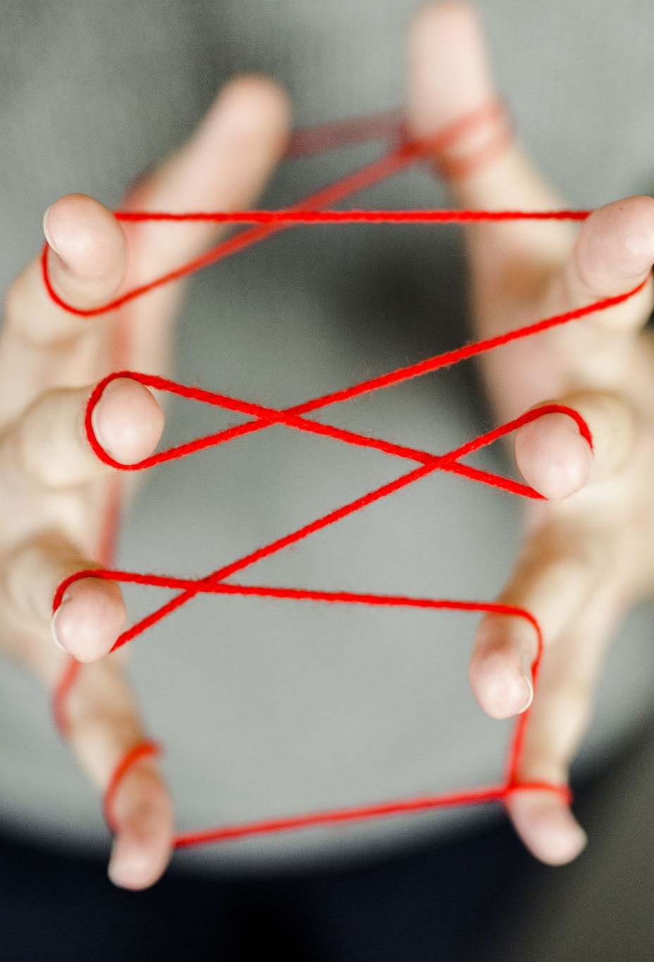
TYPES OF BARRIERS THAT CAN PREVENT ERFFECTIVE COMMUNICATION
Let’s look at the meaning of the word barrier, it is an obstacle that appears at a given time and situation and complicates a given process completely or partially.
Barriers can lead to confusion in the message, which in turn leads to wasted money and time. For this, effective communication is vital.

Slide 6
BARRIERS IN COMMUNICATION
-National culture
Language
Defendiveness
-Filteringemotions
-Information overload
-Emotions

Slide 7
NATIONAL CULTURE
Everyone has a different intelligence in themselves, some speak harshly and for them this is normal, other are disgusted by this type of speaking. This is why everyone needs to keep a normal tone and culture when communicating with their team.

Slide 8
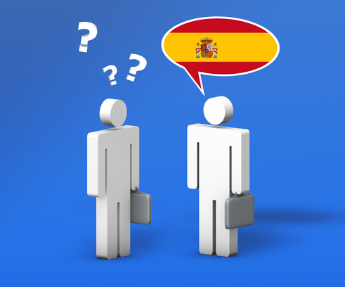
LANGUAGE
It is necessary to know the level of English a person in order to react in a correct way with an interpreter. Today, many people use google translator for example in hospitals when there is a language barrier.

Slide 9
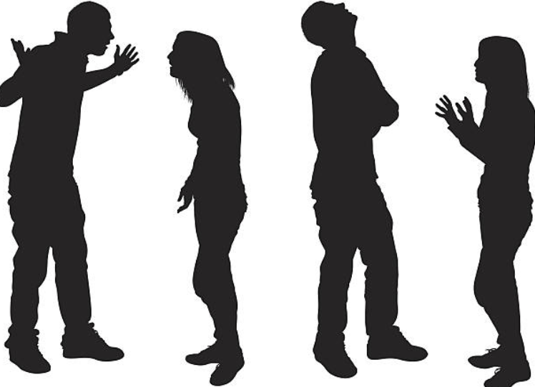
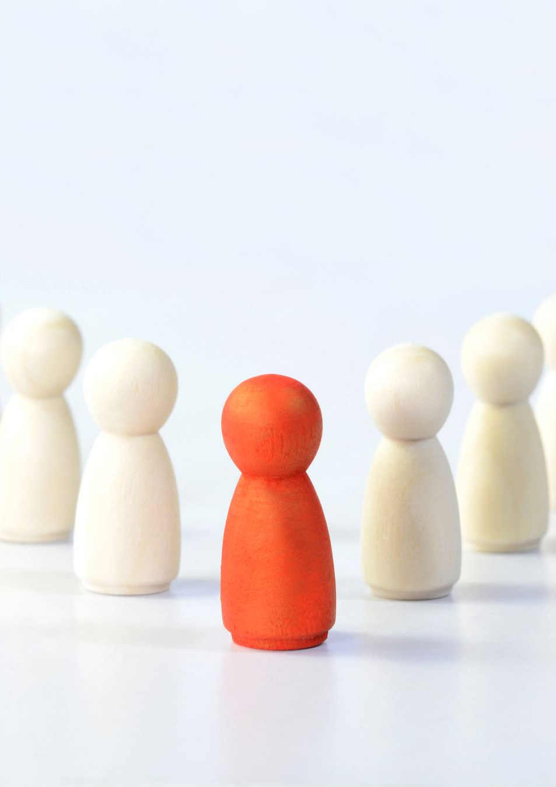
DEFENDIVENESS
People who feel threatened can through their reaction make communication with others difficult. They become sarcastic and judgmental and can de-motivate others.

Slide 10
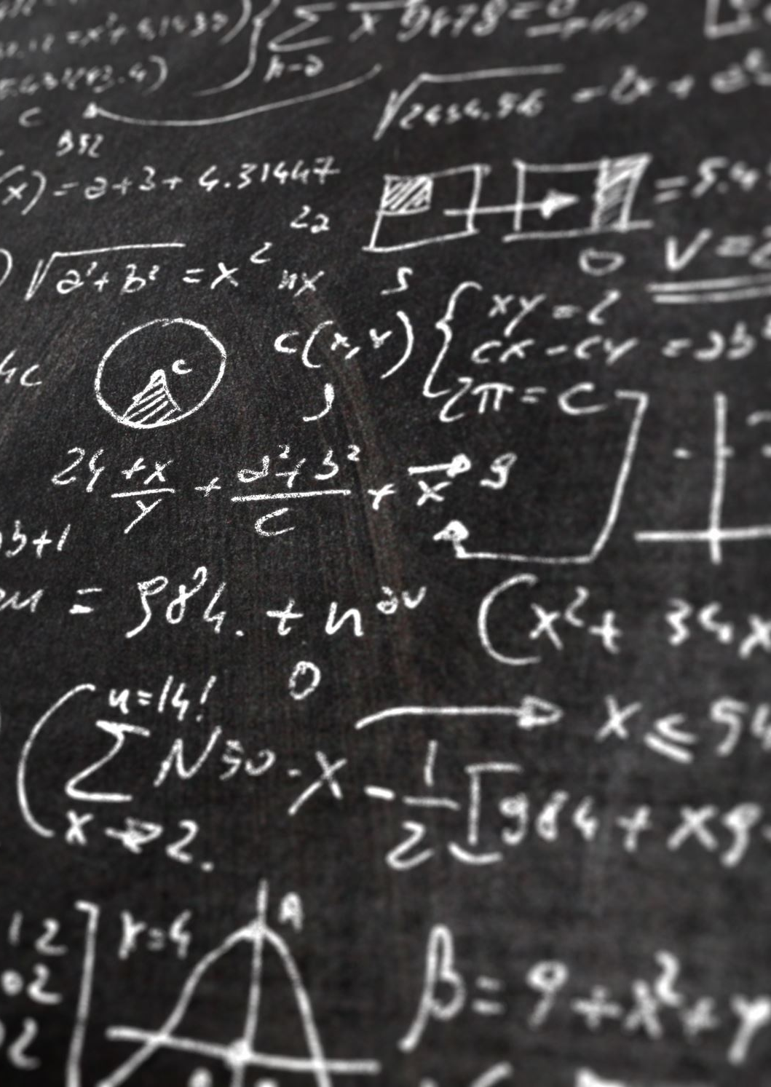
FILTERINGEMOTIONS
Here we have deliberate manipulation of information

Slide 11
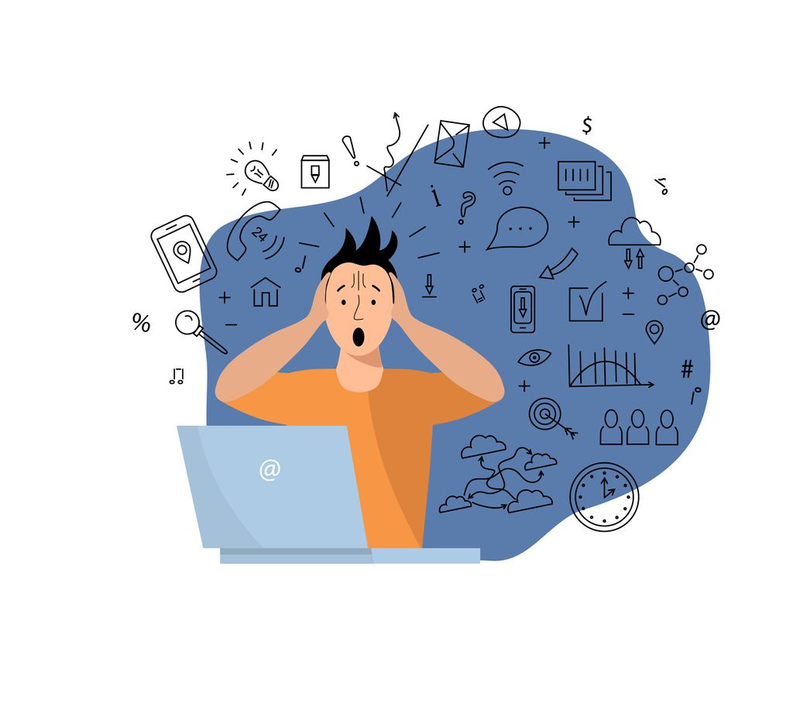

INFORMATION OVERLOAD
This is when we receive a lot of information, which is over our capacity.

Slide 12

EMOTIONS
The message that reaches us depends on how we receive it emotionally. Sometimes emotion interferes with communication. We often ignore objective thinking and get over emotions.

Slide 13
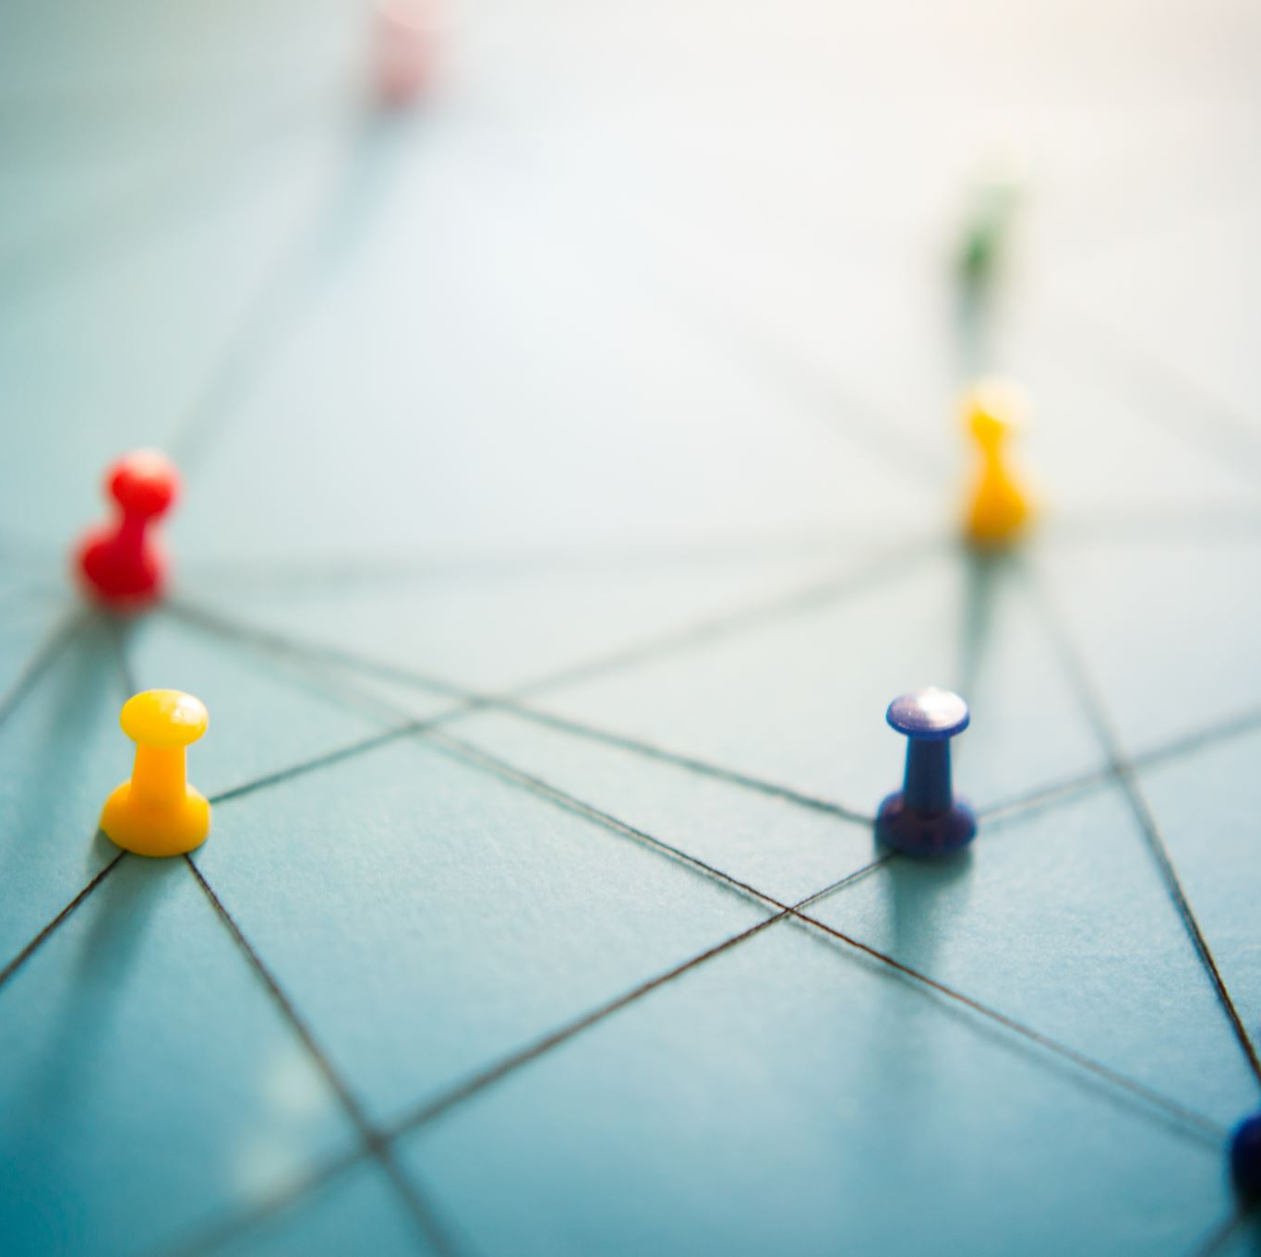
There is a lot of barriers
There are many barriers that can prevent good communication, but I have focused on those six, as they are the most common. But it is not excluded that the organization will also face technical, organizational and other different barriers, It is important to react adequately and correctly to avoid any problems between the team.

Slide 14
CHANNELS OF COMMUNICATION
Channels is a system or method for communication with other people. Communication channels are text messages, emails, phone calls. Radio, video and social media.
Communication channels are three main groups-verbal, non-verbal and written. Each has its positive and negative sides and more than one channel can be used together.

Slide 15

BENEFITS OF EFFECTIVE COMMUNICATION
Good communication skills can improve the way of working and relationship between staff. Some of the benefits of communication are:
-trust
-better relationship-team building
-increased job satisfaction
-increase productivity
-problem solving

Slide 16

CONCLUSION
Based of everything said in this presentation there are rules that if followed and applied correctly would be successful.
Good communication is a must for team to do well, and lack of it would lead to many problems.
It is good that there are various models and theories that can be applied to a successful business.

Slide 17
-REFERENCES
References
6 Barriers to Effective Communication in the Workplace | Grammarly Business. 2022. 6 Barriers to Effective Communication in the Workplace. [online] Available at: <https://www.grammarly.com/business/learn/barriers-to-effective-communication/> [Accessed 16 August 2022].
Dingwall, J., Labrie, C., McLennon, T. and Underwood, L., 2022. Communication Channel. [online] Ecampusontario.pressbooks.pub. Available at: <https://ecampusontario.pressbooks.pub/profcommsontario/chapter/communication-channel/> [Accessed 16 August 2022].
Google.com. 2022. Before you continue to Google Search. [online] Available at: <https://www.google.com/search?q=shannon+and+weaver+model+of+communication&rlz=1C1CHBF_enGB834GB834&oq=shannon+and+&aqs=chrome.0.0i512j69i57j46i512j0i512l7.4430j0j15&sourceid=chrome&ie=UTF-8> [Accessed 16 August 2022].
Impactfactory.com. 2022. Break Down Communication Barriers | Impact Factory London. [online] Available at: <https://www.impactfactory.com/library/communication-skills-seven-barriers-great-communications> [Accessed 16 August 2022].

