Slide 1
Student ID: | 2313058
Module: | BMHP6029 - Psychological Classifications and Provisions
Lecturer Name: | Tomy Adattu Chacko

Slide 2
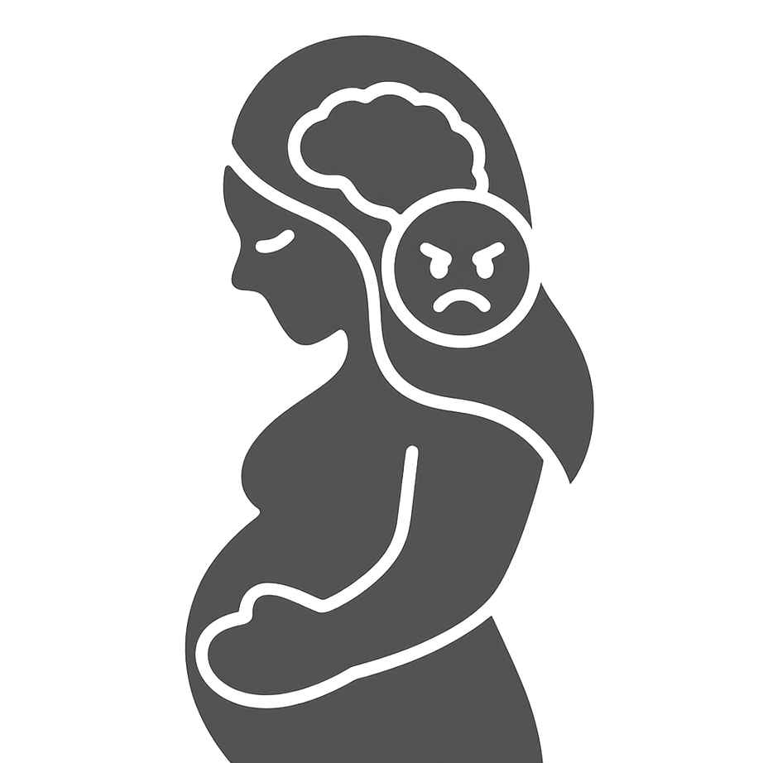
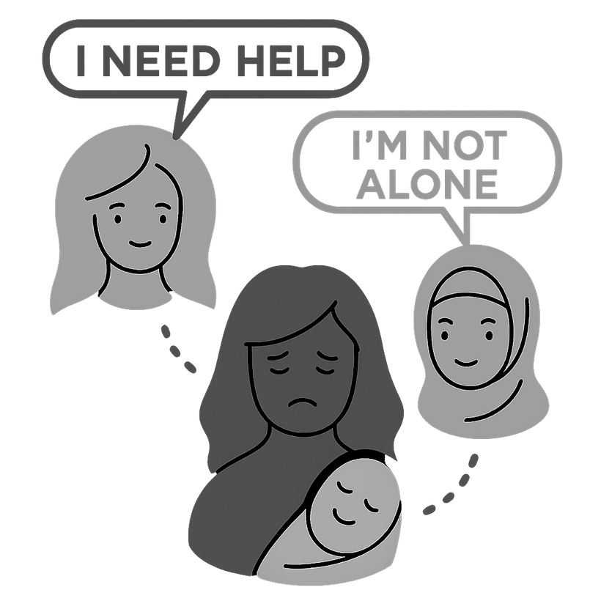


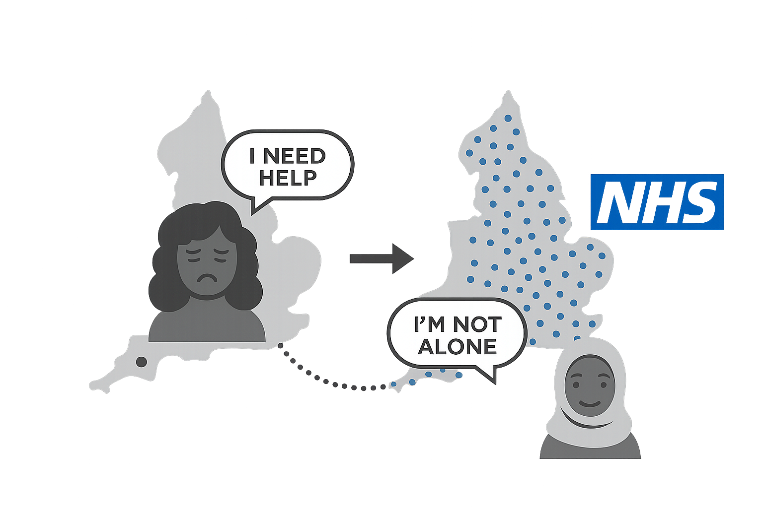
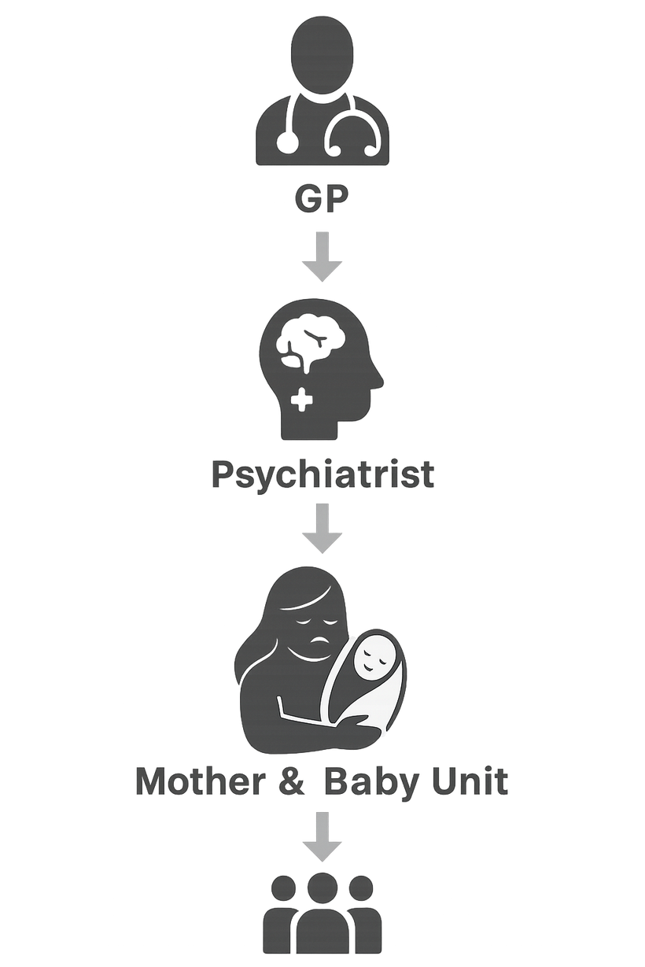

Mental or behavioural disorders associated with pregnancy, childbirth or the puerperium, with psychotic symptoms (ICD-11: 6E21)
Understanding the Historical and Contemporary Care of Postpartum Psychosis in the UK
01. Overview
04. Social and Cultural Contexts
06. Stigma, Discrimination and Inequality
  Poster Aim
To critically examine the evolution of understanding, treatment, and social attitudes toward Postpartum Psychosis (PPP), focusing on UK legislation, policy, and healthcare provisions.
  ICD-11 Description
A severe mental disorder occurring during pregnancy or within 6 weeks after childbirth, involving psychotic symptoms (delusions, hallucinations, disorganisation) with mood disturbances (WHO, 2025).
  Stigma and Silence: Many women fear being labelled bad or failed mothers, leading to underreporting (Laufe and Mun, 2025).
  Cultural influence: In some ethnic communities, postpartum mental illness is viewed as spiritual weakness, delaying help-seeking (Sorsa, Kylmä and Bondas, 2021).
  Social inequality: Ethnic minority women are less likely to receive timely diagnosis or specialist referral (‌Jones et al., 2025).
  Media misrepresentation often portrays PPP as dangerous or criminal, reinforcing public fear.
  Fear of child removal or social judgement deters mothers from help (Schofield et al., 2024).
  Public campaigns (e.g., Maternal Mental Health Alliance, Mind UK) promote awareness and reduce stigma (Papworth et al., 2021).
02. Historical Context and Early Treatment Approaches
  Cultural taboos and lack of awareness among healthcare staff create barriers to equality.
  NHS England’s Lived Experience Network now involves mothers in designing care policies — promoting inclusion and empowerment (NHS England, 2023).
  In the 19th and early 20th centuries, women were labelled as suffering from puerperal insanity and confined in asylums (Showalter, 1980).
  Treatments included isolation, sedation, or ECT, often without consent or understanding.
05. Political and Policy Developments (UK Focus)
  Mental Health Act (1983): Protects rights of detained mothers and promotes least restrictive care.
  NHS Perinatal Mental Health Services Expansion (2019–2024): Ensures all regions have access to MBUs (NHS England, 2024).
  Early psychiatric views blamed women’s fragile nature or maternal failure — reflecting gendered and moralistic biases (Wierzbinska, 2023).
  The Mental Health Act 1959 began shifting care from institutions to community-based support (Legislation.GOV.UK, 2020).
07. Critical Analysis: Evolution of Attitudes and Practice
  The shift from moral blame → medical understanding → person-centred care marks major progress.
  Despite policy improvements, service gaps remain — especially in rural areas and among migrant mothers (Zlotnick et al., 2023).
  Political focus on cost-saving and austerity has limited MBU expansion and mental health staffing (Roxburgh et al., 2022).
  A holistic care framework integrating social work, midwifery, psychiatry, and peer support remains essential.
03. Contemporary Understanding and Care Provision
  Equality Act 2010: Prohibits discrimination in access to mental health care (GOV.UK, 2010).
  NICE (2025) Guideline CG192: Recommends rapid assessment and integrated care for mothers with psychosis.
  Ten-Year Women’s Health Strategy (Department of Health and Social Care, 2022): Prioritises maternal mental health equality and early intervention.
  Today, PPP is recognised as a psychiatric emergency requiring immediate hospitalisation, ideally in Mother and Baby Units (MBUs) (Sanadi et al., 2025).
  Biopsychosocial model: Considers biological (hormonal), psychological (trauma, stress), and social (support networks) causes (Michalczyk, Miłosz and Soroka, 2023).
  Treatment approaches include:
    Antipsychotic or mood stabilising medication
    Cognitive–Behavioural Therapy (CBT)
    Family-centred interventions (Cîmpian et al., 2025)
    Peer support and early intervention services
  The NHS Long Term Plan (2019): expanded perinatal mental health services across England.
08. Recommendations for Future Policy and Practice
  Expand Mother and Baby Units (MBUs) — ensure equal access across all UK regions.
  Mandatory training for midwives and GPs on recognising PPP symptoms early (Pope et al., 2023).
  Embed cultural competence and anti-stigma modules in perinatal mental health training.
  Increase funding for community aftercare and partner education (Roxburgh, Taylor and Hodgekins, 2025).
  Promote nationwide awareness campaigns to normalise mental health conversations post-childbirth.
09. Conclusion
  Postpartum Psychosis remains rare but severe (Cleveland Clinic, 2022).
  Future success depends on policy commitment, inclusive practice, and continuous public education to protect maternal mental wellbeing.

Slide 3
References
Cîmpian, D.M., Strete, G.E., Cîmpian, C.I., Suciu, L.M., Cucerea, M., Bacârea, V. and Pușcașiu, L. (2025). The Impact of Preterm Birth on Parents’ Mental Health and the Role of Family-Centred Interventions: A Narrative Review. Children, 12(10), p.1311.
Cleveland Clinic (2022). Postpartum psychosis. [online] Cleveland Clinic. Available at: https://my.clevelandclinic.org/health/diseases/24152-postpartum-psychosis[Accessed 16 Oct. 2025].
Department of Health and Social Care (2022). Women’s Health Strategy for England. [online] GOV.UK. Available at: https://www.gov.uk/government/publications/womens-health-strategy-for-england/womens-health-strategy-for-england[Accessed 16 Oct. 2025].
GOV.UK (2010). Equality Act 2010. [online] Legislation.gov.uk. Available at: https://www.legislation.gov.uk/ukpga/2010/15/contents[Accessed 16 Oct. 2025].
‌Jones, E., Quinn, L., Tanner, J.R., Jankovic, J., Berrisford, G., MacArthur, C. and Taylor, B. (2025). Prevalence and incidence of moderate and severe mental illness in the second postpartum year in England (1995–2020): a national retrospective cohort study using primary care data. The Lancet Regional Health–Europe, 53.
Laufer, B. and Mun, N. (2025). “It shows you your fears”: a qualitative analysis and psychoanalytic interpretation of the psychotic content of postpartum psychosis. Psychosis, pp.1-14.
Legislation.GOV.UK (2020). Mental Health Act 1959. [online] Legislation.gov.uk. Available at: https://www.legislation.gov.uk/ukpga/Eliz2/7-8/72/enacted[Accessed 16 Oct. 2025].
Mental Health Act (1983). Mental Health Act 1983. [online] Legislation.gov.uk. Available at: https://www.legislation.gov.uk/ukpga/1983/20/contents[Accessed 16 Oct. 2025].
Michalczyk, J., Miłosz, A. and Soroka, E. (2023). Postpartum psychosis: a review of risk factors, clinical picture, management, prevention, and psychosocial determinants. Medical Science Monitor: International Medical Journal of Experimental and Clinical Research, 29, pp.e942520-1.
NHS England (2023). Three Year Delivery Plan for Maternity and Neonatal Services. [online] www.england.nhs.uk. Available at: https://www.england.nhs.uk/long-read/three-year-delivery-plan-for-maternity-and-neonatal-services/[Accessed 16 Oct. 2025].
NHS England (2024). Perinatal mental health. [online] England.nhs.uk. Available at: https://www.england.nhs.uk/mental-health/perinatal/[Accessed 16 Oct. 2025].
NICE (2025). Antenatal and postnatal mental health: clinical management and service guidance. [online] PubMed. London: National Institute for Health and Care Excellence (NICE). Available at: https://www.ncbi.nlm.nih.gov/books/NBK553127/[Accessed 16 Oct. 2025].
Papworth, R., Harris, A., Durcan, G., Wilton, J. and Sinclair, C. (2021). Maternal mental health during a pandemic. Centre for Mental Health.
Pope, J., Redsell, S., Houghton, C. and Matvienko-Sikar, K. (2023). Healthcare professionals’ experiences and perceptions of providing support for mental health during the period from pregnancy to two years postpartum. Midwifery, 118, p.103581.
Roxburgh, E., Morant, N., Dolman, C., Johnson, S. and Taylor, B.L. (2022). Experiences of Mental Health Care Among Women Treated for Postpartum Psychosis in England: A Qualitative Study. Community Mental Health Journal, 59(2). doi:https://doi.org/10.1007/s10597-022-01002-z.
Roxburgh, E., Taylor, B.L. and Hodgekins, J. (2025). Experiences of care from mental health services among partners of women accessing support for postpartum psychosis: A qualitative study. Community Mental Health Journal, pp.1-12.
Sanadi, R., Rao, R., Klier, C., Das, N. and Chandra, P.S. (2025). Optimal care for mother and baby in severe postpartum mental illness. neuropsychiatrie, pp.1-9.
Schofield, C.A., Brown, S., Siegel, I.E. and Moss-Racusin, C.A. (2024). What you don’t expect when you’re expecting: Demonstrating stigma against women with postpartum psychological disorders. Stigma and Health, 9(3), p.372.
Showalter, E. (1980). Victorian women and insanity. Victorian Studies, 23(2), pp.157-181.
Sorsa, M.A., Kylmä, J. and Bondas, T.E. (2021). Contemplating help-seeking in perinatal psychological distress—a meta-ethnography. International journal of environmental research and public health, 18(10), p.5226.
The NHS Long Term Plan. (2019). Available at: https://rcm.org.uk/wp-content/uploads/2024/06/nhs-long-term-plan-jan-2019.pdf[Accessed 16 Oct. 2025].
WHO (2025). ICD-11 for Mortality and Morbidity Statistics- 6E21 Mental or behavioural disorders associated with pregnancy, childbirth or the puerperium, with psychotic symptoms. [online] Available at: https://icd.who.int/browse/2025-01/mms/en#380591392[Accessed 16 Oct. 2025].
Wierzbinska, E. (2023). The Voices of Postpartum Psychosis: An Interpretive Phenomenological Analysis of Women’s Subjective Experiences in the Perinatal Period. Adelphi University.
Zlotnick, C., Manor‐Lavon, I. and Leahy‐Warren, P. (2023). Relationship between social support and postpartum depression in migrant and non‐migrant first‐time mothers. Journal of clinical nursing, 32(7-8), pp.1316-1326.

