Slide 1
Creating Believable Characters with Realistic Motivations
Mastering the Art of Character Development in Animation
Adam Head
Date: 14/11/2024

Slide 2

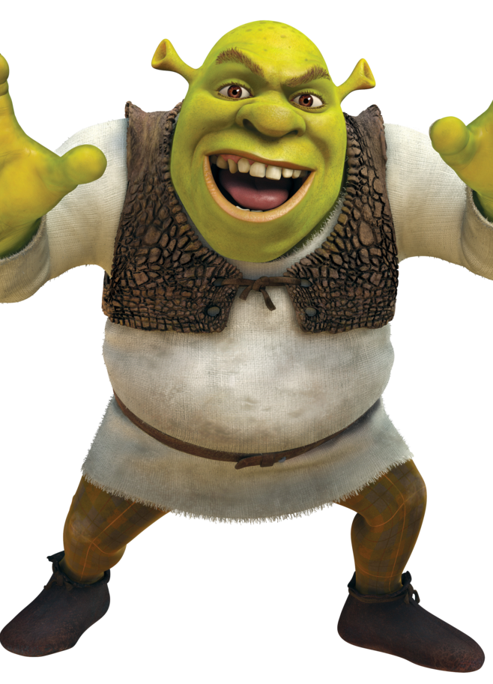
Introduction to Character Motivation
Why Motivation Matters: Motivation is the core driving force that shapes a character's actions, personality, and choices.
Audience Connection: Characters with relatable motivations engage audiences more deeply, creating emotional resonance and investment.
Example: Animated characters with clear motivations (e.g., Elsa in Frozen, Shrek).

Slide 3
Core Components of Believable Characters
Goals: What does the character want? Goals provide direction and clarity in their journey.
Desires: Deep-seated needs and wants that shape the character’s personality and choices.
Fears: What does the character want to avoid? Introducing fears creates internal conflict and depth.

Slide 4
Types of Motivations
Internal Motivations: Emotions, personal beliefs, psychological needs (e.g., Hiro in Big Hero 6).
External Motivations: Influences from the environment or circumstances (e.g., Marlin in Finding Nemo).
Characters are richer with both internal and external motivations, adding complexity to their journey.

Slide 5
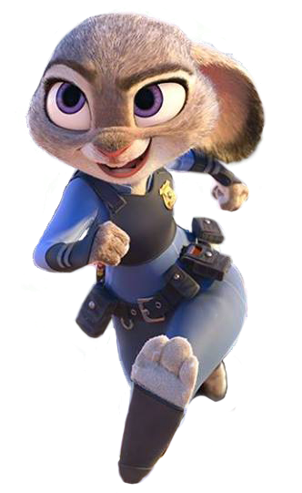
Crafting Realistic Motivations
Consistency: Characters should act in ways aligned with their motivations.
Backstory: Motivations rooted in a character’s past add context and make motivations feel natural.
Contradictions and Conflicts: Realistic characters have complex motivations (e.g., a hero who wants peace but must fight).
Example: Judy Hopps in Zootopia faces idealism challenged by prejudice and limitations.

Slide 6

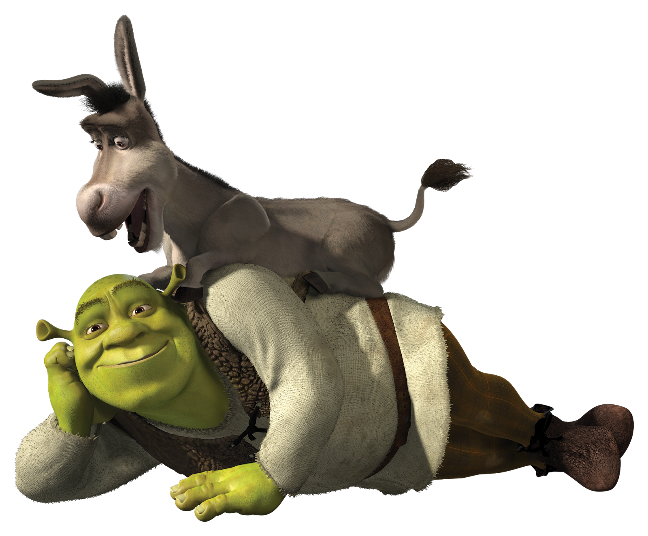
Relatable Motivations for Audience Engagement
Universal Motivations: Audiences connect with universal motivations like love, acceptance, and overcoming fear.
Humanizing Fantasy: Even in fantastical settings, characters with real-world motivations are easier to identify with.
Example: Fantasy characters can reflect universal struggles, like Shrek’s journey from isolation to self-acceptance.

Slide 7
Animation Techniques to Convey Motivation
Facial Expressions and Body Language: Subtle cues reveal internal motivations (e.g., WALL-E's loneliness).
Dialogue and Pacing: Reveal motivation through character interactions, letting audiences deduce motivations.
Visual Example: https://youtu.be/QHH3iSeDBLo

Slide 8

Case Study - Analyzing a Believable Character
Character Example: Elsa from Frozen
Motivations: Fear of her powers, desire for freedom, love for her sister.
Internal Conflict: Desire to protect others vs. longing for self-expression.
Resolution: Elsa’s motivations evolve, leading to a realistic and satisfying character arc.

Slide 9
Tips for Developing Strong Character Motivations
Start with Backstory: Begin by shaping the character’s past to explain their motivations.
Layered Motivations: Include both short-term goals and long-term desires, adding depth.
Evolving Motivations: Consider how motivations change as the character faces new challenges.

Slide 10
Conclusion and Q&A
Summary: Begin with core motivations, make them relatable, and reveal them gradually.
Use animation techniques to subtly convey motivation.
Q&A Prompt: “What’s a character whose motivation resonated with you? Why?”

