Slide 1


Communication: A key Skill For Effective Practice In Health And Social Care
STUDENT NAME: Oluwatoyin Ruth Salu
STUDENT ID: 2508698
PROGRAM: Certificate Of Higher Education Skills For Workplace (Health And Social Care)
MODULE: Professional Development Within Health and Social Care
MODULE CODE: LCHS4009
MODULE LEAD: Olubukola Adegbite
LECTURER NAME: Zara Ahmed
SUBMITTED ON: 21 JUNE 2026

Slide 2

INTRODUCTION
Good morning my name is Oluwatoyin Salu a student at the UWTSD with the student number 2508698 and I am studying Certificate of Higher Education Skills for Workplace (Health and Social Care).
Today, as Support-care worker at workplace, I choose communication as a fundamental key skill required for effective practice in health and social care. In this presentation, I will define communication and the types, explain why it is important, how it support professional practice in care sector
I will provide a practical example of how I have applied communication in a real care setting and use Argyle’s communication Cycle as a framework for understanding

Slide 3
PRESENTATION OVERVIEW
WHAT I WILL COVER IN THE NEXT 5 MINUTES:
What Is Communication And Types Of Communication
Why Communication Is Important In Health And Social
Relevance To My Role As A Support-Care Worker
The Communication Cycle: Argyle’s Model (1972)
Practical Example From Practice
Conclusion
References

Slide 4
WHAT IS COMMUNICATION
Definition: Communication is the process of exchanging information, ideas, thoughts, messages, and feeling between individuals or groups through various channel as such verbal, non-verbal, visual, written and digital, it is more than just talking, but about understand and being understood.
Types Of Communication:
Verbal communication: Spoken words, tone, clarity and pace of speech
Non-verbal communication: Gestures, body language, eye contact, facial expressions, touch and object.
Written communication: Emails, care-plan, text messages, documentation and medical charts, handover sheets. It should valid and accurate.
Visual communication: Photos, diagrams charts, symbols.
(Institute of Mental Health, 2026).
Notes:
4

Slide 5
WHY COMMUNICATION IS IMPORTANT IN HEALTH AND SOCIAL CARE
BUILDS TRUST: Effective communication promotes trust between care worker and service users this enable honest relationships.
PROMOTES DIGNITY: Good communication delivered dignity in person-centred care.
SUPPORTS WELLBEING: Active listening and empathy help meet emotional and psychological needs of service users.
ENSURES SAFETY: Clear communication will reduce errors and support accurate reporting and handover in care settings.
EFFECTIVE TEAMWORK: Strong communication build a supportive and teamworking environment where colleagues can share thoughts and resolve issues.
(University of Greater Manchester, 2023)

Slide 6
RELEVANCE TO MY ROLE AS A SUPPORT CARE WORKER
As a Support-care Worker I use Communication To:
Understand service users needs
Provide person-centred care
Work effectively with other healthcare professionals
Communication with service user family member
Maintain accurate care records
Report concerns to line-manager and safeguarding
Communication Relevance To Professional Practice:
Promotes Person-Centred Care: Help health and social professional understand the individual needs, beliefs, preferences and wishes of service users.
Safeguarding: Clear communication is a legal and professional duty. It identify all signs of abuse, neglect, or changes in wellbeing. All harm must be reported like in SBAR. (Aqua, 2023).

Slide 7

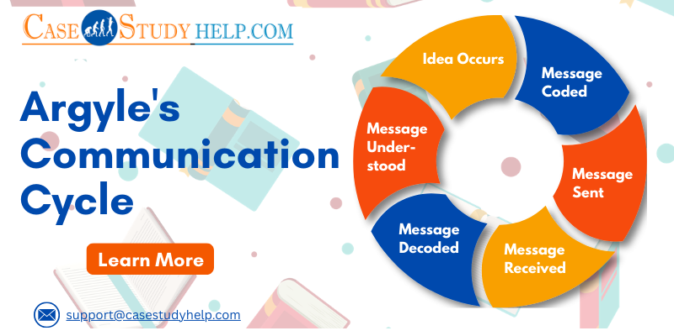



COMMUNICATION CYCLE- ARGYLE’S MODEL(1972)
Communication process:
AN IDEA OCCURS: Sender in thought decide to communicate.
MESSAGE CODED: Sender encode idea into words, tone or body language.
MESSAGE SENT: The message is transmitted verbally, non-verbally or in writing to the receiver.
MESSAGE RECEIVED: The receiver understand the message through listening, reading or observation.
MESSAGE DECODED: The receiver interprets the message into action, verbally or non-verbal cues.
Feedback/Action: The receiver responds, by confirming understanding.
(Argyle, 1972).

Slide 8
Practical Example From Practice
Supporting A Non-Verbal Service User As A Support-Care Worker At Workplace:
In my current role as a Support-Care Worker at FineFuture, I support individuals with learning disability who are non-verbal. Because verbal communication was limited, I used observation of facial expressions, active listening, sounds, gestures and visual cues to understand their needs. I also communicate with other healthcare professionals, colleagues and family members. This enable me to provide appropriate support and improve the individual’s wellbeing. I’m able to deliver a better person-centred care, accurate record, reduced anxiety and individual needs were identified correctly

Slide 9
Conclusion
In conclusion, communication is much more than talking, it involves listening, observing, body language, recording information accurately and it is tailored to individual needs.
Effectively communication is essential because health and social care professionals works closely with service users, families and other multidisciplinary teams. It helps service users feel respected, valued and understood. It also improves safety and quality of care.
In a daily professional practice, a support worker relies on a communication cycle to ensure safety. The aim is to demonstrates a message is Encode → Transmit→ Receive→ Decode→ Understood.
Finally, communication is not just one skill, among many it underpins every activities a support-care worker does. Without it, a safe, effective and dignified care is impossible.

Slide 10
REFERENCES
Aqua (2023) Quality, Service Improvement and Redesign Tools: SBAR Communication Tools. Available at: https://aqua.nhs.uk/wp-content/uploads/2023/07/qsir-sbar-communication-tool.pdf (Accessed: 5 June 2026)
Argyle, M. (1972) The Psychology of Interpersonal Behaviour. 2nd edn. Harmondsworth: Penguin Books.
Institute of Mental Health (2026) The Role of Communication in Health and Social Care: Why It Matters. Available at: https://iomh.co.uk/the-role-of-communication-in-health-and-social-care-why-it-matters/ (Accessed: 28 May 2026).
University of Greater Manchester (2023) Why is Communication Important in Health and Social Care?. Available at: https://greatermanchester.ac.uk/blogs/why-is-communication-important-in-health-and-social-care ( Accessed: 29 May 2026).
Notes:
10

