Slide 1
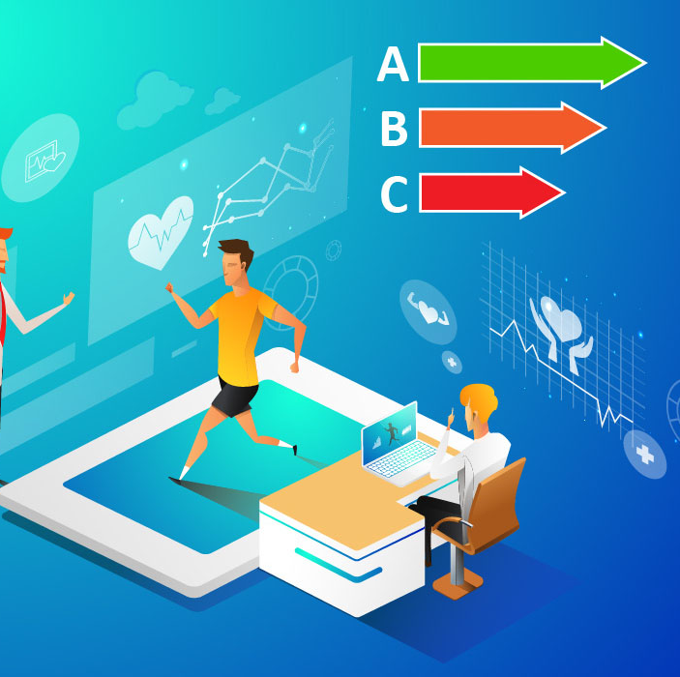
FoodScan
AR Nutrition Education for Teen Shoppers
A Digital Health Promotion Intervention
Group Member 2
Digital Health Promotion

Slide 2

Public health issues
Poor food choices
Obesity in teenage groups (Luca et al., 2025)
Lack of knowledge of food labels at the point of purchase
Notes:
Hello, Good morning. This presentation aims to offer a planning model to deliver the digital health promotion intervention by focusing on obesity in teenage groups and poor food choices. The digital interventions will monitor physical activity and diet plans of young populations, which will provide knowledge about the reductions in weight status. These technological advances will provide real-time information through a certain app named FoodScan.

Slide 3
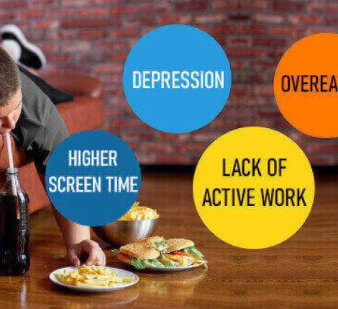
Target group
Teenagers (13-18) years old shopping in supermarkets
Environments of retail supermarkets
High engagement during shopping independently
Notes:
Due to a high consumption of junk foods, a poor diet and inactivity, the issue of obesity has become a growing concern for teenagers. Hence, this presentation targeted the teenage population. In addition, for the digital intervention through FoodScan, it will target the tennerages who are interested in purchasing retail items through supermarkets independently.

Slide 4
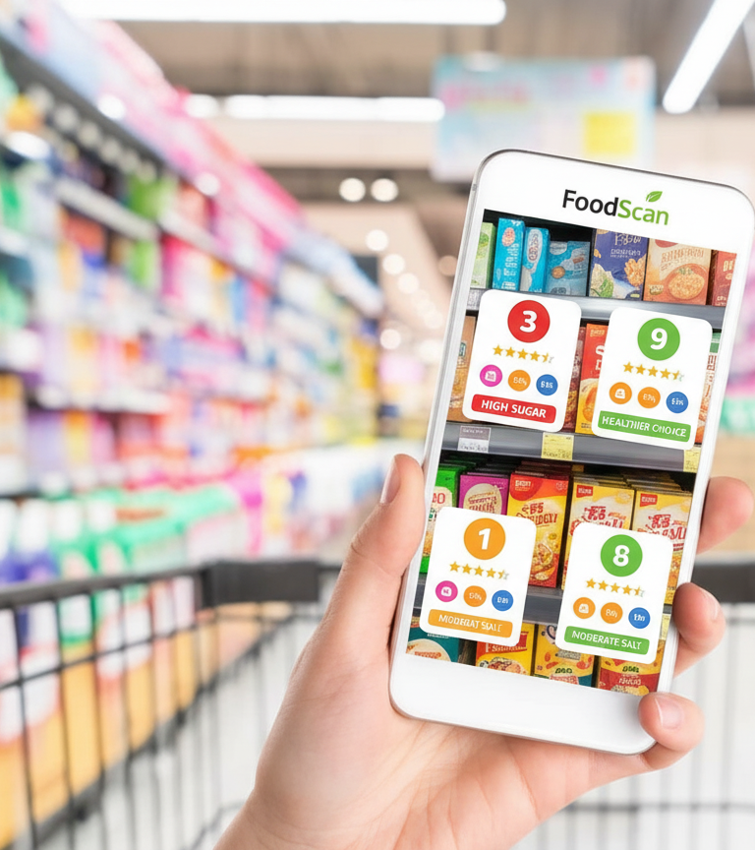
Intervention of FoodScan
AR-based phone app to give nutrition education for teen shoppers
It will scan food and provide a health score
Offers instant nutritional information and highlights health risks (Augmentedrealityity, 2017)
Notes:
FoodScan is a mostly AR-based phone app to give nutrition education for teen shoppers. It will scan food and provide a health score, offer instant nutritional information, and highlight health risks. These AR-based nutrition applications can be applied to examine consumption throughout the day, focusing on the identified foods that viewers consumed. Such mobile applications can be easily accessible and provide detailed real-time data about the food taken. Hence, it will change the capabilities of making informed choices for users and improve their overall nutrition.

Slide 5
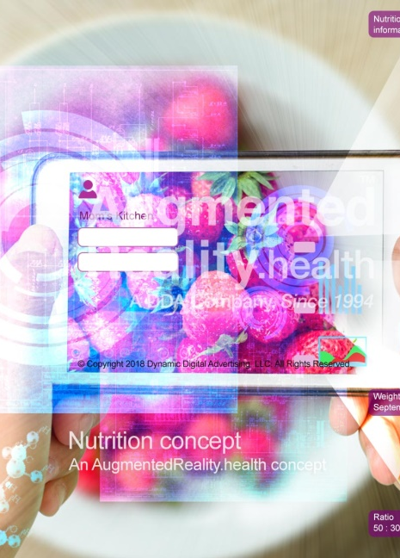
Planning model: intervention mapping
Systematic framework that focuses on evidence-based digital health expertise
Connects the objectives of public health and digital technology
Offers critical evaluation and sustainability, aligning with health promotion principles (Augmentedreality, 2017)
Notes:
The intervention mapping will work as a planning model that focuses on evidence-based digital health expertise and connects the public health objectives with digital technology. By tracking the regular diet and spotting great choices, such an app will address certain items that need to be avoided for obesity. The interactive presentation of AR allows people to fully know the results of their food choices; hence, it inspires users to maintain a healthier lifestyle.

Slide 6
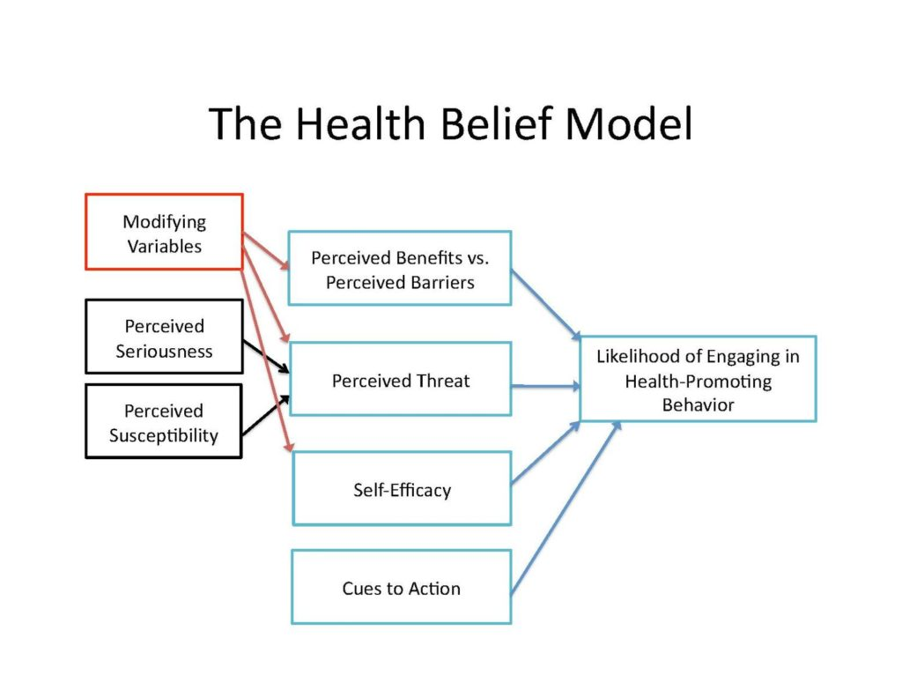
Stages of intervention mapping
Stage 1: Regular assessments and identification of health issues
Stage 2: Addresses behavioural objectives and logic models
Stage 3: Creation of health content based on the health belief model (HBM) (Urich, 2020)
Stage 4: Development of an action plan by focusing on the health-related decisions of a person during retail shopping
(Urich, 2020)
Notes:
These stages provide the work process of intervention mapping. Aligning it with a health belief model, this app can address the perceptions to change people’s modified behaviour, such as managing chronic conditions and others. For example, a sudden increase in low-sodium food purchases may address perceived high blood pressure risks that may help to predict future health issues.

Slide 7
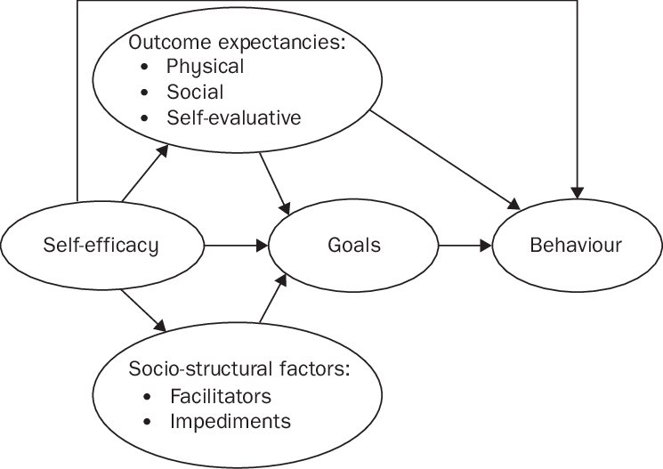
Applied behavioural change theories
Health belief model: perceived sustainability of poor nutrition (Urich, 2020)
Social cognitive theory: Increase of self-efficacy via real-time feedback (Luszczynska and Schwarzer, 2015)
(Luszczynska and Schwarzer, 2015)
Notes:
Focusing on the six core beliefs, such as perceived susceptibility, perceived severity, perceived benefits, perceived barriers, self-efficacy, and cues to action, it will address users' beliefs. Which is effective and motivates preventive behaviours. On the other hand, social cognitive theory will give real-time feedback for increasing the self-efficacy of users.

Slide 8
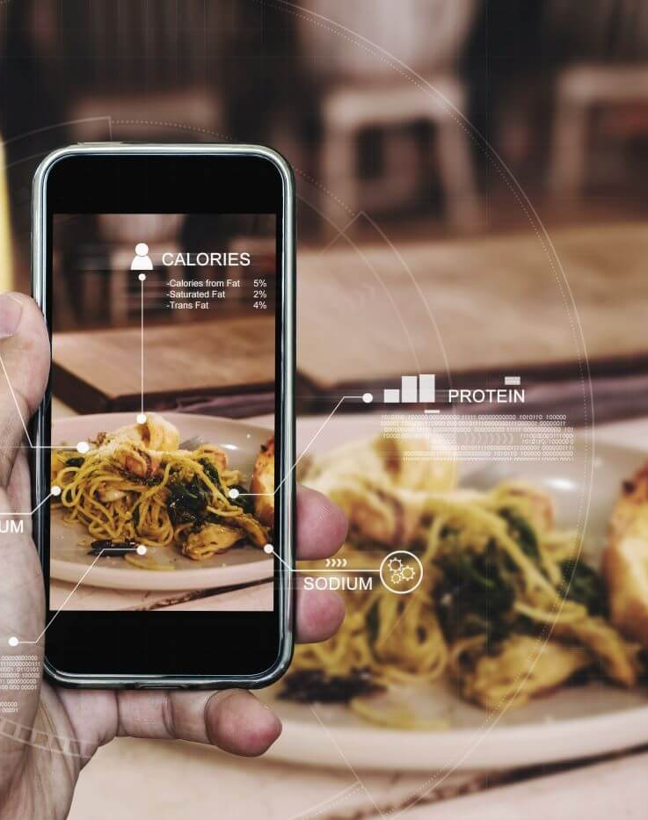
Principles and values of health promotion
Increase accessibility: A free and affordable user-friendly app suitable for all kinds of people
Focus on empowerment: Teenagers can make informed decisions and make independent food choices (WHO, 2023)
Higher sustainability: long-term change in behaviour via rapid engagement (WHO, 2023)
Equity: focus on disparities of digital health via exceptional design
Notes:
The core health promotion principles depend on the participation of the community, partnerships, equity and empowerment. Based on it, this digital health intervention aspect aims to provide an affordable and free user-friendly app that is suitable for all kinds of people. By focusing on digital health disparities through exceptional design, it will ensure equity. Through rapid engagement, long-term changes in user behaviour are proof of higher sustainability.

Slide 9
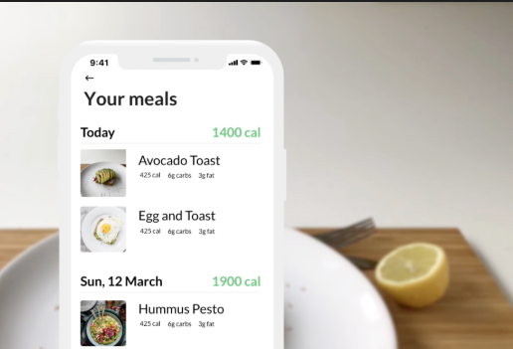
Integration of digital technologies
AR technology applied for the visualisation of food labels in real time (Juan et al., 2019)
Wearable features to track health aspects
The big data will track trends in nutrition and focus on dietary patterns.
Integrating with health records will give detailed health information.
Notes:
In the app, the AR will help users to visualise the food labels in real time and display the digital nutritional aspects and information of ingredients to make more informed decisions while product buying. By scanning products, QR codes and barcodes, it will endorse the information about product packaging and the amount of proteins, sugar and other aspects in the products.

Slide 10
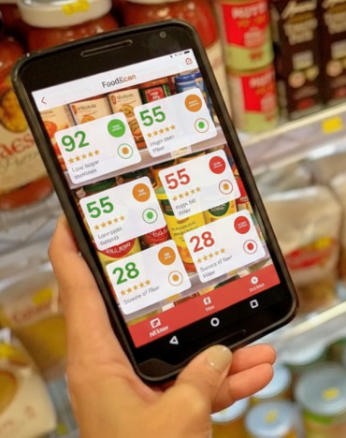
Implementation Strategies
Apply rollout by maintaining a partnership with local supermarket chains
Give education and training to local retail companies to use such innovation and help teenage customers in their shopping
Monitoring expertise by adopting real-time analytics and highlighting effectiveness (Pini et al., 2023)
Notes:
The app will be implemented by maintaining a partnership with local retailers and supermarket companies. By training local retail companies to use such innovation, it will help teenage customers in their shopping. By adopting real-time analytics, it will achieve seamless results for a satisfying user experience. The app may offer users information about certain health concerns and significant dietary needs and goals of weight management. Hence, customised according to the users' data, this app may provide knowledge of whether their purchased product is appropriate for their health or not, according to their health plan.

Slide 11
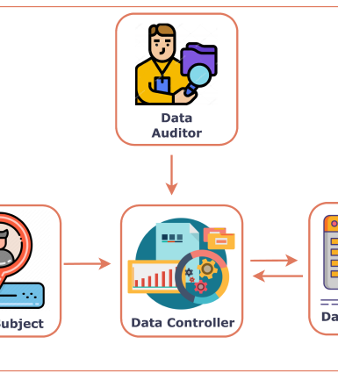
Focusing on digital inequalities and the application of big data
Has an offline feature for use in low-connectivity zones
To address dietary disparities in communities, apply big data analytics (Lutz, 2019)
Ensure data governance is ethical to protect user information while using
Notes:
By analysing the disparity practices of users, the app will develop its primary information about users. For use in low-bandwidth connectivity zones, the app has offline features, and it ensures data governance ethically to protect user data. By fostering health food purchase through AR technologies, users can get real-time and personalised data and health warnings at the point-of-purchase towards healthier food choices.

Slide 12

Summary
Follow health promotion principles
A model of systematic planning
Ensure digital equity and data protection of users
Notes:
In summary, the AR technology facilitates the access of nutritional facts from the packaged retail foods and fosters more awareness among customers. Not only can it bring nutritional information to the foreground, but it also offers available information about the food quality. Hence, it reduces information clutter during shopping and allows users to choose only the consistent food according to their needs. For example, low glycaemic index food is only suitable for a certain customer according to the suggestions of the app. Hence, it aims to reduce the fault in the purchasing choices of teenagers

Slide 13
References
A. Luszczynska and Schwarzer, R. (2015). Social Cognitive Theory. [online] Available at: https://www.researchgate.net/publication/284667057_Social_Cognitive_Theory?_tp=eyJjb250ZXh0Ijp7ImZpcnN0UGFnZSI6Il9kaXJlY3QiLCJwYWdlIjoiX2RpcmVjdCJ9fQ [Accessed 6 Dec. 2025].
Augmentedreality (2017). AugmentedReality.health. [online] AugmentedReality.health. Available at: https://augmentedreality.health/nutrition.cfm [Accessed 6 Dec. 2025].
Juan, M.-C., Charco, J.L., García-García, I. and Mollá, R. (2019). An Augmented Reality App to Learn to Interpret the Nutritional Information on Labels of Real Packaged Foods. Frontiers in Computer Science, [online] 1. doi:https://doi.org/10.3389/fcomp.2019.00001.
Luca, V.D., Virgolesi, M., Vetrani, C., Aprano, S., Cantelli, F., Martino, A.D., Mercurio, L., Iaccarino, G., Isgrò, F., Arpaia, P., Colao, A. and Maddalena Illario (2025). Digital interventions for weight control to prevent obesity in adolescents: a systematic review. Frontiers in Public Health, [online] 13. doi:https://doi.org/10.3389/fpubh.2025.1584595.
Lutz, C. (2019). Digital inequalities in the age of artificial intelligence and big data. Human Behaviour and Emerging Technologies, [online] 1(2), pp.141–148. doi:https://doi.org/10.1002/hbe2.140.
Pini, V., Orso, V., Pluchino, P. and Gamberini, L. (2023). Augmented grocery shopping: fostering healthier food purchases through AR. Virtual Reality. [online] doi:https://doi.org/10.1007/s10055-023-00792-1.
Urich, A. (2020). The Health Belief Model. [online] PennState. Available at: https://psu.pb.unizin.org/kines082/chapter/the-health-belief-model/ [Accessed 6 Dec. 2025].
WHO (2023). Health promotion. [online] www.who.int. Available at: https://www.who.int/health-topics/health-promotion [Accessed 6 Dec. 2025].

Slide 14
Thank You!

