Slide 1

A child’s experience between the ages of 0-5 years can affect the rest of their lives
Psychology in Health and Social Care
Student name: Aya Janagap
Student code: 2020123
Module code: BMSW 4005
Lecturer: Rebecca Kavanagh

Slide 2
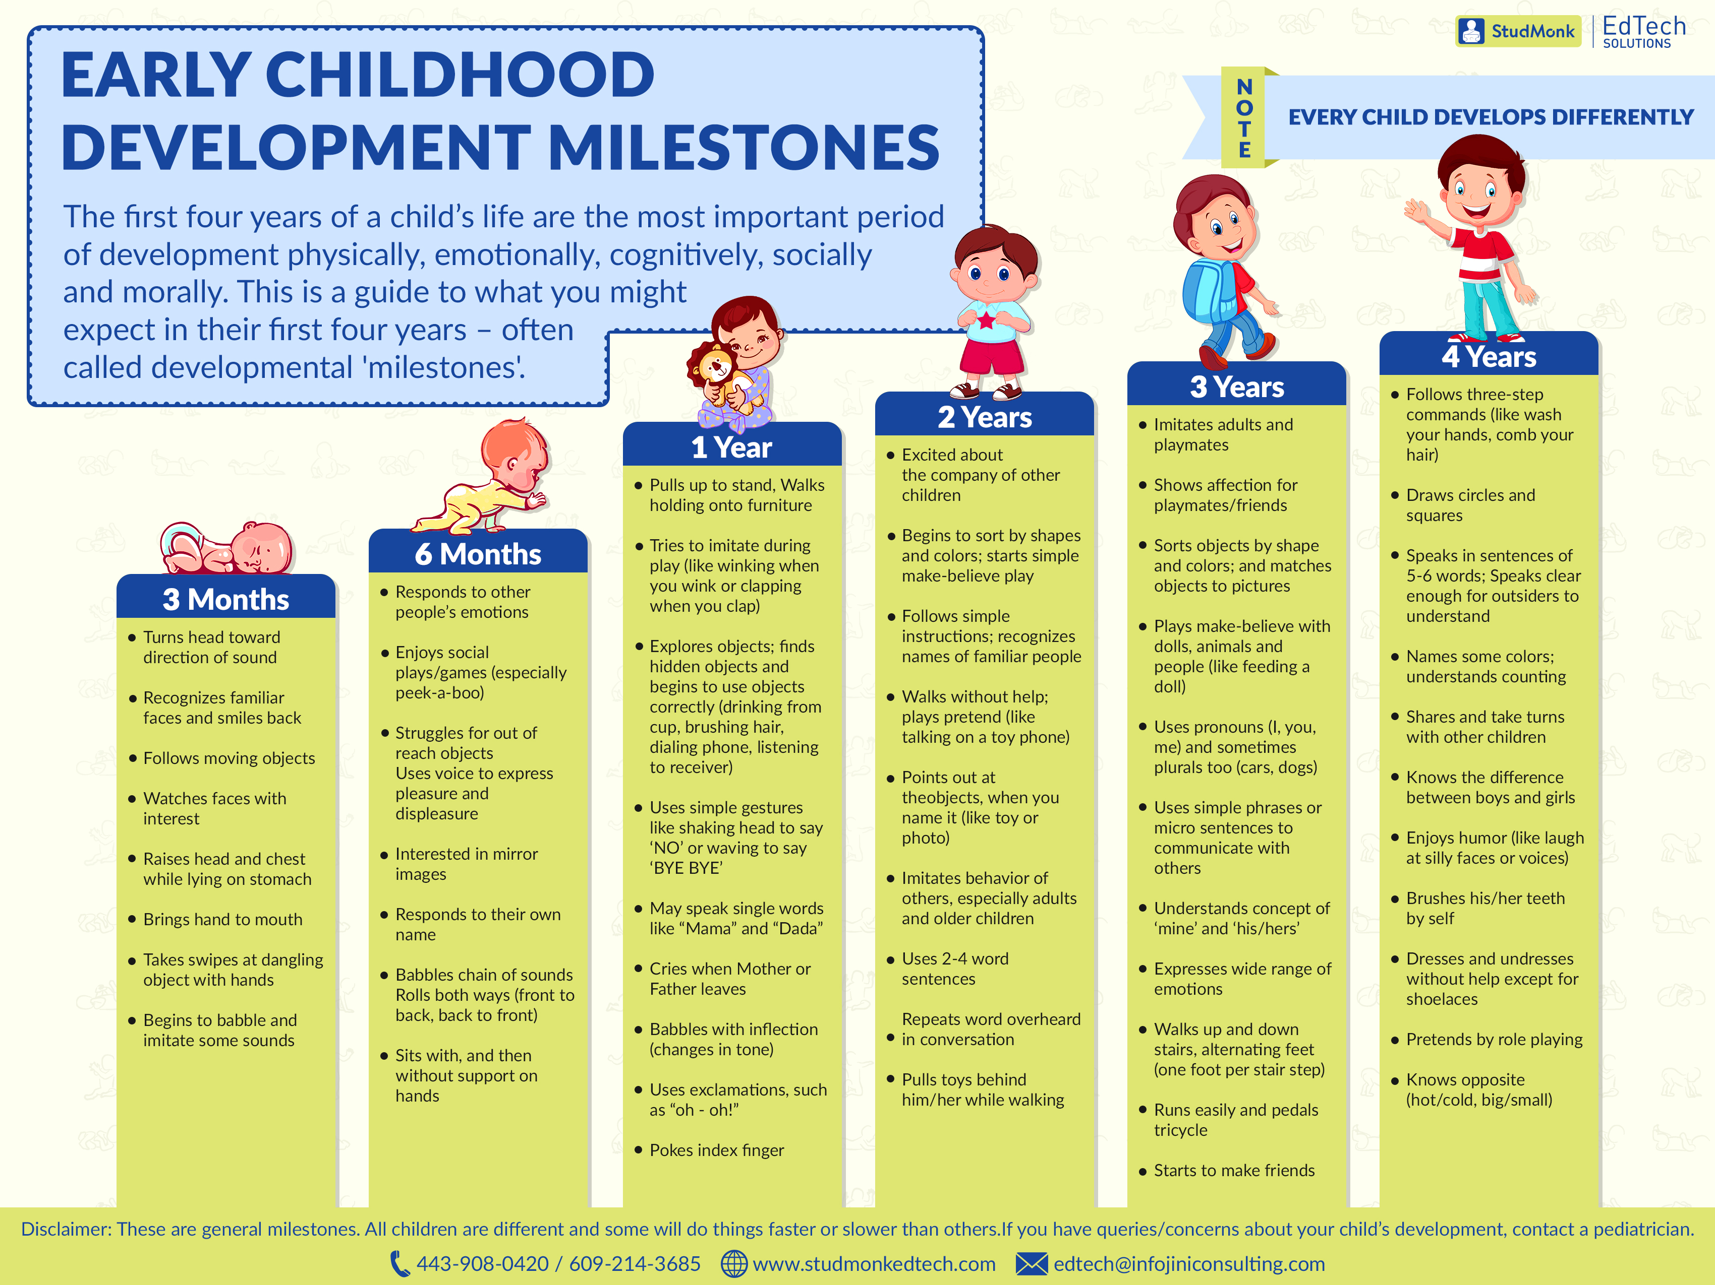
Childhood development milestone ages 0-5
Source : http://studmonkedtech.com/blog/know-early-childhood-developmental-milestones/

Slide 3
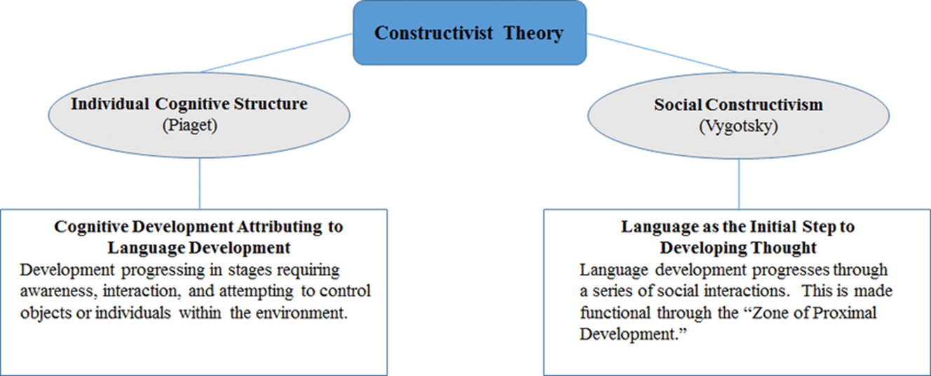
Child developmental theories

Slide 4
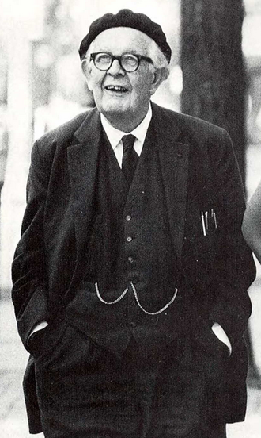
Jean Piaget: Cognitive
Theory
Piaget Identified 4 stages in cognitive development
Stage | Age | Characteristics | Goal
Sensorimotor | Birth to 18–24 months old | Motor activity without use of symbols. All things learned are based on experiences, or trial and error. | Object permanence
Preoperational | 2 to 7 years old | Development of language, memory, and imagination. Intelligence is both egocentric and intuitive. | Symbolic thought
Concrete operational | 7 to 11 years old | More logical and methodical manipulation of symbols. Less egocentric, and more aware of the outside world and events. | Operational thought
Formal operational | Adolescence to adulthood | Use of symbols to relate to abstract concepts. Able to make hypotheses and grasp abstract concepts and relationships. | Abstract concepts

Slide 5
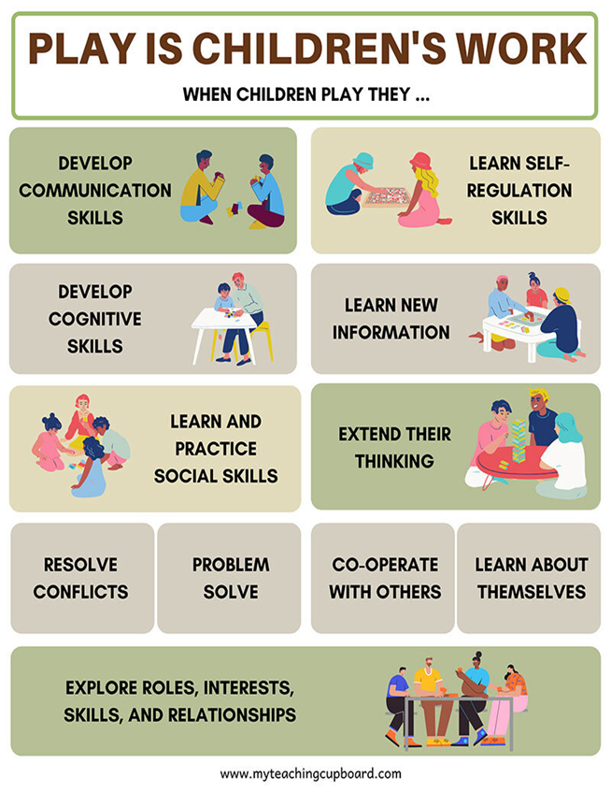
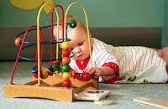
Parenting using Piaget’s theory
As a parent we should encourage growth by stepping back and allowing our children learn their dos and don’ts – promoting the logical thinking into their early adolescence and eventually adulthood through experiences. A few points according to Jeanne Ellis Ormrod (2007) are as follows:
Pincer grasp : Reflexes
Repetitive actions : Primary circular reactions
Promote creativity : Coordinations
Be patient with utensils
Build on basic skills
Picture taken from
http://pix-clouds.com/s/sensorimotor-stage.html

Slide 6
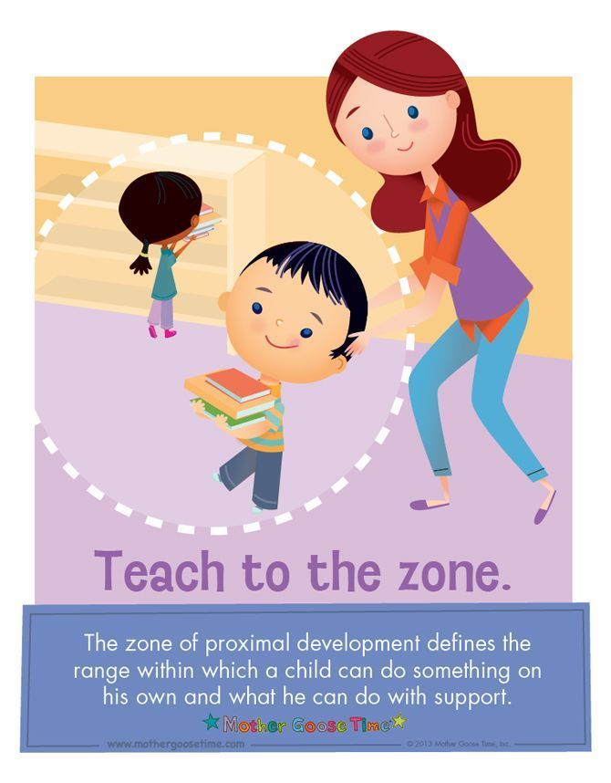
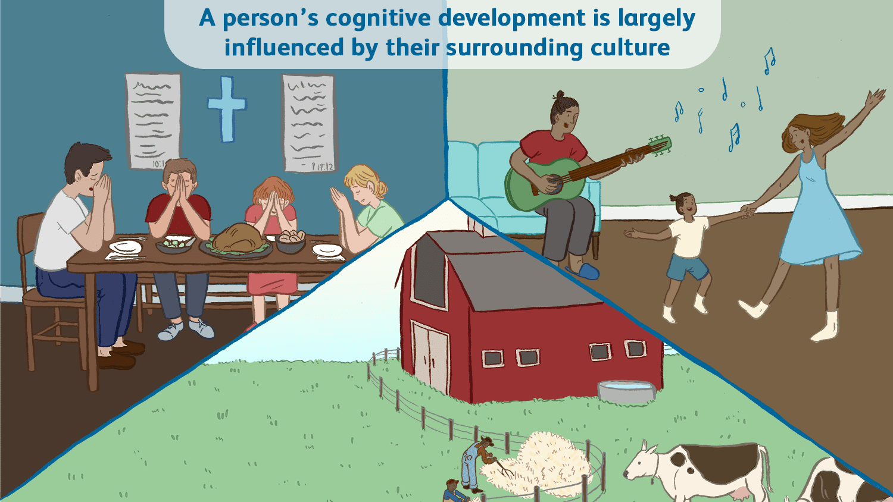
Lev Vygotsky: Social- Constructivism Theory
"the distance between the actual developmental level as determined by independent problem solving and the level of potential development as determined through problem-solving under adult guidance, or in collaboration with more capable peers" (Vygotsky, 1978, p. 86).

Slide 7
Parenting using Vygotsky’s theory
How we can incorporate Piaget’s theory into parenting?
As a parent, an adult’s presence is seen as an educator, the child will use this step to reach their full potential and achieve the child’s capabilities to expand their zone of proximal development.
Organising lessons/developing plans – if children have older siblings, you can organize an activity so skills can be shared.
Direct instructions a step-by-step guide would help improve their ability levels, comforting them that they are following the correct way
Scaffolding setting up goals to enable the child develop towards their target and progress forward
It is important that play in incorporated in learning providing opportunities for play experiences. Play and imagining will enable the child to stretch their knowledge of the world, maturing their conceptual abilities to comprehend real events.

Slide 8
Reference
Case, R. (1973). Piaget’s Theory of Child Development and Its Implications. The Phi Delta Kappan, 55(1), 20–25. http://www.jstor.org/stable/20297420 . (Accessed 22 October 2021)
DeVries, R. (1997). Piaget’s Social Theory. Educational Researcher, 26(2), 4–17. https://doi.org/10.2307/1176032. Accessed 22 October 2021)
Glassman, M. (2001). Dewey and Vygotsky: Society, Experience, and Inquiry in Educational Practice. Educational Researcher, 30(4), 3–14. http://www.jstor.org/stable/3594354. ( Accessed 23 October 2021)
Haroutunian, S. (1978). PIAGET’S EXPLANATION OF “STAGE” TRANSITION. The Monist, 61(4), 622–635. http://www.jstor.org/stable/27902565. (Accessed 24 October 2021)
Mallon, E. J. (1976). Cognitive Development and Processes: Review of the Philosophy of Jean Piaget. The American Biology Teacher, 38(1), 28–47. https://doi.org/10.2307/4445437. (Accessed 25 October 2021)

Slide 9


Slide 10
Reference
Pictures
http://studmonkedtech.com/blog/know-early-childhood-developmental-milestones/
http://pix-clouds.com/s/sensorimotor-stage.html
External
https://sites.google.com/site/vchavez1415/matrix
https://www.parents.com/toddlers-preschoolers/development/physical/child-developing-motor-skills/
https://www.healthline.com/health/piaget-stages-of-development#stages

