Slide 1
Student name: | Lee Wai Yip | Student ID number: | 2031149
Programme: | DBA
Module: | Approaches to Research and Academic Communication
Module code: | HKBM7000 | Contribution to Overall Module Assessment (%): | 40%
Lecturer: | Dr. Luk Chung Leung | Internal Verifier:
Assignment Title: | In-class Presentation | Time Allowed: | 25 minutes
Submission deadline: | 14 August 2021 | Return date of provisional marks & written feedback: | 13 September 2021
Submission method: | Each students needs to present to the class a summary of the research proposal within 20 minutes. The presentation is designed to gauge the student’s ability to communicate and present information related to research and academic matters. A soft copy of the PowerPoint slides used for the presentation should also be submitted via Turnitin before the presentation.
Academic honesty / referencing: | Academic honesty is required. In the main body of your submission you must give credit to authors on whose research and ideas your work is based. Append to your submission a reference list that indicates the books, articles, etc. that you have used, cited or quoted in order to complete this assessment.

Slide 2




An analysis of Hong Kong’s strategy in encouraging the youth for career development in the Guangdong−Hong Kong−Macau Greater Bay Area (GBA) of China with the 3H framework
Lee Wai Yip, Harry
University Student Number: 2031149
Approaches to Research and Academic Communication HKBM7000
Professor: Dr. Luk Chung Leung
Research Paper (Individual Assignment)

Slide 3
Abstract
Purpose - This paper attempts to theorize about Hong Kong’s strategy in encouraging the youth for economic development in the Guangdong-Hong Kong-Macau Greater Bay Area of China with a holistic framework – 3H (Heart-Head-Hand) framework (Yu, 2020).
Using a descriptive approach, the paper introduces the announcement from China State Council of initiation of the Guangdong-Hong Kong-Macau Greater Bay Area (GBA) with more effective economic development in that zone.
It also aligned with the Belt and Road initiative by the People's Republic of China that aims to link up Asia, Europe and Africa countries by inland and ocean connection to boost up geographic integration, improving international trade and regional economic growth.
Hong Kong, as one of the most global and energetic cities in China, it has a lot of strategies and planning to encourage and support young people to work and develop their careers in other cities in the Greater Bay Area.
The 3H framework (Yu, 2020) has been used to analyze Hong Kong’s strategy, and the framework’s assumptions are initially tested.
The 3H framework conceptualized a holistic management approach and its assumptions have been initially tested with current Hong Kong government’s strategies. The framework shows its predictability value for government’s strategic direction effectiveness.

Slide 4
Background
Globalization has changed the spatial order of countries, regions, and cities (Sassen, 2003), it leads to restructuring of cities and zone, and reshaping the global urban landscape. Large-scale urbanized areas are gradually playing the role of foundation of the global economy.
According to the 13th Five-Year Plan in 2016 from the State Council, the People's Republic of China, it mentioned the vision and actions for promoting the joint construction of the silk road economic belt and the 21st Century Maritime silk Road with Greater Bay Area.
The Guangdong-Hong Kong-Macao Greater Bay Area was officially written into a national document, and it has been elevated to a national strategic level.
The Bay Area is a new form of mega-urban area, the most important economic growth and technological growth poles which would stimulus innovations altogether globally. More than 60% of the global economy is concentrated in the leading megacity region of the bay area (Walker & Schafran,2015), and the population migration from an inland area to the bay area has been increasing.

Slide 5
Background
In 2019, the State Council, The People's Republic of China, officially announced the "Outline of the Development Plan for the Guangdong-Hong Kong-Macao Greater Bay Area". The strategic positioning of the planning of the Guangdong-Hong Kong-Macao Greater Bay Area is as follows:
Vibrant world-class urban agglomeration
An international scientific and technological innovation center with global influence
An important support for the construction of the "Belt and Road"
Demonstration zone for in-depth cooperation between the Mainland and Hong Kong and Macau
A high-quality living circle suitable for living, working and traveling

Slide 6
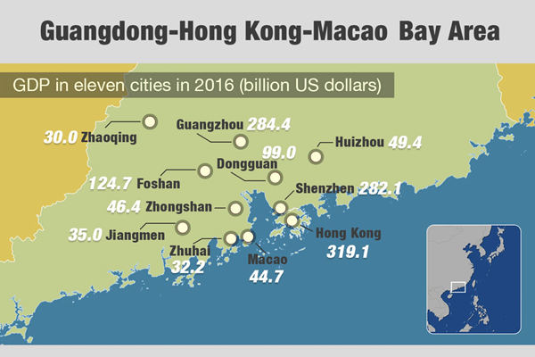
Introduction
The Guangdong-Hong Kong-Macao Greater Bay Area is composed of the two special administrative regions of Hong Kong and Macau, and nine cities in Guangdong Province, including Guangzhou, Shenzhen, Zhuhai, Foshan, Huizhou, Dongguan, Zhongshan, Jiangmen, and Zhaoqing. The Guangdong-Hong Kong-Macao Greater Bay Area has a total area of ​​56,000 square kilometers, with a total population of more than 70 million and a total GDP of over $1.3 trillion in 2016 as shown below.

Slide 7
Introduction
Each city in the bay area performs different functions, thereby generating synergistic effects and promoting economic development in the area. The current world-class bay areas are the Tokyo Bay Area, the New York Bay Area and the San Francisco Bay Area.
Connect with countries along the "Belt and Road"
The Guangdong-Hong Kong-Macao Greater Bay Area is China's "Southern Gate" facing the world.
Hong Kong has a mature financial system and shipping system, a global business network, and a global offshore RMB business hub;
Macau has an economic and trade service platform from Portuguese-speaking countries;
Guangdong Province has been active in technological innovation in recent years, and the advanced manufacturing industry chain has been perfect.
In addition, the Greater Bay Area has complete infrastructure facilities and the world's largest group of seaports and airports. Countries can use the Greater Bay Area to connect with countries along the "Belt and Road" and go to the world, especially to play a positive role in the smooth trade of the Maritime Silk Road.

Slide 8
Introduction
Enhance Hong Kong's comprehensive competitiveness
Hong Kong can make full use of this opportunity to continuously strengthen its own advantages to enhance the competitiveness of the city.
For example, as an intellectual property trading centre in Asia, Hong Kong can introduce intellectual property rights of overseas technologies for enterprises in the Greater Bay Area, and at the same time promote the achievements of innovation and technology in the region in the international market.
Hong Kong can take advantage as an international financial, shipping and trade centre to assist and promote the "going global" of cities in the Greater Bay Area, thereby enhancing Hong Kong's comprehensive competitiveness.

Slide 9
Introduction
Break through the bottleneck of Hong Kong's development
At present, the industrial structure of Hong Kong is becoming more and more uniform, and the economy is overly tilted towards the service industry, which has caused Hong Kong to face a development bottleneck.
For example, Hong Kong has many talents in the technology industry. The development of high-tech industries in some cities in the Greater Bay Area is growing which would provide the youth in Hong Kong with development opportunities.
At the same time, local companies also have a certain degree of understanding of international technology trends and technical standards, which can help the commercialization of mainland scientific and technological achievements and open up overseas markets.

Slide 10
Introduction
In order to encourage and support young people to work and develop their careers in cities in the Greater Bay Area, the Chief Executive, Mrs. Carrie Lam announced in the "2020 Policy Address" the launch of the "Greater Bay Area Youth Employment Program" to encourage companies with business in Hong Kong and the Greater Bay Area. Recruit and send graduates from local universities/colleges to work in cities in the Greater Bay Area.
The Information Service Department of Hong Kong Government (2020) reported that with the Greater Bay Area Youth Employment Program, any company that has operations in Hong Kong and cities in the Greater Bay Area can apply to participate in providing job vacancies for young people in Hong Kong.
It aims to encourage and support young people to work and develop their careers in cities in the Guangdong-Hong Kong-Macao Greater Bay Area to understand the latest developments in Hong Kong and cities in the Greater Bay Area.

Slide 11
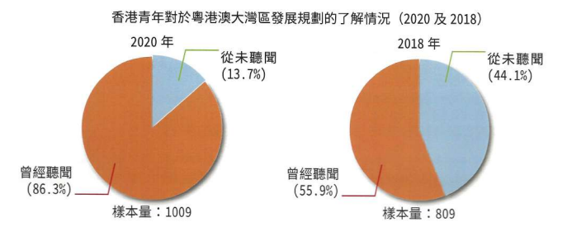
Definition of Problems
Even though there are a lot of efforts from Hong Kong government, the youth are not eager to work in Greater Bay Area.
According to the research “Hong Kong Youth Employment and Greater Bay Area Development Index 2020” from the Hong Kong GuangDong Youth Association, Proactive Think Tank Limited and Hong Kong University Hong Kong (GuangDong Youth Association, 2021), it is found that there are more youth having a better understanding of the Greater Bay Area infrastructure from 55.9% 5o 86.3% according to figure below.

Slide 12
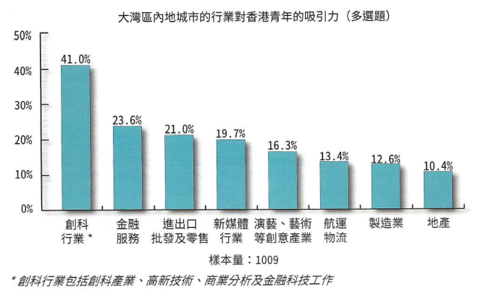
Definition of Problems
It shows the attractiveness level of industries in GBA from the Hong Kong young people. They are innovation industry, financial services, import and export, wholesaling and retailing, performing art and design, multi-media, logistics and so on. They are all within the scope from the "Outline of the Development Plan for the Guangdong-Hong Kong-Macao Greater Bay Area" under State Council, The People's Republic of China.

Slide 13
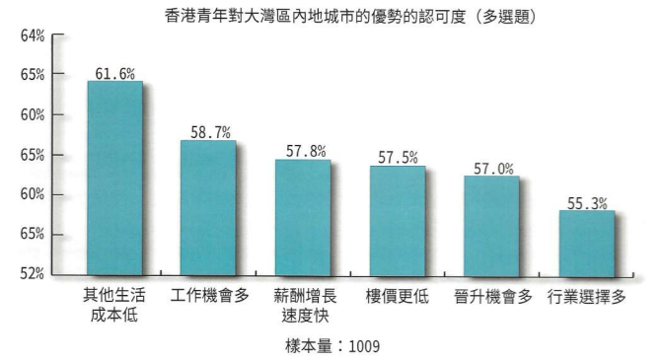
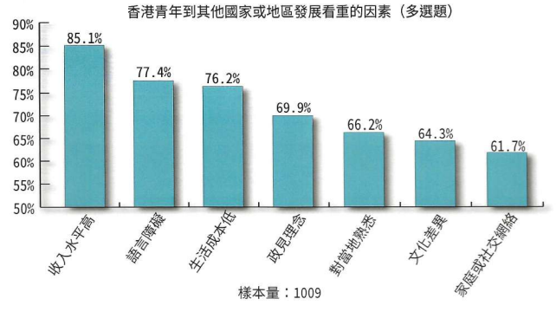
Definition of Problems
2 figures below relate to how is the recognition of competitive advantages in GBA and what are the key factors that would encourage them to work out from their home city, Hong Kong.
Not surprising, the youth have a clear understanding of the advantages in the GBA cities, especially the lower living cost, more job opportunities, better increment on salary, lower housing cost and so on. They are also the factors that would attract the young people.
Another figure information that would affect their motivation to work in GBA cities. The salary rate comes first which aligns to the living cost relatively, and for the language barriers, political views, culture differences, they are all generic factors to work out from the home city.

Slide 14
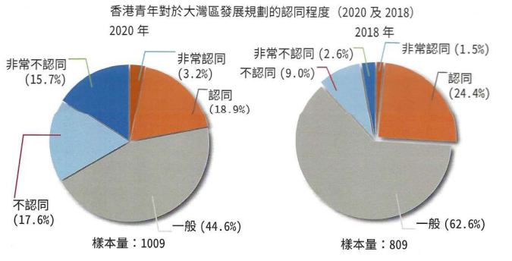
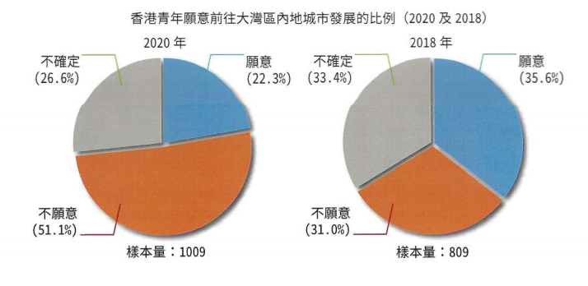
Definition of Problems
However, despite the fact that there are positive signs according from previous information, the key findings below are surprisingly different.
There was a great drop from 24.4% to 18.9 % for the positive recognition to the GBA plan between 2018 and 2020. And for the negative recognition to the GBA plan, there was a huge increase from 2.6% to 15.7%.
The final willingness of Hong Kong youth to develop the careers in GBA shows a discouraging result in the view of Hong Kong government. In 2020, there were 22.3% of the young people are willing to work in GBA cities while in 2018, it was 35.6%. Similar to the unwillingness rate, there was an increase from 31% to 51% between 2018 and 2021 which is a 20% increase.
Between 2018 and 2020, there were social activity and covid-19 issue in Hong Kong, but the change is too big against other findings in the same research

Slide 15

Research Objectives
Given the negative sign from the youth of Hong Kong to work in GBA cities, it is inevitably an important case for Hong Kong’s strategy analysis.
It is not just talking about local economic development but also relating to mainland China’s national strategies.
Hong Kong government, which takes the key role in the execution of the youth’s engagement in developing GBA, need to understand the problem behind.

Slide 16
Research Questions/Hypotheses with reference to 3H framework
With the 3H holistic approach, it would support the paper to answer the research questions:
How is current government leadership and strategy, and other Heart domain factors which caused major negative motivational result for the youth to work in Greater Bay Area?
What are the key strategies issues and other Head domain factors, which lead to the inefficient promotion from Hong Kong government to the youth.
What the key competence and other Hand domain issues for Hong Kong youth?
In this paper, we will discuss and provide opinions and suggestions to contribute to the development of youth in the Guangdong-Hong Kong-Macao Greater Bay Area.

Slide 17
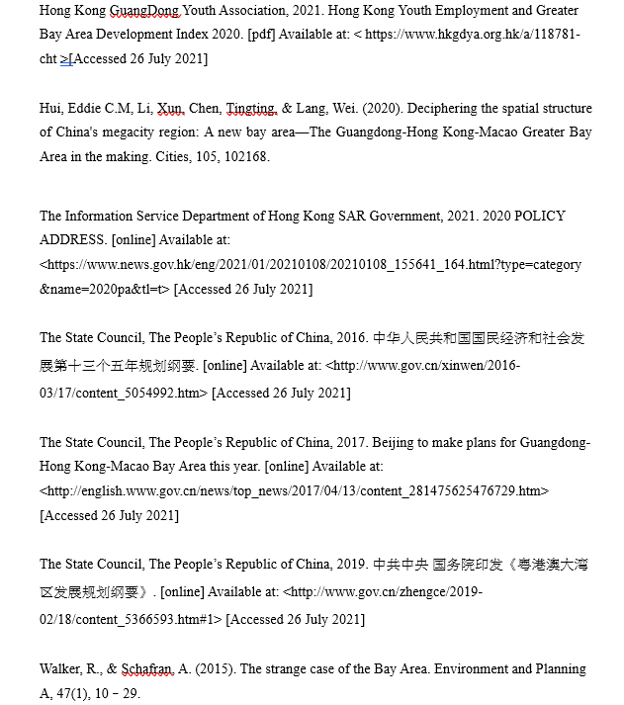
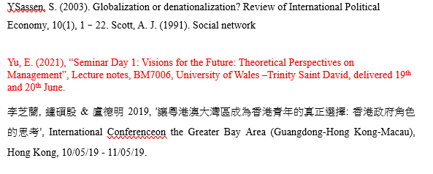
Review of the Relevant Theories and Literature
And - theoretical foundations come from the well-
established literature

Slide 18
Research Design
3H framework (Yu, 2020, p.17) is a framework is a methodology for managing people and organizational issues in a holistic way to ensure individual performance and in turn the entire organizational performance can be efficiently and effectively managed.
The key areas of the framework are metaphorical expression of Heart, Head and Hand. It aims to develop an overall solution for the management of country, city or organization issues.
Each H domain of the 3H framework has a series of theoretical foundations while these theoretical foundations come from the well-established literature in different fields

Slide 19
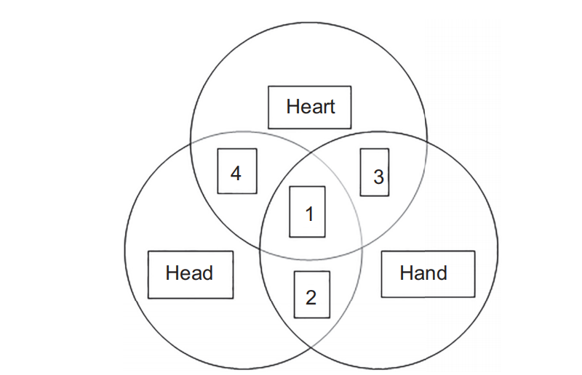
Research Design
According to Yu (2020, p.20), the well-established literature in different “H” are:
H1 Heart related literature:
Organizational behavior (OB) related (e.g., motivation , emotion, commitment, engagement, satisfaction, trust); leadership, management of change; values and organizational culture, cross cultural management; communication; managing groups and teams.
H2 Head related literature:
Organization architecture (organizational design, structure, alignment); strategic management related (e.g., macro-industry industry analysis, institution, resource based view, value chain, levels of strategy); management planning and control (e.g., balanced scorecard, strategy map).
H3 Hand related literature:
Competence related; functional strategy and practices, e.g., HR related: recruiting process, performance and compensation systems, training and coaching skills.

Slide 20
Research Design
Operational Definition of Variables:
Hong Kong’s GBA promotion performance to youth (PPY), the dependent variable, is a function of the complements among Heart (H1), Head (H2) and Head (H3) independent variables of Hong Kong’s youth promotion strategies.
PPY = f (H1cH2cH3)
PPY = Hong Kong’s GBA promotion performance to youth
c = Complement to integrate and connect
H1 = Heart domain (emotional appeal, leading, motivating and engaging people’s abilities)
H2 = Head domain (logical and strategic appeal, planning, organizational, cognitive abilities)
H3 = Hand domain (competence appeal, operational/ functional abilities)

Slide 21
Research Design
Measures and Instruments
Hong Kong’s implementation strategies are formulated from government’s press releases, The Greater Bay Area Youth Employment Scheme established, promotion activities from Chamber of Commerce and other political and business circles.
A focus group discussion with fresh graduated students from one of Hong Kong’s universities has been conducted to gather their viewpoints of career development in Greater Bay Area.
Questionnaires related to each H domain will be conducted with university students

Slide 22
Research Design
Research Method
A descriptive case was created based on content analysis on over 50 reports, press releases from different respected sources, e.g. State council, China press, Hong Kong government press, Universities’ research reference, focus group discussion transcripts with youth, questionnaire rating on each of H domain and broadcasting stations’ video clippings.
Interpretive analysis with pragmatism approach has been conducted in analysis the data and information derived from the content analysis. The assumptions of the study are created with the well-established literature in different “H” as mentioned above and tested with supporting conversational and or textual statements.

Slide 23
Research Design
Sample and sampling method
Simple random sampling for questionnaires - random selection of students from one of the Hong Kong universities
300 Questionnaires delivered to all students in the university
Make strong statistical inferences about the whole group
5 Students to form a focus group discussion - non-random selection from BBA school of the university
Easily to arrange for a 1.5 – 2 hours focus group discussion (Not affecting the quality)

Slide 24
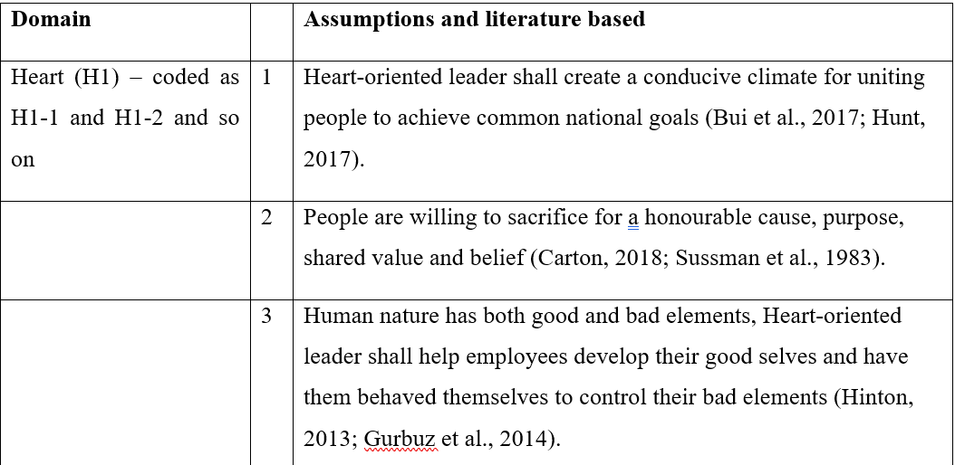
Data collection and analyses and report
Data Analyses
Underlying assumptions of the 3H framework for applying for this study
Literature based assumptions have been created, which is first referred to a H domain number and the number within that domain, e.g. the first assumption of the Heart domain is referred as: H1-1, as shown in table below which the key factors are extracted to be significant implementation of Hong Kong’s GBA promotion strategies (Yu, 2020):

Slide 25
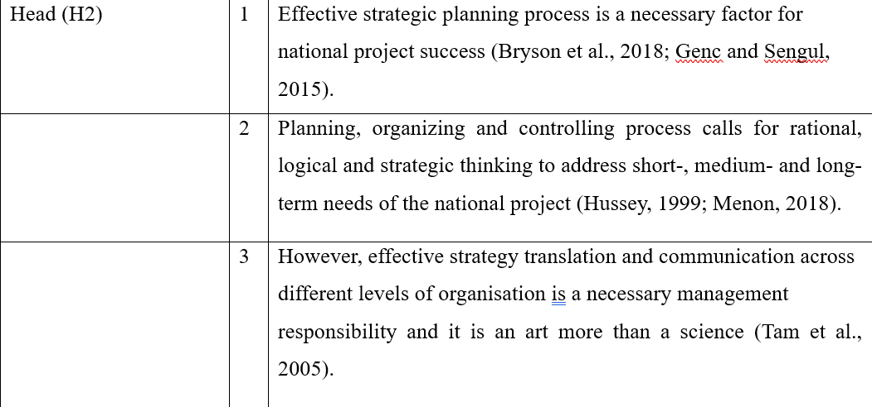
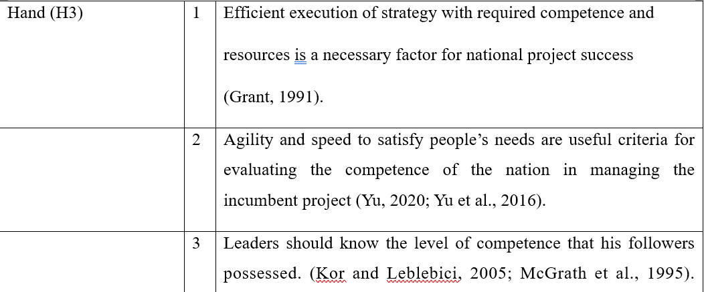
Data collection and analyses and report
Data Analyses

Slide 26
Data collection and analyses and report
Data Analyses
Testing the proposed necessary and sufficient factors
Example:
According to Yu (2020, p.32), from the leadership perspective of the H1 domain, it can be broadly divided into the Heart and Head-oriented perspectives. The Heart-oriented perspective puts youth’s true development opportunities over all other considerations; whereas the Head-oriented approach is rational and puts economic and political interests first.
H1. Heart-oriented leadership that can engage and motivate followers is the first necessary factor.
According to the Public Opinion Programme conducted by University of Hong Kong (2021), the latest issue of Chief Executive and Government Popularity, the Chief Executive Carrie Lam scored 32 points, an increase of 1.3 points from the previous survey, and the net support rating dropped by 3 percentage points to a negative 50 percentage points. (H1-1)
From the focus group discussion, all the participants do not put a trust on Chief Executive Carrie Lam and she is a liar. (H1-1)
H2. Head domain driven effective strategy planning process is the second necessary factor.
H3. Hand domain that developed the competence to efficiently execute strategic goals is the third necessary factor.

Slide 27
Data collection and analyses and report
Expected Findings
Four case scenarios:
Case 4 - Effective leadership (H1) and sound strategy (H2) are in place but lacking
competent GBA professionals (H3).
Case 3 - Effective leadership (H1) and GBA professionals (H3) in place but lacking sound strategy (H2).
Case 2 – Sound strategy (H2) and GBA professionals (H3) are in place but lacking effective leadership (H1).
Case 1 – Integration of domains of H1, H2 and H3 shall secure the necessary and sufficient conditions for effective and efficient Hong Kong’s GBA promotion performance to youth

Slide 28
Data collection and analyses and report
Managerial/Practical Implications
Each H’s domain carries different weights. In this paper, H1 has heavier weight than H2 and H3, whereas H2 has a relatively heavier weight than H3.
The reason is that, even though Hong Kong’s youth promotion strategy, system and competence are more advanced, if the chief executive fails to unify and motivate youth to participate, Hong Kong would fall apart from the GBA integration.
The desired and sufficient conditions (independent, moderating variables) requiring to effective and efficient Hong Kong’s GBA promotion performance to youth (dependent variable).
As an exploratory study, the findings show that 3H framework identifies the effectiveness of a Hong Kong government’s strategy and planning for encouraging the youth to work out of their home city and pursue their careers in the cities nearby within the economic zone, more specifically, in Greater Bag area. Strategies, which failed to align with the assumed principles of 3H domains tend to be ineffective to attract the younger generation to work in GBA.
This is a holistic approach arguably the way to encourage the youth to develop their career in GBA.

Slide 29
Data collection and analyses and report
Managerial/Practical Implications
With improved connections between Mainland cities and the rest of the world, the “front shop, back factory” model of division of labour between Hong Kong and other GBA cities may no longer be fully applicable, and a new mode (GBA) of collaboration should be sought.
Although there are many news and promotions from Hong Kong government to introduce the GBA, they often flow into the fragmentation of information. This prevents young people from forming a systematic understanding of the planning of the Greater Bay Area. The formation of a relatively complete management system from Hong Kong government would operationally integrate the youth into the Greater Bay Area.
Co-relation from each H domain questions in questionnaires would be figured out – Show how one strategy would affect another. More effective when setting new planning. (3H Framework can be used of theorizing about past (descriptive) and future (predictive) holistic management practices)

Slide 30
Data collection and analyses and report
Limitations
Some of the assumption tests was based on news, press and multi-media evidence that may be subjective
The development of the theoretical frames with this analysis of Hong Kong’s strategy in encouraging the youth for career development in the Guangdong−Hong Kong−Macau Greater Bay Area (GBA) of China with the 3H framework is intended to be exploratory.
Tests used in assumption is not meant to be an evidence

Slide 31

Research Presentation End
An analysis of Hong Kong’s strategy in encouraging the youth for career development in the Guangdong−Hong Kong−Macau Greater Bay Area (GBA) of China with the 3H framework
Notes:
You can use this slide as your opening or closing slide. Should you choose to use it as a closing, make sure you review the main points of your presentation. One creative way to do that is by adding animations to the various graphics on a slide. This slide has 4 different graphics, and, when you view the slideshow, you will see that you can click to reveal the next graphic. Similarly, as you review the main topics in your presentation, you may want each point to show up when you are addressing that topic.
Add animation to images and graphics:
Select your image or graphic.
Click on the Animations tab.
Choose from the options. The animation for this slide is “Split”. The drop-down menu in the Animation section gives even more animations you can use.
If you have multiple graphics or images, you will see a number appear next to it that notes the order of the animations.
Note: You will want to choose the animations carefully. You do not want to make your audience dizzy from your presentation.

