Slide 1

Managing People
LCBB5004

Slide 2

Stratsimir Milushev – 2009416
Lecturer: Efua Adams
Date 28/02/2022
1

Slide 3

What does a HR do? role of a HR professional and what values govern their duties

Slide 4
human resources management in organizations
Analysis and design of positions
HR Planning
Selection of HR
Main activities of HR Management
Training anddevelopment of HR
Performace evaluation
Salaries and additional benefits
Healty and safe working condition

Slide 5

relationship that can develop between the employer and employee

Slide 6
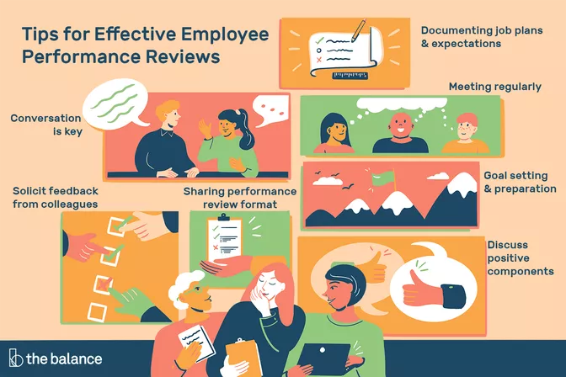
positive relationship between the employer and the employee. how to make performance reviews successful in your organization?

Slide 7

A good working company should look like this

