Slide 1
Resilience, Talent & Technology:
Module Introduction
Dr Emma Roberts

Slide 2
Module Learning Outcomes
Critically evaluate current research and advanced scholarship so to enable them to evaluate managerial and business environments, with a focus on the drivers of the Fourth Industrial Revolution; and analyse how resourcing an organisation is affected and informed by internal and external factors that in turn serve to influence the resilience (structures, processes and behaviours) adopted by the organisation.
Demonstrate the ability to systematically evaluate current HRM and IHRM issues within a variety of organisations so as to enable them to effectively adapt the design and implementation of fair, efficient and effective policies and procedures that serve to deliver upon and influence the strategic aims of the organisation in volatile, uncertain, complex and ambiguous operating conditions, while considering societal impact in the context of the Fourth Industrial Revolution.

Slide 3
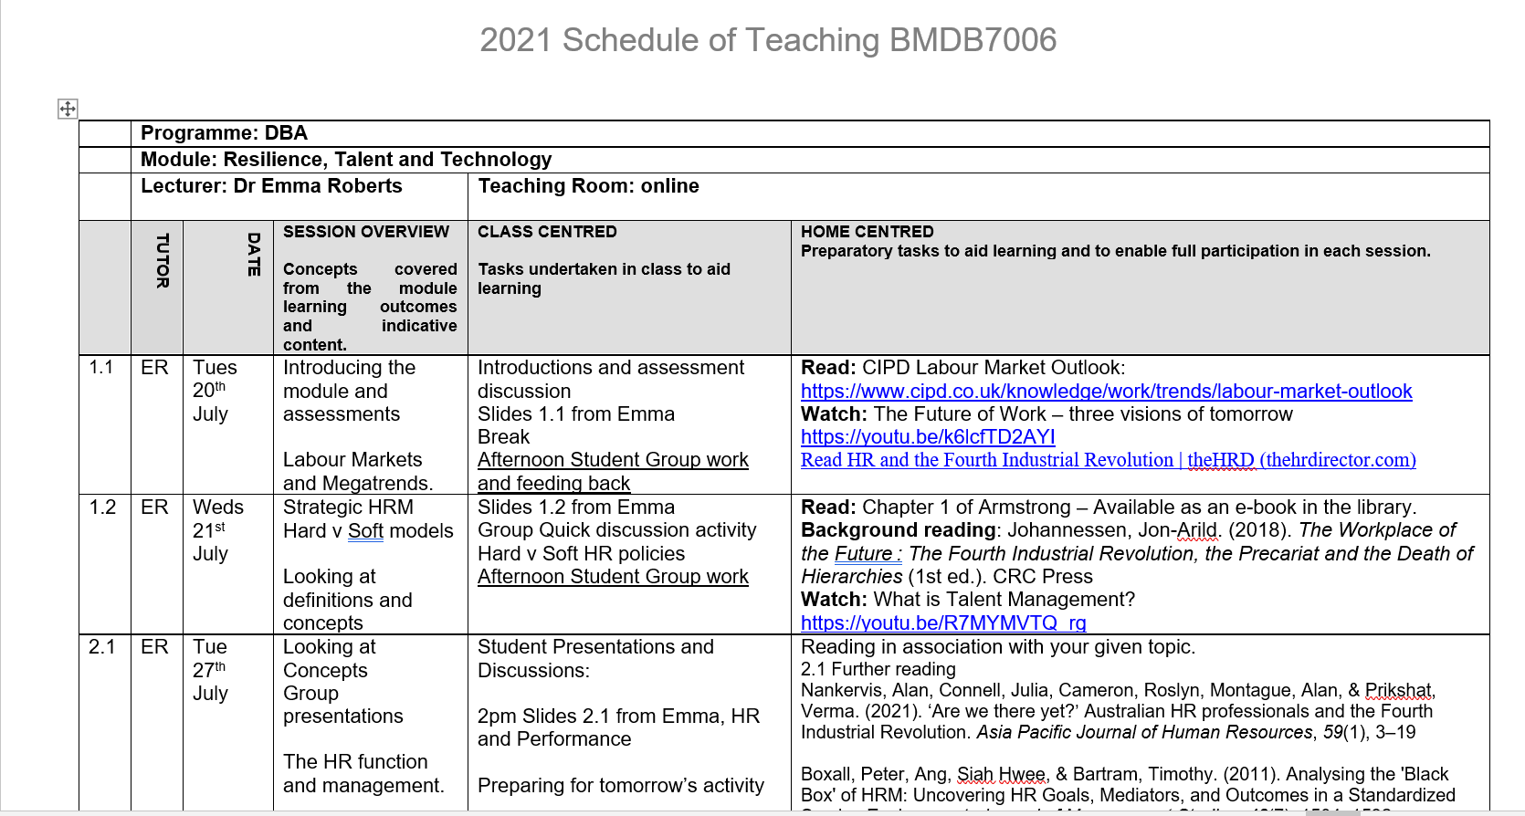
Schedule
Please look in MS Teams Files

Slide 4
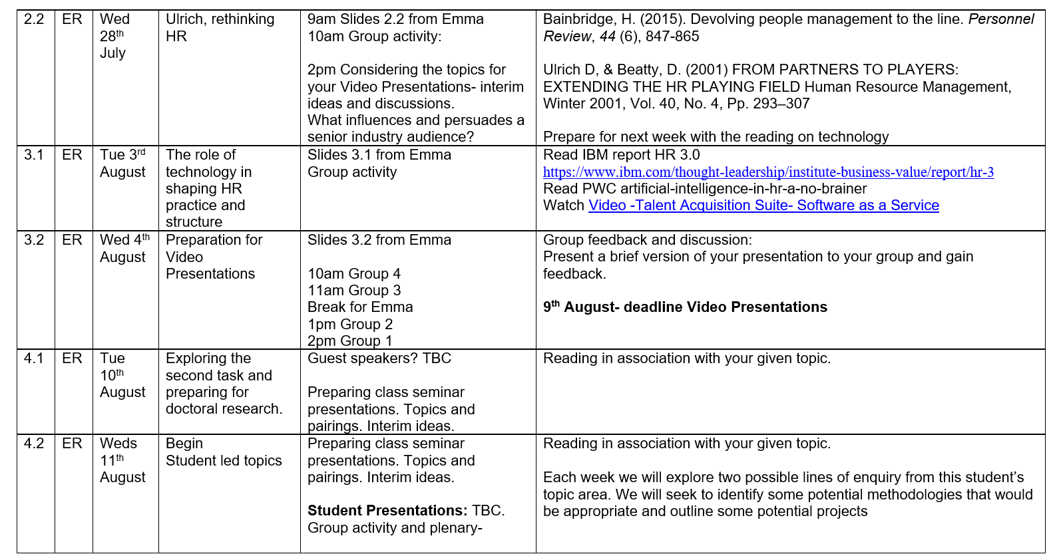

Slide 5
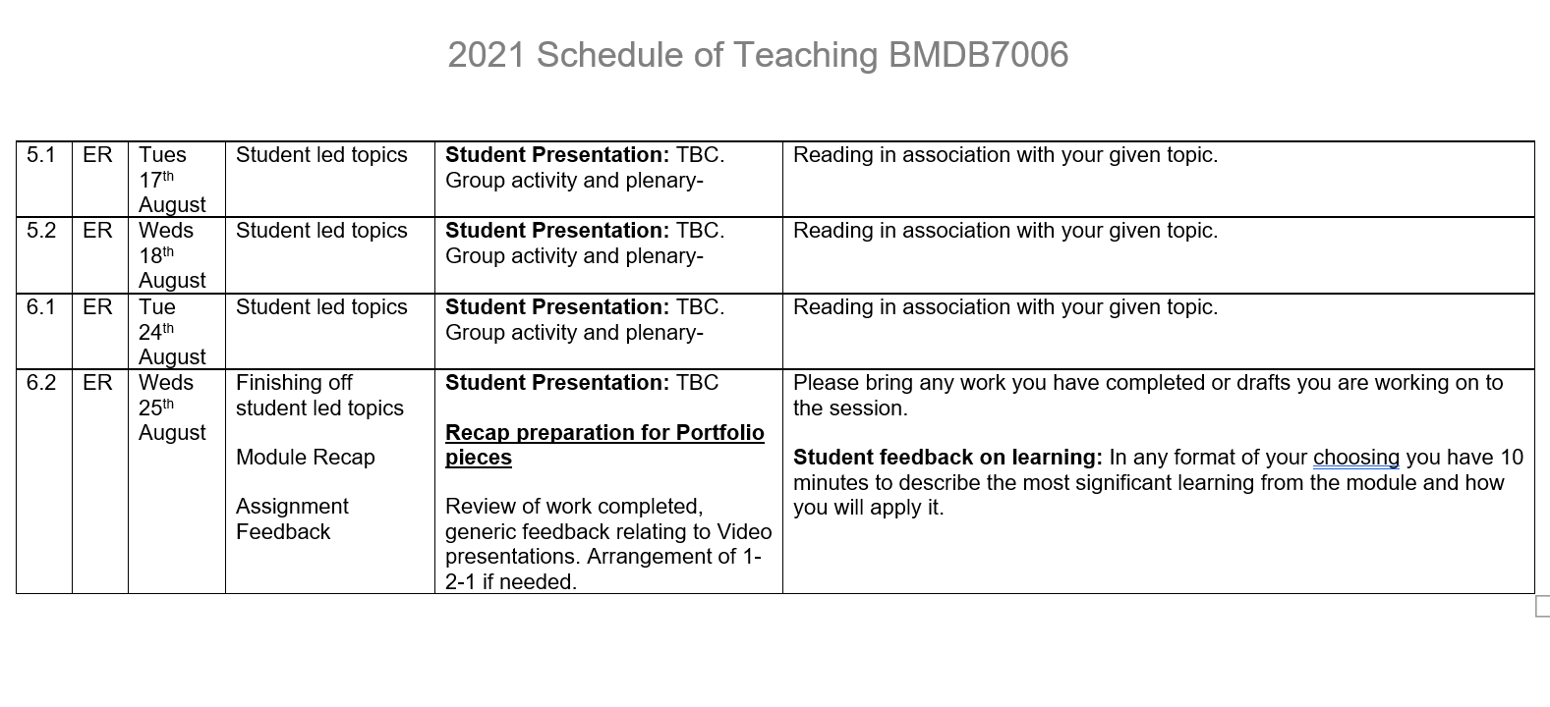

Slide 6
Assessment 1- Video Presentation
23:59 Monday 9th August 2021
You are asked to provide a video presentation that answers the following questions, using a critical academic underpinning:
How can HRM play its part in generating and maintaining competitive advantage over the coming 5 year period?
What does it mean for the structure, design and strategy of the HR function?
Please imagine this video is for senior HR managers in any organisation or industry that is of interest to you, so it is a knowledgeable audience. They will be especially interested in how these ideas can be persuasively delivered to senior company executives to raise the profile and influence of HR.
Please provide the following:
an appropriate introduction to the company or industry of no more than two minutes. This video will only be viewed by your module tutor, internal verifier and external examiner.
correct academic citation on each slide (such as in-text or footnotes). The full references are not needed on the video slides but must be in the submitted file.
a critical approach to any content ensuring your sources are credible, go beyond any reading material supplied on the module and are fully justified.
an applied focus throughout using plenty of appropriate organisational examples
In your submitted file you must submit:
a link to your video.
a script/narrative of your video.
a list (in Harvard format) of all references and information sources specifically referred to within the video.

Slide 7
Assessment 2- Portfolio
23:59 Sunday 12th September 2021
In preparation for this assessment, students are invited to deliver a 30-minute class seminar presentation for debate and discussion on a chosen topic relevant to this module, either in pairs or individually. This is not assessed but is part of the preparation to enable the student to attain the required depth and criticality of their topic area.
Students must submit a portfolio of 3 pieces of written work to demonstrate the critical examination of their topic areas appropriate to level 7 and showing a readiness for level 8.
Each of these three pieces must be the equivalent of 1,000 words, and might include tasks such as the following (these are only ideas):
A write-up of the key academic underpinning of the class presentation topic area, culminating in a preferred conceptual framework.
A preliminary, critical literature review indicating areas of further research.
Create a model of HR factors affecting an organisation in relation to the topic area with appropriate discussion and critique, and identifying potential gaps in current understanding.
Evaluate the appropriateness of various methodological approaches for researching these identified topics of interest.
Select one of the identified areas of further research and outline an appropriate research design that would further the boundaries of knowledge in the field.
As far as possible your evidence should be compiled into one word document with links to other media (where used) and activities clearly labelled. The portfolio should be presented professionally and demonstrate creativity.

Slide 8
Ways of working…
Collaborative and Participatory
Questioning, skeptical, curious
Supportive, building on others’ work
Plenary and input
small group work
presentation and feedback
plenary discussion

Slide 9
Introductions
Introductions
Please can I hear a little about your experience and what your organizational roles have been?
Either as a chat message or speak to camera.

Slide 10
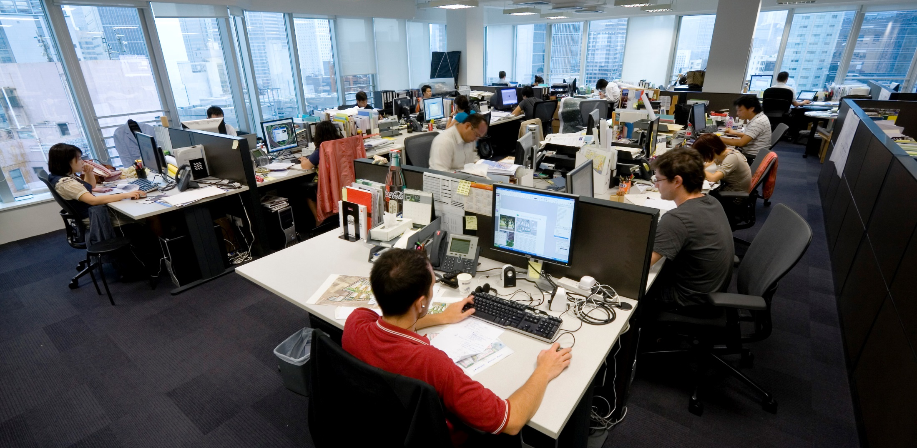
Typical Working Conditions?
5-day week/ 40 hours
Minimum wage
Four weeks paid annual leave,
Sick pay and maternity and paternity leave.
All employers have a duty to take care of the health and safety of all their employees.

Slide 11
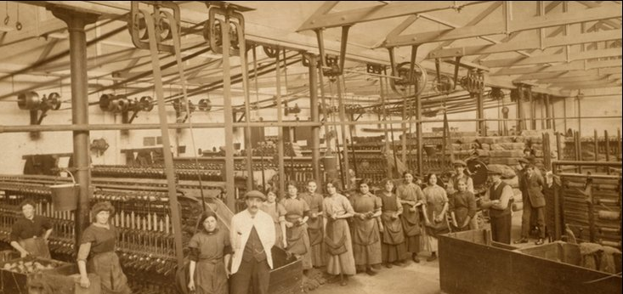
Working Life in 1800s
Prior to a protective regulatory environment
Working day of 14 hours
Sunday off
2 days holiday per year
Diseases such as bronchitis, pneumonia and tuberculosis were rife.

Slide 12
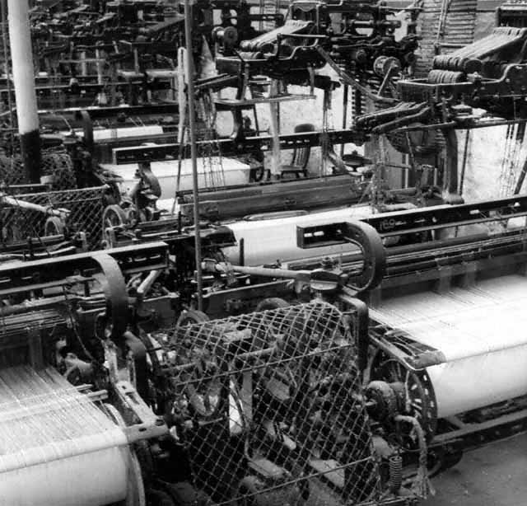
What is today’s revolution akin to Mechanisation and De-skilling?
“By developing machines…which require only unskilled instead of skilled labour, the cost of labour can be reduced [and] the bargaining position of the worker reduced”
Andrew Ure
cited in Burnes (1996) p. 10
Has the regulatory environment caught up with today’s challenges?

Slide 13
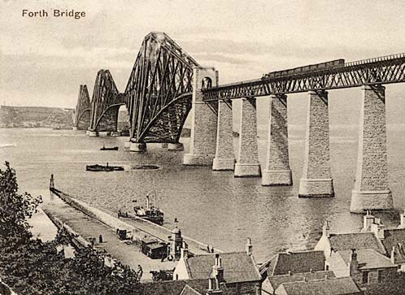
The Forth Bridge (built 1883-1890)
More than 4,600 workers were employed to work on the bridge at the peak of its construction.
A work accident book recording all those who were hurt or suffered sickness during the seven years of construction.
How many accidents? 26,000
How many deaths?
78

Slide 14

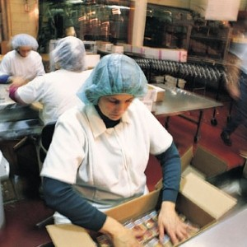
Health & Safety at Work Act 1974
What are today’s employee safety issues?

Slide 15
The Workplace of the Future
The Workplace of the future
The new panther organizations will be extremely cost effective and have very high levels of productivity (Murphy,2 016).They will also be good at problem-solving, have little staff turnover, and have creative and satisfied employees (Boxall & Purcell,2010). These very well-paid employees will find their work meaningful.
They will be living out their dreams in the panther organizations, and will have contacts among the precariat who can perform short-term contractual assignments (Brynjolfsson & McAfee,2011,2014). This kind of relationship will contribute to securing the future of ‘the company of one’.
Johannessen, Jon-Arild. (2018). The Workplace of the Future : The Fourth Industrial Revolution, the Precariat and the Death of Hierarchies (1st ed.). CRC Press..Page 3.

Slide 16
The Workplace of the future
Within a panther organization, the employees will flourish using their expertise to perform their specialized knowledge tasks (Bruce & Crook,2015). These employees will be optimistic, positive individuals who will spend much of their working lives in contact with their global competence networks (Reinmoell & Reinmoeller, 2015).
Those who do not succeed in making this transformation will have been forced to leave the organization and will number among either the precariat or the working poor.
Johannessen, Jon-Arild. (2018). The Workplace of the Future : The Fourth Industrial Revolution, the Precariat and the Death of Hierarchies (1st ed.). CRC Press.. Page 3

Slide 17
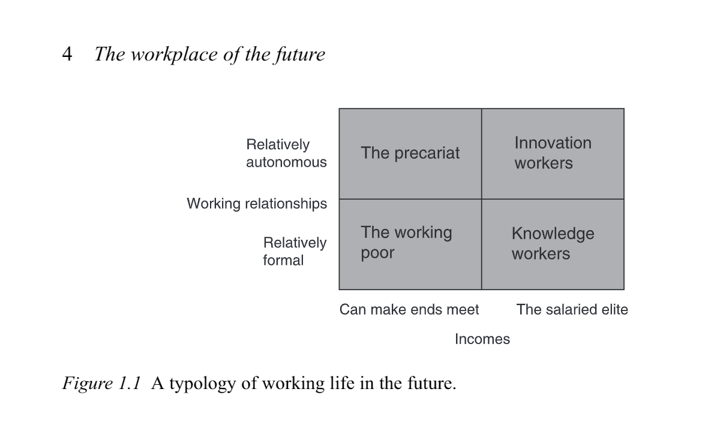
A typology of working life?
Johannessen, Jon-Arild. (2018). The Workplace of the Future : The Fourth Industrial Revolution, the Precariat and the Death of Hierarchies (1st ed.). CRC Press.. Page 4

Slide 18
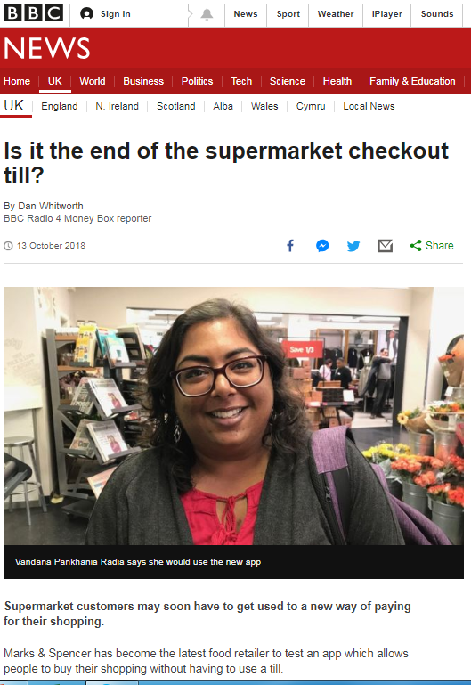
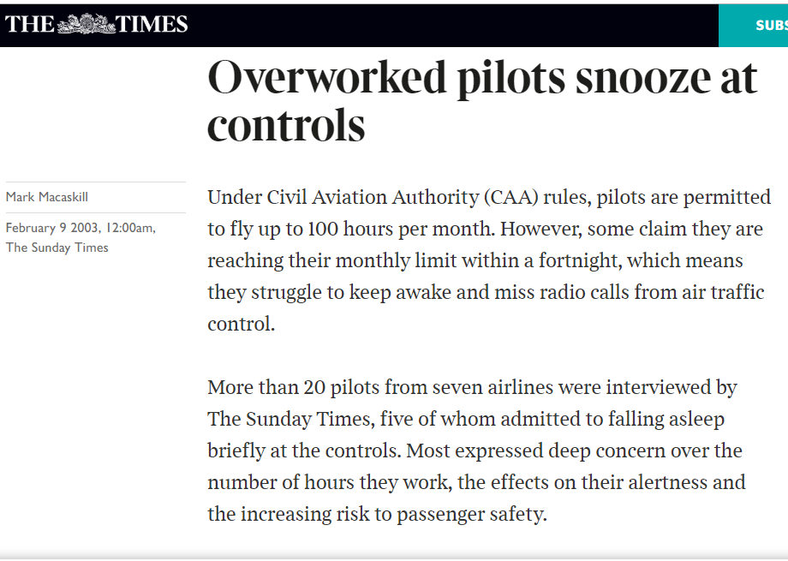
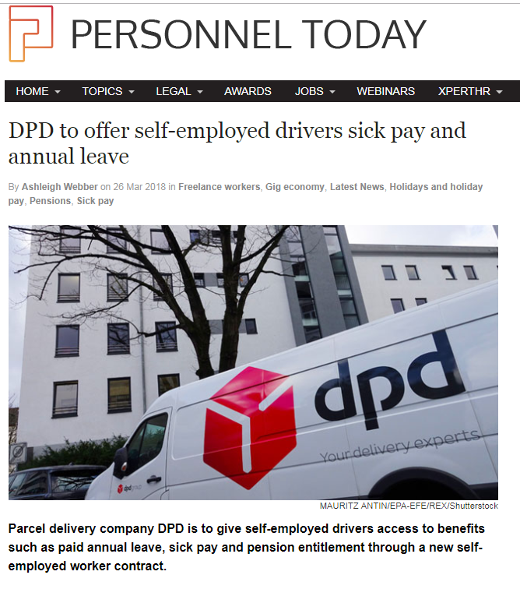

How is the role of HR changing today?
What is people management for?

Slide 19

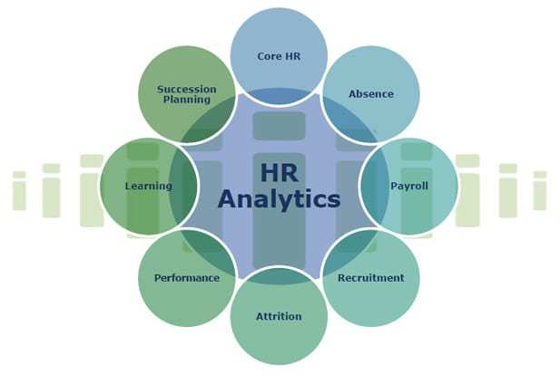


Role of Contemporary HR professionals?

Slide 20
What is the impact of 4th IR on HR?
The impending Fourth Industrial Revolution (FIR), encompassing artificial intelligence (AI), robotics and machine learning, is predicted to have both positive and negative effects on society as a whole, and many workplaces, jobs, employee skills and competencies.
Accordingly, it threatens to significantly transform contemporary human resource management (HRM) theories, models, roles and functions (Human Resources Professional Association 2017; Kavanagh, Thite and Johnson 2015; Parry and Tyson 2011; Strohmeier 2007; Willis Towers Watson 2018).
For example, AI and machine learning technologies are likely to have significant impacts on human resource planning; employee attraction, selection and retention; learning and development; remuneration and benefits systems and career planning functions, amongst others (Deloitte Access Economics – DAE, 2018; Strohmeier and Piazza; Taylor et al. 2019; World Economic Forum 2018).
Nankervis, Alan, Connell, Julia, Cameron, Roslyn, Montague, Alan, & Prikshat, Verma. (2021). ‘Are we there yet?’ Australian HR professionals and the Fourth Industrial Revolution. Asia Pacific Journal of Human Resources, 59(1), 3–19

Slide 21
Role of Contemporary HR professionals?
“HR is changing; there’s been a shift from a primary focus of supporting line managers to manage their people well…
…to one of delivering sustainable organisation capability and performance.”
ww.cipd.co.uk

Slide 22
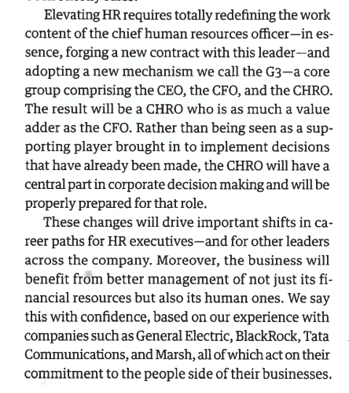
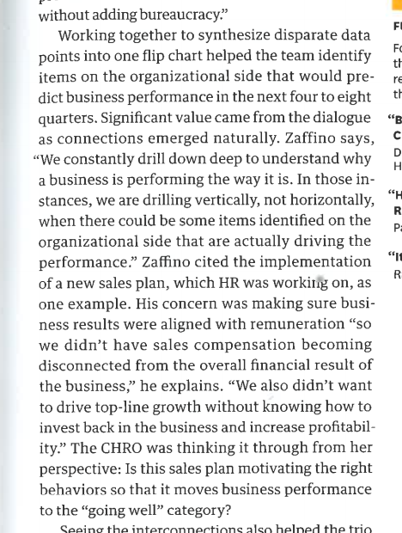
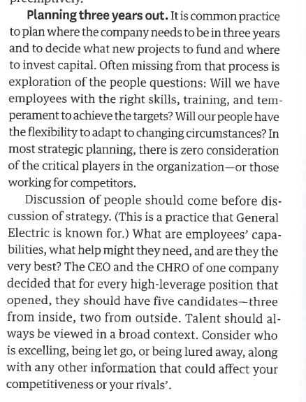
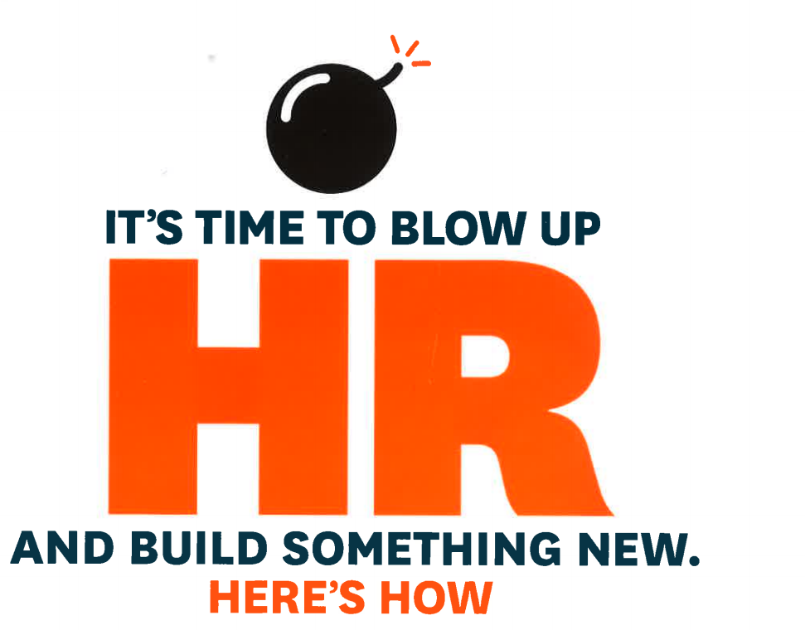
Charan, Barton & Carey, HBR July 2015

Slide 23
Big Themes and Questions to consider
How are organisations adapting and emerging to cope with the 4th IR?
What kinds of work are/will people be needed to do and how will they be managed?
What is the role, impact and limitations of technology?
  Does it depend on:
  Organisational context/ industry/ sector/skilled work/ knowledge economy
  Economic cycle/ recession/ boom/ highly competitive market for labour

Slide 24
Process of enquiry demonstrating a readiness for level 8…
What are the concepts underpinning the academic topic? How do they fit together? = conceptual framework.
Outline a preliminary, critical literature review indicating current approaches and areas of further research.
Propose a tentative model of how various factors affect the issue with annotation, critique, and identifying potential gaps in current understanding.
Evaluate the appropriateness of various methodological approaches for researching these identified gaps of interest.

Slide 25
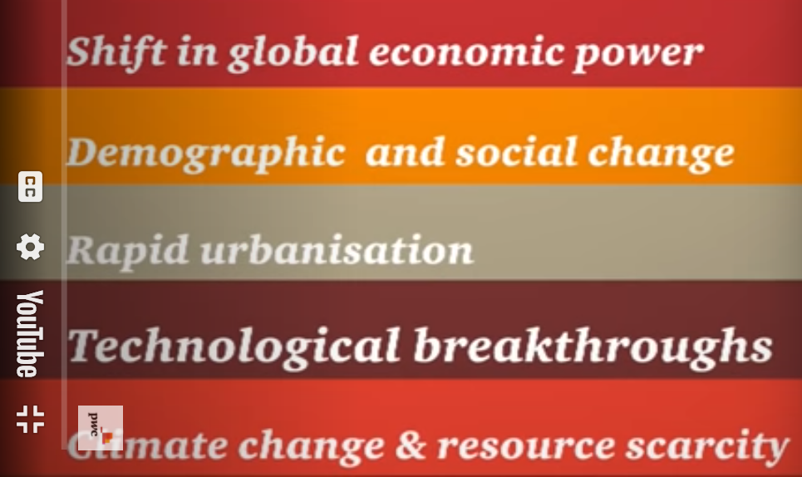
Megatrends
Watch the clip and critically review how these megatrend will affect labour markets in coming years and what the impact on organisations might be.
Link to Youtube PWC megatrends
Notes:
You can also look at some other interesting videos on YouTube about this topic including Andrew McAfee’s ‘What will future jobs look like?’
What else has been happening recently that might effect labour markets that the video didn’t consider?

Slide 26
Sources of information
Exploring Labour Market Trends
People in Work
Earnings, Employment, Hours of work
Productivity, Labour disputes
Aspects of work and jobs
Economic inactivity, redundancies, claimant count, unemployment
Job statistics
Jobs
Vacancies
Notes:
Where might you find these types of information?
Split into groups and using

Slide 27
UNDERSTANDING LABOUR MARKET TRENDS
Tight Labour Market
High Employment levels
Labour shortages for employers
Not enough people with specific skills
Demand for people outstrips supply
Employees have increased bargaining power
Loose Labour Market
High Unemployment
Plenty of available labour and skills
Demand for jobs outstrips supply
Jobs shortages for employees
Employer has increased bargaining power

Slide 28
Group Activity: Analysis of a Labour Market
In your group analyse the current labour market of a given country.
Your analysis should include:
  Current labour market statistics
  An assessment of the impact of the megatrends discussed
  Conclusions on the state of the country’s labour market

Slide 29

Break-time

