Slide 1
Presentation Title: Health and wellbeing and sustainability: Evaluating the UK NDPP
Module: BMHP6030
Student name: Nadia Akther
Student ID: 1914510
Module lecturers: Philip Jones

Slide 2
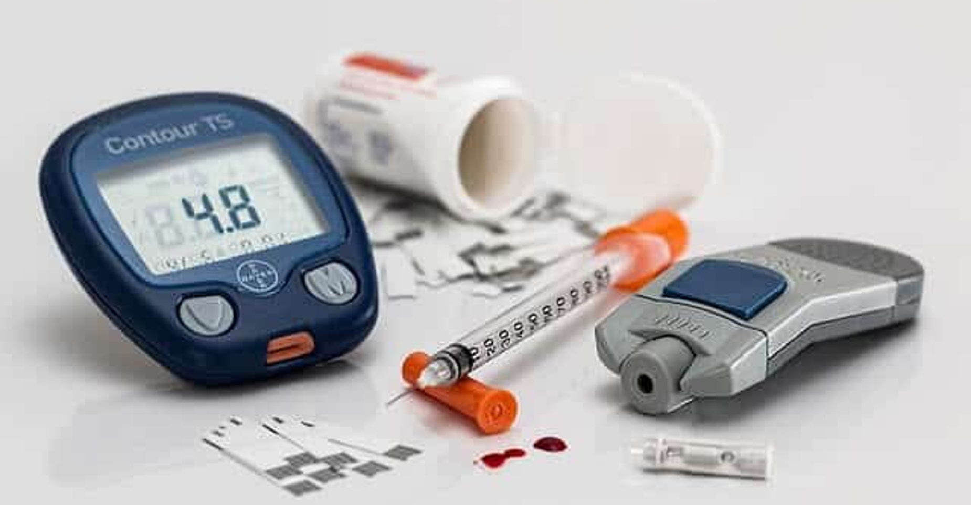
Health and wellbeing and sustainability: Evaluating the UK NDPP

Slide 3
Introduction: Aims & scope
Presentation objectives :
Global Goals
National policy
Real world services
Core Aims- To evaluate how well global sustainability targets are put into practice within UK preventative healthcare.
Case study- A critical evaluation of the UK national diabetes prevention programme (NDPP)
Policy context –outlining the link between UN sustainability development goal 3 and the and NHS long term plans.
Analytical scope- to assess health models , data trends and barriers to healthcare accessibility

Slide 4
Definitions and key concepts
Health
Wellbeing
Sustainable development
Health is defined as the state of complete physical, mental and social well being (WHO, 1948).
Not just the absence of disease
Requires proactive, multi-faceted approach to care
A positive state experienced by individuals and societies. Standard of living, safe housing and financial security (WHO, 2021).
Subjective- a persons self reported life satisfaction as well as their happiness level.
Meeting the needs of the current generation without compromising those of future generations (UN, 2015).
Specifically in healthcare, managing current patient population whilst preserving rescourses (Kaldjian, L.C. 2014).

Slide 5

Integrating Health, Wellbeing and Sustainability
Dynamic nexus: individual health outcomes are due to the availability of sustainable economic and social resources(Unwin, N. 2020) .
Paradigm shift: this is moving away from treating physical illnesses after they have already taken affect, we need to intervene and protect patients earlier on.
Recourse protection: shifting health funding into community wellness can help prevent for excess budget being used up in immediate acute treatment in long-term (kings fund, 2025).

Slide 6
Sustainable development goals
The Global Goal
The National Response
Global target- UN SDG 3, focuses on ensuring healthy lives and promoting wellbeing for all ages (Howden-Chapman, P., et al., 2017)
Specific target- by 2030. target 3.4 requires attainment of a 33% decrease in premature deaths caused by non communicable diseases, this will be done via enhanced preventative measures, enhancing global mental health and well being (WHO,2024).
Mechanism- shifting current health care focuses from reactive to proactive prevention
Policy-embedding international SDG targets into national NHS long term plans.
Action- the national diabetes prevention programme (NDPP), will be the gateway to ensure we reach target 3.4 (public health England, 2016).
Outcome- by implementing reduction strategies long term demand on health care systems is reduced, therefore making it financially sustainable.
Theory to practice

Slide 7
Relevance Of Integrated Public Health
Systemic threat: preventable chronic illness, such as type 2 diabetes are causing a financial strain on the NHS
Infrastructure load : over 4 million people in the UK live with diabetes, this takes around 10% of the NHS budget soul directed to one cause, therefore its unsustainable (NHS England, 2022)
Environmental cost: reactive care generates chemical waste and intensive energy consumption, as well as leaving a carbon footprint
Solution- integrating health care systems to invest in early prevention
7

Slide 8
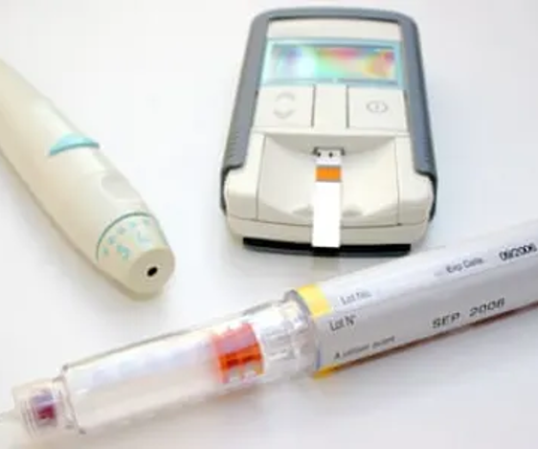
The Public Health Challenges Of Type 2 Diabetes
Rising crisis: lifestyle driven non communicable diseases are on the rise and present as the greatest risk to the modern population (Public Health England, 2018)
Diabetes burden: Type 2 diabetes is the causation for billions in annual health care budget and places immense operational strains (Khan, M.A., et al., 2020)
Current trajectory: managing chronic illnesses requires long term medication and hospital care, which is structurally unsustainable.

Slide 9
Theoretical perspectives & Health models
Biopsychosocial Model | Ecological Model | Holistic Model
Combination of biological risk, genetic vulnerability with physiological behaviours, lifestyle (diet) and social circles (Havelka, et al., 2009). | Investigate how wider environments such as fast-food marketing etc., can shape an individual's choices through influence (Sallis J.F., et al., 2015). | Utilises the comprehensive stagey of whole person system approach, prioritising proactive long-term care and wellness over reactive medication (Jasemi, M., et al., 2017).
Systematic barrier
UK healthcare budget favours immediate hospital treatment for those who are already ill rather than proactive disease prevention and long-term community health programs .

Slide 10
Evaluating Health Models
Biopsychosocial model
Ecological & Holistic model
Academic value- challenges the traditional model and rejects reductionist theories by expanding focus beyond physical pathology ( Pilgrim, D., 2015).
Multi- faceted integration- combines genetic vulnerability with individual lifestyles and dietary patterns.
Clinical strengths- identifies mental stress as well as domestic support as factors that affect metabolic health .
Institutional barriers- structural and implementation concerns between acute physical clinics and local mental health teams
Operational constraints- prevention and mitigation can be time consuming, it's easier to rely on pharmaceutical prescriptions (Benning, T.B., 2015).
Ecological:
Moves beyond individual lifestyles and focuses on analysing wider macro environments that aid decisions
Exposes policy gaps, healthcare teams lack legal rights to alter that of commercial environments
Holistic:
Treats the patients as a integrated system, it prioritises long term health over medicated substitutions
Restricted by the ridged NHS key performance indicators, which measure clinical success over future lifestyle changes and long-term satisfaction .

Slide 11

Policy & Governance
Preventative care policies: WHO ‘health in all policies’ , requires that non-health sectors such as housing, food and transport measure their impact on public health (WHO, 2018).
Uk legislations : The health care act 2022 legally developed the integrated care system( ICS), this links hospital and community care budgets (NHS England, 2022) .
Prevention paradox: despite all this, the public health grant in the Uk has been cut by 24% in real terms per capita since 2015 (the health foundation, 2021)
Conflict : Local NHS managers often must reduce and take budget from diabetes patients to cover immediate emergency room deficits (Jefferies, D., 2025)

Slide 12
Service delivery
Behaviour change
Risk perception
Risk identification
The health belief model states that patients will only engage with services if they believe that they are at risk or that intervention is necessary (Champion, V.L. and Skinner, C.S., 2008).
Perception of susceptibility- The NDPP uses clinical data e.g. HbA1c blood test to prove that patients are prediabetic this shows patients that the risk is becoming more progressive and becoming more serious.
Perception of severity – educators should explicitly detail long term consequences caused by diabetes. E.g. Blindness, amputation, heart problems.
Action- sending out GP letters/ emails, text messages to encourage patients' immediate enrolment in NDPP.

Slide 13
Case Study Evaluation
Quantitative data: an empirical evaluation of NHS data found that patient who had completed the full program lost an average of around 3.3 kg and achieves a reduced HbA1c (blood sugar) by 2.04 mmol/mol (Valabhji, J., et al., 2020).
Full engagement with the 9- month program there is a significant decrease in the long-term risks of developing type 2 diabetes
The findings indicate that changes in lifestyle works under controlled trail conditions

Slide 14

Qualitative experiences
Qualitative data: patients reported that they felt as though the program was a ‘wake- up call’ to better their health. (Aujla, N., et al., 2019).
Some researchers critiqued the dietary advice for being culturally bias, this favours western society over minority culture and traditions. (Dhir, P., et al., 2024).

Slide 15

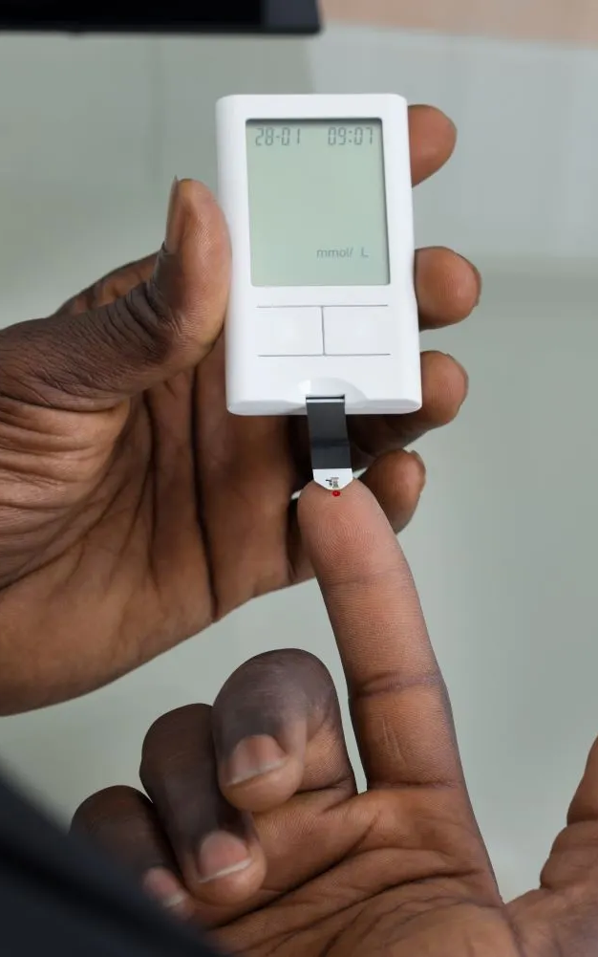
Universal Healthcare: Equity & Access Barriers
Socioeconomic gap: cumulative data shows that completion rates as well as weight loss success is disproportionately lower in deprived neighbourhoods (chatzi., et al., 2023)
Ethnic disparities: standardisation delivery frameworks fail to tailors to minority communities
Access risk: relying on generic frameworks widens preexisting health inequalities.

Slide 16
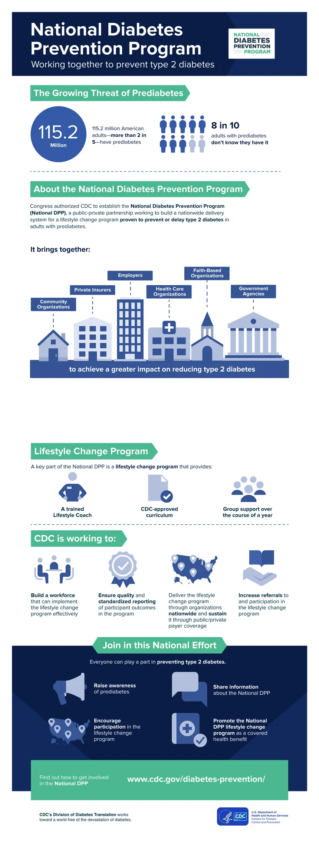
Conclusion
Sustainable imperative- shifting from reactive clinical care to proactive prevention is the best possible solution to aid the community at risk of long-term health conditions such as diabetes, and to aid the financial security of the NHS.
systemic conflict- although clinical evidence does prove that the NDPP works, its success is often undermined by short term funding cycles as well as the prioritisation of crisis management and patient drop out rates.
Equity waring – to meet the UN SDG 3 , the NHS must adjust its current delivery model in order to widen health opportunities for minority, and socioeconomically deprived communities.

Slide 17
Photo referencing list:
https://i.guim.co.uk/img/media/2ddc3c723a2815d8079e1fc014b0d808b5307d4d/0_102_3504_2102/master/3504.jpg?width=645&dpr=2&s=none&crop=none
https://iris.who.int/server/api/core/bitstreams/44261a94-8021-4ece-83ad-328c5c1965e6/content
https://painendshere.com/wp-content/uploads/2016/10/20160909111511885.jpg
https://static.wixstatic.com/media/7e20dd_8415484dddae4f82a274bf89a9130209~mv2.png/v1/fill/w_925,h_801,al_c,q_90,usm_0.66_1.00_0.01,enc_avif,quality_auto/7e20dd_8415484dddae4f82a274bf89a9130209~mv2.png
https://www.cdc.gov/diabetes/images/library/socialmedia/ndpp_workingtogetherdiabetes_print.pdf

Slide 18
Reference list
Aujla, N., Yates, T., Dallosso, H. and Kai, J. (2019). Users’ experiences of a pragmatic diabetes prevention intervention implemented in primary care: qualitative study. BMJ Open, 9(8), p.e028491. available at https://pmc.ncbi.nlm.nih.gov/articles/PMC6687001/
Last accessed on: 19/06/2026
Benning, T.B., (2015). Limitations of the biopsychosocial model in psychiatry. Advances in Medical Education and practice, pp.347-352.
Available at: https://www.tandfonline.com/doi/full/10.2147/AMEP.S82937
Last accessed on: 18/06/2026
Champion, V.L. and Skinner, C.S., (2008). The health belief model. Health behavior and health education: Theory, research, and practice, 4, pp.45-65.
Available at: https://d1wqtxts1xzle7.cloudfront.net/49289960/Health_Behavior___Health_Education_book_4th_Ed-libre.pdf?1475413657=&response-content-disposition=inline%3B+filename%3DHealth_Behavior_and_Health_Education_boo.pdf&Expires=1781657475&Signature=NrVcpVZO1gMPGjzJAQQNgzc32ef8h0uQNKtt~iQRSY7Ni9Ey--SjiHHC27NVDYtDnlWYLFaYGM9OX0fkZ3i9UqeqMfbEjL1qZxRUt9mpoMe3SD-Ok2PkDHXPcMQoVRNrk0h3m8VexFlAqpMoliN0o5OX2QT~z5C2g0ZscRCpQqxECexmjts5tMmrlA-TQGQyaz4vASdyQ5reGA9Kpivg6MGWyaSy4~JSdd8Gl57kBJ9vc27W5U2fbs0g7YuuDJYe4dEDY3ehKQTR-8fBmoOIeHCQbIL4Ub3a2YOlSjvAdTBO-h5SGXUUXbgq6utfhWDQSuHn89U8nfNzsoLQ0QHWyg__&Key-Pair-Id=APKAJLOHF5GGSLRBV4ZA#page=83
Last accessed on: 17/06/2026
Chatzi, G., Whittaker, W., Chandola, T., Mason, T., Soiland-Reyes, C., Sutton, M. and Bower, P. (2023). Could diabetes prevention programmes result in the widening of sociodemographic inequalities in type 2 diabetes? Comparison of survey and administrative data for England. J Epidemiol Community Health, [online] 77(9), pp.565–570.
Available at :https://jech.bmj.com/content/77/9/565
Last accessed on: 19/06/2026

Slide 19
Reference list
Dhir, P., Maynard, M., Drew, K.J., Catherine Verity Homer, Chirag Bakhai and Louisa Jane Ells (2024). A Qualitative evaluation in community settings in England exploring the experiences of coaches delivering the NHS Low Calorie Diet programme pilot to ethnically diverse participants. BMJ open, 14(5), pp.e085200–e085200.
Available at: https://pmc.ncbi.nlm.nih.gov/articles/PMC11097852/
‌last accessed on: 18/06/2026
Havelka, M., Despot Lučanin, J. and Lučanin, D., (2009). Biopsychosocial model–the integrated approach to health and disease. Collegium antropologicum, 33(1), pp.303-310.
Available at: https://hrcak.srce.hr/39603
Last accessed on 13/06/2026
Howden-Chapman, P., Siri, J., Chisholm, E., Chapman, R., Doll, C.N. and Capon, A., (2017). SDG 3: Ensure healthy lives and promote wellbeing for all at all ages. A guide to SDG interactions: from science to implementation. Paris, France: International Council for Science, pp.81-126.
Available at: https://link.springer.com/article/10.1186/s12913-017-2183-6
Last accessed on: 15/06/2026
Jasemi, M., Valizadeh, L., Zamanzadeh, V. and Keogh, B., (2017). A concept analysis of holistic care by hybrid model. Indian journal of palliative care,.23(1), p.71.
Available at: https://pmc.ncbi.nlm.nih.gov/articles/PMC5294442/#
Last accessed on: 13/06/2026
‌Jefferies, D. and Wickens, C. (2025). Tight Budgets and Tough Decisions | the Impact of NHS Financial Decisions ,the King’s Fund. [online] The King’s Fund.
Available at: https://www.kingsfund.org.uk/insight-and-analysis/long-reads/tight-budgets-tough-choices.
Last accessed on: 16/06/2026

Slide 20
Reference list
Kaldjian, L.C. (2014). Patient care and population health: goals, roles and costs. Journal of Public Health Research
Available at: https://journals.sagepub.com/doi/full/10.4081/jphr.2014.311
Last accessed on: 13/06/2026
Khan, M.A., Hashim, M.J., King, J., Govender, R.D., Mustafa, H. and Al Kaabi, J. (2020). Epidemiology of Type 2 Diabetes – Global Burden of Disease and Forecasted Trends. Journal of Epidemiology and Global Health, 10(1), pp.107–111.
Available at: https://pmc.ncbi.nlm.nih.gov/articles/PMC7310804/
Last accessed on: 18/06/2026
NHS England (2022). NHS Prevention Programme cuts chances of Type 2 diabetes for thousands. [online]
Available at: https://www.england.nhs.uk/2022/03/nhs-prevention-programme-cuts-chances-of-type-2-diabetes-for-thousands/
Last accessed on: 19/06/2026
NHS England (2022). What Are Integrated Care systems? [online] NHS England.
Available at: https://www.england.nhs.uk/integratedcare/what-is-integrated-care/
Last accessed on: 16/06/2026
NHS England (2024). NHS Identifies over Half a Million More People at Risk of Type 2 Diabetes in a Year. [online] www.england.nhs.uk.
Available at: https://www.england.nhs.uk/2024/06/nhs-identifies-over-half-a-million-more-people-at-risk-of-type-2-diabetes-in-a-year/.
Last accessed on:18/06/2026

Slide 21
Reference list
Pilgrim, D., (2015). The biopsychosocial model in health research: Its strengths and limitations for critical realists. Journal of Critical Realism, 14(2), pp.164-180.
Available at: https://www.tandfonline.com/doi/abs/10.1179/1572513814Y.0000000007
Last accessed on:18/06/2026
Public Health England (2016). NHS Diabetes Prevention Programme NHSDPP overview and FAQ NHS England Publications Gateway Reference 05728. [online]
Available at: https://www.england.nhs.uk/wp-content/uploads/2016/08/dpp-faq.pdf.
Last accessed on: 15/06/2026
Public Health England (2018). Health matters: Preventing Type 2 Diabetes. [online] GOV.UK.
Available at: https://www.gov.uk/government/publications/health-matters-preventing-type-2-diabetes/health-matters-preventing-type-2-diabetes.
Last accessed on: 18/06/2026
Sallis, J.F., Owen, N. and Fisher, E., (2015). Ecological models of health behavior. Health behavior: Theory, research, and practice, 5(43-64).
Available at: https://books.google.co.uk/books?hl=en&lr=&id=9BQWCgAAQBAJ&oi=fnd&pg=PA43&ots=efP37fzSb6&sig=rumJqHWMGblf0nyPJIRo8-npEyM&redir_esc=y#v=onepage&q&f=false
Last accessed on: 13/06/2026
The Health Foundation. (2021). Cuts to public health run counter to levelling up, say leading health organisations. [online]
Available at: https://www.health.org.uk/media-office/press-releases/cuts-to-public-health-run-counter-to-levelling-up-say-leading-health-organisations
Last accessed on: 16/06/2026
‌
‌
‌

Slide 22
Reference list
The King’s Fund. (2025). Truly Fit For The Future? The 10 Year Health Plan Explained, The King’s Fund. [online]
Available at: https://www.kingsfund.org.uk/insight-and-analysis/long-reads/ten-year-health-plan-explained.
last accessed on: 19/06/2026
United Nations (2015). The 17 sustainable development goals. [online] United Nations
Available at: https://sdgs.un.org/goals
Lasted accessed on: 12/06/2026
Unwin, N. (2020). Socio economic position, the risk of pre and type 2 diabetes, and implications for prevention. [online]
Available at: https://www.nice.org.uk/guidance/ph35/evidence/ep-3-socioeconomic-status-and-risk-factors-for-type-2-diabetes-pdf-433771165.
Last accessed on: 19/06/2026
Valabhji, J., Barron, E., Bradley, D., Bakhai, C., Fagg, J., O’Neill, S., Young, B., Wareham, N., Khunti, K., Jebb, S. and Smith, J. (2020). Early Outcomes from the English National Health Service Diabetes Prevention Programme. Diabetes Care, [online] 43(1), pp.152–160.
‌Available at: https://pubmed.ncbi.nlm.nih.gov/31719054/
Last accessed on: 17/06/2026
WHO (2018). Promoting Health in All Policies and intersectoral action capacities. [online] world health organization.
Available at: https://www.who.int/activities/promoting-health-in-all-policies-and-intersectoral-action-capacities
Last accessed on: 16/06/2026
‌
‌
‌
‌
‌

Slide 23
Reference list
WHO (2024). SDG Target 3.4 | Noncommunicable diseases and mental health. [online]
Available at: https://www.who.int/data/gho/data/themes/topics/indicator-groups/indicator-group-details/GHO/sdg-target-3.4-noncommunicable-diseases-and-mental-health.
Last accessed on: 15/06/2026
World Health Organization (1948). Constitution of the world health organization. [online] World Health Organization.
Available at: https://www.who.int/about/governance/constitution
Last accessed on: 12/06/2026
World Health Organization (2021). Promoting well-being. [online] World Health Organization.
Available at: https://www.who.int/activities/promoting-well-being
Last accessed on: 12/06/2026

