Slide 1
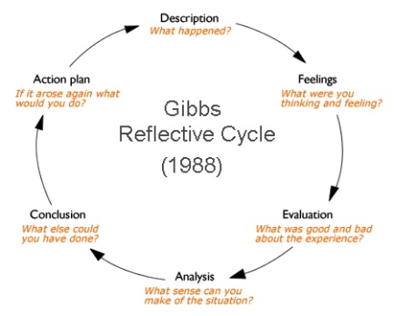
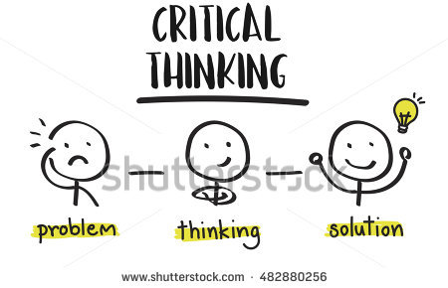
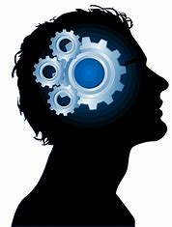
What?
Objectivity
How?
Who?
What is critical thinking?
“Objective thinking is not a natural product of the existence of an enlarged brain or culmination of innate biological tendencies. Rather, it is a way of learning to use the brain hat runs counter to the natural characteristics involved in being an animal.”
(Martell 2003)
(Gibbs 1988)
Where?
When?
Reflectivity
Why?
“Reflective thinking is an active, persistent and careful consideration of a belief or supposed form of knowledge, of the grounds that support knowledge and the further conclusions to which that knowledge leads.”
(Dewey,1993)
“Critical thinking is defined as the process of determining the authenticity accuracy and worth of information or knowledge claims. It consists of a number of discrete skills.”
(Beyer 1985)
Non biased
“Free from all prejudice and favoritism : eminently fair”
(Webster 2018)

Slide 2
Reference list
Beyer,Barry K . (1985). What is critical thinking . Available: https://eric.ed.gov/?id=EJ316045. Last accessed 18/10/18.
Dewey. (1993). How we think. Available: http://infed.org/mobi/reflection-learning-and-education/18. Last accessed 18/10/18.
Gibbs,G. (1988). Using Gibbs’ Reflective Cycle . Available: https://www.kcl.ac.uk/campuslife/services/disability/onlineresources/StudyGuides/USING-GIBBS-REFLECTIVE-CYCLE-IN-COURSEWORK-DEC-2016-P-LIA.pdf. Last accessed 18/10/18.
Johnson,DM. (2003). How history made the mind. Available: https://www.booktopia.com.au/how-history-made-the-mind-david-martel-johnson/prod9780812695366.html. Last accessed 18/10/18.
Webster,M. (1982). Definition . Available: https://www.merriam-webster.com/dictionary/unbiased. Last accessed 18/10/18.

