Slide 1
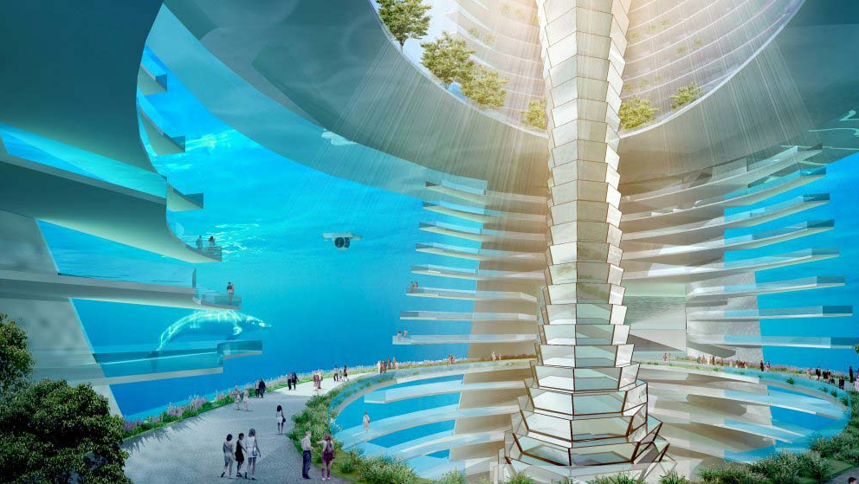
Welcome in your underwater adventure

Slide 2
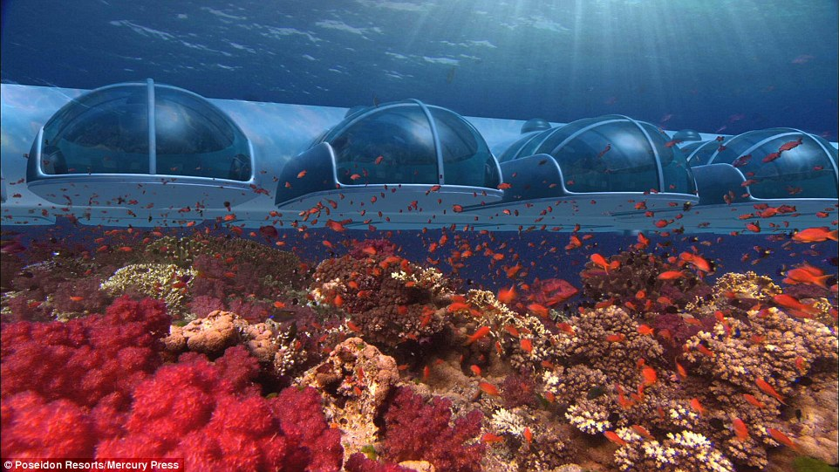
Presented BY:
Elza Soares
1815430
Monuar Moni
1818185
Stilyana Mincheva
1816276
Specifically designed for:
Marketing Essentials
M4X01916
Lecturer: Olu Adegbite

Slide 3
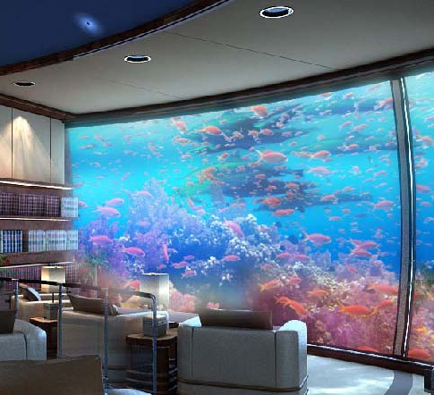
Our mission:
Being innovative, unique and different all the time, fascinating for the lovers in the marine world.
Mermaid’s Mysterious Island present you an unforgettable experience full of adventures and emotions.
Adventure in the magical world

Slide 4
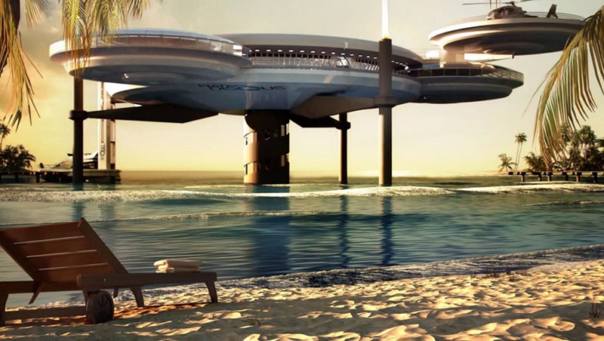
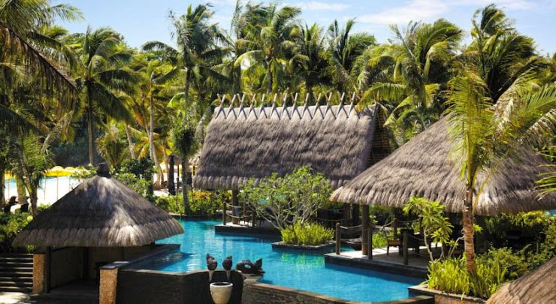
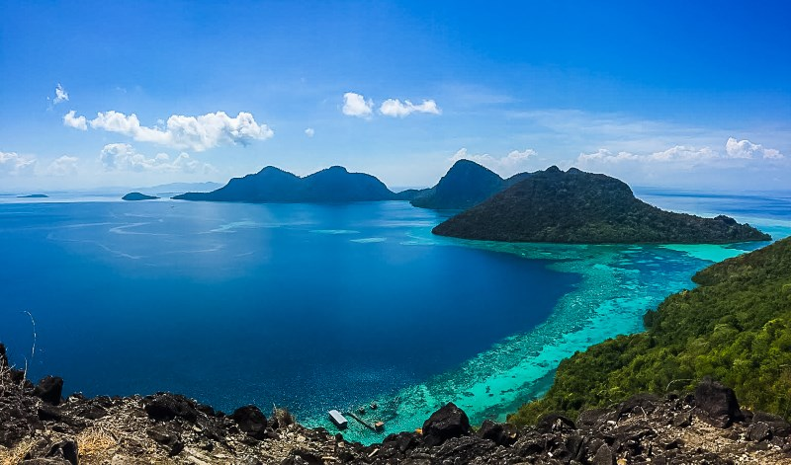
Business overview:
Providing all the comforts and conveniences that best a five-superstar resort can provide, Mermaid's Mysterious Island is the culmination of the vision of each elite holiday.
The Mermaid venture is more than a hotel. This is a lifestyles-changing enjoy, a celebration of the miracles of nature, an instance of accountable conduct towards our surroundings.
Around Mermaid Mysterious Island site visitors will anticipate an intact tropical marine atmosphere. A special application has been created to prevent the terrible impact in this environment - in the course of the construction and operation of the lodge, which provides the most inspiring imaginative and prescient of our guests for many years.

Slide 5
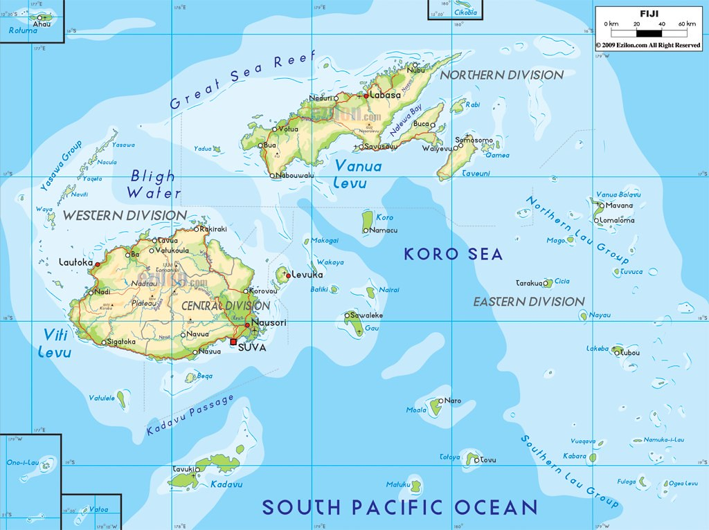
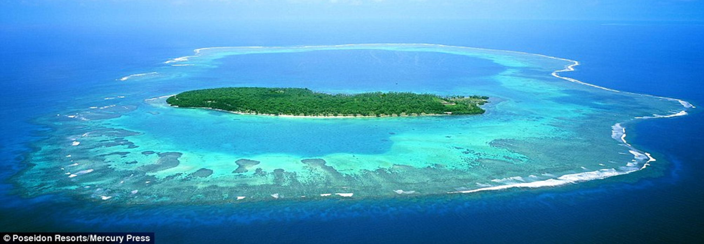
Our Location: the mystery will begin once you are arrived in Fiji
Take your passport up, as you're about to embark on a world–elegance voyage to a vicinity that no one knew existed… till now.

Slide 6
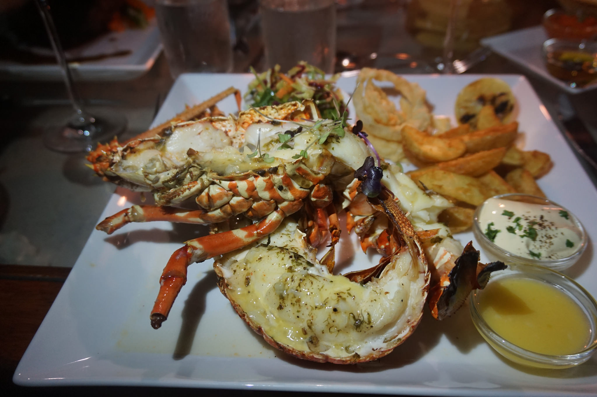
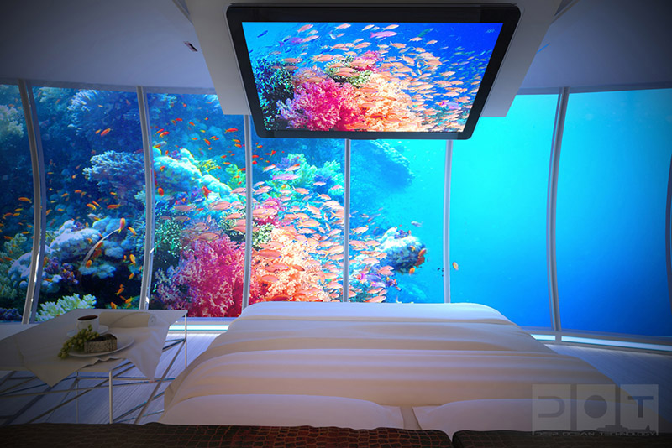
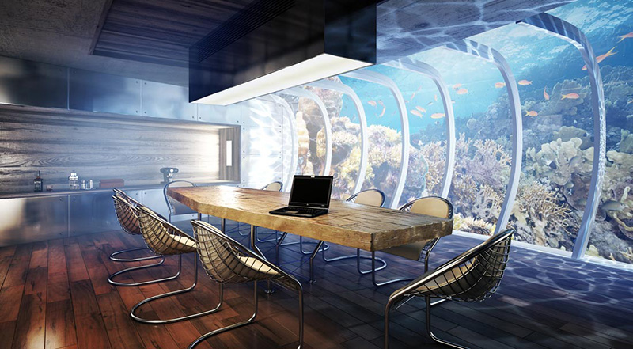
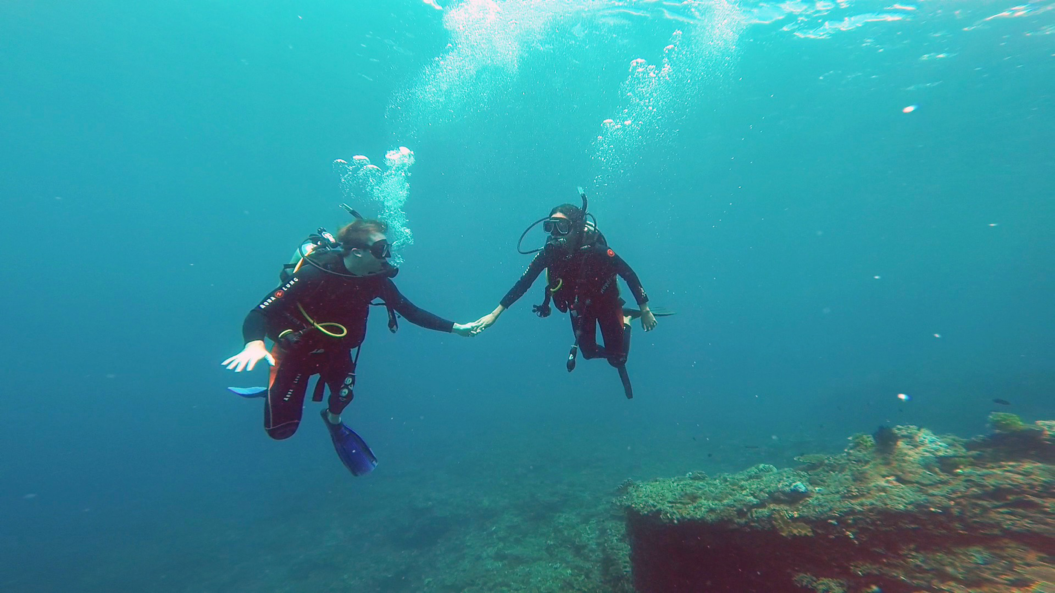
Our product’s and service’s:
Mermaid Mysterious Island offers two types of guest rooms, one above the ground and one under the surface. Guests will have the opportunity to get to know each comfortable, intimate world during their stay, with full access to facilities in both areas.
Each of 24 suites and 48 luxury bungalows includes:
Library;
Personal cabinet with voice/data access, Wi-Fi and high-speed internet, as well as multi-line phones;
Entertainment technologies: CD/DVD player; and satellite radio with surround sound;
Refrigerators with gourmet snacks, champagne, wines, and soft drinks;
Rich marble bathrooms with a large jacuzzi.
Available services include:
Two fine dining options, one on the land and one under the sea;
A diving shop;
A retail boutique;
A library;
A theatre room;
A conference room;
A wedding chapel.
Fitness facilities include:
A nine-hole golf course;
A tennis courts;
A private pools;
A fitness centre.
Adventures Offers:
Submarine Piloting;
Deep Reef Excursions;
Explore the Abyss;
Scuba Diving;
Water Sports;
Para Sailing;
Sea Trek on the Sea Floor-experience the amazing reefs on foot with Sea Trek®;
Ultralight Flight;
Cave Exploration;
Driving and Walking Tours;
Lectures/workshops.
Mermaid’s Mysterious Island

Slide 7
Target market / market segmentation
The business
traveler
The Leisure traveler
The group travelers
The families
The students
The scientists
The explorer and adventure travelers
The Elite
vacationer
The wellness

Slide 8
Micro environment
Company
Suppliers
Marketing intermediaries
Customers
Publics

Slide 9
SOCIAL
ECONOMIC
ENVIRONMENTAL
MACRO ENVIRONMENT
Quality of life; Education; Law & Ethics
Smart Growth; Long Range Planning
Environmental Protection; Habitat Restoration & Preservation

Slide 10
SWOT Analysis
Strengths
Great brand recognition
High quality, unique product (not just a resort…)
Opportunities
Improve the quality of service
Threats
Lack of governmental involvement in the area's promotion internationally.
Weaknesses
High price
Lack of government support for the area's development
Difficulties in sustainable profitability during the first year
Individual attitude towards customers
Day by day people’s interest are increasing for experiencing luxury holiday
Increasing corporate image
Constant change of customer buying behaviors.
Global climate change is one of our biggest threat for future.

Slide 11
PESTEL
analysis
Political
Funding grants and initiatives
Economical
Laboure and Energy costs
Social
Education, fashion, culture
Technological
We are using the best software in the market to keep our data up to date
Environmental
Weather,
Green & ethical issues
Pollutions, waste, recycling
Legal
Employment law

Slide 12
Marketing Communications
Mix
Advertising
We have a professional advertising body to present us in front of public. Also we are taking advantage of social media platform.
Sales Promotion
We have effective sales and promotion for pick time and off-pick.
Events & Experiences
We are more than a resort. We have a strong event management department who are always planning for interesting event for our customer. They are always making sure that our guests are meet a life-changing experience in celebration of nature’s wonders, an illustration of responsible behaviour towards our environment
Public Relations & Publicity.
As a brand we are very careful about (CSR) corporate social responsibilities. And that what will brings us closer to public and publicity.
Direct & Interactive Marketing
We are using social media platform to get closer to our guests. Also upload video of our events, adventures of our visitors and scientist program to give more clear idea about us, to impress customer. Also use an APP which is always update with new system, moreover we use email marketing to interact with customer directly.
Personal Selling
Our strategy gives option to our guests to help boost out selling too. Which is we offer voucher to every guest on their first visit to use it for their second visit. We also offer a voucher for referral.
Word-of-mouth
Marketing
Our excellent product and service motivate gust for boost our selling by word of mouth. Also we use trip adviser where our gust give us positive response and other existing gust can get inspire by looking at it.

Slide 13
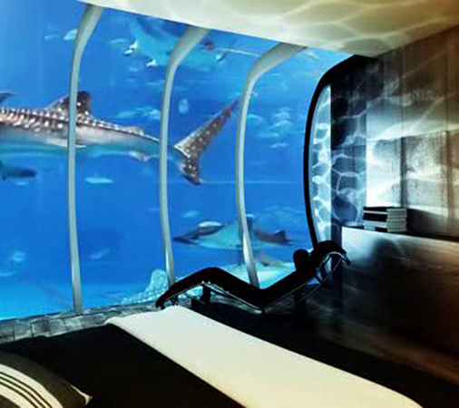
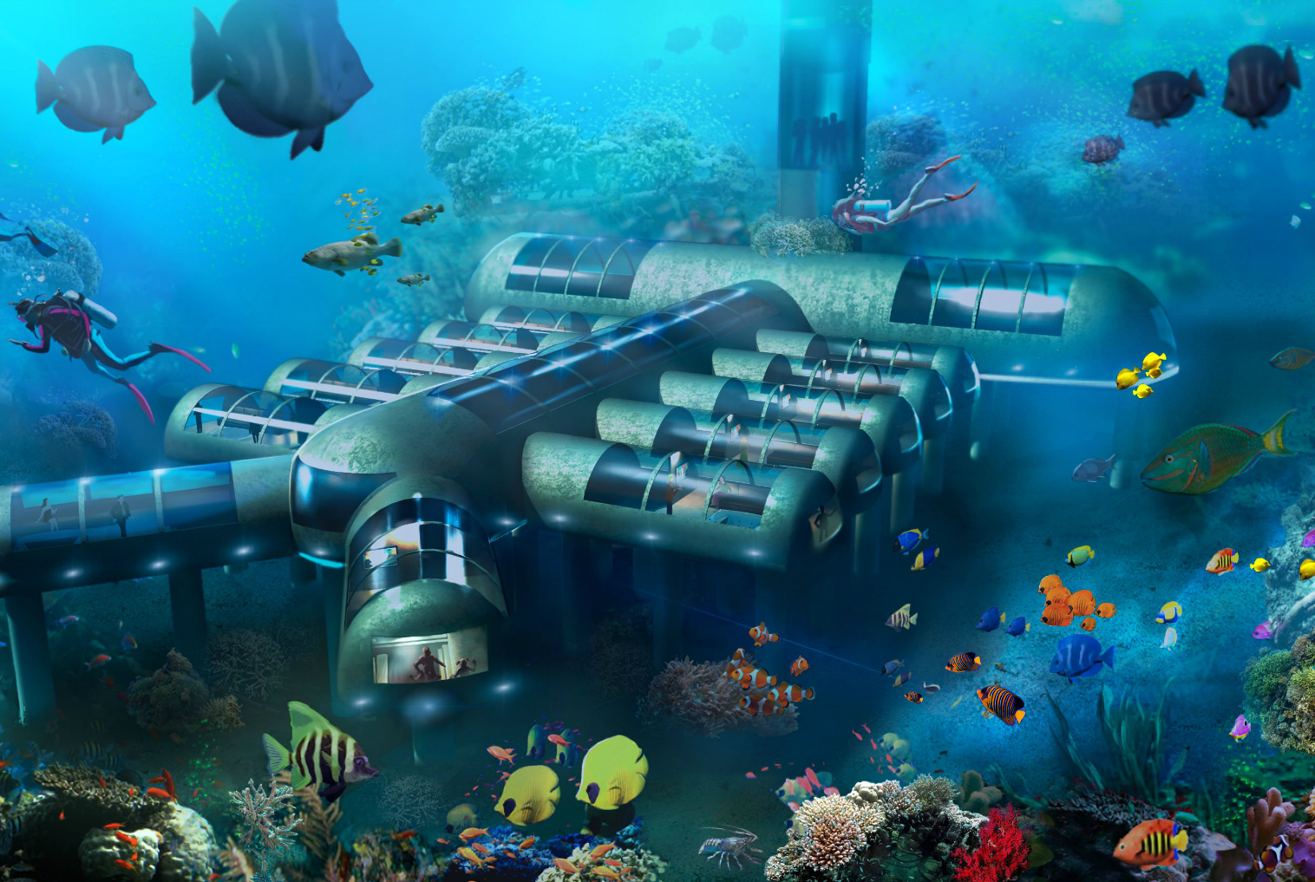
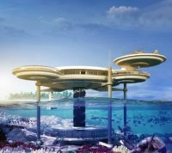
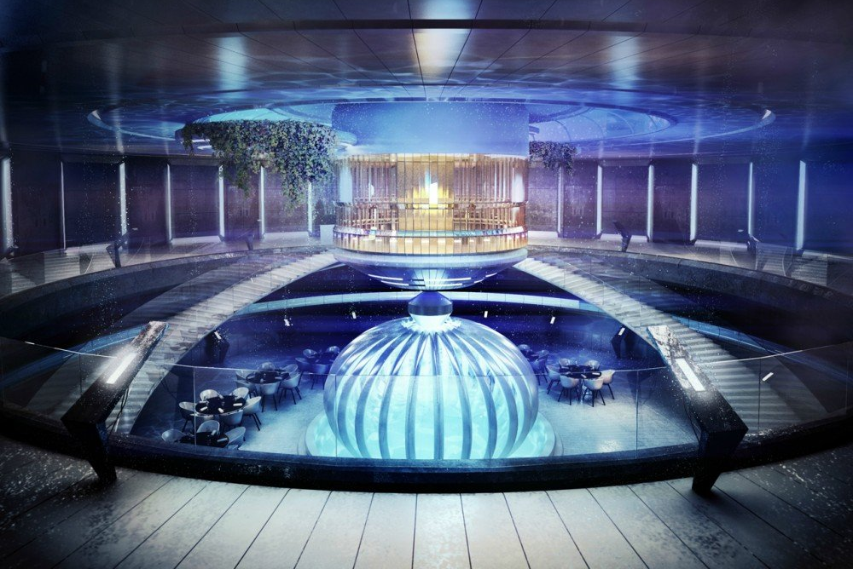
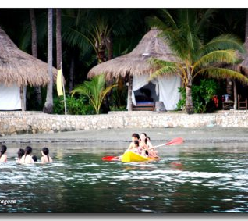
Business Strategy
In the short term, the biggest challenge for our management team is finding a suitable place to build a second complex to meet all the reservations made so far by 150000 guests.
In the long run, the goal is to create a new world that has not yet been achieved not only to provoke our creative capabilities but also to engage our employees and our customers in creating something extraordinary in human history. It is a time of exploring human opportunities for creating and discovering new areas of development and progress. Demonstration of human abilities.

Slide 14
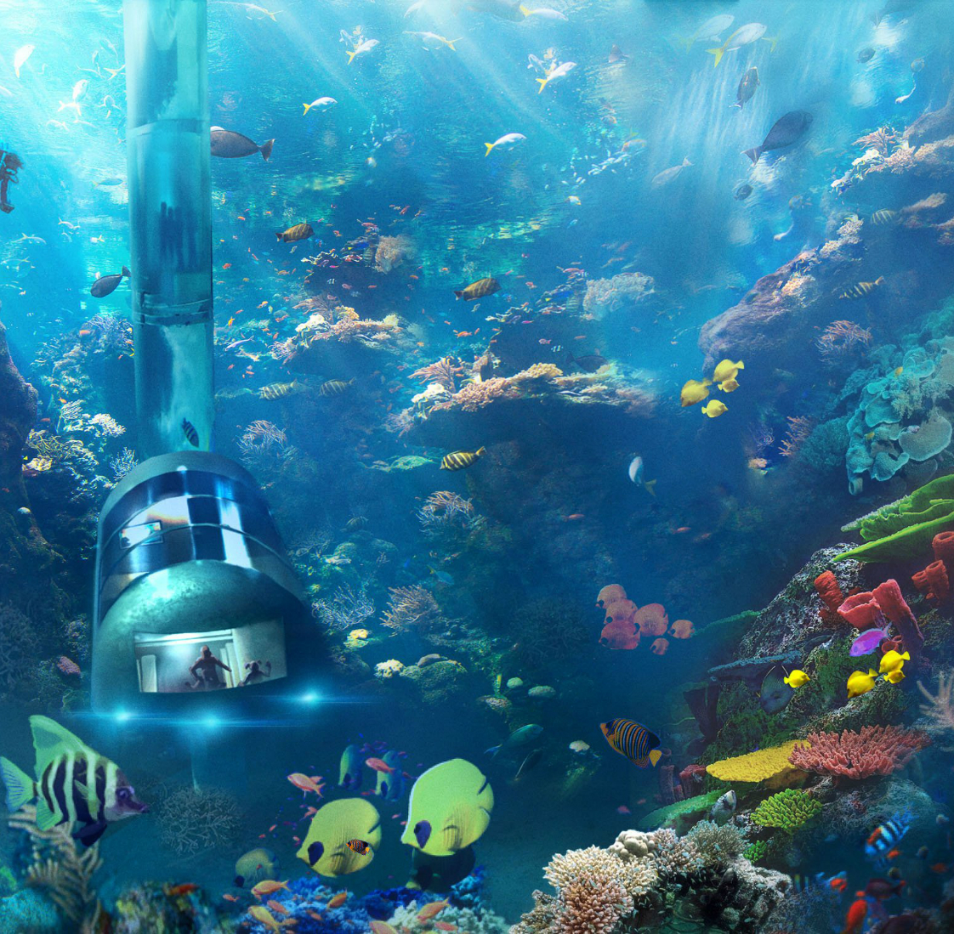
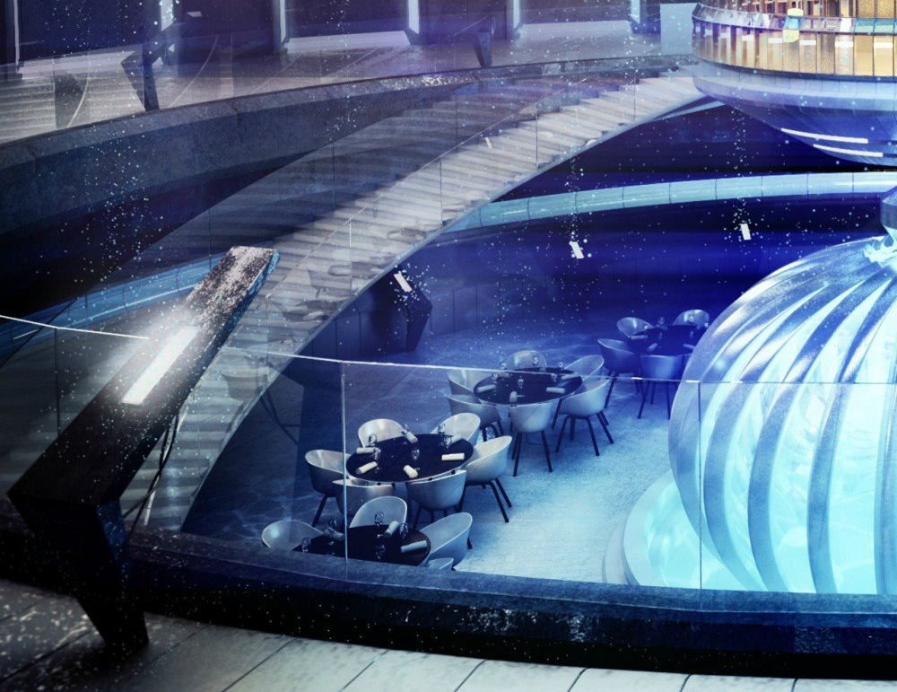
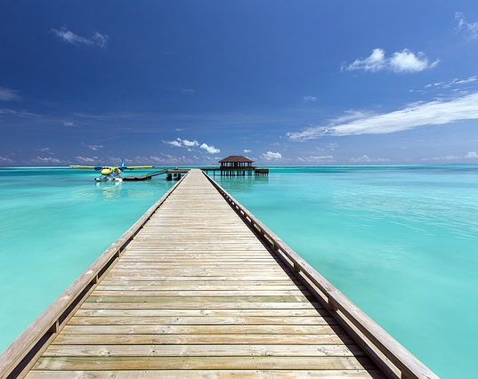
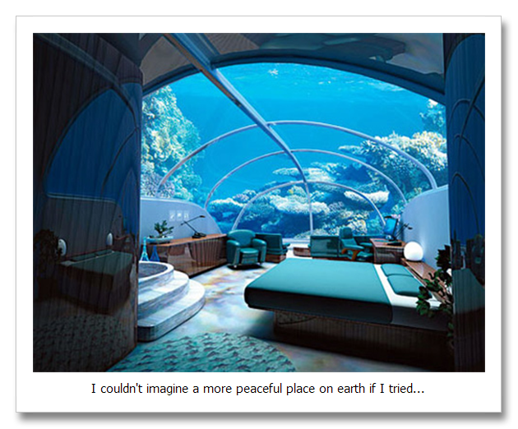
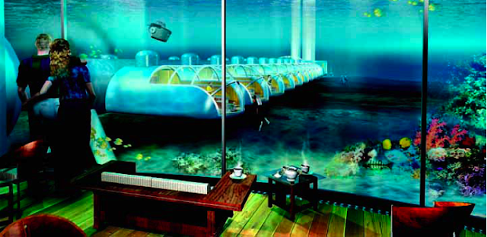
CONCLUSION:
This was a very challenging task for us. The main goal was to demonstrate our knowledge in a unique project that would enable us to showcase our creativity, innovation and look forward to the future. We have succeeded in finding a new world, having the opportunity to explore and expand our knowledge through the information provided to us, so that we can clearly understand the meaning and content of this course. The whole process of work was a great adventure filled with incredible emotions and the discovery of new opportunities.

Slide 15

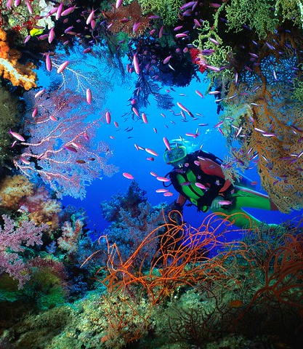
References:
McCabe, S., (2009), Marketing Communications in Tourism and Hospitality: Concepts, Strategies, Elsevier Ltd, Oxford, UK;
Kotler, P., Bowen, J. & Makens, J., Baloglu, S. (2016), Marketing for Hospitality and Tourism, Seventh Edition, Pearson; UK;
Porter, M., (1980) Competitive Strategy: Techniques for Analysing Industries and Competitors with a brand-new introduction; The Free Press; New York;
Sargeant, A. & West, D., (2001), Direct and Interactive Marketing; Oxford University Press, UK;
Todorov K. & Akbar Y., (2018); Strategic Management in Emerging Markets: Aligning Business and Corporate Strategy; Emerald Publishing Limited; UK;
https://www.Kilroy.Internet/media

Slide 16
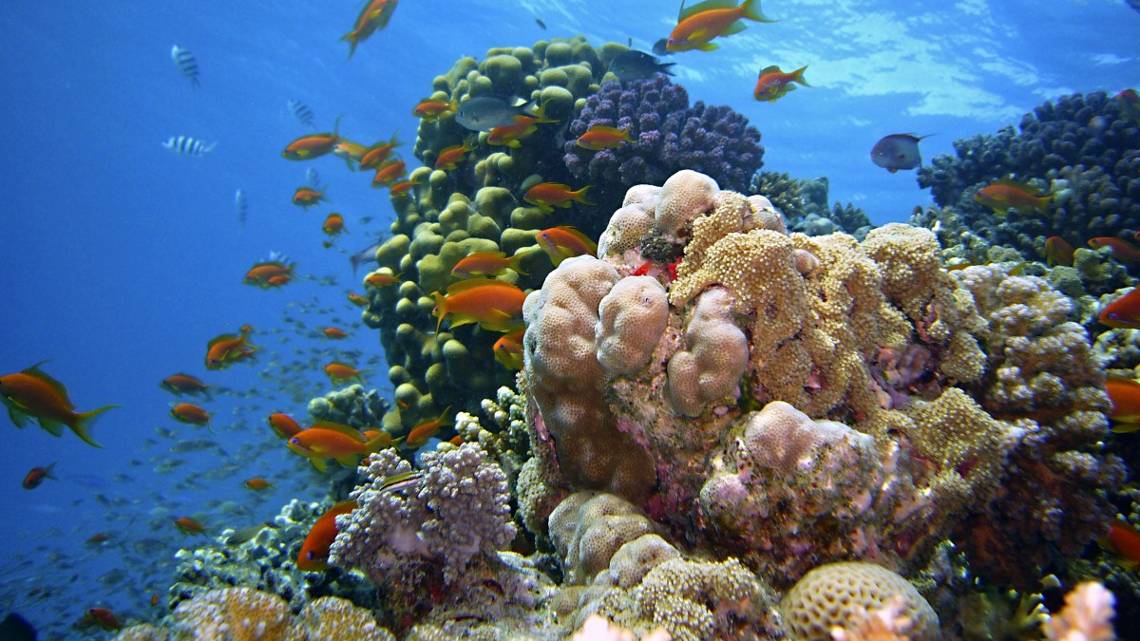
Thank you for being with us in this amazing underwater adventure.

