Slide 1
Student Name: Nadia Muriel Grobry
Student Number: 2244710
BMHP6029_BIRM – Component 1 – Poster Presentation
Lecturer Name: Neale Haddon
Title of Poster: Component 1: Individual Presentation (Academic Poster)

Slide 2
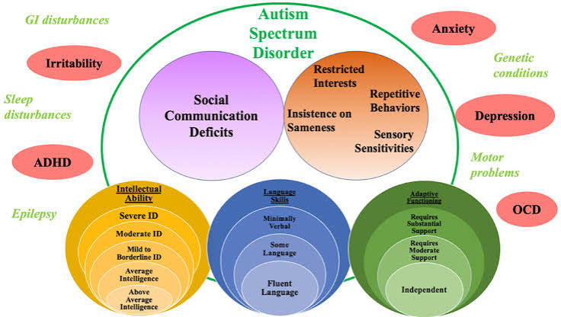
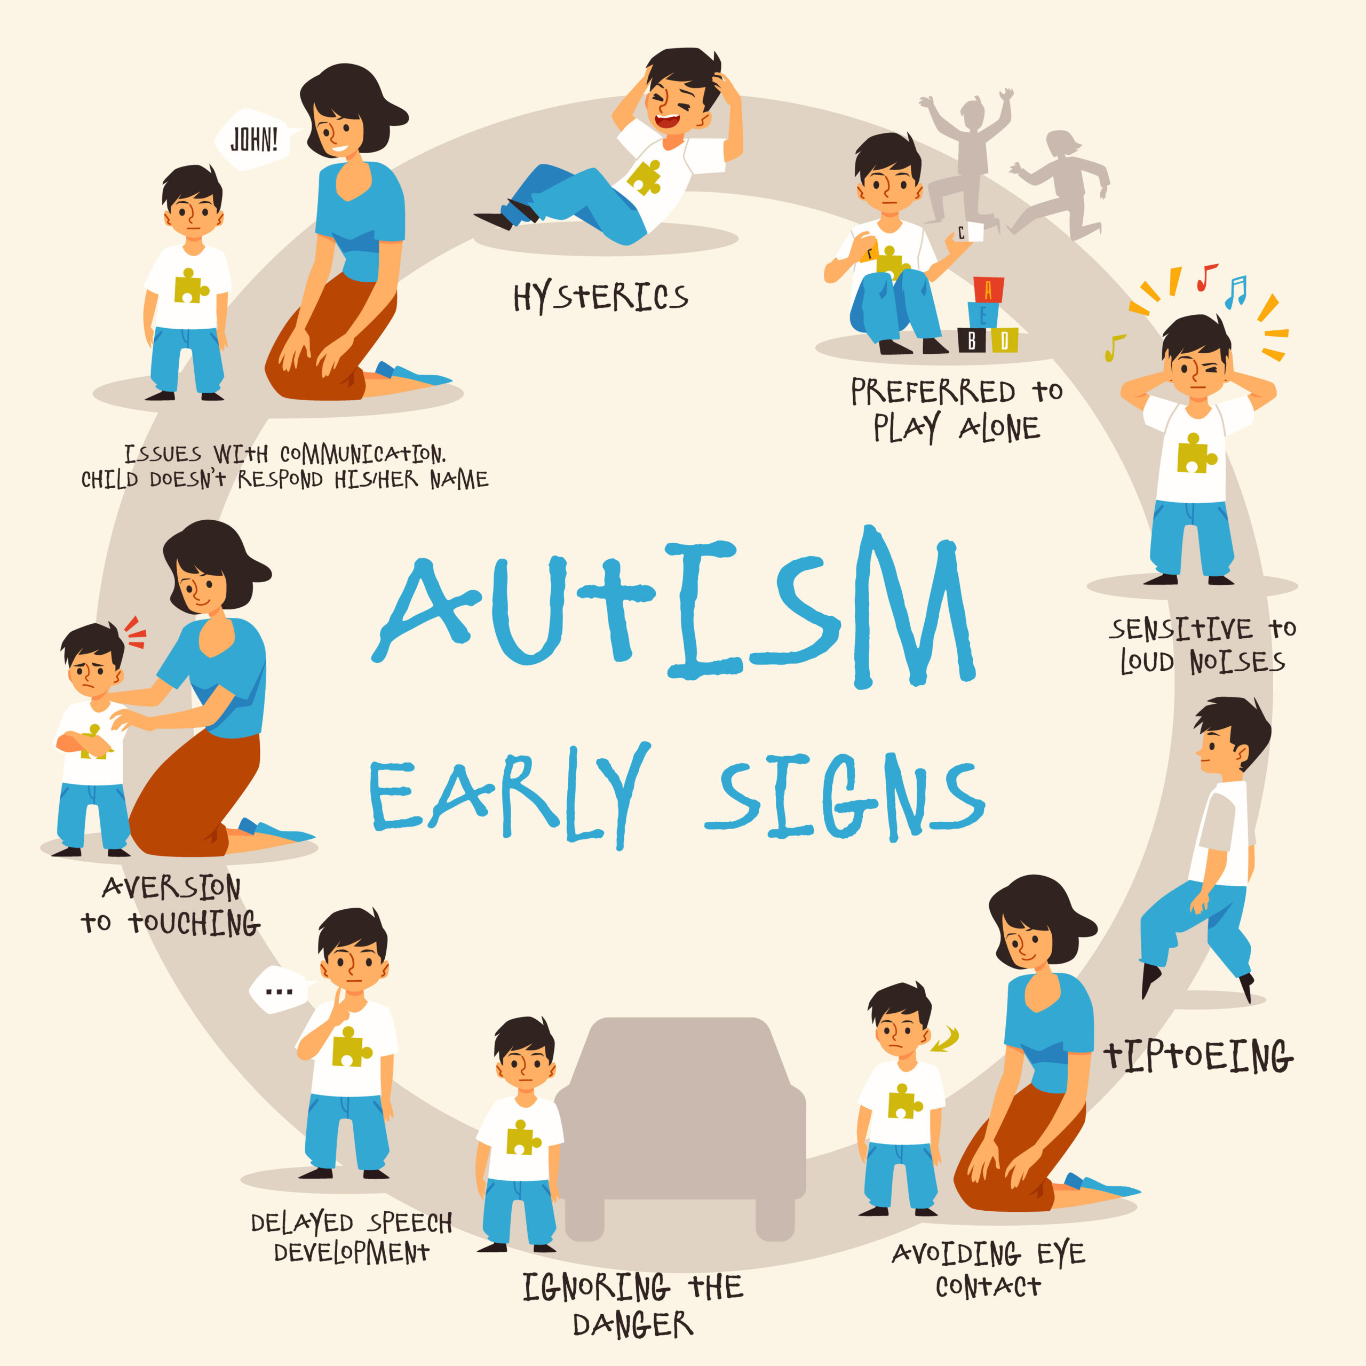
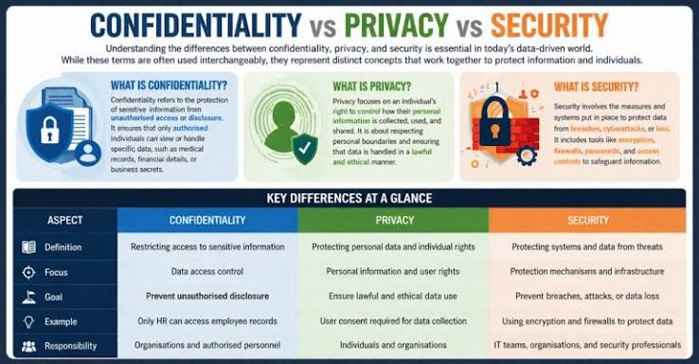
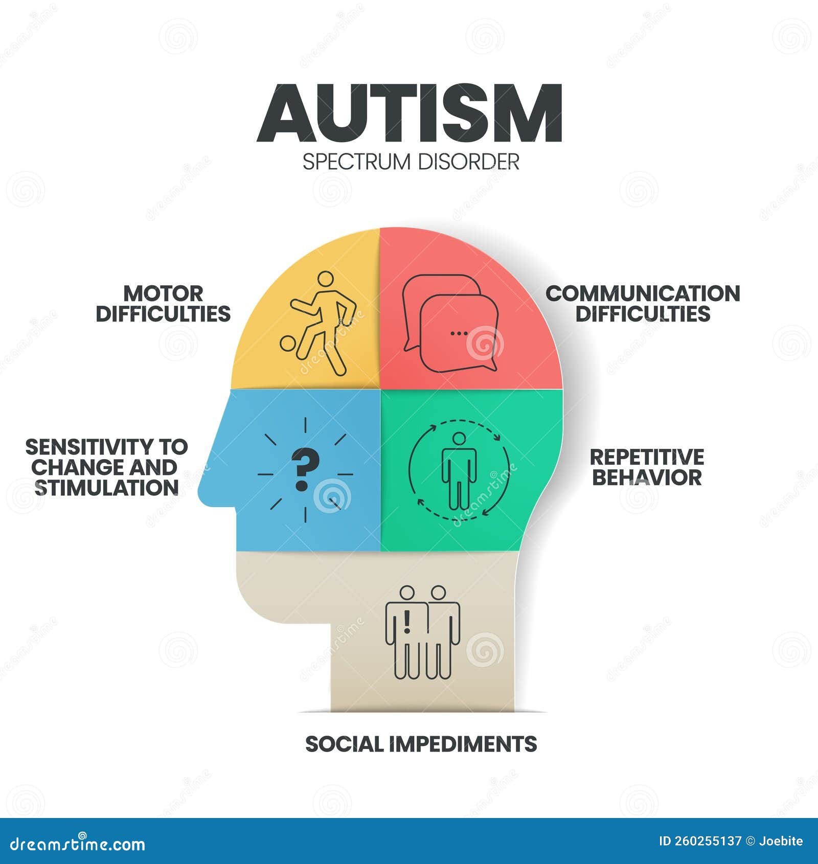

Historical and Contemporary Treatment and Provision of Care for Autism Spectrum Disorder (ASD)
Understanding Autism Spectrum Disorder:
ICD-11 who
Definition: What is Autism?
Confidentiality, Transparency and Security
How is it diagnostic?
[Text]
[Text] k
[Text]
Autism Spectrum Disorder (ASD) is a lifelong neurodevelopmental condition recognised in ICD-11 NIH, 2024 ABrignell, A. et al. (2022) ASD is a condition related to brain development that affect how people see other in the society with them.
The Autism Diagnostic Services (ADS) follow NHS policies to protect personal information and ensure data is handled safely. NHS England (2024) Confidentiality Transparency Security (NHS England, 2024).
nn
•Allely, C.S., Woodhouse, E. and Mukherjee, R.A. (2023) A team of professionals such as doctors, psychologists, paediatricians, and therapists, work together. They access: Matson, J.L. and Minshawi, N.F. (2006) Social interaction and communication Repetitive behaviours and interests Sensory responses Early development history. Baloyi, O. et al. (2024)
Before the Autism Act 2009, Austism was often misunderstood, and many autistic people faced stigma, discrimination, and poor access to appropriate support. The Act improved awareness and promoted better services for autistic adults and their families. and access of Crowson, M. et al. 2024Crowson, M., et al. (2024)

Slide 3
Reference List
Brignell, A. et al. (2022) “Overall prognosis of preschool autism spectrum disorder diagnoses,” Cochrane database of systematic reviews, 2022(9), p. CD012749. Available at: https://doi.org/10.1002/14651858.CD012749.pub2.
Lehti, V. et al. (2013) “Autism spectrum disorders in IVF children: a national case–control study in Finland,” Human reproduction (Oxford), 28(3), pp. 812–818. Available at: https://doi.org/10.1093/humrep/des430.
Baloyi, O. et al. (2024) “Experiences of families with children diagnosed with Autism Spectrum Disorder in World Health Organization Afro‐Regions: A scoping review,” Nursing & health sciences, 26(2), pp. e13123-n/a. Available at: https://doi.org/10.1111/nhs.13123.
Matson, J.L. and Minshawi, N.F. (2006) Early intervention for autism spectrum disorders : a critical analysis. 1st ed. Boston: Elsevier.
Allely, C.S., Woodhouse, E. and Mukherjee, R.A. (2023) “Autism spectrum disorder and personality disorders: How do clinicians carry out a differential diagnosis?,” Autism : the international journal of research and practice, 27(6), pp. 1847–1850. Available at: https://doi.org/10.1177/13623613231151356.

Slide 4
Reference List
Crowson, M., et al. (2024) Diagnostic Inequalities and Service Access for Autistic Children and Young People in the UK. London: Autistica Research Report.
www.gov.uk
NHS England (2024) Autism statistics: Autism diagnosis waiting times and pathways to diagnosis. Available at: https://www.england.nhs.uk/statistics/statistical-work-areas/autism-statistics/
NHS England (2024) Statistical disclosure control and confidentiality guidance. Available at: https://www.england.nhs.uk/statistics
/ (Accessed: 6 July 2026).Copy response￼Good responseBad responseShareSwitch modelMore actions￼Gravitee Topco LimitedAdSponsored optionsFull Visibility Into LLM Usage with GraviteeMonitor and control prompt traffic, model usage and LLM access with Gravitee. Learn …more today

