Slide 1


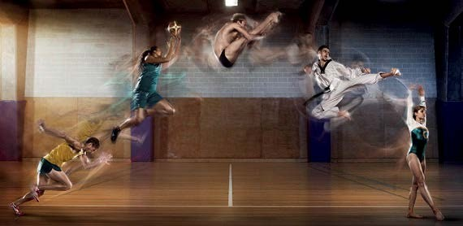


Sports Trauma Management
Exposure, Environment & Everything Else
a. Musculoskeletal Trauma
16 Royal Terrace, Glasgow, G3 7NY, T: 0845 600 2613, F: 0141 332 5335, W:www.society-of-sports-therapists.org, E: admin@society-of-sports-therapists.org

Slide 2
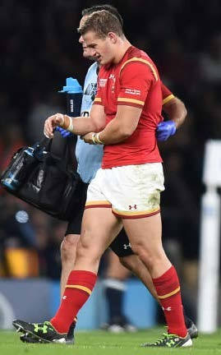
Musculoskeletal Trauma
Safe Approach
Response
Airway
Breathing
Circulation
Disability
Exposure, Environment & Everything Else

Slide 3
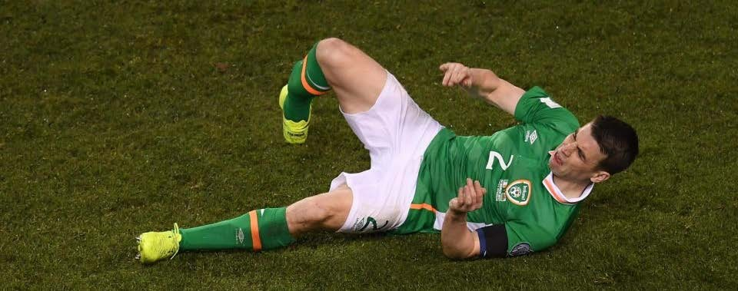
SABCDE would detect significant blood loss from a major limb fracture
Estimated that a closed femur fracture results in 1000-1500mls blood loss
This can double in an open (compound) fracture
Class III haemorrhagic shock
These are dealt with as per circulation
  Fluid therapy

Slide 4
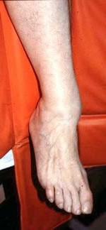
Secondary Survey
Deformity
Pain
Tender on palpation
External haemorrhage
Crepitus
Swelling
Neurovascular compromise

Slide 5
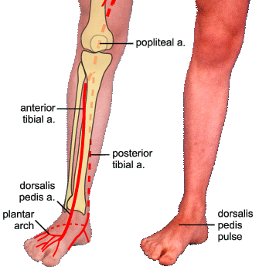
Check Neurovascular Status
Capillary Refill Time (CRT)
Colour
Muscle contraction
Pulse
Sensation

Slide 6
If the player is lacking a PULSE & SENSATION consider:-
Analgesia
  Entonox (if there is NO head and chest trauma or LoC)
  IV paracetamol
  IV tramadol
  Morphine
  Ketamine
Reduce/ Relocate
Recheck Neurovascular Status

Slide 7
Complications of Fractures
Haemorrhage
Nerve and muscle damage
Fat embolism (bone marrow fragment)
  Fat clot
  1-3d post trauma
Necrosis
  >6hours post trauma
Infection

Slide 8
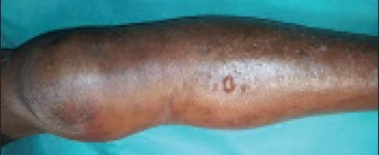
Acute Compartment Syndrome
Neurological deficit
Ischaemic contracture
Infection
Amputation/death
Signs
  Disproportionate amount of Pain
  P+ on PROM
  Tense Swelling
  Paraesthesia (LATE)
  Paresis/ Weakness (LATE)
  Pulseless (LATE)

Slide 9
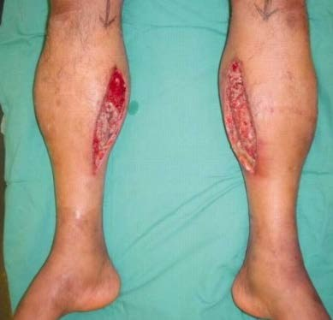
Management of Acute Compartment Syndrome
ABCDE
Analgesia
Refer to Emergency Department ASAP
  Fasciotomy

Slide 10
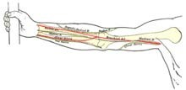
Shoulder Dislocations
Relocation approaches
  Spaso Technique
    Supine, FLXN & ER to 90º
  Kocher’s Method
    Seated, elbow at 90º FLXN & ER, then Shoulder FLXN & IR
  Modified Milch
    Seated, 100º ABD & ER
  Stimson
    Prone, wrist weighted
Check the military patch for axillary nerve sensation
Check radial pulse

Slide 11
Elbow Dislocations
Check
  Radial nerve – wrist extension
  Median nerve – pronation
  Ulnar nerve – flexion of 4th & 5th fingers

Slide 12

Sports Trauma Management
Exposure, Environment & Everything Else
a. Musculoskeletal Trauma
16 Royal Terrace, Glasgow, G3 7NY, T: 0845 600 2613, F: 0141 332 5335, W:www.society-of-sports-therapists.org, E: admin@society-of-sports-therapists.org

