Slide 1
LCBB4004
Marketing Fundamentals
Week 4
Social Media. Blogs

Slide 2
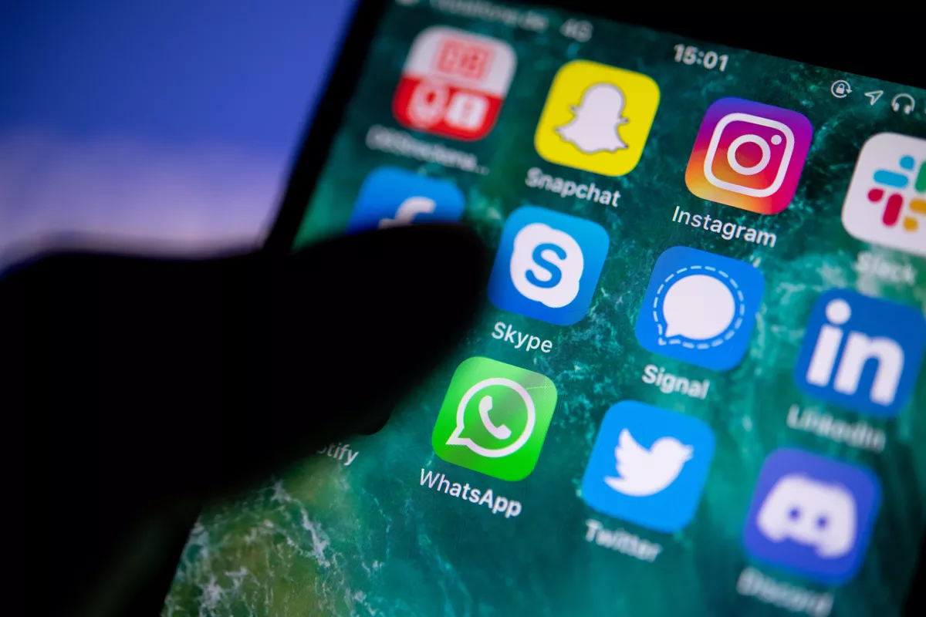
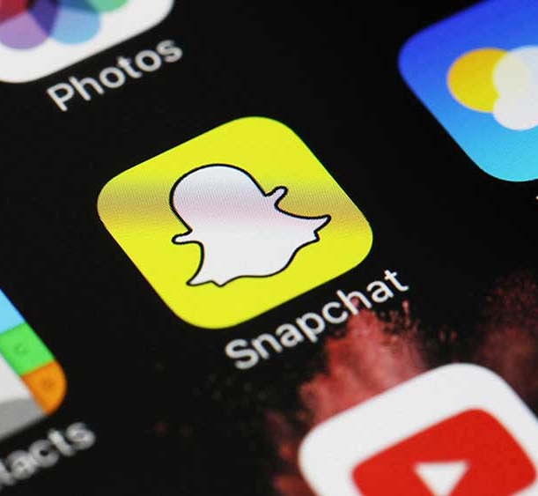
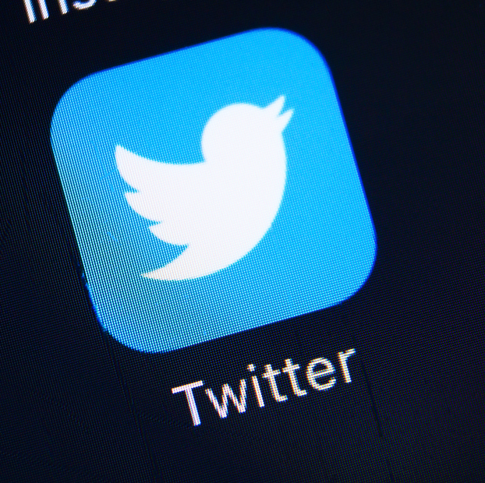
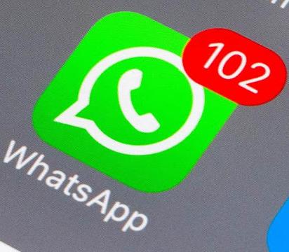
Its a Social World
What was the first thing you did when you woke up this morning?
Checked your mobile?
Maybe set up your snapchat story?
Scrolled through a few Tweets
or checked out WhatsApp
You wouldn't be alone one survey of people from 31 countries reported that 96% of them use their smartphone within an hour of waking up often before they get out of bed
(Lee & Calugar-Pop 2016)

Slide 3
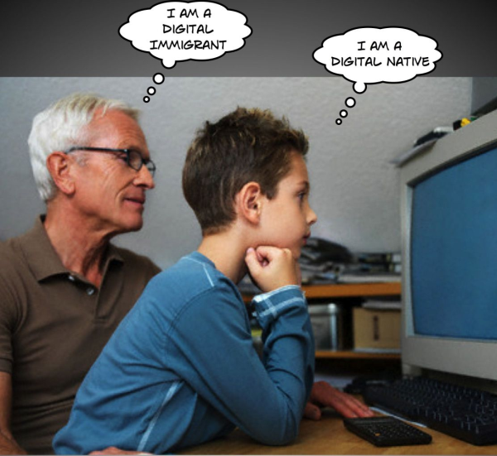
Being a Digital Native
Let's face it you are probably a digital native! And cannot a recall a time when the internet was just a static, one-way platform that transmitted text and a few sketchy images.
The term Digital Native originated in a 2001 article by Marc Prensky (2001) titles “Digital Natives, Digital Immigrants”.
There he tried to explain a new type of student who was starting to enter educational institutions. These students… like you were born in an era in which digital technology has always existed.
Think of the questions you were asked at your student interview… how are you with IT, what equipment do you have at home, what is your Wi-Fi connection like?
So the majority of you and your fellow “natives” grew up “wired” in a highly networked, always-on world.
Its an exciting time- but it continues to change so constantly that we need to study it carefully.

Slide 4

So How Connected are our Customers?
Today the internet is the backbone of our society.
Widespread access to connected device like personal computers, digital video and audio records, webcams, smartphones and wearable like smartwatches ensure that consumers who live in virtually any part of the World can create and share content.
Worldwide there are about 4.38 billion global Internet users today… hat roughly 57%,of the world population (Kemp 2019)
With most of these internet users, about 45% of the World population, being active on at least one social media network. That’s about 3.5 billion people (We are social 2019).
Of course social media penetration vary by global region, with the lowest penetration rates reported in Central Asia, Africa and South Asia.
But even these areas are expected to experience growth, worldwide and 63% of mobile users are active on social media via mobile applications.

Slide 5

So Who’s seen the most Growth?
Snap chat posted the largest relative gains this quarter, with advertisers now able to reach over 9 % more people via the platform than they could just three months ago.
The addition of 36 million new users between July and September takes snapchats global advertising audience to 433 million, which is 20% larger than the audience the company's tools were reporting this time last year!
Why do you think this may have been?

Slide 6

So let’s consider a definition….
Information doesn't just flow from big companies or governments down to the rest of us; Today each of us communicates with huge numbers of people by a click on a keypad, so information flows across people as well.
This fundamental change in the way we live, work, and play is characterised in part by the prevalence of social media.
Social media are the online means of
Communication
Conveyance
Collaboration
and cultivation
Among
Interconnected and interdependent networks
Of
People, communities and organisations enhanced
by
Technological capabilities and mobility.
Does this sound like a complex definition?
It is… because social media exist within a complex and rapidly advancing environment

Slide 7

Mind Boggling Social Media Stats
It took Radio 38 years to reach 50 million listeners
TV 13 years to reach 50 million viewers
The internet took 4 years to reach 50 million people, in less than 9 months, Facebook added 100 million users (Hird 2011)
Just over 13% of Facebook users are in north America, more than a third of users are in the Asia-Pacific region (We are social 2019)
More than 90% of companies use LinkedIn as their primary recruiting tool (Osman 2019)
The top YouTubers, like PewDiePie and Lily Singh, earn millions of dollars each year (Berg 2016)
Generation X (ages 35-49)spend the most time on social media- 6 hours and 58 minutes per week.
Millennials (ages 18-34) come in second spending 6 hours and 19 minutes of their time per week on social networks (We are social 2019)
Two-thirds of internet users worldwide use social media (Ortiz-Ospina 2019)
While Facebook dominates in size and penetration worldwide, Instagram dominates in user engagements. Brands see a median engagement rate of 0.09% per Facebook post, in comparison to a 1.60% median engagement rate per post on Instagram (Jackson 2019)
QQ, Wechat and Qzone social networks with heavy user bases in Asia, are more popular than Tumblr ,Instagram, Twitter and Pinterest (We are Social 2019)

Slide 8

So what can we use social media for?
We can…
Share and document an event using live video
Watch television while discussing the program on social media
Create a blog to chare your favourite recipes.
Mobilise a group of people to protest against an unpopular policy
Instant message or voice chat with friends to carry on a synchronous conversation online.
Share an infographic with our friends
Locate the best vegan restaurant in a city you're visiting for the first time based upon reviews by other vegans.
Keep a travel diary of a trip abroad complete with photos, videos, journal entries , and destination rating.
Find and review hotels and share our photos not just with our friends but millions of other people as well on feedback sites.

Slide 9
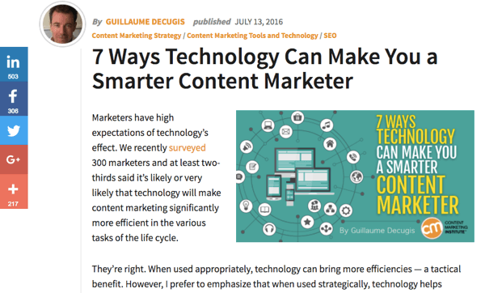

What is a Blog?

Slide 10
Do you know what a Blog is?
Blogs began in 1994. A blog was more of a personal diary that people shared online. In this online journal, you could talk about your daily life or share about things that you were doing. Then, people saw an opportunity to communicate information in a new way online. Then began blogging.
Definition: A blog (a shortened version of “weblog”) is an online journal or informational website displaying information in reverse chronological order, with the latest posts appearing first, at the top. It is a platform where a writer or a group of writers share their views on an individual subject

Slide 11
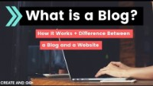
Website or Blog?
https://www.youtube.com/watch?v=SXbEN5lWRt8

Slide 12
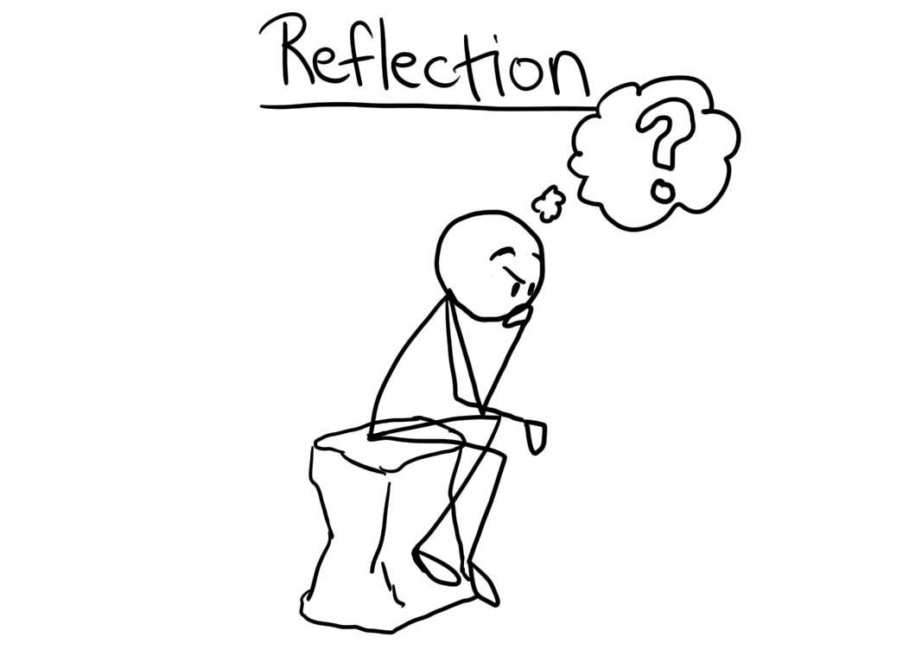
How do I Start a Blog?
https://firstsiteguide.com/start-blog/
https://makeawebsitehub.com/what-is-a-blog/

Slide 13
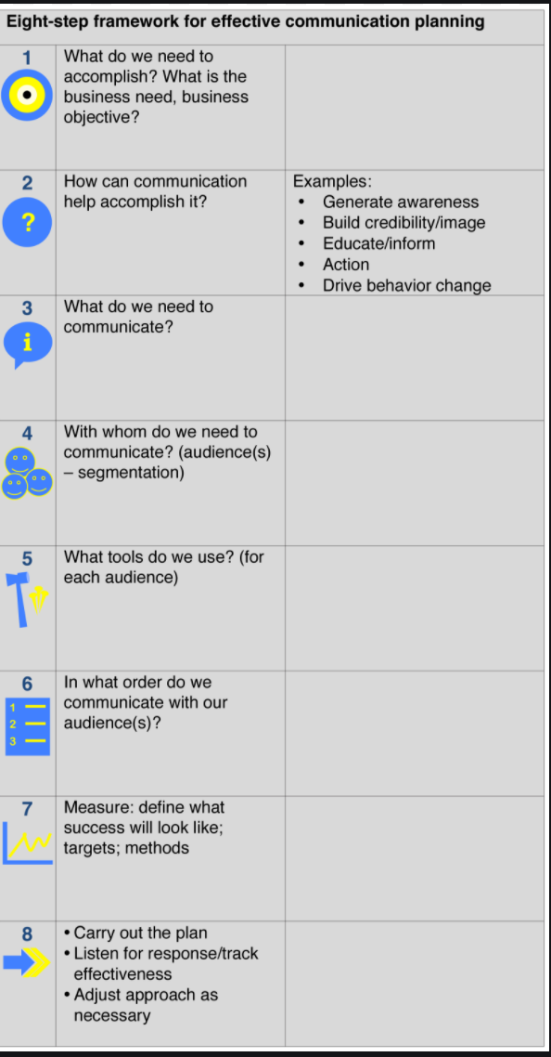
PLANNING THE BUSINESS MESSAGE

Slide 14
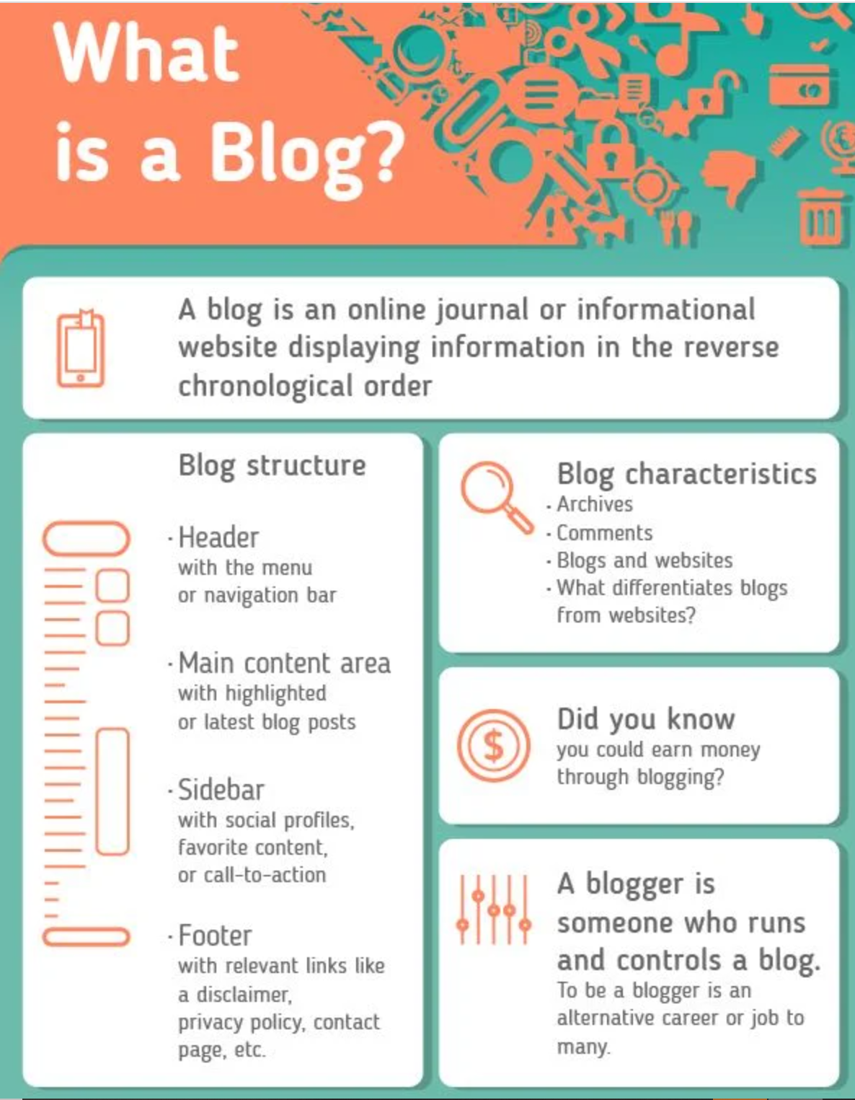

Slide 15

What do you think of today?
Now’s your chance to have a chat…
Any questions?
Don’t Forget – There is Study Skill hour every Wednesday during term times between 1-2pm

