Slide 1
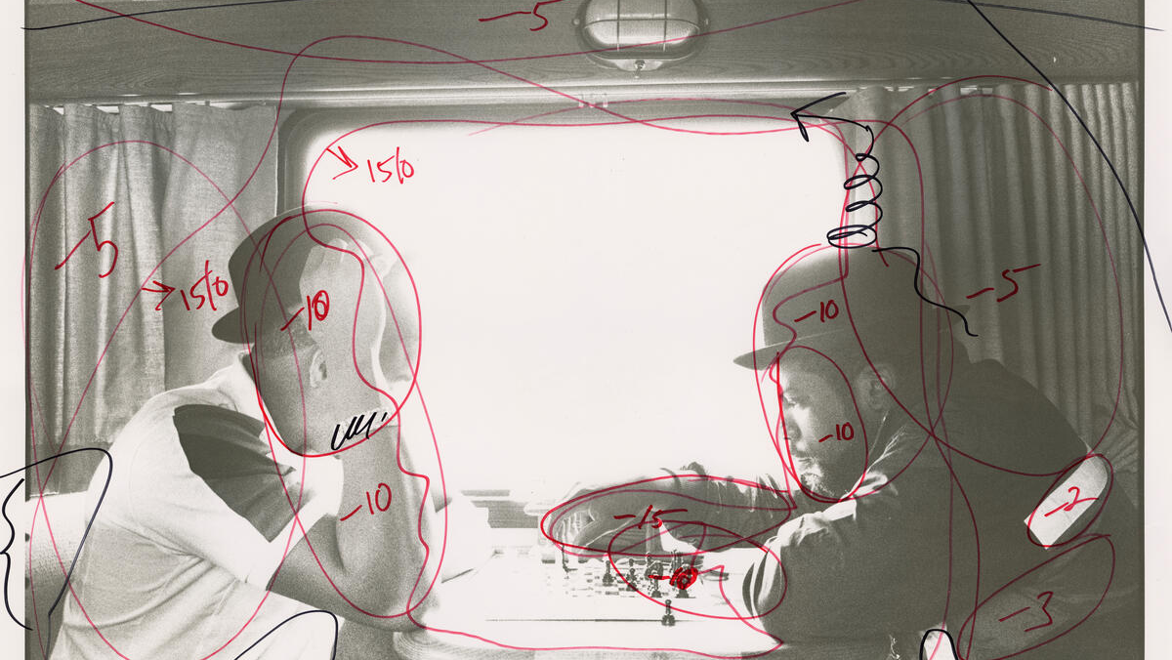
PROJECT CYCLE-
Editing & Evaluating

Slide 2
Task
Complete the following slides.
Start with an overview on why planning and documenting is useful as a photographer.
task 1 – How did they do that Use your notes from the session to explain in detail how one of the photographs was planned.
Plan your own roll of film in the same way using the headings provided.
Document the shoot
Use your session notes and photos.
Don’t include this slide

Slide 3
Editing
100-300 words on why documenting your editing is important:
Enlarger settings
Crops
Contrast settings
Screenshots in photoshop
Think about how these notes form a record for the future.
Include a finished print from the darkroom.

Slide 4
Evaluating
100-300 words on why evaluation is important:
How it connects you with your aim and intention
Reflect on things you’ve learned
Reflect on things you’ve excelled at
Reflect on mistakes you’d like to avoid in the future.
Discuss how it can shape your next steps.
Include an image of the project cycle

Slide 5
Editing – Darkroom Printing
100-300 words on how this work was printed
Using numbered steps, discuss the set of images on the right. Try to note the detailed steps you took, including the enlarger timings, crop and any other decisions.
Try to describe why you were doing this, whether you were successful and list any issues.
Include a set of images from the darkroom – preferably laid out in the order printed.

Slide 6
Critique
100-300 words noting your findings from the critique
Respond to 3 post it notes left about your work.
Reflect on how your work has been received.
Include an image of the critique

Slide 7
Evaluating
100-300 evaluation.
Using the list belowprepare a short but thorough evaluation of this roll of film, from planning, through to final images.
Aim – did you achieve your aim. Reflect on this
Planning – Did you plan well. What would you do differently?
Shoot – How did the shoot go? Did you perform well. Would you change anything?
Selection (from contact Sheet) – Does your selection make sense for your aims?
Editing/Printing– Are your edits good quality? Did you learn something new?
*Critique – What do other people think? Is your work talking to your audience?
Outcomes – Have your outcomes displayed new skills? Do they achieve aims? What can you improve?
Include either: a successful image, contact sheet, image from printing or a final print from this roll of film.

