Slide 1

Workplace change
Nishat Choudhury & Jorna Ali
1704979 & 1706149

Slide 2

Agenda
Task 1 – Nishat Choudhury
Slide - 1
Task 2 – Jorna Ali
Slides – 2 & 3
Task 3 – Nishat Choudhury
Slides – 4-16
Task 4 – Jorna Ali
Slides – 17-21
Task 5 – Nishat Choudhury
Slides – 22&23
Task 1 – Jorna Ali
Slide - 24

Slide 3

Introduction
The organisation which will be looked at in this proposal presentation is Marks and Spencer. This proposal will describe the change process planned along with the success and failures of Marks and Spencer during the implementation phase.
M&S prepares a radical strategic change through the opening of their massive supermarket stores swapping clothing and homeware for products targeted at families for their regular food shop.
As per a report produced in January 2018 Marks and Spencer plans to reposition 25 percent of Clothing & Home stores by merging them to food-only stores and through the closure and downsizing of the current stores.
Sacha Berendji, Director of Retail at M&S stated that, We believe such changes are crucial to the success of M&S and so we will continue to accelerate the process by making difficult yet appropriate choices while we concentrate on expertise in M&S.
(M&S, 2018), (Craven, 2019)

Slide 4
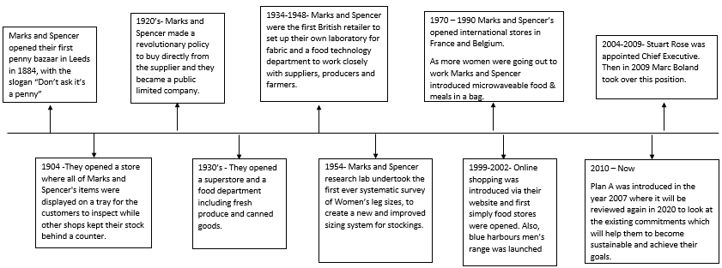
Timeline
Marks and Spencer were formed in 1884 when Michael Mark a Polish exile opened a market stall in Leeds, with the motto 'don't ask the value, it's a penny'. In 1894 Marks began his partnership with Spencer from where Marks and Spencer started.
(Marks & Spencer, 2019).

Slide 5
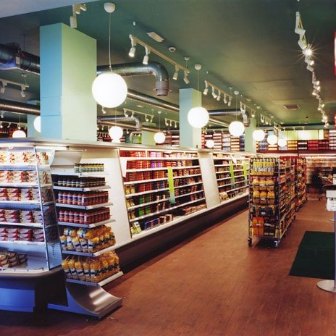

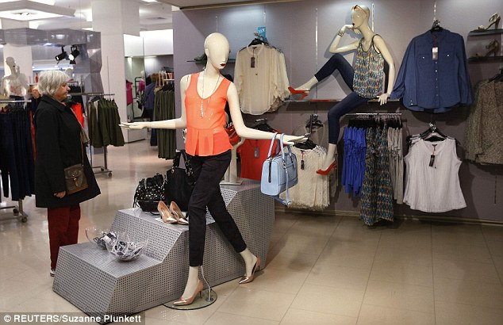
About M&S
M&S operates within the public sector and is a substantial international retailer with deep British origins and head offices located in the UK. They sell quality clothing, home and food products-most of which are own-branded M&S products. Marks & Spencer offers high first-rate fashion, award-winning food and fashionable homeware.
M&S currently holds 1,025 UK stores 302 Fashion, Home and Food shops, 684 Food-only stores and 39 Outlets. The organisation hires around 85,000 people globally, over ninety percent of which are based within the UK. The organisations head offices are based in Stockley Park, Nottingham and Manchester.
(M&S, 2018), (M&S, 2019)

Slide 6




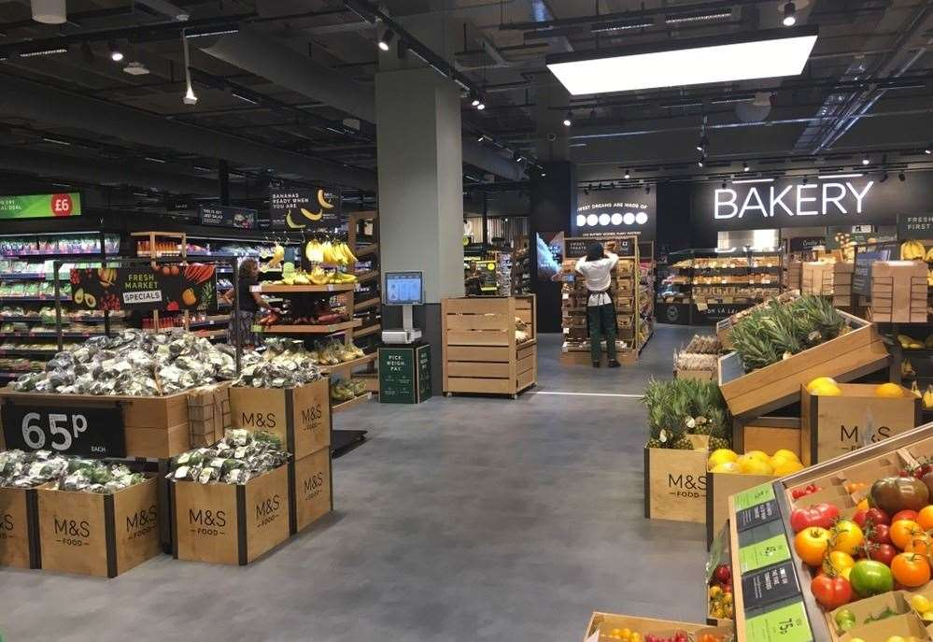
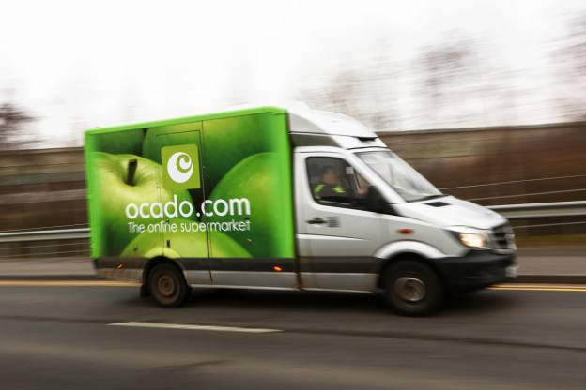
M&S want to change the perception of people
that its stores are not only for singles and couples but also for families. They want to encourage customers to purchase more of their everyday food from their stores.
The radical change will include the transformation of current stores to remove clothing displays and convert it into supermarkets as well as their partnership with Ocado by moving one third of their sales online with a wider range of over 40,000 products available.
(M&S, 2018)

Slide 7
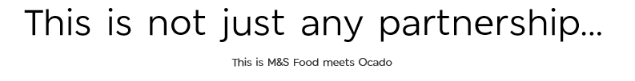
M&S wants to move a third of their sales online. Customers will be assisted by a consistent online experience throughout all digital channels across the web and social media, as well as a conveniently located selection of food stores providing customers a next day collection in store for clothes and household buys.
Benefits of the Partnership
Convincing approach to unlock M&S Food development
Partnership with complementary skills and assets
Opportunities to establish long term value for both companies.
Combination of technology, innovation and high quality food.
M&S, (2019).

Slide 8
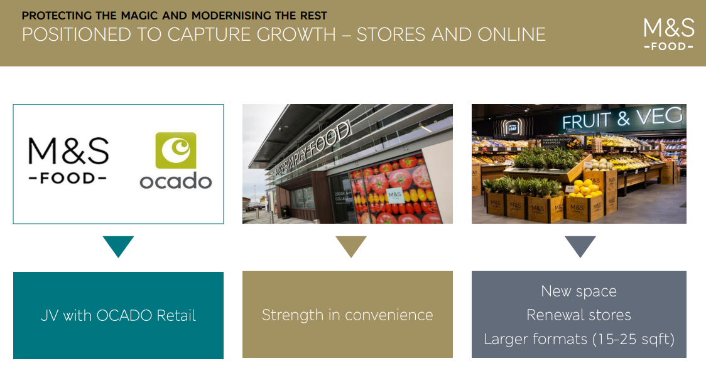

Slide 9
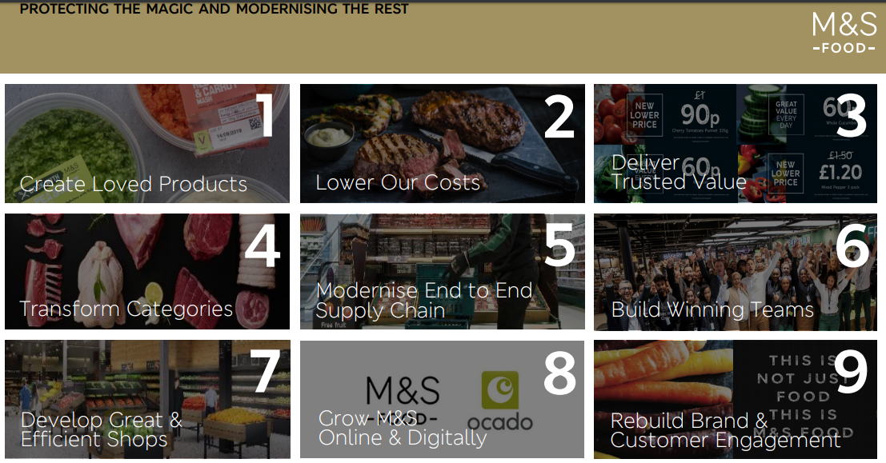

Slide 10
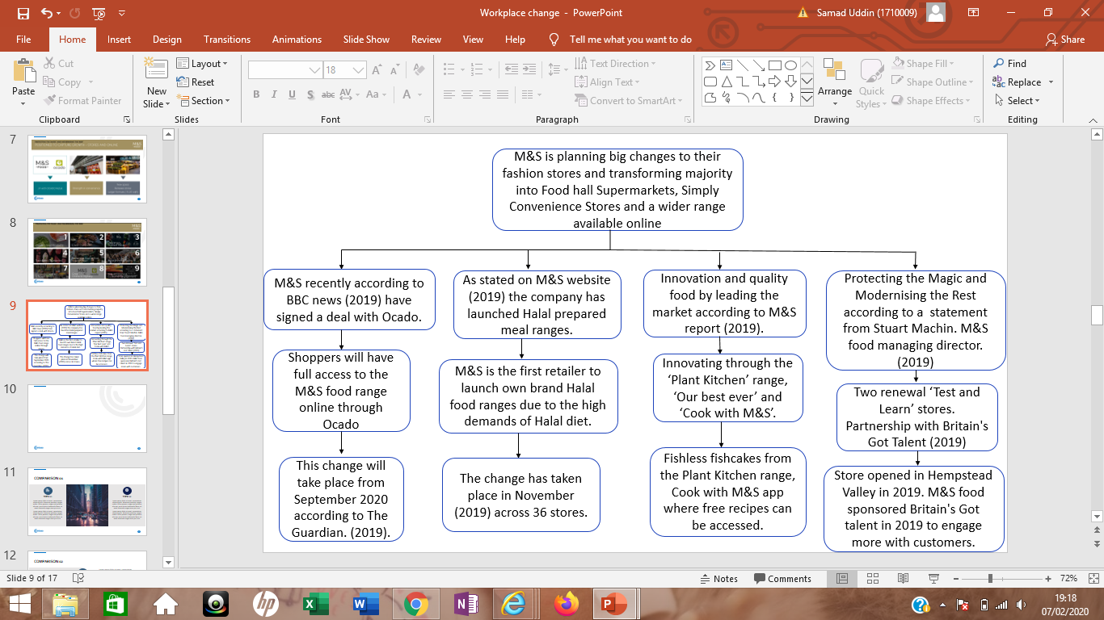
(Machin, 2019)

Slide 11
Transformational Change
Transformational change has become a comparatively new corporate change. It is adamant with radical change and is fundamentally changing the way organisation is viewed both internally and externally as well as how it functions. That level of change will be pertinent to Marks and Spencer’s situation, because this would fundamentally change the way the organisation works in a completive situation. They have encountered many tough competition from their rivals these days, such as competitive pricing strategies and the use of outstanding marketing strategies and latest trends as lower prices.
(Neate, 2019)

Slide 12

Collaboration
Marks and Spencer's collaboration with Ocado has been influenced by the growing market interests of people who want value for money and prefer to have quality food rather than quantity. Steve Rowe in an interview with The Guardian stated that “partnering with Ocado was the only way to bring M&S food to more shoppers, because its range of products was too small for consumers to do a whole weekly shop directly with M&S”.
(Neate, 2019)

Slide 13
Stuart Machin - Managing Director of M&S food
Stuart Machin, the MD of M&S Food believes that he has a great team geared up to bring change into their food trade by creating great tasting, quality food for their customers. (2018). Lastly he states that the main aim is to have a store “with the mind of a supermarket and the soul of a fresh market”. (2019)
(Butler, 2019)
Stuart Machin claims that by loosening up and attracting in more household customers, M&S is attempting to make significant progress on the extremely-tight grocery industry. He states that they intend to be much more than special occasions and a fresh ready meal. When there are larger stores they do well however in reality there are very few of them. (2019)
(M&S, 2018)

Slide 14
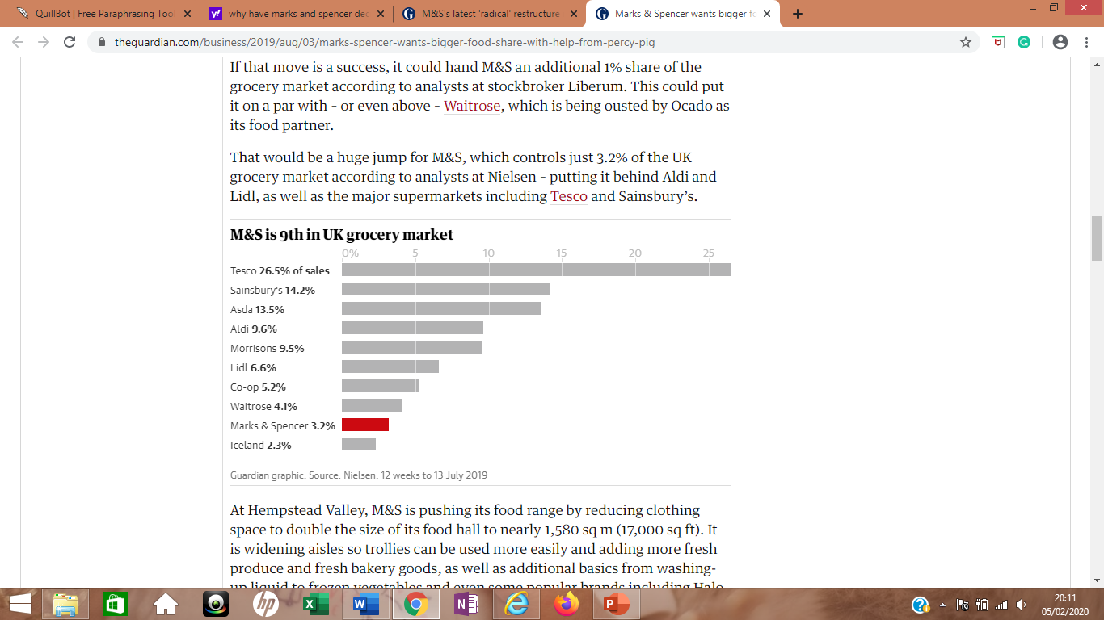
chart
(Butler, 2019)

Slide 15
swot
Strengths
Weaknesses
Delivering trusted value and creating long term value opportunities for M&S the brand
Customers will benefit from the broadest range in UK food retail
Hempstead supermarket store which attracts customers to do their full weekly shop as its bigger and stocks a wide range of products
A strategically convincing way to accelerate M&S food development through a competitive flexible position on the online grocery sector, the fastest growing platform in the UK.
Own brand product which means they are not comparable with others in the market.
Whereas food sales are rising M&S clothing and homeware sales are falling
Closures of around 100 stores as of March (2019) to move everything online.
Having to cut down on hundreds of promotions to keep the competitive price and better value.
Late joining the online platform as competitors have been there for several years.

Slide 16
swot
Opportunities
Threats
Being more innovative and combining the magic of M&S food with the leadership of Ocado.
Transformational step towards the future of M&S by moving a third of the business online.
Unlock growth within the food industry
Trying to compete against larger supermarkets such as Tesco
Price matching with Aldi and Lidl

Slide 17
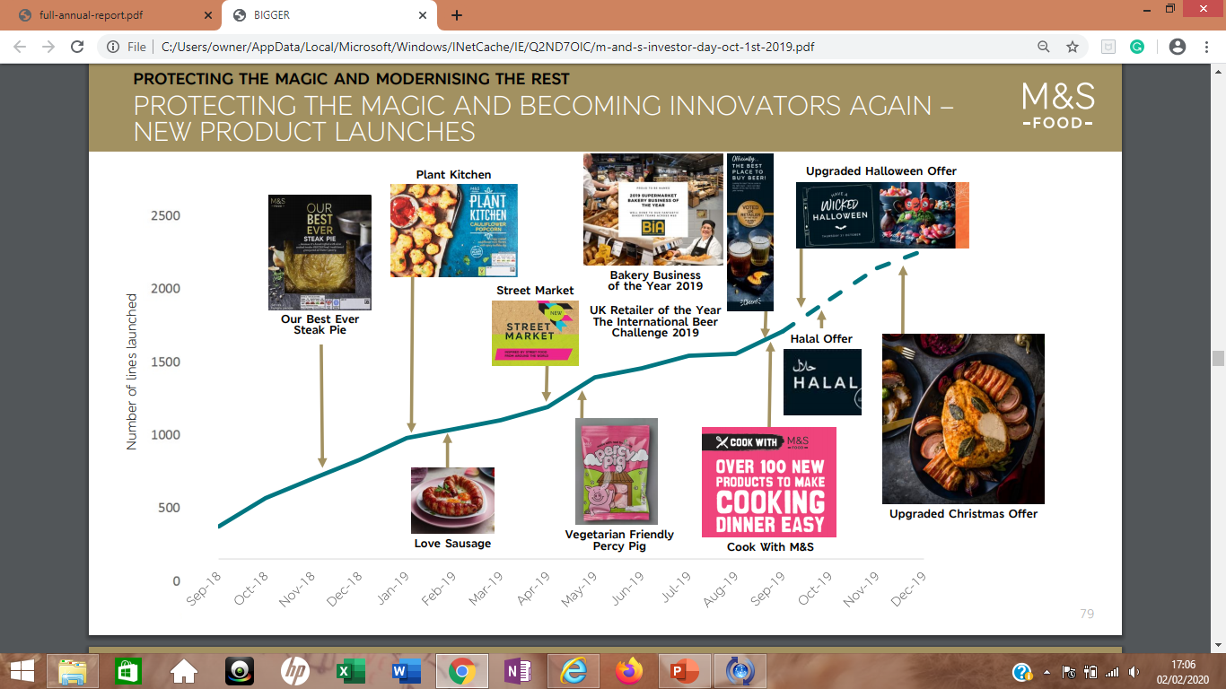
(M&S, 2019)

Slide 18
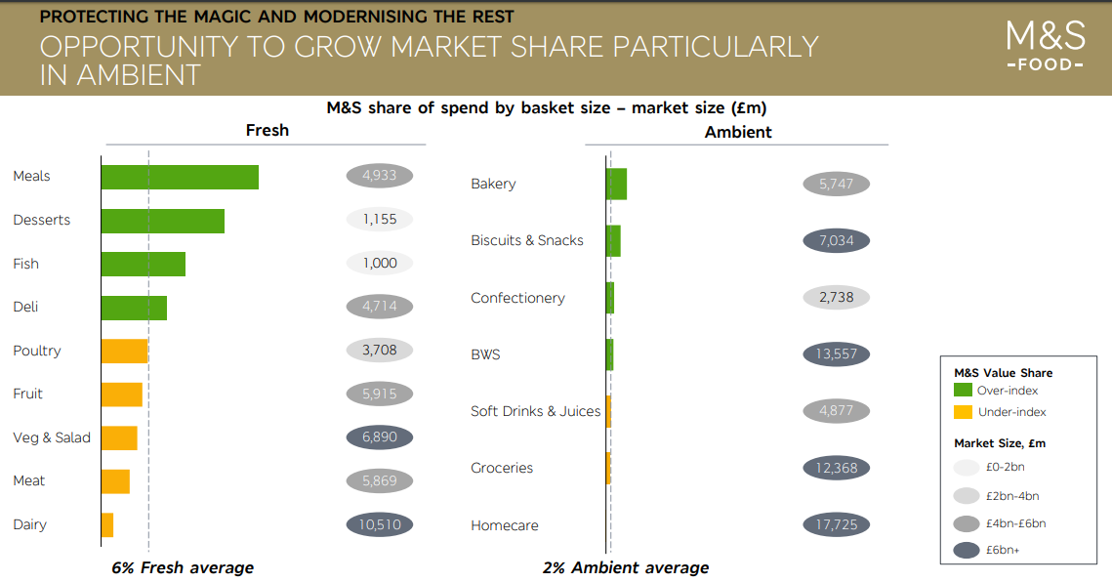
(M&S, 2019)

Slide 19
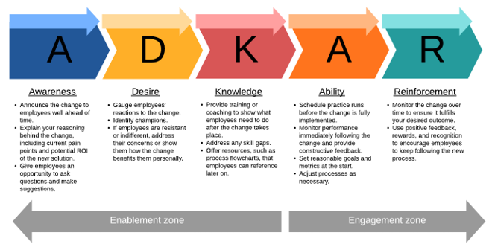
PROSCI ADKAR MODEL
The ADKAR model is a change management tool to help identify why change is difficult and why some changes succeed while others are unsuccessful. The name ADKAR is an acronym that is based on five building blocks that bring about successful change.
(Thought Leadership Articles , 2020)

Slide 20
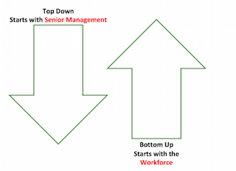
Lupton 1971 “Top down” “Bottom up” Management
Top-down management occurs when goals, project and tasks are determined among organisation’s senior leaders . Top-down management is the most common approach to organisation management.
Bottom-up management occurs when goals, projects and tasks are informed largely by employee feedback. Employees are invited to participate in goals settings – sometimes simply with feedback, sometimes with stake in the decisions. These goals are then communicated by each team to senior leadership.
(Lupton, 1971)

Slide 21
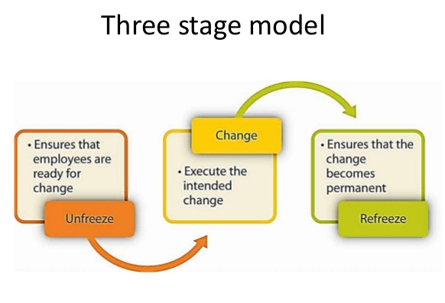
Lewin 1951
Unfreezing is the process by which people become aware of the need change.
Change itself is the movement from the old way of doing things to new way.
Refreezing makes new behaviour relatively permanent and resistant to further change.
(Jeffrey Lee Russell, 2006)

Slide 22

Case Study 1: McDonald
A failure to balance innovation with process efficiency
McDonald came up with a concept called “Made for you”
It required expensive equipment upgrade
The concept drastically slowed down waiting times
McDonalds did not plan properly and struggled to juggle conflicting priority
By prioritising innovation this drastically reduced satisfaction
They failed to use customer feedback and misjudged what customers really wanted
Ultimately “Made for you” failed and it damaged the company’s stock price
Poor leadership
(Lepsinger, 2018)

Slide 23
Case Study 2: NHS
Created and implemented an innovative technology that helps patients stay healthy and maintain their independence
This technology was targeted at terminally ill with long term health condition that requires regular monitoring
It also covers elderly people suffering from dementia and individuals with down syndrome
This technology, increases clinical efficiency and reduces the financial cost of institutional health care in the UK
The implementation is the worlds biggest trial of remote monitoring of chronically ill patients in their homes
Many people have benefitted from this programme
The technology enables people to live independently in their homes
It is not intended to replace hospitals and care homes but to make better use recourse and reduce financial burden on the system
NHS leadership was able to provide a clear vision of the change programme and shared goal across the NHS.
One of the key positives of the planning process is all the stakeholders were involved to bring about change.
(NHS Improvement , 2011)

Slide 24
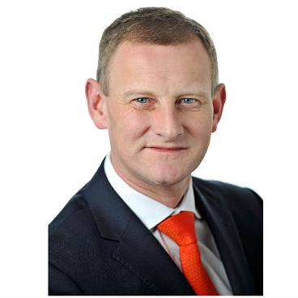

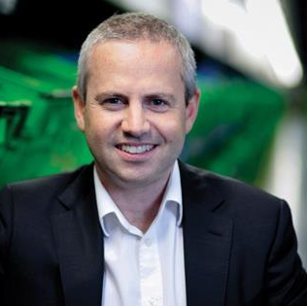

Views & Opinions
Steve Rowe
The Guardian
Tim Steiner – CEO of Ocado
The independent
“I have always believed that M&S food could and should be online”.
Rowe rejected suggestions that M&S had paid too much to get into the growing internet grocery business. “We think we’re paying a fair price and I think Ocado do too,”
M&S shares fell by 12% as investors and analysts raised concerns that the 134-year-old high street retailer had overpaid for access to Ocado’s technology and delivery network.
“We are delighted that our UK retail business will become a joint venture with M&S”.
“The combination of Ocado and M&S will allow us to grow faster, add more jobs, and create more value. We are very excited by the many opportunities ahead.”
Is the Marks & Spencer and Ocado partnership just what shoppers ordered, or an expensive mistake?
M&S clearly can’t compete with the big supermarkets when it comes to customers’ weekly shops, says Paul Mumford at Cavendish Asset Management, which holds shares in M&S.
(Neate, 2019), (M&S, 2019), (Chapman, 2019)

Slide 25
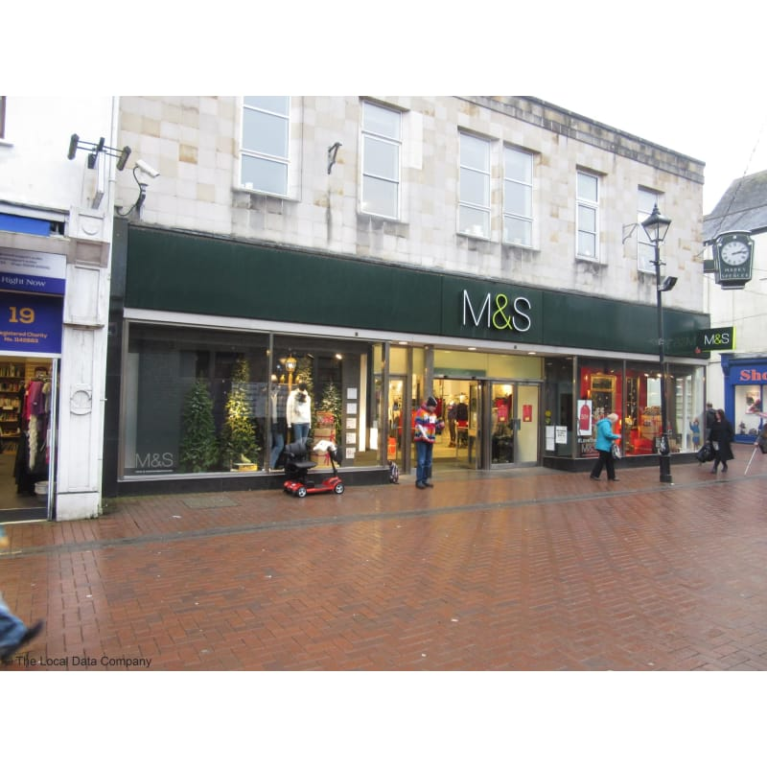
Primary Research- Interview with Jan Samuel
An interview with Jan Samuel-Manager at the Neath M&S store to confirm the recent changes taken place.
She has stated “There has been a closure of international stores some within the UK. The biggest change we are going through at the moment is the collaboration with Ocado the online food retailer”.
(Samuels, 2020)
23

Slide 26
Aims
To understand a critical analysis of the change process at Marks and Spencer’s.
Objectives
To enable the achievement of the proposal aim the following objectives have been set:
To identify a current change being planned at M&S.
Analyse the nature of the change by investigating influencesly and compiling a SWOT analysis.
Support the analysis with primary and secondary research
Undertake a compare and contrast scenario tested on the proposed change.

Slide 27

Thank you!

Slide 28
references
Butler, S. (2019). The Guardian - Marks & Spencer wants bigger food share (with help from Percy Pig). [Online]
Available at: https://www.theguardian.com/business/2019/aug/03/marks-spencer-wants-bigger-food-share-with-help-from-percy-pig
[Accessed 04 02 2020].
Chapman, B. (2019). The Independent - Is the Marks & Spencer and Ocado partnership just what shoppers ordered, or an expensive mistake?. [Online]
Available at: https://www.independent.co.uk/news/business/news/marks-spencer-ocado-online-grocery-shopping-share-price-a8799631.html
[Accessed 08 02 2020].
Lepsinger, R. (2018). 3 Companies That Failed To Adapt, and Where They Went Wrong. [Online]
Available at: https://www.google.co.uk/amp/s/www.business2community.com/business-innovation/3-companies-failed-adapt-went-wrong-01895678/amp
[Accessed 10 02 2020].

Slide 29
Lupton, T. (1971). Organisational Change: “Top‐Down” or “Bottom‐Up” Management?. Bingely: MCB UP Ltd.
Machin, S. (2019). PROTECTING THE MAGIC AND MODERNISING THE REST: FOOD STORE RENEWAL TRIAL UNDERWAY AT HEMPSTEAD VALLEY. [Online]
Available at: https://corporate.marksandspencer.com/stories/blog/protecting-the-magic-and-modernising-the-rest-food-store-renewal-trial-underway-at-hempstead-valley
[Accessed 04 02 2020].
M&S, (2019). BRINGING THE BEST TOGETHER: TRANSFORMING UK ONLINE GROCERY SHOPPING M&S AND OCADO ANNOUNCE NEW JOINT VENTURE. [Online]
Available at: https://corporate.marksandspencer.com/media/press-releases/5c2f8d617880b21084450f5e/bringing-the-best-together-transforming-uk-online-grocery-shopping-m-and-s-and-ocado-announce-new-joint-venture
[Accessed 08 02 2020].
M&S, (2019). Business Wide. [Online]
Available at: https://corporate.marksandspencer.com/sustainability/business-wide
[Accessed 04 02 2020].
M&S, (2019). Far Reaching Change Report At M&S, England: M&S.
M&S, (2018). M&S FOOD MD KICKS OFF TRANSFORMATION PLAN WITH NEW LEADERSHIP TEAM. [Online]
Available at: https://corporate.marksandspencer.com/media/press-releases/2018/food
[Accessed 04 02 2020].

Slide 30
M&S, (2018). M&S UK STORE ESTATE UPDATE. [Online]. Available at: https://corporate.marksandspencer.com/media/press-releases/2018/m-and-s-uk-store-estate-update_1
[Accessed 03 02 2020].
Neate, R. (2019). The Guardian - M&S agrees £750m food delivery deal with Ocado. [Online]
Available at: https://www.theguardian.com/business/2019/feb/27/marks-and-spencer-agrees-750m-food-delivery-deal-with-ocado
[Accessed 08 02 2020].
NHS Improvement , (2011). Overview-Change Management- The Systems and Tools for Managing Change, Leicester: NHS Improvement.
Raven, N. (2019). Daily Mail - It’s not just any supermarket…M&S plans radical strategic change by opening huge grocery stores and swapping clothes for produce to target the family food shop market. [Online]
Available at: https://www.dailymail.co.uk/news/article-6817683/M-S-target-family-food-shop-opening-string-large-grocery-stores.html
[Accessed 04 02 2020].
Russell, J.L. (2006). Change Basics. United States of America : ASTD Press.
Samuels, J. (2020). M&S - Neath [Interview] (01 02 2020).

Slide 31
Thought Leadership Articles , (2020). The Seven Concepts of Change. [Online]
Available at: https://www.prosci.com/resources/articles/seven-change-concepts
[Accessed 05 02 2020].

