Slide 1
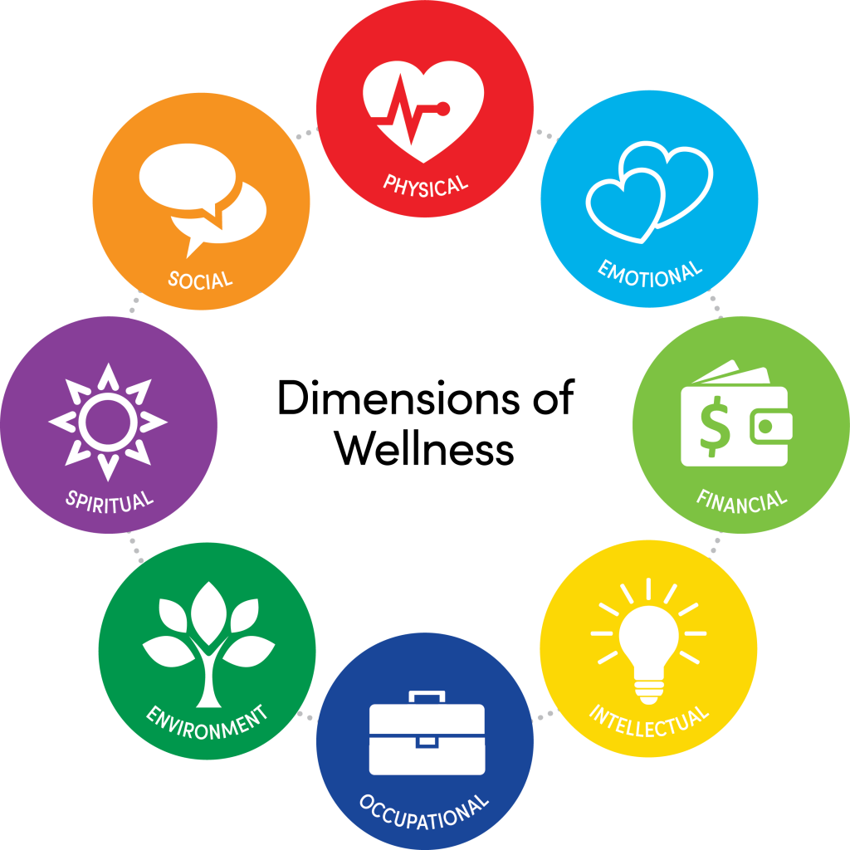
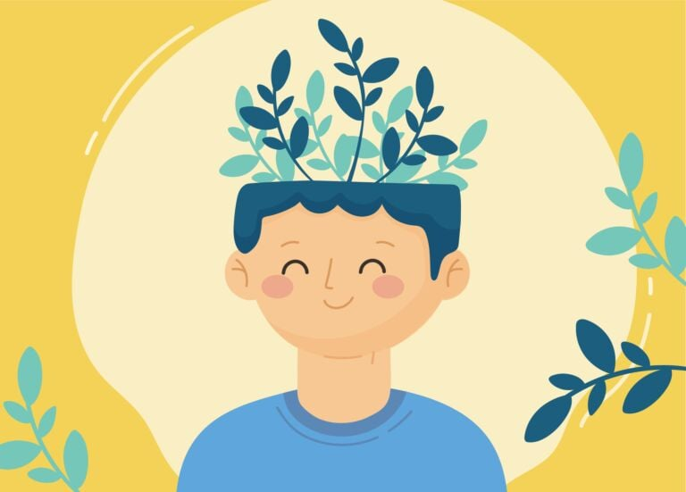

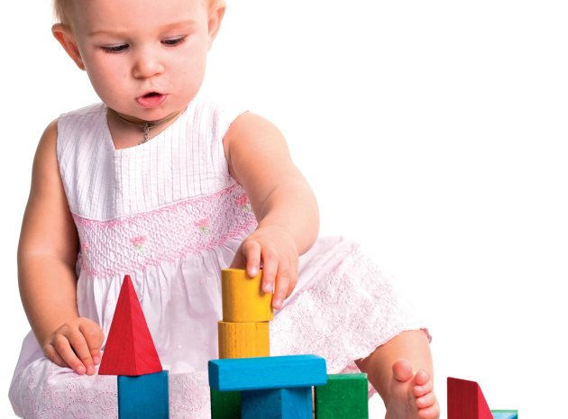
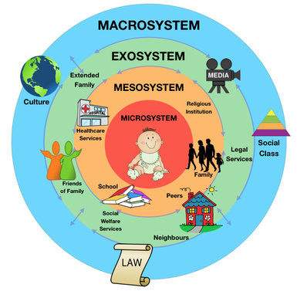
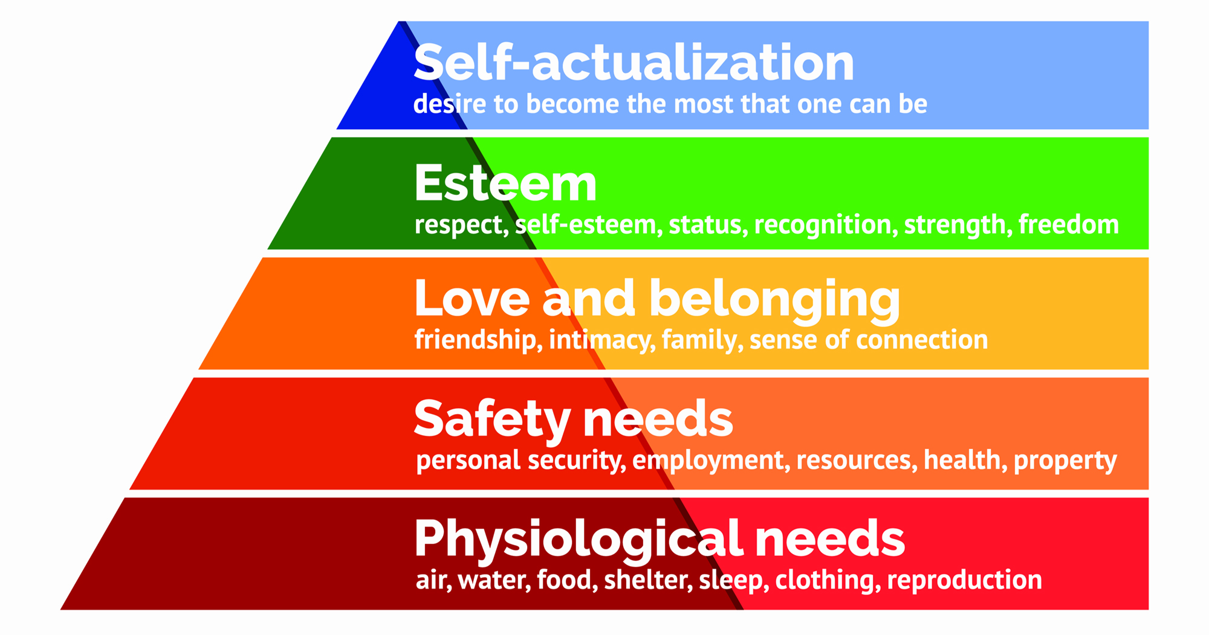
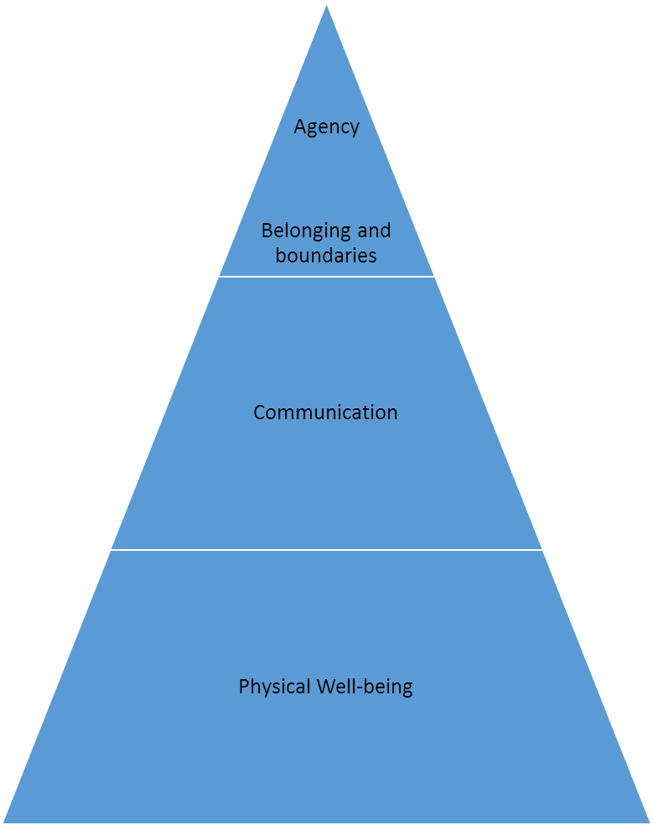
Health, Well-Being, and Lifestyle During Early Years of Young Children
1. Introduction
The concepts of health, well-being and lifestyle have been discussed with reference to early years, as well as adulthood.
This poster includes the definition of concepts of health, well-being, and lifestyle, with reference to the theories of Bowlby, Bronfenbrenner, Maslow, and the ABC Model of Wellbeing.
It discusses the reasons why the concepts of health, well-being, and lifestyle are important with reference to the early years of children.
It also includes an explanation of the manner, in which the early years' professionals do to contribute to the health, lifestyle and well-being of early years children.
Bronfenbrenner Theory
With reference to Bronfenbrenner's Theory, five essential environmental systems interact with one another and influence the development of the child.
These five systems include the mesosystem, macrosystem, microsystem, chronosystem, and exosystem. With reference to this theory, the components of the mental health of individuals are embedded into the ecological contexts related to influential relationships. The ecological systems include peers, family members, educational institutes, places of employment, and social circles.
Mesosystem represents the relationship between different microsystems.
Exosystem referred to as the environmental setting, having an indirect influence on individuals. For example, social services, and neighbors are exosystems.
Macrosystem is a culture of individuals; therefore, customs, beliefs, and government are mesosystem.
Chronosystem is made up of several environmental transitions, as well as events during the life course. For instance, the circumstances of happiness, or sorrow in the family.
3. Health and Wellbeing with reference to Theoretical Foundation
Maslow Theory
The Hierarchy of Needs Theory proposed by Maslow is a health model which is based on the organization of needs, rather than typical models of health and illness (Hopper, 2020).
With reference to Maslow’s theory of health, certain needs are significant, as compared to others; therefore, individuals tend to acquire the important needs, prior to satisfying other needs.
Maslow’s theory of health is categorized into physiological needs, and self-actualization needs.
With reference to Maslow’s hierarchy, physiological needs are basic needs, which are essential for individuals requiring physical survival. For instance, food, drinks, clothing, shelter, warmth, as well as health, are physiological needs defined by Maslow Hopper, 2020).
These needs are required for the appropriate functioning, health, and well-being of individuals. Whereas the fifth level of the pyramid of Maslow is referred to as growth needs, which enable individuals to self-actualize, and reach to full potential as human beings.
2. Definition of Concepts of Health, Well-being, and Lifestyle
The analysis of definitions of health, well-being, and lifestyle revealed that there are several different ways of thinking, and perceiving health, and well-being. Different definitions of health and well-being are described below:
Health can be defined as the absence of disease, physical illness, and mental distress.
Health can also be referred to as the state of complete mental, physical, as well as social well-being, and cannot be defined as the absence of disease or infirmity (WHO, 2022).
Health and well-being can also be defined as achieving and maintaining physical fitness, as well as mental stability.
Health and well-being can also be referred to as a combination resulted due to a combination of physical, intellectual, social, as well as emotional factors (Musgrave, 2017).
The analysis of the definition of well-being revealed that well-being means that an individual has been performing well in all areas of life, including being happy, safe, and healthy (Gov.Wales, 2019).
Well-being can be defined as a multi-dimensional concept, encompassing physical, social, as well as emotional well-being and having a focus on the immediate and future lives of individuals(Statham and Chase, 2010).
Well-being can be described as a positive outcome which is meaningful for individuals, as well as different sectors of society. Well-being also influences the lifestyle of individuals by providing them with opportunities for housing, employment, and good living conditions.
Well-being can also be described as the way individuals feel about themselves, and have feelings of happiness, health, and economic stability. Thus, having a good self-concept can be considered a feeling of well-being of individuals (Health, Social Care, and Children Services, 2022).
Health and wellbeing can also be defined with reference to several determinants, including, living circumstances, environment, residence, income, as well as relationships.(Public Health, England , 2017). Thus, there has been a close association between health, well-being, and lifestyle.
ABC Model of Wellbeing
The ABC model of wellbeing comprises four essential constructs, including agency, belonging and boundaries, communication, and physical wellbeing. With reference to the early years' practitioners, the wellbeing of children is dependent on these factors, and missing any of these factors is likely to have e negative impact on the health and well-being of children during early life, as well as during adulthood (Roberts, 2014).
Bowlby Theory
With reference to Bowlby's theory, the initial two years of the life of children are most significant for the formation, as well as maintenance of relationships, and attachments (Heard, Lake, and McCluskey, 2018).
The disturbance in the attachment at this stage is likely to contribute to antisocial behavior, depression, and delinquency throughout life.
The continual disruption of attachment between mother and infant is likely to give rise to a range of social, cognitive, as well as emotional difficulties for infants, and these effects can be considered irreversible (Heard, Lake, and McCluskey, 2018).

Slide 2
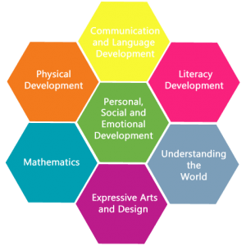
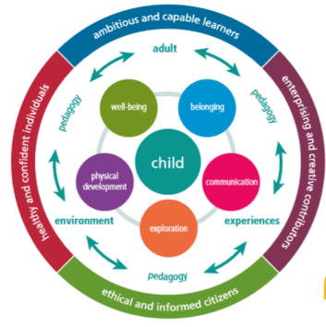
4. Significance of Considering Health and Wellbeing Concepts with reference to Early Years Children
The concept of health is not confined to merely the absence of disease (Musgrave, 2017); rather, health is a human resource facilitating children as well as adults in adapting to the challenges of daily life resisting infections, coping with adversity, feeling a sense of personal wellbeing, and interacting with their surroundings for promotion of successful development.
The nations having positive indicators of health, including longer life expectancy and lower rates of infant mortality have been reported to possess higher levels of wealth, as well as lower levels of income inequality. Thus, the health and well-being of young children can be considered the wealth of nations.
The sound body, as well as mind of young children, is likely to enhance their capacity for developing several competencies, which are essential for becoming contributing members of any society (Yoshikawa, 2010).
The management of the development needs of young children is more than the development of a strong foundation for physical, and mental health, and enhancing the learning capacity of children at school (Wassell and Dodge, 2015).
Early Year Educators have an increased emphasis on the health and well-being of children in their early years because children learn and experience since their birth. The experiences which are built within the bodies of young children during the early years of life are likely to produce psychological disturbances, as well as embedded biological memories (Yoshikawa, 2010). These memories then persist till adulthood and lead towards lifelong impairments in physical as well as mental health.
The genes, as well as experiences of children during the early years of life, interact with each other for determining the vulnerability of individuals towards the early years of diversity (Morgan et al., 2019). For young children experiencing adversity, the influence of the environment is one of the most powerful as compared to genetic predisposition, increasing the odds of having chronic illness during adulthood.
According to Early Year Educators, investing time, resources, and efforts for strengthening the foundations of health, and mitigating the adverse effects of the environment, relationships, and health in prenatal, as well as early childhood, is likely to contribute to promoting health, and preventing illness during the adulthood.
5. Ways to Help and Support Health , Lifestyle and Well- being of Children in Early Years of Life
With reference to the biology of early health and well-being, there are complex interactions among genes, environmental conditions, as well as experiences, causing either negative disruptions, or positive emotions within the basic systems of biology that cause life consequences on the physical, as well as mental health of individuals (Steptoe, 2019).
Society can adopt several ways the create an environment for children according to the needs of their biological systems and provide positive outcomes of health. Some of the ways for supporting the health, well-being, and lifestyles of children are as follows.
Creating a Stable and Responsive Environment of Relationships
Human infants are unique among all other species, due to having a prolonged period of dependence on are provided by adults. Human infants require protection for survival, as well as for their healthy development (Yoshikawa, 2010).
The care received by infants from parents, childcare professionals, extended family members, or other individuals present within their social circle builds the foundation for their development. The foundation is based on several basic biological features, supporting the regulation of emotions, attention, the sleep-wake cycle, and other psychosocial functions (Farrell, Law, and Thomas, 2020).
Thus, the delivery of responsive, stable, as well as nurturing care during the early years of life contributes to better physical, as well as mental health of children, higher achievements in education, and fewer problems associated with behavior.
Learned Behaviors for Health-Promotion
Early caregiving and education also influence the development of behavioral patterns, and routines of young children, which influence their lifelong trajectories.
The early behaviors including tooth brushing, levels of physical activity, screen time, and several other activities influence their lifelong behaviors and patterns. In this regard, the provision of education and training regarding food preferences, and the significance of levels of physical activity are some of the behaviors of health promotion, which can be conveyed to children during the early years to assuring their health and well-being in adulthood.
Contribution of early years professionals towards health, lifestyle and well-being of early years children
The Early Years Professionals contribute to the development of Children during the early years create an environment of relationships for children, which might contribute to lifelong outcomes with reference to the stress response system, emotional health, competence of the immune system, as well as establishment of health-related behaviours. The early years professionals can also facilitate parents, and care providers in enhancing the quality of life for young children by providing them with an adequate environment for growth and development.
The Early Years Professionals play an active role in assuring the health and well-being of children during their early years by providing them with the opportunities to establish close relationships with their peers, and educators at school. Moreover, these practitioners are likely to guide parents, and family members of young children regarding the formation of secure attachments with children for having a positive impact on their health and well-being.
The Early Years Professionals are likely to work in collaboration with the health and social care professionals to assuring parenting education, as well as home visiting programs for the health and wellbeing of young children. The early-year professionals introduce programs to assuring that primary caregivers or parents of young children have the skills and knowledge to assuring the availability of a safe environment and learning experiences for the health and well-being of young children.
The awareness provided by the early years' practitioners to parents of young children is likely to contribute to the creation of a healthy home environment and improve the health and well-being of children during the early years, as well as in the long run.
Provision of a Secure Environment
Responsive caregiving and the formation of strong, as well as positive bonds with children in their early years, have long-lasting impacts on their physical and mental health. Infants who are securely attached are likely to demonstrate positive emotions and fewer levels of anxiety during the early childhood years (Yoshikawa, 2010). In addition, infants having secure attachments are likely to have an easier time in the establishment of a relationship with their peers, and educators.
The patterns of attachment developed during the early few years of life are likely to influence mental and psychological health and functioning during childhood and adulthood.
5. Conclusion
In conclusion, it can be stated that early years are significant for health, well-being and development of children. The early years practitioners, parents, and other family members of children are required to work in coordination with each other for creating a foundation for lifelong health, and well-being of children.

