Slide 1
Adolygu syml – dysgu cyfeiriol
Simple revision – directed learning
Darlith 2 / Lecture 2

Slide 2
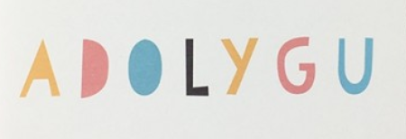
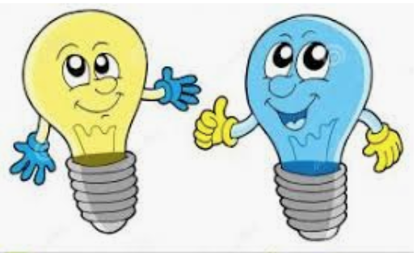
Gorchmynion
Sawl gorchymyn ydych
chi’n cofio?
How many commands can you remember?

Slide 3
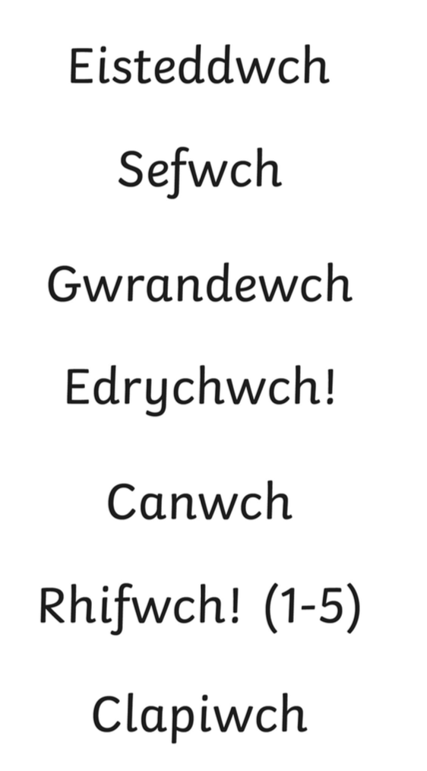

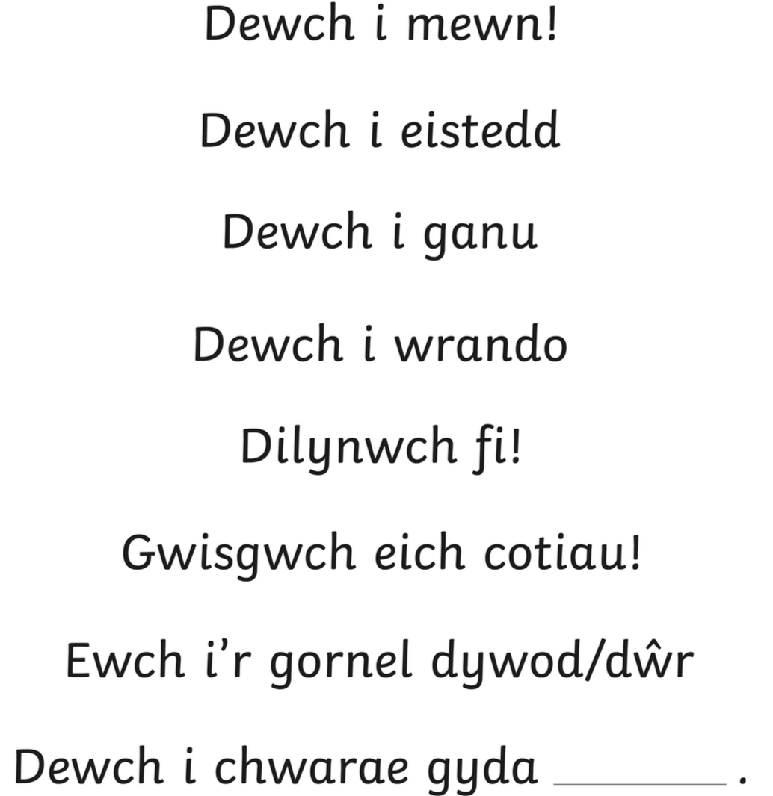

Lluosog

Slide 4
Tasg
Nawr – ysgrifennwch ffurfiau unigol y gorchymion
(Write the single form of these commands)

Slide 5
Atebion
Answers
Eistedda
Dere
Sefa
Gwranda
Edrycha
Dilyna
Cana
Gwisga
Rhifa
Cer
Clapia

Slide 6
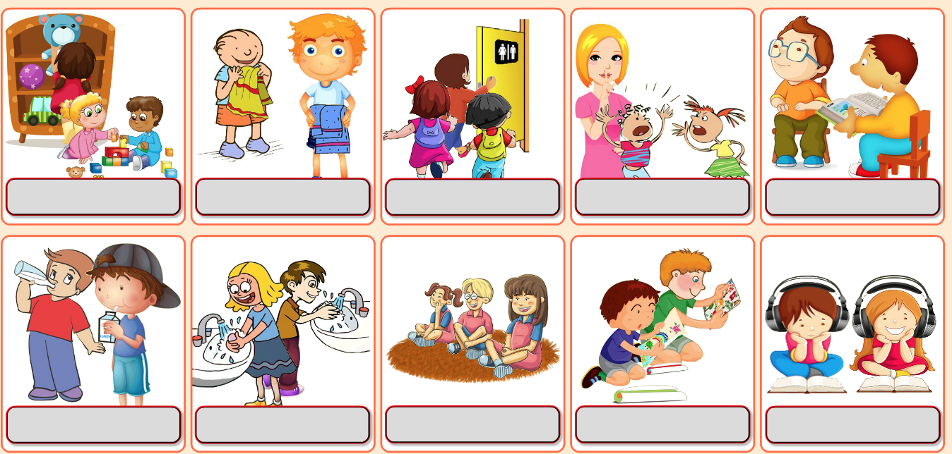
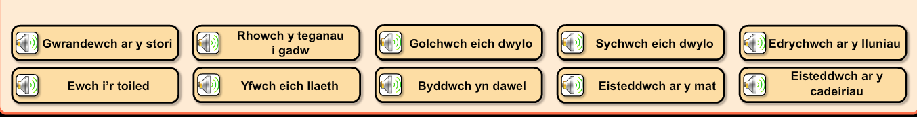
https://ybont.org/pluginfile.php/30649/mod_resource/content/3/Sesiwn%202%20-%20Gorchmynion%20%28De%29/Gorchmynion%20%28De%29.html

Slide 7
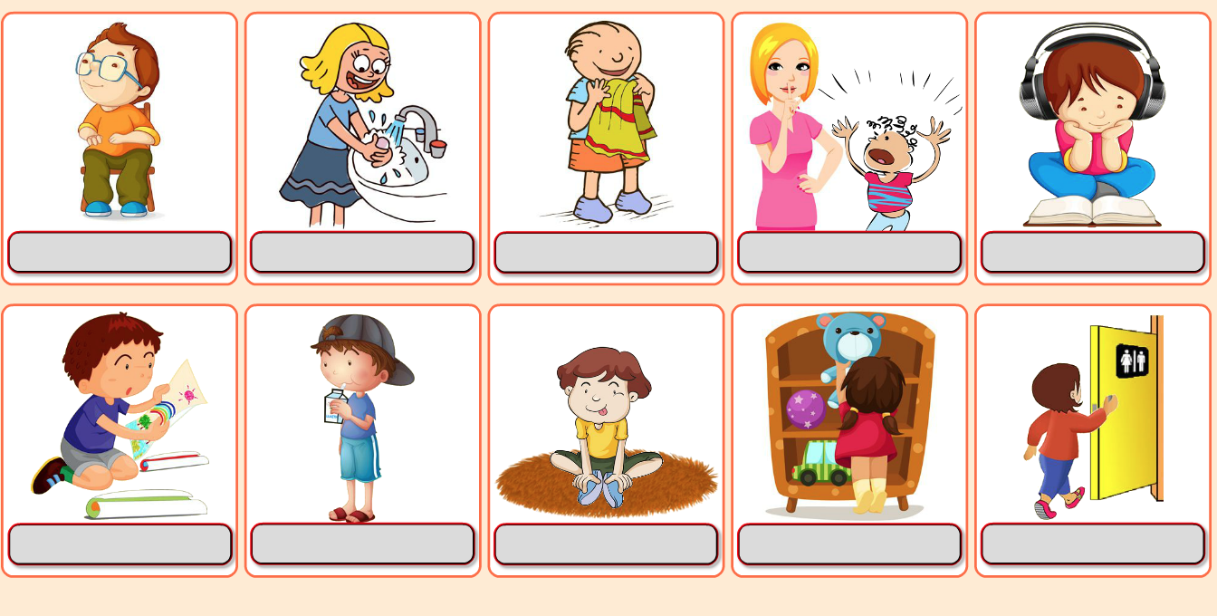
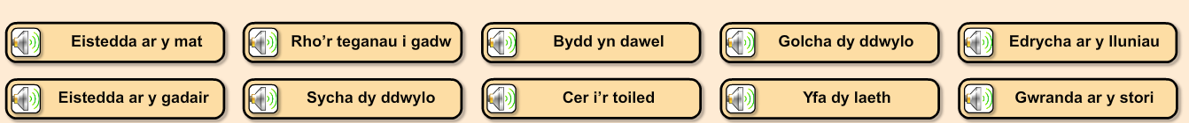

Slide 8
Gwrandewch ac ailadroddwch
Listen and repeat

Slide 9
Barod!
Pawb yn barod?

Slide 11
Rhowch y sain wrth y llun cywir
Put the correct recording next to each picture

Slide 13
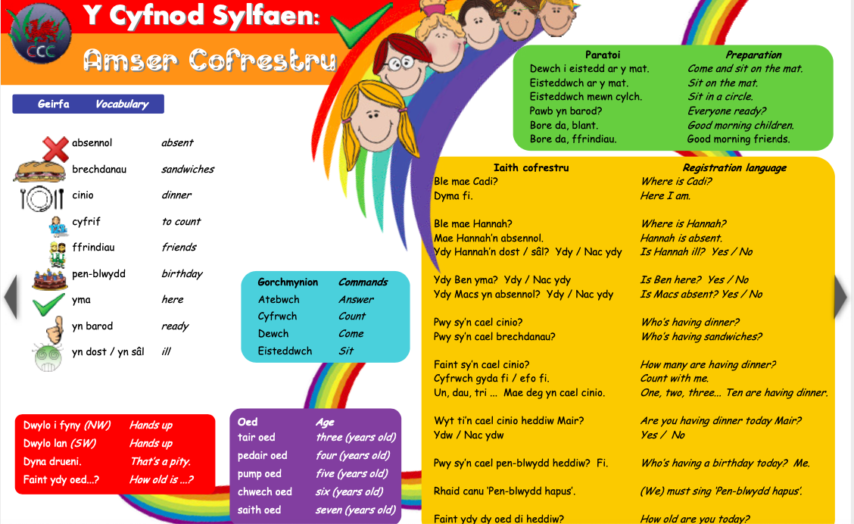

Slide 14
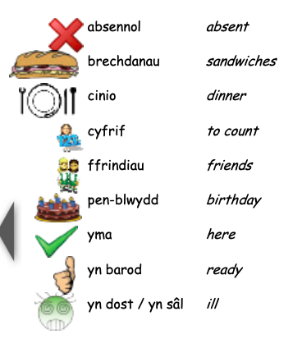
Beth ydy’r termau Cymraeg?
What are the Welsh terms?
1
2
3
4
5
6
7
8

Slide 15
Dyma nhw! Oeddech chi’n gywir?
Here they are! Were you correct?
1
2
3
4
5
6
7
8

