Slide 1

Counselling

Slide 2

TEAM MEMBERS
Gzala Saddique 1808935
Justina Demming 1810908
Iram Shazadi 1807072

Slide 3

Does counselling help ?

Slide 4
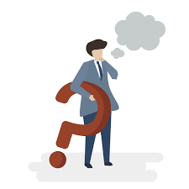
Why do people attend counselling ?

Slide 5

Why do some people refuse to go t0 counselling ?

Slide 6

What are the different types of counselling?

Slide 7
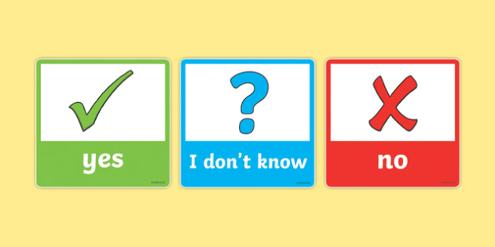
Is it affective or not ?

Slide 8

Conclusion

Slide 9
References
All Psychology Schools (2020) Types of counselling [online] available from https://www.allpsychologyschools.com/counseling/types-of-counseling/ (15 June 2020]
Best Counselling Degrees (2020) What is Rehabilitation Counseling [online] available from https://www.bestcounselingdegrees.net/faq/what-is-rehabilitation-counseling/ [16 June 2020]
Bower, P, Rowland, N & Hardy, R (2003), 'The clinical effectiveness of counselling in primary care: A systematic review and meta-analysis', Psychological Medicine, vol. 33, no. 2, pp. 203-215. https://doi.org/10.1017/S0033291702006979
Counselling Directory (2020) Drug Addiction [online] available from https://www.counselling-directory.org.uk/drug.html#treatmentfordrugaddiction [16 June 2020]
Counselling Directory (2020) Mental Health [online] available from https://www.counselling-directory.org.uk/mentalhealth.html#mentalhealthsupport [16 June 2020]
An introduction to counselling (2003) (online) available from https://www.questia.com/library/119519668/an-introduction-to-counselling

Slide 10
Counselling Directory (2020) Mental Health [online] available from https://www.counselling-directory.org.uk/mentalhealth.html#mentalhealthsupport [16 June 2020]
Counselling Directory (2020). Types of therapy [online] available from https://www.counselling-directory.org.uk/counselling.html (June 2020]
Counselling NHS (2017) (online) available from
https://www.nhs.uk/conditions/counselling/
Online counselling pros and cons (2020)(online) available from
https://schools.au.reachout.com/articles/online-counselling-pros-and-cons
Psychology Today (2017) 10 Reasons why people refuse to talk to therapists [online] available from https://www.psychologytoday.com/gb/blog/i-hear-you/201710/10-reasons-why-people-refuse-talk-therapists [16 June 2020]
Study.com (2020) Marriage and family counseling [online] available from https://study.com/directory/category/Medical_and_Health_Professions/Mental_Health_Services/Marriage_and_Family_Counseling.html (16 June 2020]

