Slide 1
INTERACTION DESIGN
Lecture 8: Analysing and Solving Problems
Dr Redhwan Al-amri

Slide 2
Outline
Interaction Design – Definition and Goals
Example of Good and Bad Designs
What to Design – the Who, What, Where
Understanding user needs
Evolution of HCI to Interaction Design
Interaction Design Process and its core characteristics
Usability goals and User Experience Goals
Norman Design Principles
Nielson Usability Principles

Slide 3
What is interaction Design?
Definition from the References:
“Designing interactive products to support people in their everyday and working lives.”
      Sharp, Rogers and Preece (2002)
“The design of spaces for human communication and interaction.”
      Winograd (1997)

Slide 4
Goals of Interaction Design
Develop usable products
  Usability means
    easy to learn,
    effective to use
    and provide an enjoyable experience
Involve users in the design process

Slide 5
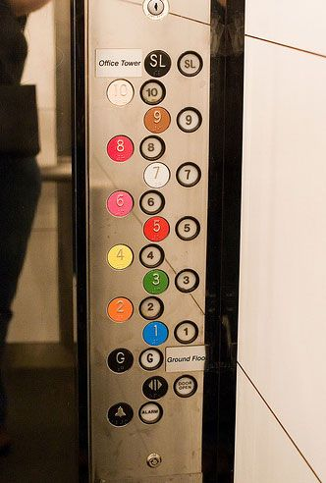
Bad and Good Design – Example 1
  Lift controls and labels are confusing, so it is easy to push a label by mistake instead of a control button.

Slide 6
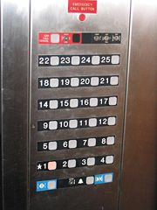
Bad and Good Design – Example 1
  People do not make same mistake for the labels and buttons in this control panel. Why not?

Slide 7
What to Design?
Need to take into account:
Who the users are
What activities are being carried out
Where the interaction is taking place
Need to optimise the interactions users have with a product
Are they matching the users’ activities and needs?

Slide 8
Understanding Users’ Needs
Need to take into account what people are good and bad at
Consider what might help people in the way they currently do things
Listen to what people want and get them involved
Use tried and tested user-based methods

Slide 9
Evolution of HCI Interface
60-70s - interface at the programming level - COBOL, FORTRAN
70-90s - Interface at the terminal level - command languages
80s - Interface at the interaction dialogue level - GUIs, multimedia
90s - Interface at the work setting - networked systems, groupware
00s - Interface becomes pervasive
RF tags, Bluetooth technology, mobile devices, consumer electronics, interactive screens, embedded technology
50s - Interface at the hardware level for engineers - switch panels

Slide 10
From HCI to Interaction Design
Human-computer interaction (HCI) is:
Concerned with the design, evaluation and implementation of interactive computing systems for human use and with the study of major phenomena surrounding them
Interaction design (ID) is
The design of spaces for human communication and interaction.
Increasingly, more application areas, more technologies and more issues to consider when designing ‘interfaces’.

Slide 11
Professionals in Interaction Design (ID) Business
interaction designers
usability engineers
web designers
information architects
user experience designers
people involved in the design of all the interactive aspects of a product
people who focus on evaluating products, using usability methods and principles
people who develop and create the visual design of websites, such as layouts
people who come up with ideas of how to plan and structure interactive products
people who do all the above but who may also carry out field studies to inform the design of products

Slide 12
Process of Interaction Design
Identify needs and establish requirements
Develop alternative designs
Build interactive prototypes that can be communicated and assessed
Evaluate what is being built throughout the process

Slide 13
Core Characteristics of Interaction Design
Users should be involved through the development of the project
Specific usability and user experience goals need to be identified, clearly documented and agreed at the beginning of the project
Iteration is needed through the core activities

Slide 14
Usability Goals
Effective to use
Efficient to use
Safe to use
Have good utility
Easy to learn
Easy to remember how to use

Slide 15
Usability Goals
Effective to use
Efficient to use
Safe to use
Have good utility
Easy to learn
Easy to remember how to use
Effective to use
Refers to how good a system is at doing what it is supposed to do
Is the system capable of allowing people to carry out work, access information that they need, buy the goods that they want, etc

Slide 16
Usability Goals
Effective to use
Efficient to use
Safe to use
Have good utility
Easy to learn
Easy to remember how to use
Efficient to use
Refers to the way a system supports its users in carrying out their tasks, least time possible to complete a particular task
E.g preserving customer history and details for returning customers to make future purchase

Slide 17
Usability Goals
Effective to use
Efficient to use
Safe to use
Have good utility
Easy to learn
Easy to remember how to use
Safe to use
Involves protecting the user from dangerous conditions and undesirable situations
  Ergonomic aspect: refers to external conditions where people work
    E.g operating xray machines: operators should be able to interact via computer based system remotely
  Reducing risk aspect: avoid the danger of users carrying out unwanted incidents accidentally
    E.g preventing users by making errors by reducing risk of wrong key being mistakenly activated (save – delete button very nearly placed)

Slide 18
Usability Goals
Effective to use
Efficient to use
Safe to use
Have good utility
Easy to learn
Easy to remember how to use
Have a good utility
Refers to the extent of the system providing the right kind of functionality so that users can do what they need or want to do
  E.g: High utility: an accounting software package provides powerful computation tools that accountants use to work out tax returns
  E.g Low utility: a software drawing tool that does not allow users to draw free-hand but forces them to use a mouse to create their drawing using only polygon shapes

Slide 19
Usability Goals
Effective to use
Efficient to use
Safe to use
Have good utility
Easy to learn
Easy to remember how to use
Easy to learn
Refers to how easy a system is to learn to use
How easy is it and how long does it take to get started to perform core tasks and wider/ more complex taks
Well known fact that people don’t like spending long time learning how to use a system
They want to get started straightaway and become competent at carrying tasks without too much effort
  E.g learning curve for email application is much more shorter than video conferencing tool

Slide 20
Usability Goals
Effective to use
Efficient to use
Safe to use
Have good utility
Easy to learn
Easy to remember how to use
Easy to remember how to use
Refers to how easy a system is to remember how to use, once learned
Especially important for interactive systems that are used frequently
Interaction designing can support this by providing sequence of operations to complete a task

Slide 21
User Experience Goals
Satisfying
Fun
Enjoyable
Entertaining
Helpful
Motivating
Aesthetically pleasing
Motivating & rewarding
Supports creativity
Emotionally fulfilling, and many more

Slide 22
Usability vs User Experience Goals
How do usability goals differ from user experience goals?
Are there trade-offs between the two kinds of goals?
  e.g. can a product be both fun and safe?
What is important depends on:
The use context
The task at hand
Who the intended users are
*

Slide 23
Norman Design Principles
Norman Design Principles
Visibility
Feedback
Constraint
Mapping
Affordance
Consistency
Generalisable abstractions for thinking about different aspects of design.
The do’s and don’ts of interaction design.
What to provide and what not to provide at the interface.
Derived from a mix of theory-based knowledge, experience and common-sense.

Slide 24
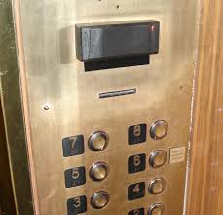
Norman Design Principles
1. Visibility
This is a control panel for a lift.
How does it work?
Push a button for the floor you want?
Nothing happens. Push any other button? Still nothing. What do you need to do?
It is not visible as to what to do!

Slide 25
Norman Design Principles
1. Visibility
…you need to insert your card in the slot above the buttons to get the elevator to work!
How would you make this action more visible?
make the card reader more obvious
provide an auditory message, that says what to do (which language?)
provide a big label next to the card reader that flashes when someone enters
make relevant parts visible
make what has to be done obvious

Slide 26
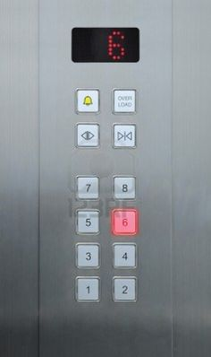
Norman Design Principles
2. Feedback
Sending information back to the user about what has been done
Includes sound, highlighting, animation and combinations of these
  e.g. when screen button clicked on provides sound or red highlight feedback

Slide 27
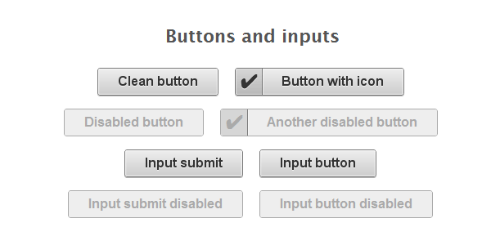
Norman Design Principles
3. Constraint
Restricting the possible actions that can be performed
Helps prevent user from selecting incorrect options
Three main types (Norman, 1999)
  physical
  Logical
  cultural

Slide 28
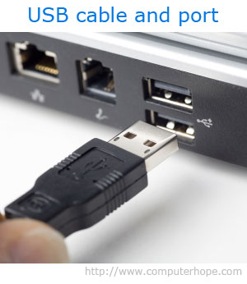
Norman Design Principles
3. Constraint : Physical
Refer to the way physical objects restrict the movement of things
  E.g. only one way you can insert a key into a lock
How many ways can you insert a CD or DVD disk into a computer?
How physically constraining is this action?

Slide 29
Norman Design Principles
3. Constraint : Logical
Exploits people’s everyday common sense reasoning about the way the world works
Relies on people’s common sense reasoning about actions and their consequences
An example is they logical relationship between physical layout of a device and the way it works as the next slide illustrates

Slide 30
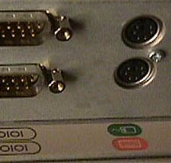
Norman Design Principles
3. Constraint : Logical
Where do you plug the mouse?
Where do you plug the keyboard?
top or bottom connector?
Do the color coded icons help?

Slide 31


Norman Design Principles
3. Constraint : Logical
provides direct adjacent mapping between icon and connector
provides color coding to associate the connectors with the labels

Slide 32

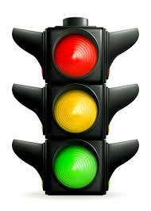
Norman Design Principles
3. Constraint : Cultural
Rely on learned conventions
Can be universal or culturally specific
Red triangle for warning
Ambulance siren

Slide 33
Norman Design Principles
4. Mapping
Relationship between controls and their movements and the results in the world
Mapping between control and effect
Why is this a poor mapping of control buttons?

Slide 34
Norman Design Principles
4. Mapping
Why is this a better mapping?
The control buttons are mapped better onto the sequence of actions of fast rewind, rewind, play and fast forward

Slide 35
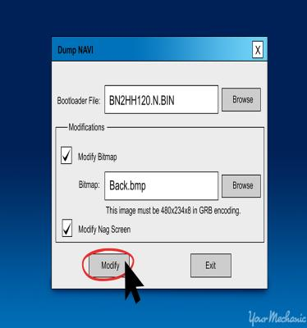
Norman Design Principles
5. Consistency
Design interfaces to have similar operations and use similar elements for similar tasks
A consistent interface is one that follows rules, such as using the same operation to select all object
For example:
  Always label modify operations as ‘Modify’ and not to use other terms such as ‘Edit’ in other pages
Main benefit is consistent interfaces are easier to learn and use

Slide 36
Norman Design Principles
5. Consistency
What happens if there is more than one command starting with the same letter?
  e.g. save, spelling, select, style
Have to find other initials or combinations of keys, thereby breaking the consistency rule
  E.g. ctrl+S, ctrl+Sp, ctrl+shift+L
Increases learning burden (and memorizing burden) on user, making them more prone to errors

Slide 37
Norman Design Principles
5. Consistency: Internal vs External
External consistency
To determine what aspect of an interface to make consistent with other applications or devices
e.g can Ctrl+C and Ctrl+V be used all across different application; swiping using fingers are applicable across multiple devices?
refers to designing operations, interfaces, etc., to be the same across applications and devices
Internal consistency
refers to designing operations to behave the same within an application
e.g modify button with same label across the application

Slide 38
Norman Design Principles
6. Affordance: in Physical objects
Refers to an attribute of an object that allows people to know how to use it
To afford = ‘to give a clue’
  e.g. a mouse button invites pushing, a door handle affords pulling (high affordance vs low affordance)
Norman (1988) used the term to discuss the design of everyday objects
Since has been much popularised in interaction design to discuss how to design interface objects
  e.g. scrollbars to afford moving up and down, icons to afford clicking on

Slide 39
Norman Design Principles
6. Affordance: in interaction design
Interfaces are virtual and do not have affordances like physical objects
Instead interfaces are better conceptualised as ‘perceived’ affordances
  Learned conventions of arbitrary mappings between action and effect at the interface
  Some mappings are better than others

Slide 40
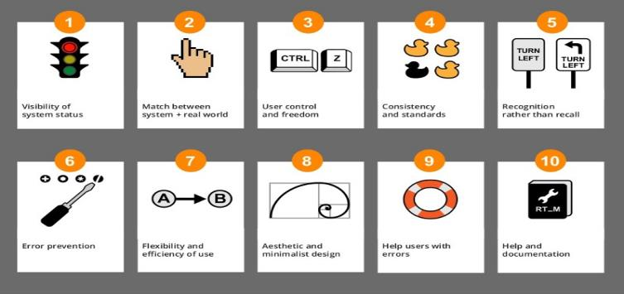
Nielsen’s 10 Usability Principles
Similar to design principles, except more prescriptive
Used mainly as the basis for evaluating systems
Provide a framework for heuristic evaluation

Slide 41
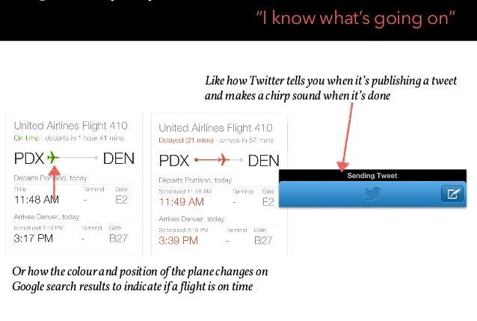
Nielsen’s 10 Usability Principles
1. Visibility of system status
Always keep users informed about what is going on , through providing appropriate feedback within reasonable time

Slide 42
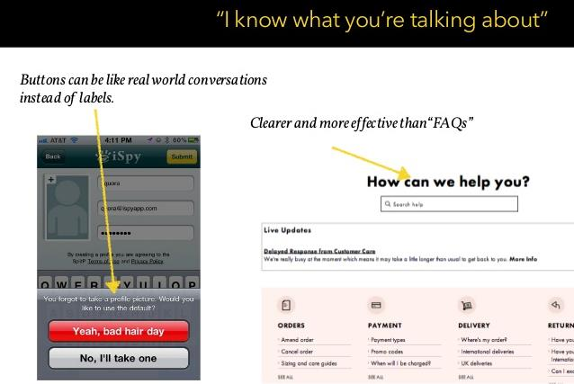
Nielsen’s 10 Usability Principles
2. Match between system and the real world
Speak the user’s language, using words, phrases and concepts familiar to users, rather than system-oriented terms

Slide 43
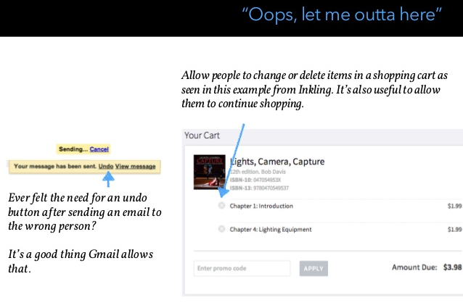
Nielsen’s 10 Usability Principles
3. User control and freedom
Provide ways of allowing users to easily escape from places they unexpectedly find themselves, using clearly marked ‘emergency exits’

Slide 44
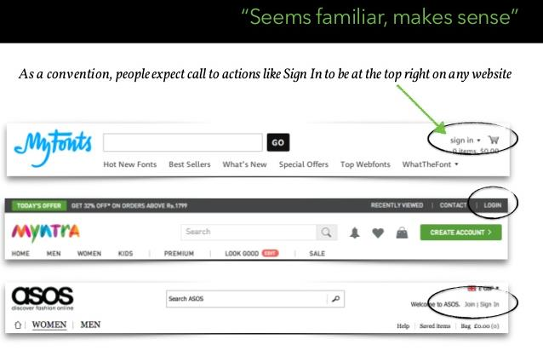
Nielsen’s 10 Usability Principles
4. Consistency and standards
Avoid making users wonder whether different words, situation, or actions mean the same thing

Slide 45
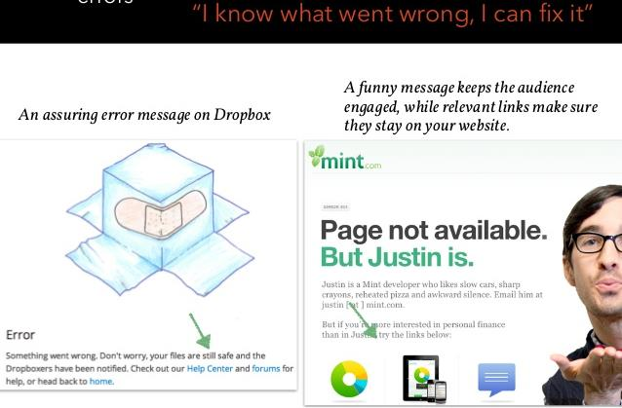
Nielsen’s 10 Usability Principles
5. Help users recognize, diagnose and recover from errors
Use plain language to describe the nature of problem and suggest a way of solving it

Slide 46
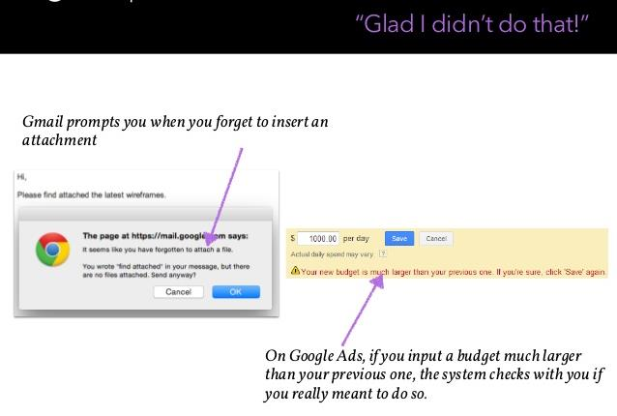
Nielsen’s 10 Usability Principles
6. Error prevention
Where possible, prevent errors occurring in the first place

Slide 47
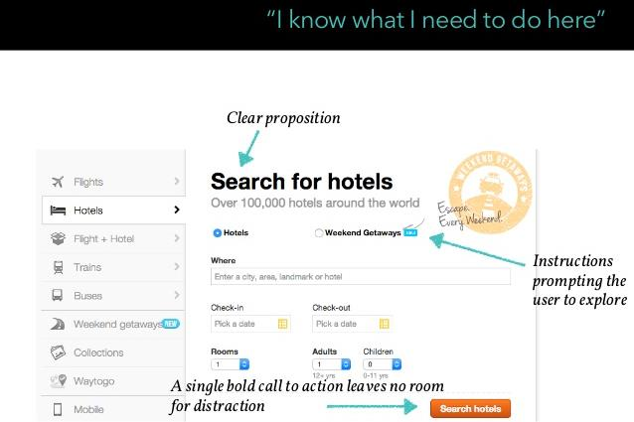
Nielsen’s 10 Usability Principles
7. Recognition rather than recall
Make objects, actions and options visible

Slide 48
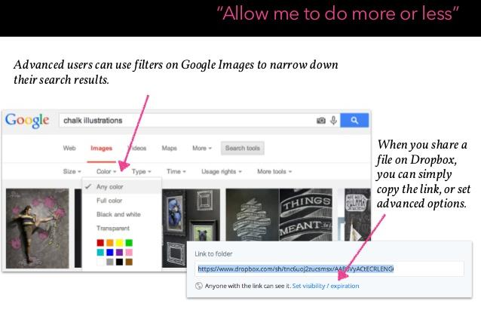
Nielsen’s 10 Usability Principles
8. Flexibility and efficiency of use
Provide accelerators that are invisible to novice users, but allow for more experiences users to carry out tasks more quickly

Slide 49
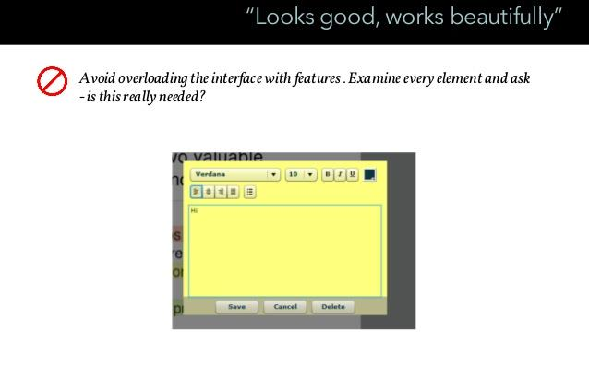
Nielsen’s 10 Usability Principles
9. Aesthetic and minimalist design
Avoid using information that is rarely needed or irrelevant

Slide 50
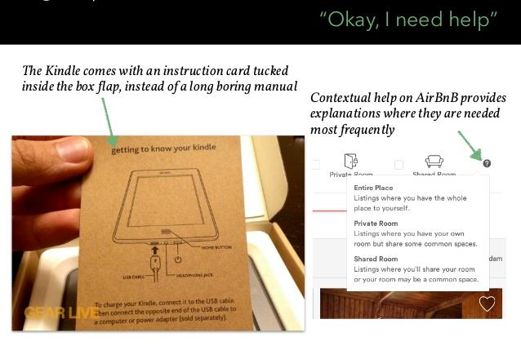
Nielsen’s 10 Usability Principles
10. Help and documentation
Provide information that can be easily searched and provides help in a set of concrete steps that can easily be followed
*

Slide 51
THE END

