Slide 1
Judaism and Christianity
An overview of Christian History
The beginnings to the Middle Ages

Slide 2
Paul’s First Missionary Journey
Begun around 44 CE; ended by 50 AD
Barnabas
Mark
Antioch
Seleucia, Cyprus, Perga in Pamphylia (Mark then went to Jerusalem; Paul and Barnabas turn to the Gentiles), Iconium, Lystra, Derbe.
They then retrace their steps to Antioch.

Slide 3
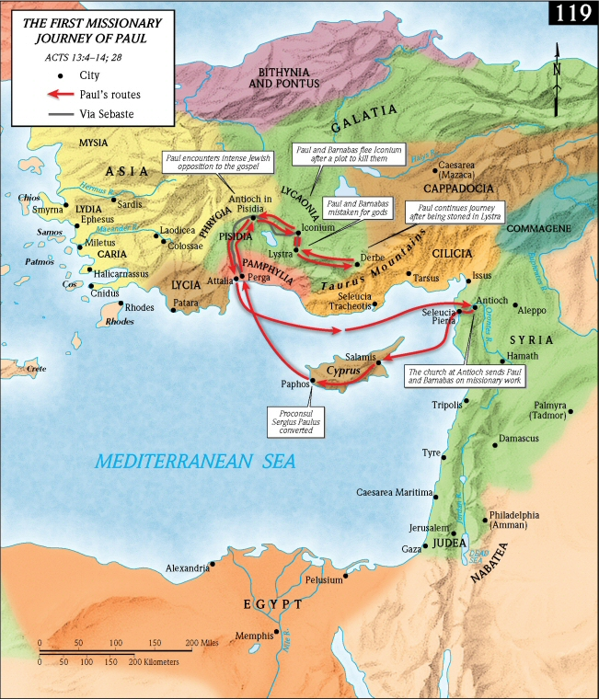

Slide 4
Paul’s Second Missionary Journey
Begins around 51 CE; ends around 53-54 CE
Silas
Syria and Cilicia (now southeastern Turkey); Derbe, Lystra (Timothy), Phrygia and Galatia; Mysia to Troas, the island of Samothracia,, Neapolis (now northern Greece), Philippi, Amphipolis, Appolonia, Thessalonica, Berea, Achaia, Athens, Corinth (where he stays a year and a half)
No further mention of Silas.
From Corinth to Cenchrea, Ephesus, Caesarea, to Antioch.

Slide 5
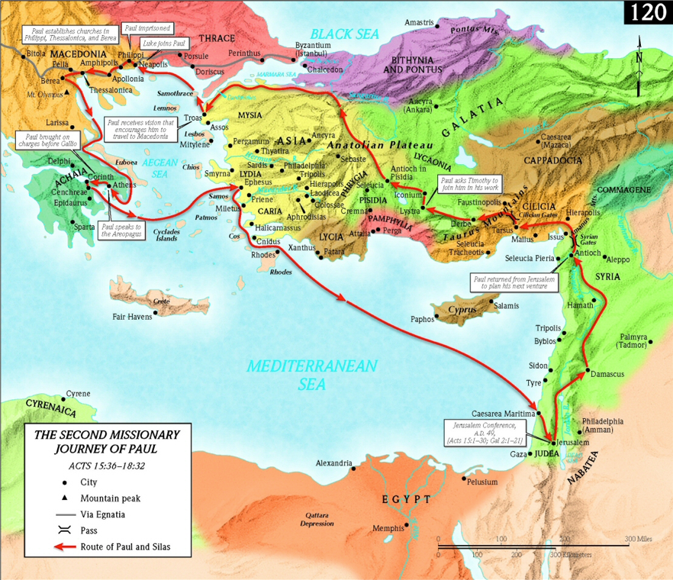

Slide 6
Paul’s Third Missionary Journey
Begins around 54 CE; ends around 58 CE
Galatia, Ephesus (where he stayed for 3 years).
Timothy and Erastus sent ahead into Macedonia.
Troas, to Macedonia (where he was joined by Titus)
Corinth, Achaia, Philippi, Troas, Assos, Mitylene, Chios, Samos, Trogylium, and Miletus (now in southwestern Turkey), Coos, Rhodes, Patara, Tyre (which is now in Lebanon), Ptolemais, Caesarea, Jerusalem.

Slide 7
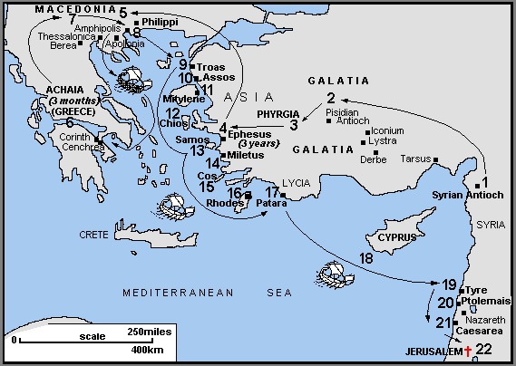

Slide 8
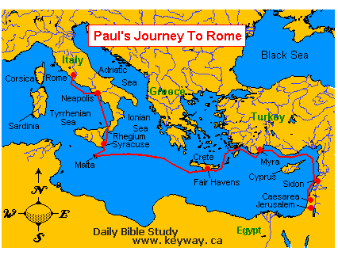

Slide 9
The Apostolic Age
Clement of Rome (d.99)
Ignatius of Antioch (c.35-110)
Polycarp of Smyrna (c.69-c.155)

Slide 10
The Greek Fathers
Irenaeus of Lyons (130-202)
Clement of Alexandria (c.150-c.215)
Origen of Alexandria (c.185-c.254)
Athanasius of Alexandria (c.293-373)

Slide 11
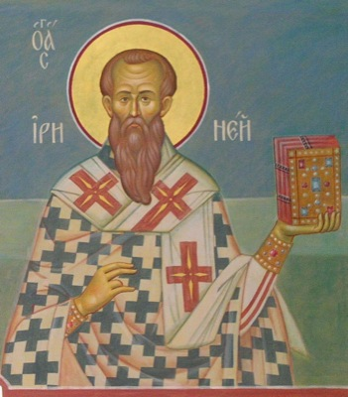
Irenaeus (130-202)
Against the Gnostics
God’s work performed by his ‘two hands’ – the Son and the Spirit

Slide 12
The Cappadocian Fathers
Basil the Great (c.329-379)
Gregory of Nyssa (335-394)
Peter of Sabaste (c.340-391)
Gregory Nazianzus (c.329-390)
Apologists – speak to the learned Greeks
Trinity – circumincessio, perichoresis

Slide 13
John Chrysostom (c.347-c.407)
Cyril of Alexandria (c.378-444)
Maximus the Confessor (c.580-662)
John of Damascus (c.676-749)

Slide 14
Latin Fathers
Tertullian (c.165-c.225) ‘Father of Latin Christianity’
  Trinity
  Christian is made not born
  The blood of the martyrs is the seed of the church
Cyprian of Carthage (d.258)
Hilary of Poitiers (c.300-c.368)

Slide 15
Ambrose of Milan (337-397)
Jerome of Stridonium (c.347-420)
Augustine of Hippo (354-430)
Gregory the Great (c.540-604)

Slide 16
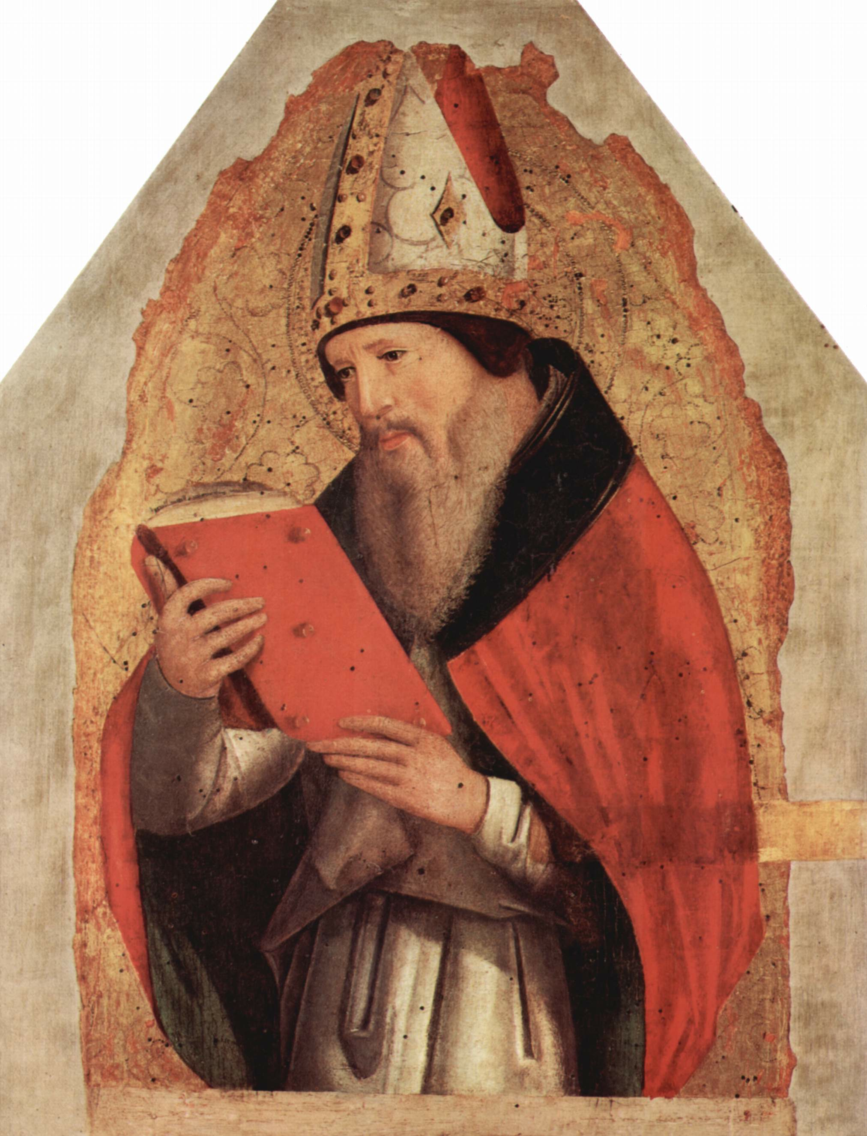
Augustine of Hippo (354-430)
Salvation by grace
Predestination to salvation
Confessions
‘Thou hast made us for Thyself, and our hearts are restless until they find themselves in Thee.’
Civitate Dei

Slide 17
Eight Doctors of the Church
Western Church
Ambrose
Jerome
Augustine
Gregory the Great
Eastern Church
Athanasius
Basil the Great
Gregory of Nazianzus
John Chrysostom

Slide 18
Ecumenical Councils
First Council of Nicaea (325) – repudiated Arianism; Christ ‘homoouisos with the Father’; Nicene Creed
First Council of Constantinople (381) – repudiated Arianism
Council of Ephesus (431) – Nestorianism; Pelagianism Mary as Theotokos

Slide 19
Council of Chalcedon (451) – Eutychianism; adopted Chalcedonian Creed
Second Council of Constantinople (553) – Nestorianism
Third Council of Constantinople (680-681) – Monolethitism and Monoenergism
Second Council of Nicaea (787) – repudiated iconoclasm and restored veneration of icons

Slide 20
Christianization of Britain
Roman Conquest of Britain in 42 (Londinium established the following year)
Christianity by 3rd century (Alban, died 304; Julius and Aaron, died 304 at Caerleon)
Romans withdrew from 383
Augustine sent to Kent in 597 by Gregory the Great (converted indigenous church to Rome)
Theodore of Tarsus, 669

Slide 21
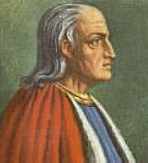
Anselm of Canterbury (1033-1109)
Monologion (1077)
Proslogion (1077-1078)
Ontological Argument for the existence of God

Slide 22
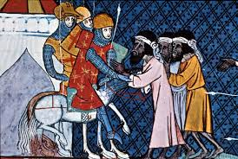
Crusades
Seven crusades in all
First, 1095, to restore the Holy Land to Christian control
Final one ended in 1291
Brutal conflict; seen as self-serving
Left Christendom divided, led to fall of Byzantine (Eastern) Empire to Ottomans

Slide 23
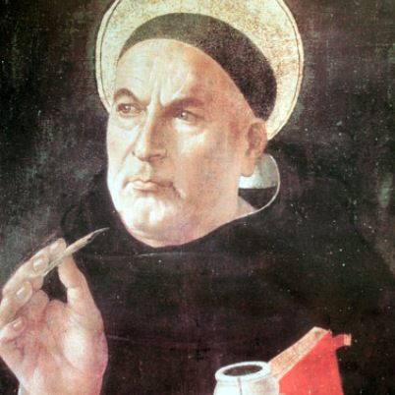
Thomas Aquinas (1225-1274)
Summa Theologica
Natural Law
Cosmological Argument

Slide 24
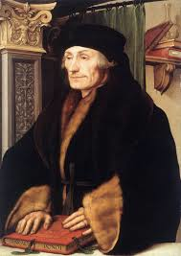
Humanism
Emphasizes value and agency of human beings
Has become secular, was initially religious
Concerned learning from original sources (and study of original languages) – ad fontes
Erasmus of Rotterdam (1466-1536)

Slide 25
Enconium Moriae – ‘In Praise of Folly’ (1511)
Instrumentum novem omne (1516)

Slide 26


