Slide 1


BMCJ7001:
The Criminal Justice System, Youth Justice & Prison Systems in England and Wales
Register Reminder!
Lecturer: Rhiannon Lloyd
Email: r.lloyd@uwtsd.ac.uk

Slide 2


Module Structure
Workshop: Fridays 10:00hrs-13:00hrs
Reading Week: 8th-12th November 2021

Slide 3



Workshop Structure:
Introductions
What to expect every week
What is expected of you at this level
Module aims
Learning outcomes
Assignments

Slide 4


Private study:
Reading expectations:
225 hours
75% of the time required for this module
Core reading list
Supplementary reading lists
Set reading every week to generate discussion
Meet up online outside of lectures and discuss content
Email if you’re struggling with any of the information or concepts

Slide 5
Main aims of the module:
Offer a critical insight into and facilitate an holistic understanding of the Criminal Justice System of England and Wales
Public opinion and the CJS
Describe the role of the courts & judges
Explore issues around youth justice
Encourage evaluation of the prison service
Look at reoffending and the rehabilitation of offenders
Analyse the role of victims in the CJS
Discuss restorative justice and practices
Engage with contemporary issues in criminal justice

Slide 6

Learning outcomes:
Demonstrate a critical understanding of the theoretical, strategic and policy issues surrounding the criminal justice system
Critically evaluate the management of crime within adult crime, youth crime and the prison service
Systematically analyse the methods and reforms to tackle reoffending and reduce crime in England and Wales.

Slide 7

Help me, Help you!
Think about what YOU want from the module
Let me know about any particular aspects of the Criminal Justice System, Youth Justice or Prisons that you would like to learn more about, or any specific contemporary issues you are interested in
Speak up if there is anything that isn’t on the module outline that you think should be there

Slide 8

Assessment 1: Written Assignment
Word Count: 3,000 words
Contribution to Overall Module Assessment Grade: 50 %
Submission Date: Friday 5th November 2021 before 23:59hrs
TASK
‘Students will prepare a 3000-word essay on ONE of the TEN question choices...’ (Please look at assessment sheet on Moodle)

Slide 9
Assessment 2:
Contribution to Overall Module Assessment Grade: 50 %
Submission Date: Monday 3rd January 2022 before 23:59hrs
Task(s)
Students will prepare a portfolio consisting of THREE different small pieces of work to be submitted together:
An academic book or article review (1000 words) This is to be written formally, as if it was going to be submitted to an academic journal.
An academic poster
This should be on a topic of personal interest directly relevant to the module - to include 500 words of text and visual elements such as graphs, photographs and images.
A reflective report (1500 words)
This should be written in the first person and offer personal opinions on one or more topics covered in the module.

Slide 10

The essay
3000 words
Approx. 10 questions to choose from
Academic language
Introduction
Main body – discussion
Conclusions
List of sources (the Reference List)

Slide 11
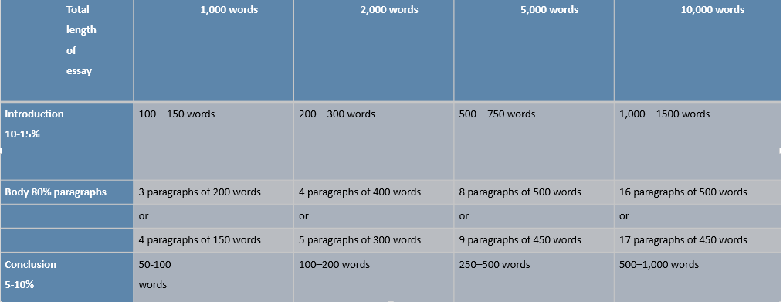
How to organise your essay’s word count

Slide 12

Harvard Referencing
List of all the sources you have used to inform and develop the essay
In text referencing should be used appropriately – direct quotations short and paraphrasing/describing/summarising a text should also be referenced
The Reference List is in alphabetical order (by author’s surname)
Harvard style
See the UWTSD Library Referencing Guide for how to set out your reference list.

Slide 13

Why create a poster?
Three Main Purposes:
Inform
Persuade
Educate

Slide 14
Academic posters contd…
Why use images/graphs/charts?
To make, explain or identify a point
To emphasize, clarify or reinforce a point
Add variety
Lasting impact
Enhance understanding
We remember –
  10% of what we read
  30% of what we see

Slide 15

Academic posters
https://www.britsoccrim.org/pgrposterprize/
Widely used at conferences
Get research ‘out there’
Generate discussion
Transferable skill
Large – stand 10’ away

Slide 16
Academic posters contd….
Title is short and is attention grabbing/gets peoples’ interest
A maximum word count of 500 words + references (to be included in a separate text box)
Text is clear and to the point – if it doesn’t add value, don’t use it!
Use of bullets, numbering, and headlines make it easy to read
Consistent and clean layout, using sub-headings
Includes acknowledgments, your name and institutional affiliation
Clarity and brevity of language with accompanying graphics highlighting the poster’s main points
Elaboration of specific aspects of topic by use of diagrams and graphs where appropriate

Slide 17
Substantive content: what should you include on the poster?
Introduction to the chosen subject area providing contextual knowledge to the audience, usually includes references to scholarly material that falls in the subject domain.
Identification of gaps in the research and literature, critical analysis and the justification of importance of the question/area of interest.

Slide 18
How the poster will be marked? – things to bear in mind
Marks will be given for:
Relevant choice of topic – cannot be too broad
Substantive content and use of available literature
Impact and overall layout
Use of graphs/charts and images
Use of colour and suitable font
Correct referencing of sources – textual and visual

Slide 19

The Book/Article Review
Approx. 1000 words
Must be on a scholarly text
Short book or book chapter
Long article (more than 6 pages) from a peer reviewed journal
It is often easier to read something longer as there is more to discuss!

Slide 20
What is a critical review?
Summarises
Questions the content
Evaluates
Analyses
Situates it in the context of wider literature
Demonstrates a close reading of the text

Slide 21

How to structure your review
Introduction
Summary
Main body – critical reviewing – appraisal or criticism? Strengths and weaknesses. Situate in wider literature if possible.
Conclusion

Slide 22



How do you find a suitable text?
Reading lists from this module
Any suitable textbooks you may have at home that are published by an academic publishing house
UWTSD library resources (online)
A peer reviewed journal
It’s a good idea to email me with your choice of text
Would an Info Skills/HR session be beneficial?

Slide 23

Speak to me!
You’re struggling with any of the material in any way
You can’t make your lecture for any reason
You need to talk about difficulties with the assessment
You need extra support with anything
Additional Learning Needs

Slide 24
Use of Colour – the red/blue conflict
Red letters on blue background
creates “flicker effect”
Blue letters on red background
just as awful!

Slide 25
Low contrast
White on yellow
Yellow on white
Black on blue
Blue on black

Slide 26
Any Questions?
r.lloyd@uwtsd.ac.uk

