Slide 1

STRATEGIES FOR EFFECTIVE COMMUNICATION IN A BUSINESS SETTING
BSMW4002
Effective Team Working & Communications
Joanne Davies
Reema Parveen 2117189
Aleah Khan 2119469
Corina Radu 2117956

Slide 2

"Our aim is to offer every one of our valued clients a fully bespoke and affordable solution so you can retain your independence with our ongoing support. With Caregenics you are in full control of the care you receive, with personal one-to-one care for however long you require."
(Caregenics Healthcare Ltd, 2022)
Caregenics Healthcare Limited
Kings Court, 17 School Road
Hall Green B28 8JG
Call- 0121 244 1800

Slide 3
Introduction
What is communication?
Body language
Eye contact
Important to understand the language spoken
Good listening skills
Different strategies that can be used in a care setting
Control – managing staff
Motivation – rewards and recognitions
Thoughts
Ideas
Emotions
Spoken words verbal/non-verbal
What makes communication effective in a care setting?
To make it possible for people to communicate what is essential to them (Dynes, 2017).
Have the ability to use and recognise information
Ability to remember and comprehend information
Reading skills
Being attentive to patients’ needs and involving them therapeutically (Jootun and McGhee, 2011).
Emotional expression- facial expression, tone of voice and touch
Being informative- policies and procedures, risk assessments, email
Written rules
The process of creating meaning through the exchange of symbols among people is known as communication (Fielding, 2006).
Reema Parveen

Slide 4
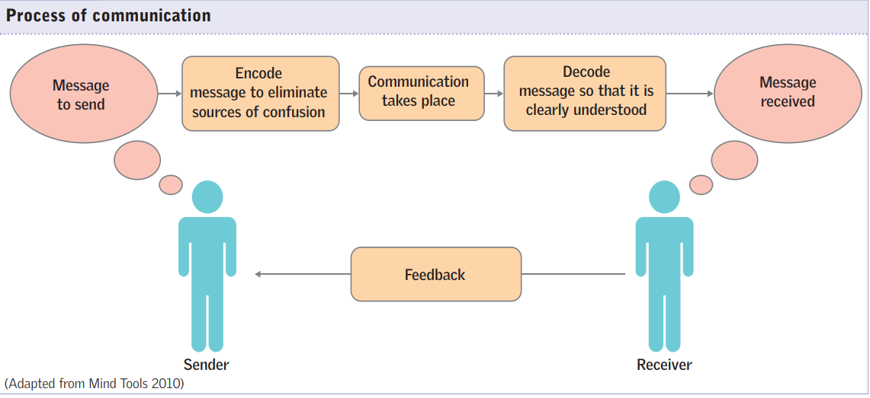
One of life's essential activities is communication. Throughout this action, a sender sends information to the receiver via the appropriate process (Jootun and McGhee, 2011).
(Jootun and McGhee, 2011)
Reema Parveen

Slide 5

Benefits of effective communication on the organization
Benefits of this include:
Building Trust
Increased Job Satisfaction
Problem Solving
Team Building
An Increase In Productivity And Engagement – effective teamwork
(Johnson, 2021).
Effective communication is beneficial within an organisation as it promotes high performance and withdraws unnecessary problems within a team (Efectio, 2020).
EXAMPLES:
Active listening
Compromising
Discuss a situation
Produce an outcome/ solution
The most important aspect of communication is when you communicate with your clients, because without them a business cannot function (Fielding, 2006).
Reema Parveen

Slide 6
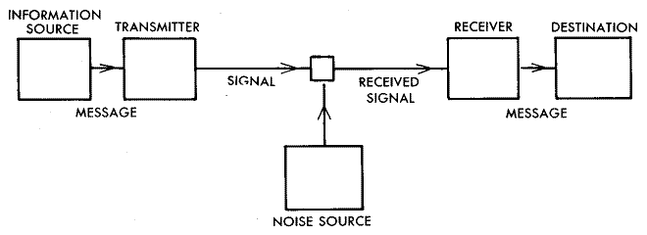
Theories Relating to models of Communication
A model in communication establishes a structure for talking about issues with the process of communication (Al-Fedaghi, 2012).
Shannon-Weaver Communication system Model, 1949
A source of information that generates messages
A transmitter that converts the message's data into signals
a path (channel) through which signals can be transmitted
A receiver extracts the message from the signal and decodes it.
A place where the message is delivered.
The sixth component, noise, is a malfunctioning factor. It is any disruption to the message's path through the channel that could cause the transmitted signal to change from the information sent.
(Chandler, 1994)
Schematic diagram of a general communication system (Shannon-Weaver, 1949).
Communication through the use of a technological channel, e.g., Telephone.
Corina Radu

Slide 7
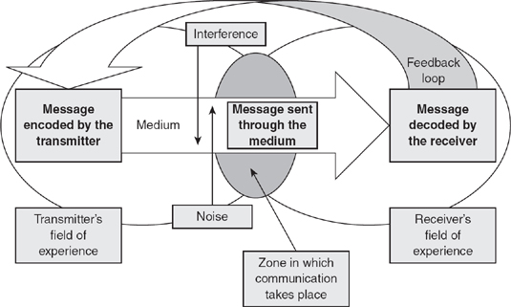
The most common theory we actively use today is Schramm's Model of Communication.
Schramm's Model of Communication
Wilbur Schramm proposed this theory in 1948
The process of communication involves a message being encoded by the transmitter (sender) and decoded by the receiver.
The receiver has the ability to send feedback back to the sender to verify that the information has been successfully interpreted and delivered.
Before the message is received by the receiver, the message is sent through the medium.
Noise and interference can affect the ability of the message to be correctly received and the ability to understand the message being sent.
'The Schramm Model of Communication' process.
(Blythe, 2009, pp. 178).
Communication encoding activities include voice, nonverbal cues, and writing.
Communication decoding skills include listening, reading, and interpreting verbal and nonverbal cues.
(Floyd, 2006)
(Blythe, 2009, pp. 178).
Corina Radu

Slide 8
Barriers preventing effective communication between the organisation and their external stakeholders
Barriers in Communication
National Culture
(values and beliefs)
Language (things that prevent people from understanding each other)
Defensiveness (when a message triggers a sense of threat)
Filtering (distortion or withholding of information)
Emotions
(can get within the course of the communication process)
Information Overload (huge amount of information)
When two individuals try to work together to achieve mutual goals, barriers almost always appear as no two persons are the same in terms of history, experience, mood, and expectations (Quill, 1995).
Culture of the organization is becoming more widely acknowledged, being a substantial barrier to using conceptual skills (De Long and Fahey, 2000).
Corina Radu

Slide 9
barriers in communication
Organisational Barriers:
Complex organisational structure
Excessive layering o administration
Lack of policies
Improper delegation of authority and responsibility
Individual Barriers:
Personality
Wrong explanation
Individual conflict
Fear
Pre-Idea
Language/Semantic Barrier:
Use of local dialect
Use of different language
Use of specific terms- different professions
(Skjeggestad, 2017)
Barriers due to position:
Status/Position
Mental state
Barriers due to Resistance to Change:
Following the ‘Old way’
Lack of attention
Own interpretation or assumption
Other Barriers:
Geographical
Lack of harmony
Faulty expression
Cultural difference
Absence of Feedback
Having a language barrier can cause miscommunication and misunderstandings.
Corina Radu

Slide 10
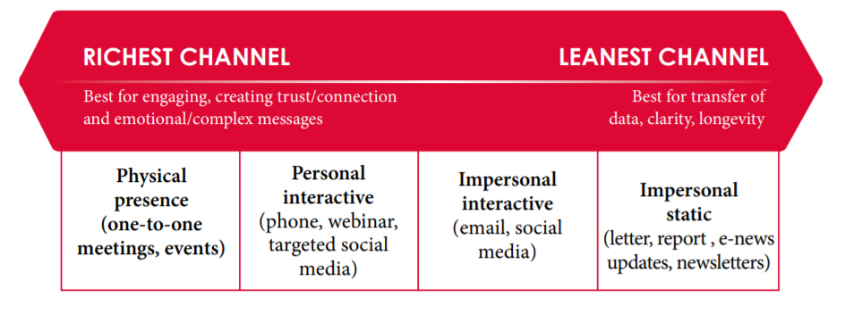
The term "communication channel" refers to the method or platform that the message travels through (Rayudu, 2009, p10)
Channels of communication used by the organisation
The majority of your channels will be on the left of the mentioned spectrum if you need to express a complicated subject (The Health Foundation, 2015).
Understanding of these channels is needed as nearly all forms of these are executed in a healthcare setting
Makes it easier for information to flow throughout the business
(The Health Foundation, 2015)
Channels of Richness in a healthcare setting
Aleah Khan

Slide 11

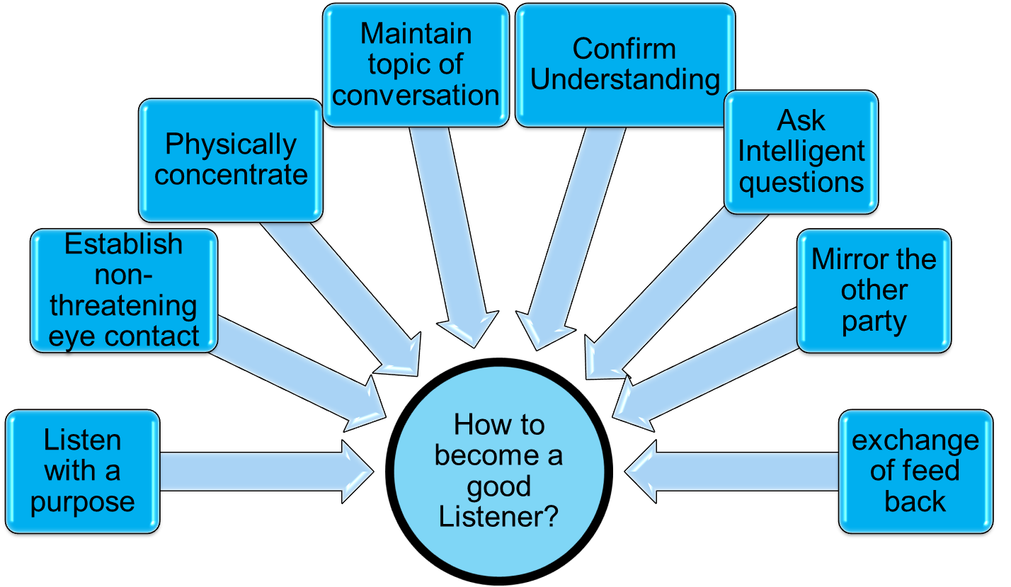
LISTENING
Channels that can be used to improve communication
*Body language and
Face to face communication can also be used*
Acronym SOLER describes five specific behaviours
–S- Square- Address the person squarely/directly
–O- Open –Maintain an open stance without crossing your arms or legs.
–L- Lean – Lean forward to demonstrate your curiosity.
–E- Eye contact- Make eye contact
–R – Relax- Stay relaxed
(Griffiths & Dunham, 2015)
(Hoppe, 2007)
To improve listening performance:
Observe Acknowledge Focus Respect
Quintanilla and Wahl (2017 as cited by Maund et al, 2017), p.98
Aleah Khan

Slide 12

Conclusion and Recommendation
What has been identified:
Communication process requires more than the delivery of information; it is ultimately about expressing and giving meaning and through engagement, communicators co-create the moral value of messages (Kuznar and Yager, 2020).
Communication examples:
Listening- The most effective and without this messages can be misunderstood
Face-to-face communication- Creates the framework for trust and improved collaboration.
Body language- Helps comprehend and grasp what the individual is saying.
In a healthcare setting, effective communication is crucial because without it, the standard of care would suffer (Ratna, 2019).
Recommended Model:
Schramm's Model of communication
Why is it effective?
Schramm's methodology makes it clear that encoding and decoding are the two most essential steps in any successful communication (Kalogiannidis, 2020).
Feedback is necessary and important, especially in Health and Social care – allows you to implement and is utilised daily.
After the recipient has decoded the message, feedback is crucial (Bowman & Targowski, 1987 cited by Kalogiannidis, 2020).
Aleah Khan

Slide 13
References
Al-Fedaghi, S. (2012) ‘A conceptual foundation for the Shannon-Weaver model of communication’, International journal of soft computing, 7(1), pp.12-19.
Blythe, J. (2009) Key Concepts in Marketing. Los Angeles, California.: SAGE Publications Ltd. pp.178-180.
Chandler, D. (1994) The transmission model of communication. Available at: http://visual-memory.co.uk/Daniel/ (Accessed: 6 July 2022).
De Long, D. W. and Fahey, L. (2000) ‘Diagnosing Cultural Barriers to Knowledge Management’, Academy of Management perspectives. Briarcliff Manor: Academy of Management, 14(4), pp. 113–127.
Dynes, R. (2017) 'Positive Communication: Activities to Reduce Isolation and Improve the Wellbeing of Older Adults' London: Jessica Kingsley Publishers.
Efectio (2020). Why is Communication in the Workplace Important. [online] Efectio - Employee Engagement Platform. Available at: https://efectio.com/en/why-is-communication-in-the-workplace-important-and-how-to-improve-it/ (Accessed: 11th July 2022).
Fielding, M., (2006). Effective communication in organisations. Juta and Company Ltd.
Floyd, K. (2006) 'ENCODING AFFECTIONATE MESSAGES,' in Communicating Affection: Interpersonal Behaviour and Social Context. Cambridge: Cambridge University Press (Advances in Personal Relationships), pp. 28–50.
Griffith, B. and Dunham, E. (2015) ‘Interpersonal Dynamics and Conflict’, in Working in Teams: Moving from High Potential to High Performance. 55 City Road: SAGE Publications, Inc, p. 43.

Slide 14
Jootun, D. and McGhee, G. (2011) ‘Effective communication with people who have dementia’, Nursing standard, 25(25), pp. 40–47.
Kalogiannidis, S. and Papaevangelou, O., (2020) 'Impact of Business Communication on the Performance of Adult Trainees', International Journal of Academic Research in Progressive Education and Development, 9(3), pp.213-222
Kuznar, L.A. and Yager, M., (2020). The Development of Communication Models, Quick Look. Joint Staff J39, Strategic Multi-layer Assessment Washington, DC United States.
Quill, T.E. (1995) ‘Barriers to effective communication’, In The medical interview (pp. 110-121). Springer, New York, NY.
Quintanilla, K.M. and Wahl, S, T., (2017) Business and Professional Communication, 3rd eds. Thousand Oaks: SAGE.
Ratna, H., (2019) 'The importance of effective communication in healthcare practice', Harvard Public Health Review, 23, pp.1-6.
Rayudu, C., (2009) Communication, Global Media, Mumbai. Available from: ProQuest Ebook Central.
Shannon, C. E. and Weaver, W. (1949) The Mathematical Theory of Communication, Urbana: University of Illinois Press
Skjeggestad, E., Gerwing, J. and Gulbrandsen, P. (2017) ‘Language barriers and professional identity: A qualitative interview study of newly employed international medical doctors and Norwegian colleagues’, Patient education and counselling. Ireland: Elsevier B.V, 100(8), pp. 1466–1472.
The Health Foundation (2020) Communication Channels: A Guide. [online] Available at: https://www.health.org.uk/sites/default/files/Communications-channels.pdf / (Accessed: 11th July 2022).

Slide 15
Team Evaluation
Teamwork Evaluation | Team responses.
Who was in your team? | Aleah, Reema and Corina
What were the key strengths of your team? | Understanding, work collectively, teamwork, effective communication
What were the challenges that you overcame as a team? | Revolving around work, Health issues, Catching up
What would you do differently if you worked as a team again? | Face to face interaction rather than messages Or video chat/teams if not able to attend in campus
How would you rate your team working? Out of 10? | 7.5 - including all issues/obstacles that we overcome (health issues) Time management based on work schedule.
Reema, Corina and Aleah

