Slide 1

Business skills for the Workplace
Enterprise And Entrepreneurship
LCLM 4006 – BIRM
Fouziya Farheen
Daulphin Tambi Bessong (2421621)

Slide 2
Table of Contents
Overview of the business idea ….....
Legal format of the business idea......
Management structure of the startup enterprise.......
PESTEL Analysis..........
Explanation of the marketing strategies one will adopt to reach its customers.........
The amount of funding required , its source and why …......
Outline the main startup costs during the first month of operation …........
Reference.........

Slide 3

Overview of the Business Idea
The Legal Format
The Legal format is a Limited Company which is Bessong & Bessong Ltd with a permit to operate a Transport and Logistics company. The company will be registered in the Company House in UK. It will secure an Operator’s Licence and appoint a qualified Transport Manager. There will be contracts and documents like the Bill of Lading and Logistics Services Agreements. One will need to show evidence of enough finance to purchase a vehicle(s). There must be a warehouse agreement, packing lists (The content of a shipment) used for inventory and customs purposes as so on and so forth. There must be a Shiper’ Declaration for Dangerous Goods. In terms of organisation and management, this will be the sole responsibility of the director. Audretsch (2012, pp.755-764) where he talked about the importance of decision making for a business to succeed. Considering the operating plan, Bessong & Bessong will be located and operating from Barwell Industrial Park, Unit 7A, Leicestershire with an office space of about 30 metres square, a parking space for 21 cars and ten vans and lorries Shane and Venkataraman, (2000) argue that entrepreneurship involves the discovery, evaluation and exploitation of opportunities.

Slide 4
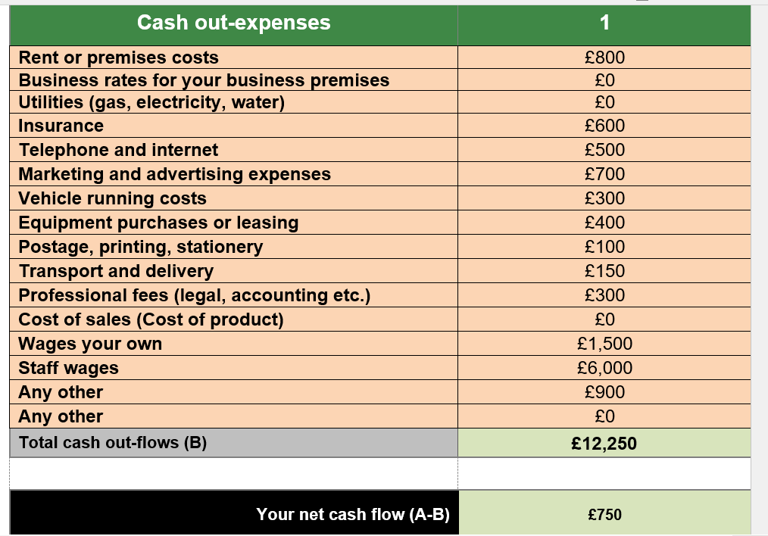

Slide 5
PESTEL Analysis
The PESTEL analysis here is a strategic tool that can evaluate the macro environmental factors influencing a business. How can this strategic tool evaluate the new Transport and Logistics company that is about to be set up. (Yuksel, 2012)
First, the Political factor comes from the government in place. Infrastructure development such as roads, bridges and tunnels come with a tax on transporters to pay. Toll gates to be paid. Trade agreements with other countries have a great role to play.
The economic part of it is the rising cost for Then comes inflation which is not good for business. Spare parts for vehicles can be costly as well. Interest rate if high can increase the borrowing cost especially if a new vehicle is to be bought.
Socially, there can be a change in consumers’ behaviour which can have a negative or positive effect on transport and logistics. Driver shortages will impact the steady
flow of the business adversely. After the BREXIT, huge number of Europeans left the country especially those with EU driving licences and with them their driving skills which is needed here
Technological changes such as electric vehicles do create opportunities but do equally comes with various challenges. The good news is that it reduces carbon emission. Digitalization enhanced better customer service thus efficiency.
The environmental factor here is the limit on carbon emission harmful to the ozone layer. The Laws on the environment are very important to be taken seriously. A company can be fined if these laws are not implemented or respected. The use of electric vehicles is greatly encouraged by the UK government.

Slide 6
Marketing Strategies
Sales and marketing will be under the direction of the manager and Human Resources. The use of social media such as Facebook, Instagram, emails can be of great help to market our services. Newspapers and Fliers will be used. Telephone calls to collect feedback from our customers. This will help us correct mistakes being made. A consulting firm will be hired as well to help us solve this problem as well. Offering of incentives and discounts or coupon or join an online platform. There is also the use of Local Market Penetration where one will collaborate with restaurants, retailers, and e-commerce stores to become their delivery partner. The use of a friendly mobile app can be very helpful. The is also Competitive Pricing and Promotions.

Slide 7
The Amount of Funding required, Sources and Why.
£13,000 is required to cover the initial startup costs (equipment, setup and legal). Equally there is the first month of operational expenses. Marketing and working capital reserves is not excluded. Bessong & Bessong financial plan will be to raise its capital from Past savings and inheritance. Family members that are willing to assist. There are some Angel investors in exchange for equity. The business will borrow from a bank to repay with interest. Grants for specific purposes such as innovation and green tech.
The source will be £ 30 – 60 % personal savings which will show commitments to future investors and lenders. 10 -20% bank loan for initial setup and inventory that will provide sufficient capital. 30% will come from an Angel Investor if there is rapid growth. Family members and friends will help because this fund can easily be raised, and refunding can be flexible. The funding is needed to establish a smooth operation, cover upfront costs before steady income starts pouring in.

Slide 8
The Main Startup Cost
As in any business, when it is about to begin operations, there is always the first month of operational expenses. In the case of Bessong & Bessong Ltd they will be the purchase or leasing of company vehicles that is expected during the first month of operation. Vehicles registration and licensing fees, title, the tag and the business use registration. Commercial auto insurance and the general liability coverage. Fuel, maintenance, branding and decals (company logo, contact information, etc
Renting the premises and utilities (rent, security deposit, electricity) and contingencies contingencies.

Slide 9
References
Valencia-Arias, A., Londoño-Celis, W., Palacios Moya, L., Iparraguirre Sanchez, G.K., Cardona- Acevedo, S. and Rodríguez-Correa, P.A., 2025. Determinants of sustainable entrepreneurial intention in Colombian and Peruvian University students: a theory of planned behaviour approach. Discover Sustainability, 6(1), pp.1-23.

Slide 10
Audretsch, D., 2012. Entrepreneurship research. Management decision, 50(5), pp.755-764.
Bygrave, W.D., Zacharakis, A., Wise, S. and Corbett, A.C., 2024. Entrepreneurship. John Wiley & Sons.
Dollinger, M.J., 2008. Entrepreneurship strategies and resources. Marsh Publications.
Hansmann, H., 2000. The ownership of enterprise. Harvard University Press.
Weinstein, R., 2005. RFID: a technical overview and its application to the enterprise. IT professional, 7(3), pp.27-33.
Department for Business, Energy & Industrial Strategy (2021) Supporting entrepreneurship and business growth in the UK. London: HM Government.
Kerlin, J.A., 2007. Social Enterprise: At the Crossroads of Market, Public Policies and Civil Society, edited by Marthe Nyssens. London and New York: Routledge, 2006. 335 pp., $46.95. Nonprofit and Voluntary Sector Quarterly, 36(4), pp.747-750.

Slide 11
Dietz, J.L., 2006. Enterprise ontology: theory and methodology. Berlin, Heidelberg: Springer Berlin Heidelberg.
Bromiley, P., McShane, M., Nair, A. and Rustambekov, E., 2015. Enterprise risk management: Review, critique, and research directions. Long range planning, 48(4), pp.265-276.
Fonnardy, B.C., Randa, F., Ng, S. and Asri, M., 2025. Women on Boards and Enterprise Risk Management: Pathways to Firm Value in Emerging Markets.
Naomi, J. and Hanggraeni, D., 2025. Navigating Sustainability: Bank Dynamics, Market Structure, and Enterprise Risk Management in ASEAN Exchanges. Eduvest-Journal of Universal Studies, 5(9), pp.10516-10932.
Masanpally, M., Bhattacharjee, T. and Butt, T.E., 2025. An innovative performance assessment approach of ESG- (environment, social and governance) related risk management. Journal of Accounting Literature, pp.1-28.
Eisenmann, T. (2021) ‘Why Start-ups Fail: A New Roadmap for Entrepreneurial Success’, Havard Business Review, May- June 2021

Slide 12
Eisenmann, T. (2021) ‘Why Start-ups Fail: A New Roadmap for Entrepreneurial Success’, Havard Business Review, May- June 2021
Grebel, T., 2004. Entrepreneurship. Taylor & Francis.
Eckhardt, J.T. and Shane, S.A., 2003. Opportunities and entrepreneurship. Journal of management, 29(3), pp.333-349.
Rumelt, R.P., 2005. Theory, strategy, and entrepreneurship. In Handbook of entrepreneurship research: Interdisciplinary perspectives (pp. 11-32). Boston, MA: Springer US.
Shane, S. and Venkataraman, S. (2000) ‘The promise of entrepreneurship as a field of research ‘, Academy of Management Review, 25(1), pp. 217 – 226.
Aldrich, H. E. and Zimmer, C. (1986) ‘Entrepreneurship through social networks’, The Art and Science of Entrepreneurship, 1(1), pp. 3 – 23.
GOV.UK. (n.d.) Starting Business: Explore funding and finance options for your business. Available at: https: www.gov.uk/government/publications/starting -a-business/starting -a-business (Accessed: 18 October 2025).
Yuksel, I. (2021) ‘Developing a multi- criteria decision-making model for PESTEL analysis ‘, International Journal of Business and Management, 7 (24), pp. 52-66.

