Slide 1
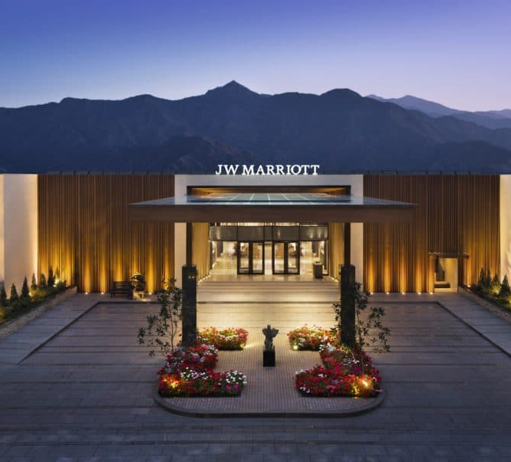
Hospitality & Guest Services
Module Code: BMIH4003
Krystal Gardner
Student ID:2027750
Lecture: Charlotte Joyner
JW Marriott
The role and importance of quality services, hospitality, and guest services within the hotel industry.

Slide 2
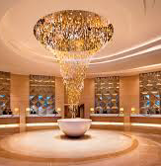
Contents Page
Introduction
JW Marriott target market
Guest service scope at JW Marriott
Guest services personal touch
Facilities provided by the guest to the JW Marriott
Role and function of guest services
Importance of hospitality
Meeting guest expectations
Conclusion
References

Slide 3
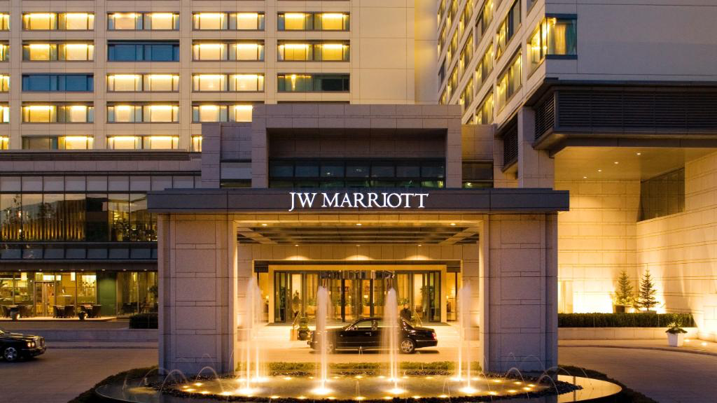
Introduction
JW Marriott is a brand within Marriott International.
Marriott International was founded by J. Willard Marriott and Alice S. Marriott in 1927.
Jw Marriott is known for providing luxury accommodations and services to upscale travellers.
A brand that prioritises warm hospitality and personalisation (Anderson 2023).

Slide 4
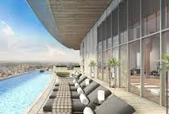
JW Marriotts Target Market
Upscale and luxury traveler’s (JW Marriott 2023).
Business traveler’s
Leisure traveler’s seeking high-end experiences.
Corporate events and conferences.
Special occasions like weddings and celebrations.
Guests who value premium amenities and personalised services.

Slide 5
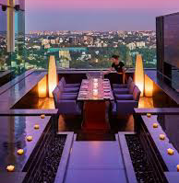
Guest service scope at JW Marriott
The primary objective of JW Marriott is to ensure guest satisfaction with an extensive array of services and amenities tailored to deliver an unparalleled and remarkable experience.
Check-In and Check-Out: Smooth and personalised processes.
Concierge Services, Recommendations, reservations, and local arrangements.
Room Service: High-quality in-room dining options.
Dining: On-site restaurants and bars with culinary experiences.
Spa and Wellness: Luxurious spa facilities and wellness services.
Fitness Centres: Well-equipped for guest fitness needs.
Event and Meeting Facilities: Modern spaces for corporate events.
Weddings and Celebrations: Elegant venues for special occasions.

Slide 6

Guest services personal touch
JW Marriott provides exceptional guest services (“Luxury Hotels & Resorts: Mindful Experiences | JW Marriott,” 2023).
They offer personalised greetings and concierge assistance.
The staff goes the extra mile for guests.
They aim to make every stay special with a personal touch.

Slide 7
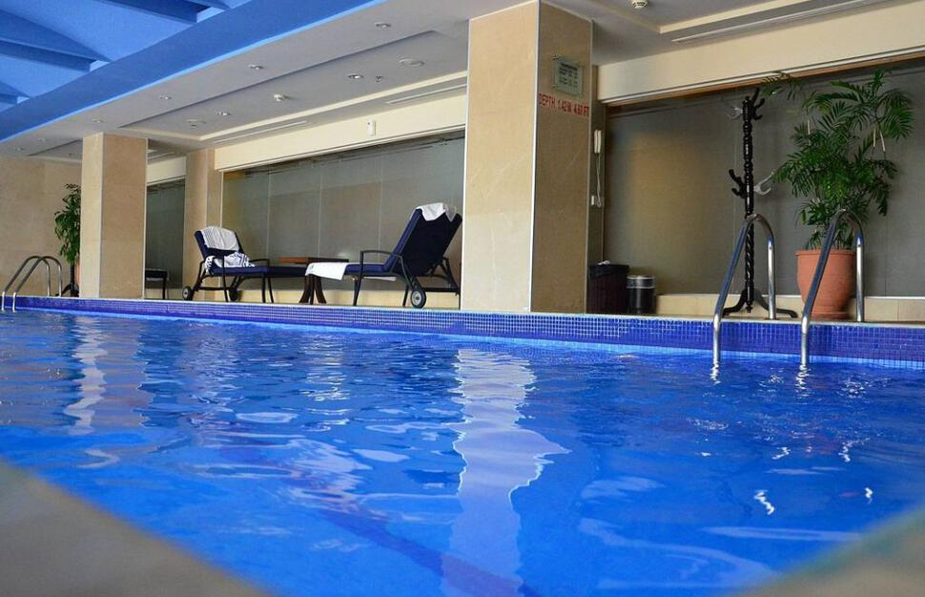
Facilities provided to guest by JW Marriot
Luxurious Accommodation.
Dining Options.
Meeting and Event Spaces.
Swimming Pools.
Concierge Services.
In-Room Amenities.
Transportation Services (“Marriott Seattle Airport (SEA) Review,” 2023).
Wi-Fi and Connectivity.
Spas and wellness centre’s offer relation and rejuvenation opportunities, enhancing the overall well-being of guest (Marriott Hotels 2023)

Slide 8

Role and function of guest services
Resolving guest issues promptly.
Responsibilities include greeting guest, check-in and check-out processes, and addressing inquires.
They provide valuable local information and recommendations to enhance the guest stay.
Handling special request, reservations, and room preferences to meet individual's needs.

Slide 9
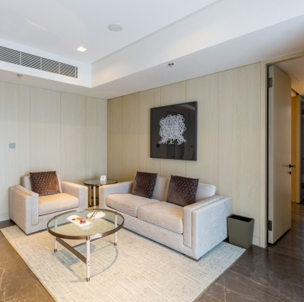
Importance of Hospitality
Hospitality is making your guests feel at home, even if you wish they were (Vogt, 2023).
Boosts customer satisfaction and business success.
Builds a positive reputation and attracts more customers.
Fosters cultural exchange and economic growth.
Creates personal connections and competitive advantages.Encourages repeat business and loyal customers.

Slide 10
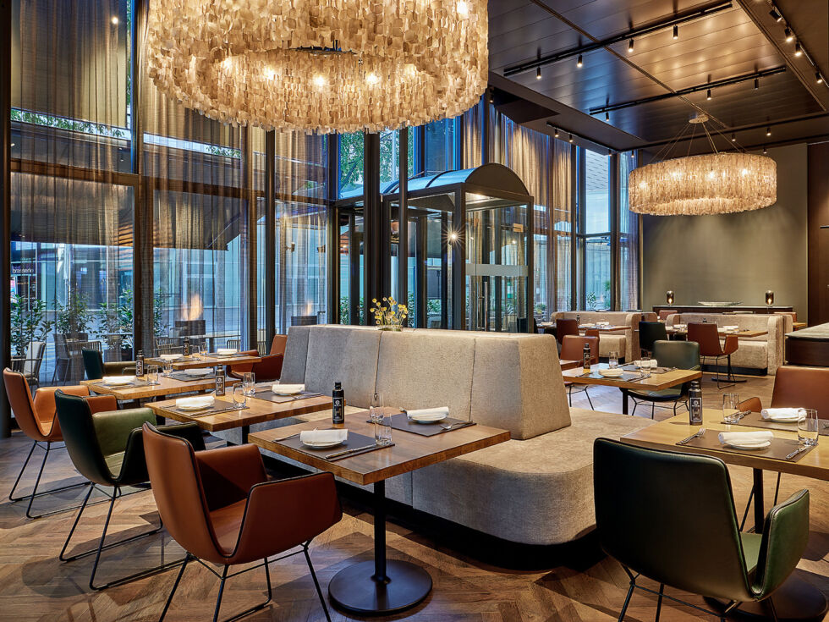
Meeting guest expectations
JW Marriott consistently enhances the guest experience and meets their expectations for a luxurious stay.
Personalised service.
Luxurious amenities.
Attentive staff.
Fine dining.
Impeccable cleanliness.
Sustainability initiatives.
Ongoing innovation.

Slide 11
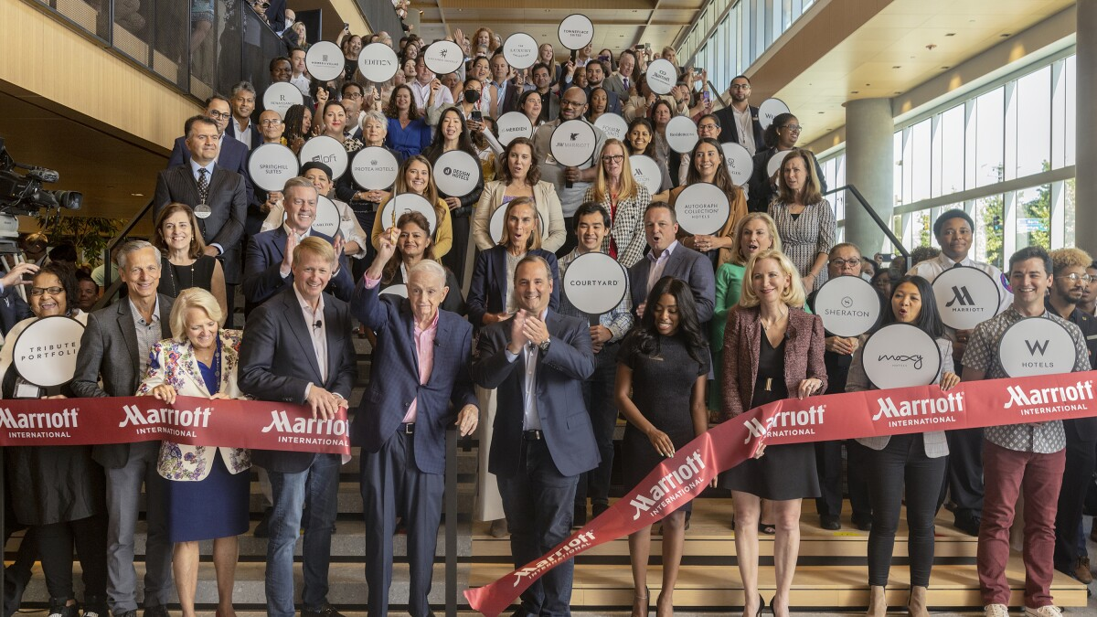
Conclusion
The success of any hospitality business is largely dependent on providing excellent service, hospitality, and guest services. them is clear that JW Marriott offers the best possible hospitality and customer service, and its commitment to these qualities has earned them a stellar reputation in the business.
The amount of work put in by guest services demonstrates the significant impact they have on the performance of hospitality businesses because they interact with clients and serve as the company's face.
In the end, unsatisfactory guest services can affect the business's profitability by generating complaints and discouraged customers from returning. A poor reputation combined with lost sales is a surefire recipe for failure. Once gone, a customer's confidence is almost tough to regain (Taylor 2023).

Slide 12
References
Anderson, A. (2023). “How Customer Experience Strategy Encourages Customer Loyalty.”(Online) Available at: https://sharpencx.com/blog/marriott-customer-experience-strategy/ (Accessed: 26 October 2023) Marriott’s Personalised .
JW Marriott. (2023) “Luxury Hotels & Resorts: Mindful Experiences.” Available at: (Online) https://jw-marriott.marriott.com/ (Accessed: 27 October 2023).
Marriott Seattle Airport (SEA) - One Mile at a Time. 2023. (Online)!Available at: https://onemileatatime.com/reviews/marriott-seattle-airport/. (Accessed: 27 October 2023).
Luxury Hotels & Resorts: Mindful Experiences | JW Marriott 2023. (Online) Available at: https://jw-marriott.marriott.com/. (Accessed: 27 October 2023).
Marriott Hotels. (2023). “Wonderful Hotel Services & Facilities.” Marriott Hotels. (Online)Available at: https://marriott-hotels.marriott.com/experience/ (Accessed: 26 October 2023).
Marriott Logo and Symbol, Meaning, History, PNG, Brand. (2022).(Online) Available at : https://1000logos.net/marriott-logo/#google_vignette (Accessed: 26 October 2023).
Marriott International. (2023). Foundation & Growth Story. (Online) Available at: https://www.hotel-development.marriott.com/power-of-marriott ( Accessed: 25 October 2023).
Taylor, S. (2023). “Customer Complaints in Hospitality – From Our Very Own Experts.” (Online) Available at: https://www.highspeedtraining.co.uk/hub/customer-complaints-in-hospitality/#:~:text=They%20could%20feel%20they%20have,to%20empathise%20with%20the%20customer. (Accessed: 26 October 2023).
Spa & Fitness | Park Plaza Westminster Bridge London, part of Radisson Hotel Group. (2023). (Online)Available at: (https://www.parkplazawestminsterbridge.com/spa-fitness/ (Accessed: 26 October 2023)
Vogt, J. (2023). “The J-1 Blog - International Trainee Network.” (Online) Available at: https://www.itnusa.com/j1-blog/inspirational-quotes-for-the-hospitality-world#:~:text=A%20favorite%20quote%20from%20awarded,if%20you%20wish%20they%20were.” (Accessed: 26 October 2023).

