Slide 1

The Caring Society PowerPoint
http://www.phoenix-society.org/get-get-support
Heike Griffiths
Module: SJSS4002
By Katrina James

Slide 2
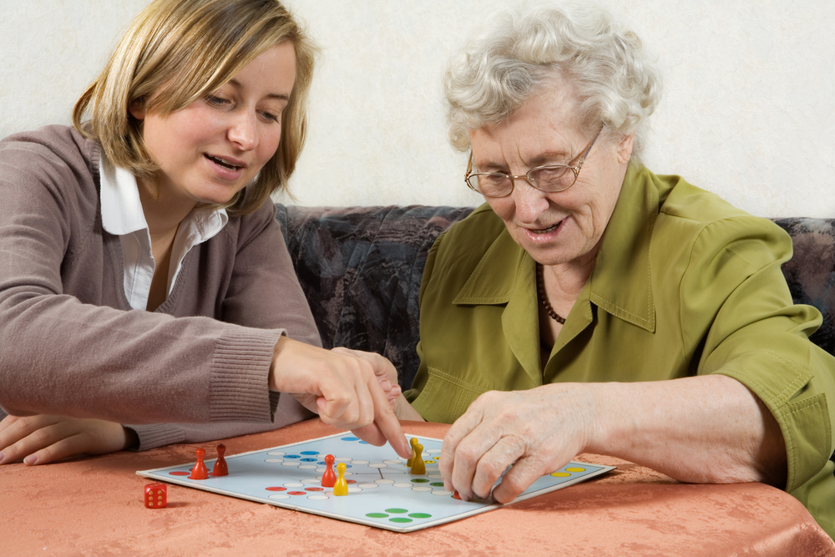
Introduction
In this PowerPoint presentation I will be exploring the barriers to the well-being and inclusion for informal careers, referring to theory, policy and practice.
http://www.goredforwomen.org/about-he-heart-disease/living-with-caring-for-someone

Slide 3

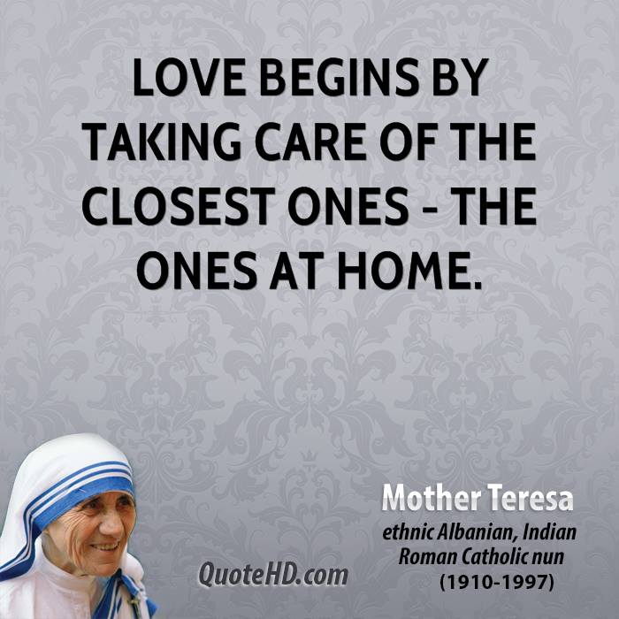
What is care ?
Care can mean many different things. You take care of yourself, you care for your children, family and friends. But if you care for someone who is ill, disabled or a frail elderly person you should think of yourself as a carer. (Johnson, J., and Souze, C, D. 2008, P.47)
http://goalcast.com/2017/04/10/top-20-inspiring-mother-tersea-qoutes

Slide 4

Values and Principles of Care:
Privacy
Confidentiality
Dignity
Anti – Discrimination
Communication
Independence
Fulfilment
Choice
http://www.vandelaydesign.com/customer-service/
Adelaide Care, no date)

Slide 5
History
Reverend Mary Webster started the timeline of care, we know today. She wrote a letter concerning how hard it is to manage a adult life (work, children) and support her aging parents (1967)
Tax Allowance (1967)
Invalid Tax care allowance (1976)
CNA (carers national association) was renamed to ‘Carers UK’ (2001)
Over 400 Million pounds were provided to assist the health and social sector. (2002)
Carers equal opportunities act 2004 (2004)
The equality act protected carers (2010)
Social Services and Well – being act 2014 (2014)
(Carers UK, 2018)

Slide 6
Barriers that informal carers face.
Physical and Mental Health
Financial Difficulties
Housing Issues
Employment
Juggling other responsibilities
Access for relevant information

Slide 7
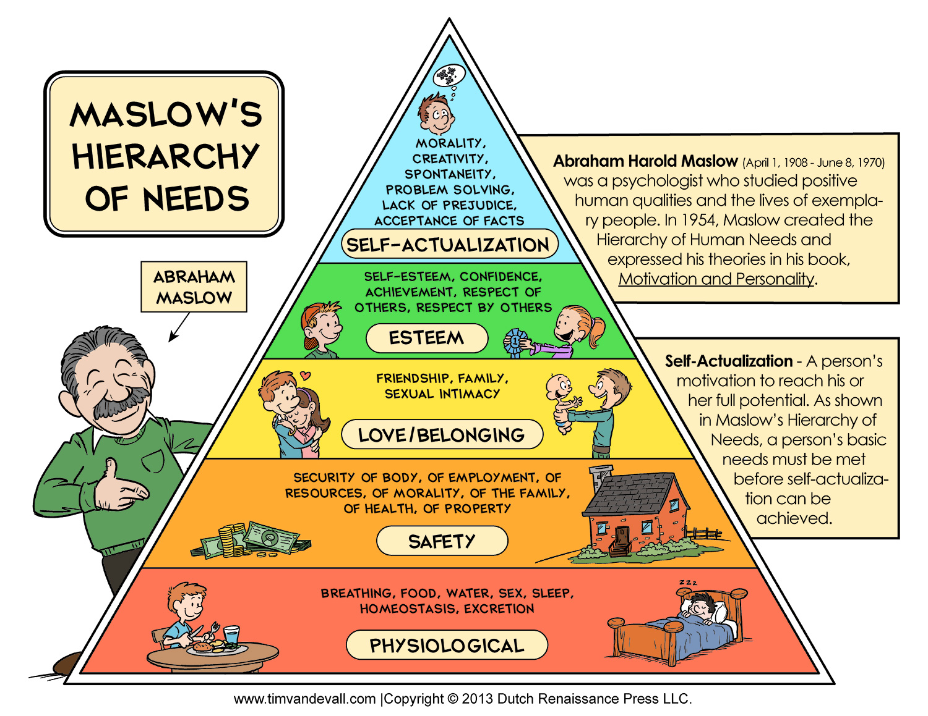
Social and Psychological theories within care.
Maslow is one of the most popular theories relating to the needs of human beings.
As I have previously mentioned, carers have often neglected their needs, resulting as a low satisfaction of their life. (Learning Theories, 2018)
https://doodlesbaker.wordpress.com/2014/03/31/maslows-hierarchy-of-needs/

Slide 8
Reference list for Image:
Picture http://www.phoenix-society.org/get-get-support
Picture http://www.goredforwomen.org/about-he-heart-disease/living-with-caring-for-someone
Picture http://goalcast.com/2017/04/10/top-20-inspiring-mother-tersea-qoutes
Picture http://www.vandelaydesign.com/customer-service/
Picture https://doodlesbaker.wordpress.com/2014/03/31/maslows-hierarchy-of-needs/

Slide 9
Reference:
Carers UK (2018) Our history. Available at: http://www.carersuk.org/about-us/who-we-are/our-history (Accessed on: 12th of January 2018).
Johnson, J., and Corinne D, E. (2008) Understanding health and social care: an introductory reader. SAGE Publications LTD
Adelaide Care (no date) Values and Principles of care. Available at: adelaidecare.com/values.hmli (Accessed on: 12th of January 2018)
Learning Theories (2017) Maslow's Hierarchy of needs. Available at: http:/learningtheories-maslow-hierarchy-of-needs-pdf (Accessed on: 12th of January 2018).

