Slide 1
Certificate of Higher Education – Skills for the Workplace
Health and Social Care
Academic and Employability Skills
(LCHS4001)
Session 3:
Notetaking & paraphrasing
Giving & receiving feedback

Slide 2
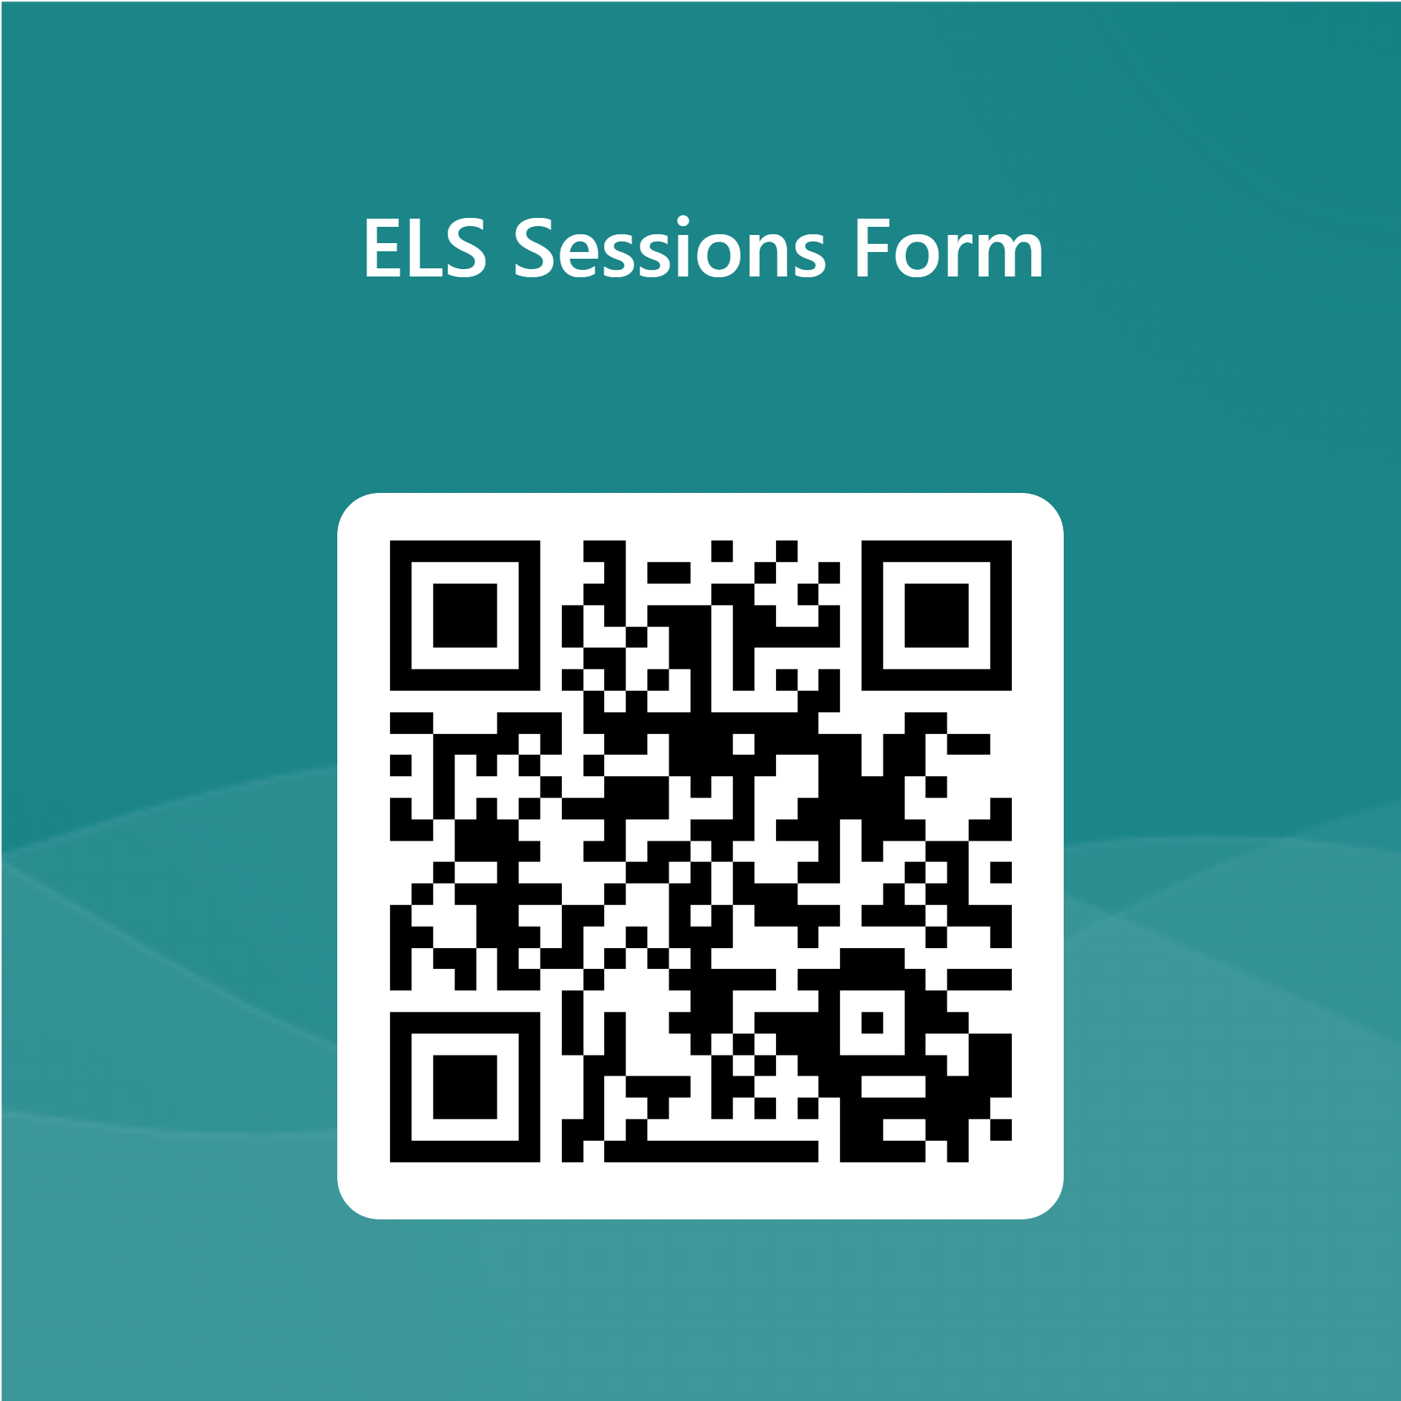
Notices: English Language Support (Quay Place - weekdays)

Slide 3
Notices: Library/Digital Skills Support
Academic Liaison Librarian Support
Book a one-to-one session with one of our Academic Liaison Librarians to develop your research, reading and referencing skills.
Click here to book or email birminghamlibrary@uwtsd.ac.uk
Digital Skills Support
Book a one-to-one session with one of our Digital Skills Advisors to develop your IT skills Click here to book (Or ask for Taran!)

Slide 4
Recap quiz!
Notes:
Quiz will be in the Session Three materials, hidden from students, and called Session 2 Recap Quiz (or feel free to do your own recap)

Slide 5

In this session we will…
Research and teach each other about notetaking
Learn about paraphrasing (and occasional quoting)
Do our first “formative feedback” activity on a search and evaluation strategy
Learn how to reference a webpage
Notes:
5

Slide 6
Notetaking

Slide 7
Why take notes?
?
Discuss in pairs/small groups
reasons for taking notes
(and any previous experiences good or bad)
and choose one point
to share with the whole class

Slide 8
Reasons for taking notes
To focus on what is important
To process information and understand it
To help us remember things
To get ideas for an assignment
To organise information and ideas
To see what gaps we still have
To record important points
And finally, but very importantly, to record where our information/ideas have come from

Slide 9
Teach each other notetaking methods
Step one: choose a method
In small groups, choose one of the following methods of notetaking:
Mind map
Cornell notes
Outline notes
You can find a brief introduction to each here: https://www.learninghub.ac.nz/study-skills/readings/note-taking/

Slide 10
Teach each other notetaking methods
Step two: learn about and try out the method
Research the method – you could use:
the materials on Moodle
the module reading list
reliable websites (remember to evaluate them!)
Try out the method:
choose a page of a book from the module reading list
make notes using the chosen method
check your use of the method with your lecturer

Slide 11
Teach each other notetaking methods
Step three: teach the class what you’ve learnt
Prepare and give an informal presentation to the rest of the class
What are the key points about the notetaking method?
  How are the notes laid out?
  What is the function of each part?
  Is the method useful for particular kinds of notes?
Could you give a demonstration or show an example?
Remember to include the references for sources you have used (you will learn the correct format later – for now you can include links/notes to acknowledge your sources)

Slide 12
How to evaluate our notes
Make list of points that you could use to decide whether a set of notes are useful…
…then…
Compare your list to the list on page 231 of Cottrell (2019) (on Moodle or given to you by your lecturer)
Notes:
Lecturers – set this for self-study/homework if you are concerned about time

Slide 13
Writing notes in your own words
It is important to make most of your notes in your own words
If you copy down a quotation, i.e. copy text from the source exactly...
  You must clearly separate those words, so you know they are a quote when you look back at your notes later
  You should use quote marks, even in your notes i.e. “….”
  You need to note the exact page number(s) for where the quote is from (you will need this information later when you come to reference your quote)
If you don’t do this, you may end up copying the source by accident in your work. This is an academic offence – we will learn more about it in a later class.

Slide 14
Paraphrasing

Slide 15
What is paraphrasing?
Restating an idea in your own words
Read, Think, Restate
(and remember to reference the idea with
an in-text citation and
a full reference in the reference list at the end)

Slide 16
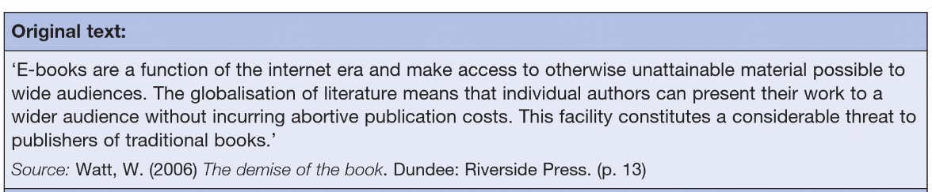
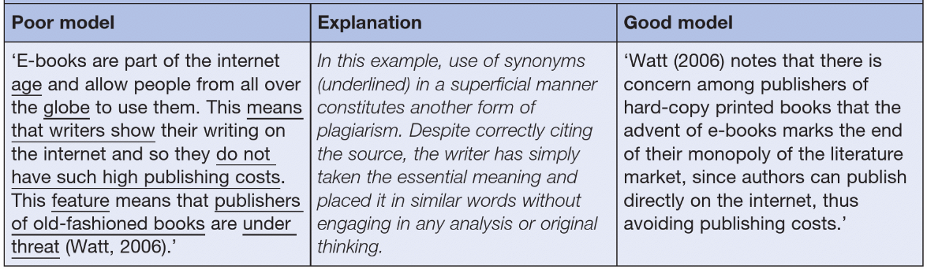
What is a good paraphrase?
Taken from: McMillan (2021) p. 223

Slide 17
Why is paraphrasing an art?
You are writing your own version of the original idea (with in-text citation and reference)
You are expressing your understanding
TIP: Close the original source when you are writing

Slide 18
What not to do
Don’t copy the original and go along the sentence swapping each word for a similar one
Don’t keep parts of the original sentence (unless quoting and citing appropriately)
We will return to paraphrasing in a later class.

Slide 19
Quoting
(occasionally)

Slide 20
Quoting – extra things to remember
Quoting is when you copy word for word from the original source (known as verbatim – exactly what was written/said)
You should only do this occasionally if you really need to keep the original words e.g.
  You are taking something very specific e.g. a definition
  The author’s original words were highly impactful/expressive/unusual
You MUST add the exact page number(s) for the quote to your in-text citation [you can use the paragraph number if there is no page number e.g. on a webpage]

Slide 21
Short quotations
  Short quotations (up to 30 words or 2 lines) should be put in the body of your text and enclosed in double quotation marks. You must put the page number(s) e.g. p.8 or pp.8-10 or the paragraph number if there is no page number e.g. para. 5.
  For example:
  A normal paragraph has been started here. “There is no substitute for work experience” (Cottrell, 2019, p.58). Then the writer carries on with the rest of the paragraph.
  Or…
  A normal paragraph has been started here. Cottrell (2019, p.58) states that “there is no substitute for work experience”. Then the writer carries on with the rest of the paragraph.

Slide 22
Longer quotations
Longer quotations should be entered as a separate indented paragraph:
There is no substitute for work experience; it develops skills and attributes hard to gain through study alone. It need not be in your intended career area if opportunities don’t arise there. It is better to have any recent work experience than none, especially if you haven’t had paid employment before. (Cottrell, 2019, p.58)
You must put the page number(s) e.g. p.8 or pp.8-10 or the paragraph number if there is no page number e.g. para. 5.
(quotation marks are not required in this layout)

Slide 23
Paraphrasing compared to quoting
Direct quote:
Cottrell (2019, p.302) says, “Write so that your reader can easily follow what you are trying to say. Do not use long words and technical jargon simply in order to sound impressive”.
Paraphrase:
Cottrell (2019) suggests that it is more important to be understood than to use complex vocabulary.
Complex vocabulary can prevent people understanding your ideas (Cottrell, 2019).
Note that the brackets depend upon whether the emphasis is on the author (a) or the information (b)
Note that in (b) the full stop comes after the citation – the citation is always part of the sentence.

Slide 24
BREAK

Slide 25
Giving and Receiving Feedback

Slide 26

Giving and receiving feedback
Notes:
https://www.youtube.com/watch?v=vCyKK03UVMs
Lecturers – please break up the video – pre-empt and discuss the sections (in small groups or as a whole class)

Slide 27
Feedback – highlights
Feedback involves dialogue, including asking for what you need and asking questions
Feedback is a process (not one result)
Feedback can be taken on board or put aside (but should be considered)

Slide 28
Formative Feedback Activity
Search and Evaluation Strategy

Slide 29
Formative feedback activities: The Rules
In order to be awarded some marks:
You must work on the task in class
You must upload what you have done before the end of the class (it doesn’t have to be finished – we just want to see that you have started and be able to give you feeback comments)
You can work on your laptop/a computer and upload your work by 13.15 if you have a morning class/18.00 if you have an afternoon class
Next week, your lecturer will give you feedback (not a grade)

Slide 30
Purpose of this week’s formative feedback activity
To develop your skills in searching for and evaluating information
  To experiment using what you learnt in Sessions 1 and 2 about searching for and evaluating information
  To practice taking the first step towards producing a piece of work
  To actually take the first step for your own assessment!

Slide 31
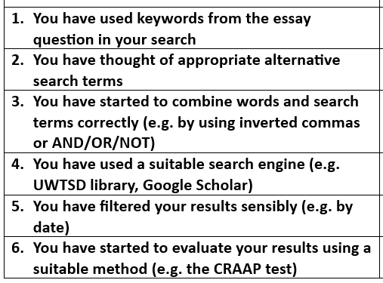
The feedback criteria for this activity

Slide 32
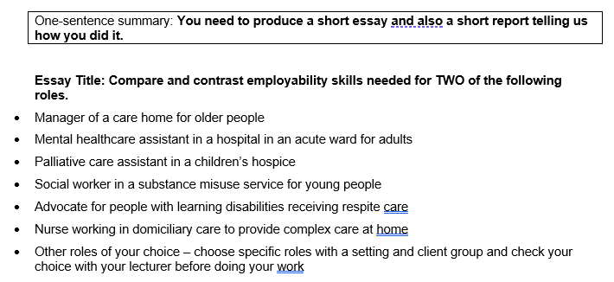
Before you start: Check you understand the essay question and choose two roles
Notes:
Lecturers – please explain “compare and contrast” i.e. what is similar and different (we don’t have time to go into essay question verbs yet)

Slide 33
Search and evaluation strategy
Step one – take stock
What do I already know? What do I need to find out?
Employability skills
Think back to Session 1 and our exploration of job profiles on the National Careers Services website
What do you already know about employability skills in general – what would you like more information about?
Two roles
What do you already know about the roles you are interested in? What do you need to find out?

Slide 34
Search and evaluation strategy
Step two – think about your search strategy
What search engine are you going to use i.e. where are you going to search for sources of information?
Try to use the UWTSD library/Google Scholar for academic information
You may also want to find professional websites, using Google
What search terms could you use?
How will you combine your search terms?
How will you filter your results?
Experiment in the search engine – remember that you need to play around with different words and combinations
As you go along – if you are happy with a search, you could save your search or take a screenshot to keep a record of what you have done

Slide 35
Search and evaluation strategy
Step three – evaluate your results
When you have some search results, start to evaluate them in more detail
You can use the CRAAP test (Blakeslee, 2004) (see Session 2)
Start to make some notes about why you plan to use some of the results and why you will reject some of the results
Remember that eventually you will need to write about your process (as well as your essay) …. so make some notes about what you have done and why when using these search and evaluation skills

Slide 36
Very Important
VERY IMPORTANT – by the end of today’s session, make sure you have saved your screenshots of your searches and saved your notes/writing
Remember to upload what you have done, following your lecturer’s instructions, before you leave class (for feedback to help you improve your work)
Well done for getting started!

Slide 37
Referencing a webpage

Slide 38
Have a go at the
Referencing a Webpage
activity on Moodle

Slide 39
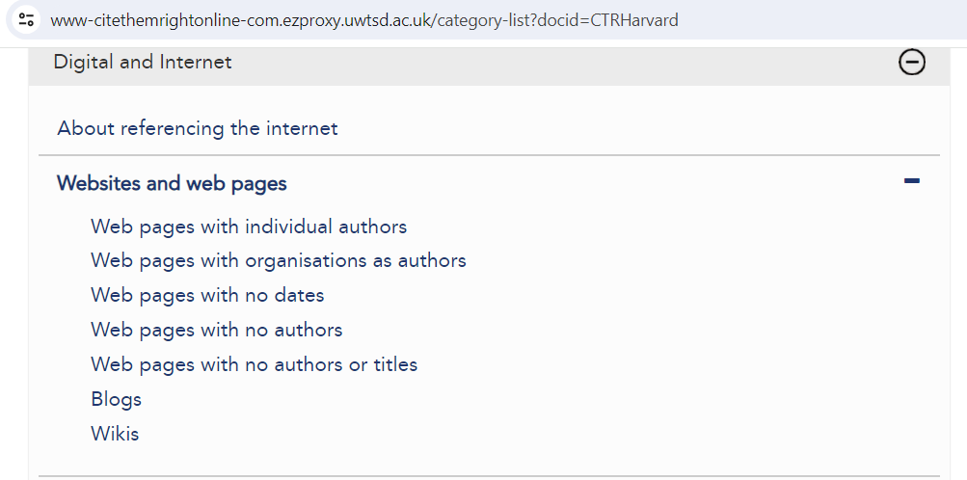
How to reference a webpage
(it depends…)

Slide 40
Referencing a webpage with an organisation as the author
Year of publication
in brackets
Title of webpage in italics (end with full stop)
Name of organisation
National Health Service (2021) Coronavirus (COVID-19). Available at: https://www.nhs.uk/conditions/coronavirus-covid-19/ (Accessed: 17 May 2021).
Web address (begin with Available at:)
When you looked at it
(begin with Accessed:
And end with full stop)

Slide 41
Reflective journal entry
Write this week’s entry in your reflective journal. You could consider:
What have I learnt about notetaking?
What did I understand about the difference between paraphrasing and quoting
What do I need to get help with?
What was it like to do the first “formative feedback” activity?
How will I use my self-study time this week (e.g. read about and practice notetaking (including paraphrasing), do some extra activities on Moodle)

Slide 42

Summary
Can you remember any reasons for taking notes?
Can you name three ways of laying out your notes?
What is paraphrasing?

Slide 43
References
Cottrell, S. (2019) The Study Skills Handbook. 5th edn. London: Red Globe Press.
Learning hub (no date) Note taking methods. Available at: https://www.learninghub.ac.nz/study-skills/readings/note-taking/ (Accessed: 21 January 2024).
McMillan, K. (2021) The Study Skills Book. 4th edn. Harlow: Pearson.

Slide 44

Next session…..
We will look at:
Writing an academic paragraph
The practice of reflection
AND
We will do some notetaking (and paraphrasing)
And a bit more referencing

