Slide 1
Problem Solving and Decision Making
Work place Stress at care homes
Student name: Leonas Alexandru NICOLAE
Student number: 2026944
Module code: BMSW 4004
Lecturer: Jonathan Wyatt

Slide 2
Introduction
Work place stress has been a topic of discussion for experts since a long time. The modern work place is entirely task oriented which makes the work place very demanding and the increased work load can result in work place stress for staff and employees.
Identifying the factors that causes the work place stress and creating strategies to manage and solve the problem is crucial to make sure that employees can perform better and deliver better outcomes (Bhui et al., 2016).

Slide 3
Nature and Impact of Workplace Stress
Work place stress can happen to individuals due to various reasons. Different people can get affected by work place stress because of different reasons.
The impact of work place stress can differ from person to person. The impact of the problem depends on which reason caused the problem.
Work place stress can be of physical and mental in nature.
Organizations which need their staff to be involved in harsh physical activities, might experience staff with physical issues (Li, 2017).
Staff who are more involved in more psychological works, might experience mental stress and mental health issues.

Slide 4
Cause & Effect Analysis of Workplace Stress
Causes of work place stress
Long hours of work
Conflicts with co-workers or higher authority
Heavy work load (Tentama et al., 2019).
Job contents and demands
Lack of support
Effects of work place stress
Anxiety
Depression
Irritability
Lack of motivation
Heart palpitations
Sleeping difficulties

Slide 5
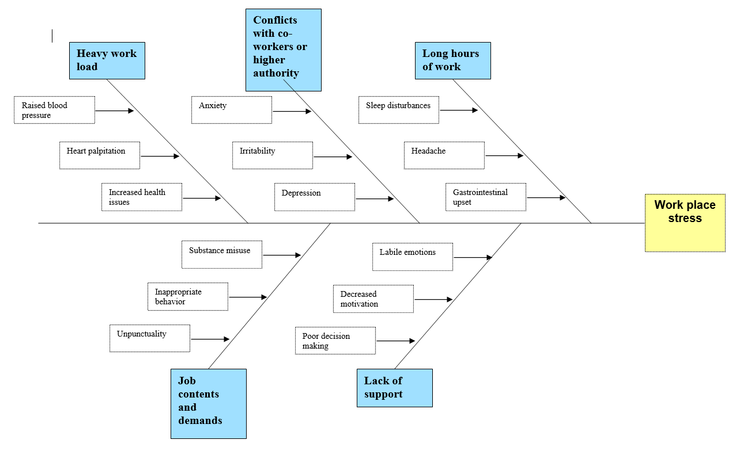
Fishbone Diagram of Problem Solving

Slide 6
PESTEL Analysis of Workplace Stress
Political factors
Staff and employees feeling replaceable by the organization
Lack of loyalty of the organizations
A constant search for new talents
Lack of effort by the organization to retain the existing employees
Economic factors
Remote workers are getting more importance which makes ways for more talents to enter
Prices of day to day necessities have increased significantly compared to average wages
Employees overseas workers more than ever

Slide 7
PESTEL Analysis of Workplace Stress
Social factors
Existence of variety of demographic characteristics in the work place
Different behavioral attributes of different people
Language barriers for overseas employees
Pressure of adapting to a diverse work ambience
Technological factors
Pressure to handle very large data simultaneously
Pressure to deal with over load of information
The need to have advanced technology based skills

Slide 8
PESTEL Analysis of Workplace Stress
Environmental factors
Strictly following the rules and regulations of environmental laws
Introducing operational processes and components that do not cause any environmental inconveniences
Legal factors
Strict legal rules and legislations about work place behavior
Fear of getting fired due to lack of knowledge about various rules
Authorities having the power to hire and fire employees

Slide 9
Alternative Solutions to Workplace Stress
Motivating workplace wellness
Renovating the work environment
Encouraging remote working process
Encouraging social activities
Giving off time to employees if needed
Arranging counselling sessions
Encouraging healthy relationship between employee and employer

Slide 10
Choosing the Most Appropriate Solution
The most appropriate solution to the problem at hand from the various alternative solutions can be found using the plus minus interesting method. The PMI method is utilized in the evaluation of various ideas that are thought to be prospective solutions for a given problem (Lester, 2006). The method works by addressing the positive aspects and adding them to the solution, subtracting the negative aspects and evaluating interesting factors that can be further discussed.

Slide 11
Conclusion
Work place stress take the form of a serious issue in both personal and work life. The UK government is trying constantly to decrease workplace stresses by taking various measures.
Proper identification of the factors that cause work place stress and appropriate measures taken to eliminate the factors can ensure the dismissal of work place stress.

Slide 12
References
Bhui,K., Dinos, S. and Stansfeld, S., (2016), Perceptions of work stress causes and effective interventions in employees working in public, private and non- government organizations, BJPsych Bull, 40(6):318-325.
Lester, A., 2006. Project management, planning and control: managing engineering, construction and manufacturing projects to PMI, APM and BSI standards. Elsevier.
Li, J., (2017), Work stress and the development of chronic diseases, International Journal of Environmental Research and Public Health, 15(3): 536.
Tentama, F., Mulasari, S. A. and Merdiaty, N., (2019), Factors affecting work stress in university, International Journal of Public Health Science, 8(3): 381.

