Slide 1
Setting up OpenGL
Installing GLFW & GLEW

Slide 2
GLFW
GLFW stands for Graphics Library Framework. It is an open-source, multi-platform library designed to provide a simple API for creating windows, contexts, and handling input and events in OpenGL, OpenGL ES, and Vulkan applications.

Slide 3
What does GLFW do for us?
Window Creation and Management
Cross-Platform Support
Window Customization
OpenGL Context Creation
Context Management: Simplifies the creation and management of OpenGL contexts
Version and Profile Selection: Enables developers to specify the desired OpenGL version and profile (core or compatibility).
Input Handling
Event Handling
Polling and Waiting
Timing Functions
Vulkan Support: In addition to OpenGL, GLFW also supports Vulkan

Slide 4
But why?
OpenGL is Just a Graphics API
OpenGL provides a specification for rendering 2D and 3D graphics but does not handle window creation, input processing, or context management.
To build a functional application, you need to handle these aspects, which is where GLFW comes into play.

Slide 5
OpenGL Extension Wrangler Library (GLEW)
It is an open-source C/C++ library designed to manage OpenGL extensions and facilitate the use of modern OpenGL features by automatically loading available features. It ensures cross-platform compatibility, allowing developers to easily access and utilise modern OpenGL capabilities in their graphics applications without manual extension management.

Slide 6
Lets jump in
To start off we’ll
Install Visual Studio 2022 (Community)
Check the drivers on the machine are up to date
Install GLFW
Install GLEW
You’ll know you are done when a blank window displays

Slide 7
Create a project
Open visual studio
Create an empty project

Slide 8
Define a library folder
You’ll likely be acquiring a selection of C++ libraries and it is good practice to reduce repetitive steps like installing it to every project but we will install it into the project itself for this example
In your project create a structure like this I find it easier to set vs to folder view for this
projectname
-deps
-glfw
-glew
-src
-main.cpp

Slide 9
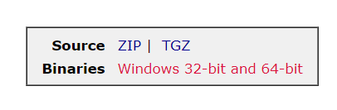
Links
https://visualstudio.microsoft.com/vs/community/
To grab GLFW we’ll go to this link and select Windows pre-compiled binaries and pick 32/64… I will go with 32-bit but it is important to stick with the same architecture going forward
https://www.glfw.org/download
Next lets pick up GLEW Binaries
https://glew.sourceforge.net/
**You could always pick up the source code and compile it yourself to your dev environment but that is a bit more work

Slide 10
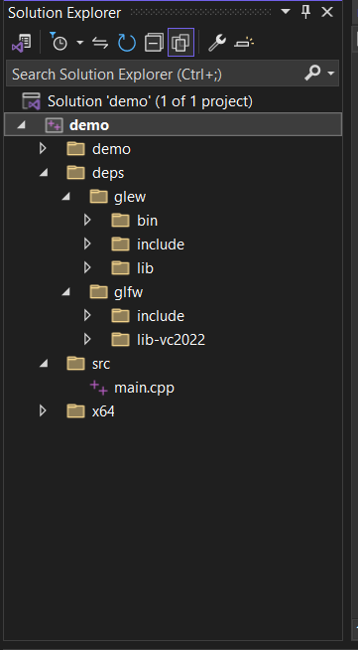
Extract and copy
Unzip the downloaded glfw and glew files. Then copy the respective includes, bin and lib subfolders into your dep directory

Slide 11
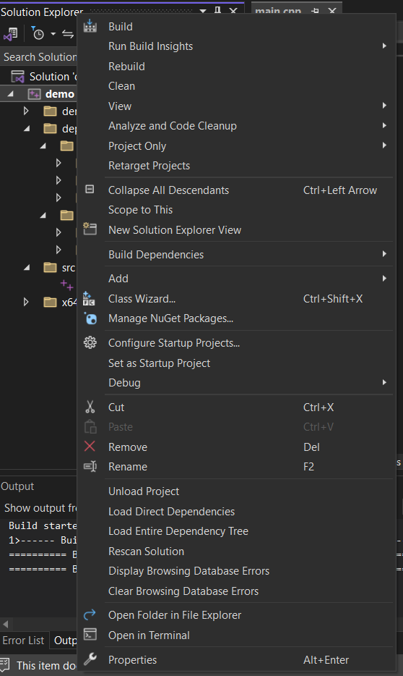
Right-click on the project
Click on properties at the bottom (ALT + ENTER)
Ensure you are configuring the "All Configurations" and "All Platforms" for consistency.

Slide 12
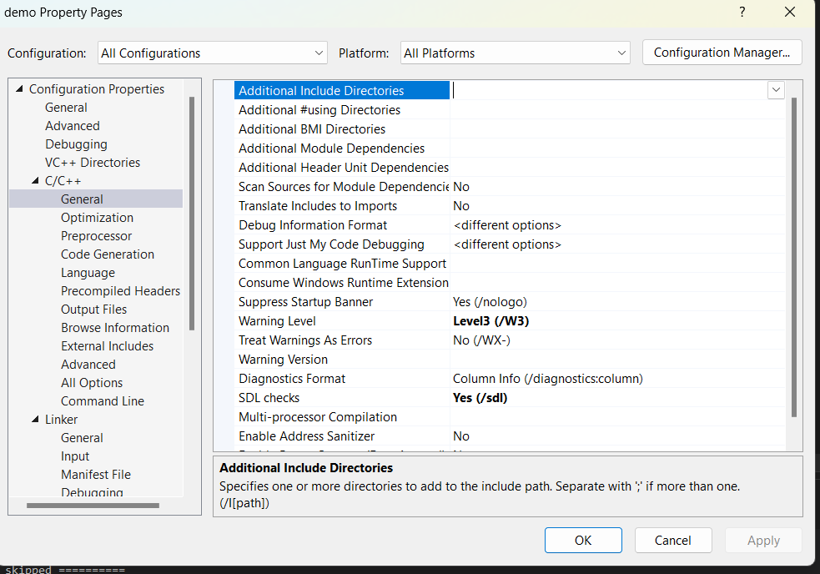
Under the section c/c++ -> general -> Add the include paths to “additional include directories”

Slide 13
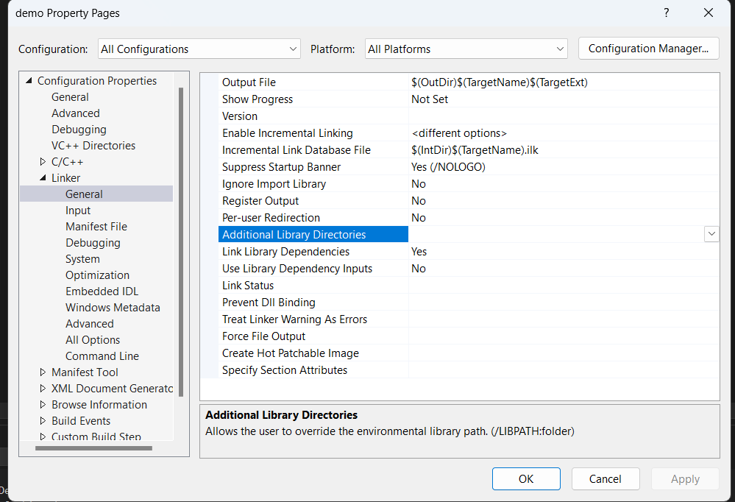
Under the section called Linker -> General -> “Additional library Directories” we’ll include the paths for the libs

Slide 14
Next under Linker -> Additional dependencies -> we’ll include the following
opengl32.lib; glfw3.lib; glew32.lib;

Slide 15
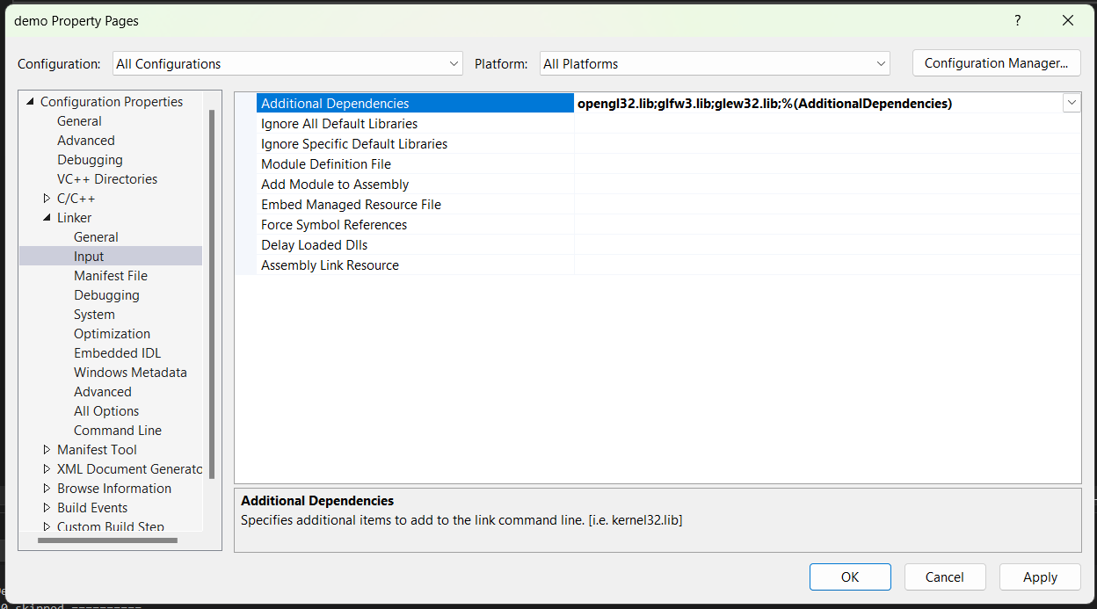

Slide 16
Now we’ll add code, build and run
We expect it to not quite work yet as we haven’t done a few things
Lets add some boilerplate code that just creates a window

Slide 17
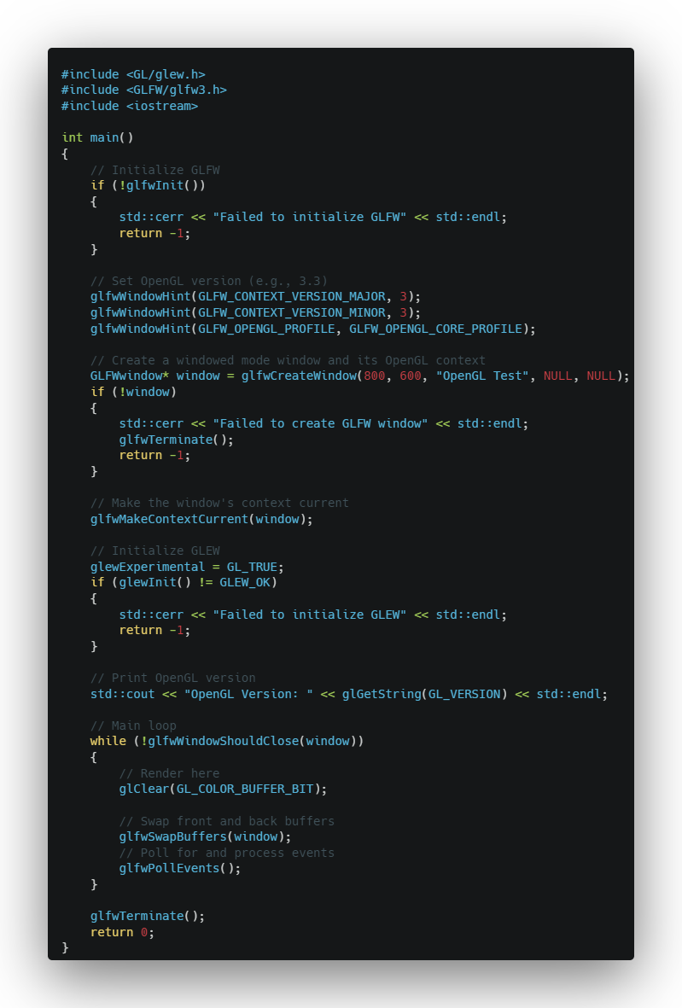
Boilerplate
Notes:
#include <GL/glew.h>
#include <GLFW/glfw3.h>
#include <iostream>
int main()
{
// Initialize GLFW
if (!glfwInit())
{
std::cerr << "Failed to initialize GLFW" << std::endl;
return -1;
}
// Set OpenGL version (e.g., 3.3)
glfwWindowHint(GLFW_CONTEXT_VERSION_MAJOR, 3);
glfwWindowHint(GLFW_CONTEXT_VERSION_MINOR, 3);
glfwWindowHint(GLFW_OPENGL_PROFILE, GLFW_OPENGL_CORE_PROFILE);
// Create a windowed mode window and its OpenGL context
GLFWwindow* window = glfwCreateWindow(800, 600, "OpenGL Test", NULL, NULL);
if (!window)
{
std::cerr << "Failed to create GLFW window" << std::endl;
glfwTerminate();
return -1;
}
// Make the window's context current
glfwMakeContextCurrent(window);
// Initialize GLEW
glewExperimental = GL_TRUE;
if (glewInit() != GLEW_OK)
{
std::cerr << "Failed to initialize GLEW" << std::endl;
return -1;
}
// Print OpenGL version
std::cout << "OpenGL Version: " << glGetString(GL_VERSION) << std::endl;
// Main loop
while (!glfwWindowShouldClose(window))
{
// Render here
glClear(GL_COLOR_BUFFER_BIT);
// Swap front and back buffers
glfwSwapBuffers(window);
// Poll for and process events
glfwPollEvents();
}
glfwTerminate();
return 0;
}

Slide 18
Click build to generate an output file
Once you’ve run build and run. It will throw an error about missing DLL, so we’ll grab the ones from the glew/bin and copy them into the output folder
(The output folder is automatically generated when we run the program)
Finally, the window should open!

