Slide 1
Effective Team Working and Communication
Studen id:2027938
Name: Alin Raileanu
Student id:2027234
Name:Ana Maria Fugaru
Student id:1911764
Name:Beniamin Lupu
Courese id:BMSW2_BIRM
Subject name:task 2 Assignment
Lecturer name: Dr Sujeewa Herat

Slide 2
Table of Contents
Introduction
Models of Communication
Theories to Models of Communication
Channels of Communication
Communication Channels Used to Improve Communication
Barriers of Communication
Impact of Effective Communication in Business
Conclusion
References

Slide 3
Introduction
Communication tends to be the way to share relevant information and data among different individuals
Models and theories of communication-related to achieving modern-day information shall be discussed
The importance of the communication process for gathering significant data at Walmart shall be highlighted
The impacts of the effective communication process, as well as communication barriers, shall be discussed for Walmart organisation
Notes:
Communication is known to be such a process that is applied for sharing significant information between different people in different types of circumstances. The process of communication helps in transmitting significant information between individuals to understand and analyse various types of opinions. There tend to be various models related to the process of communication that plays a crucial role in enhancing the communication standards as well as establishing a certain network of transparency among people for sharing key data and information (Hänninen & Karjaluoto, 2017). This presentation focuses on highlighting the significance of different channels of communication by modifying the network shared between different functions at Walmart. Moreover, different communication barriers and the impact of communication network effectiveness by enhancing the flexible business process.

Slide 4
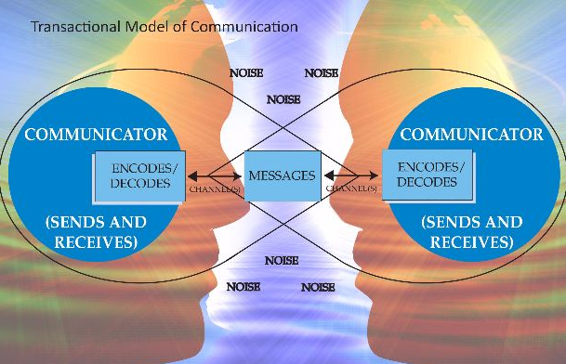
Models of Communication
Model of communication is known to be a visual representation of the facts and information that could intensify the understanding aspects of individual interaction
The interactive model of communication is mainly framed as a two-way transfer of message in terms of getting authentic reviews.
When Walmart applies the linear model of communication it becomes crucial to the business to encode the information shared along with maintaining the sustainable channel of transmission that gets decoded by the senders.
While applying the transactional model of communication within Walmart, it mainly interacts face to face along with providing a certain key to adapt different skills of observation for understanding the information transmitted.
Notes:
The model of communication is most effective in terms of intensifying the facts related to certain information interacted among different organizational employees. The linear model of communication tends to be one of the most effective communication models that is crucial to encode the information shared along with maintaining the sustainable channel of transmission that gets decoded by the senders (Srivastava et al., 2020). The main important lie on this model helps to maintain the efficient panel of security to acquire authentic and private information that is targeted towards different demographics. On the other hand, the interactive model of communication is mainly framed as a two-way transfer of message in terms of getting authentic reviews. Lastly, the transactional model of communication mainly raises the significance of the communication method by interacting face to face along with providing a certain key to adapt different skills of observation for understanding the information transmitted.

Slide 5
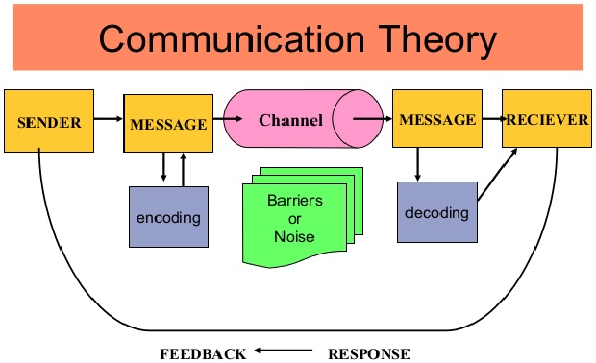
Theories to Models of Communication
The theories of communication tend to be effective towards supporting a transparent informational network for transferring different data
Walmart is generally observed to apply the Actor-Network Theory which favours the development of social intuitive organizations for the workers to wipe out the limits of social association
If Walmart intends to use the transactional communication model, then it predominantly followed the standards of this hypothesis in guiding the workers to start the methods of conveying vis-à-vis cooperation
Cognitive dissonance theory depends on the convictions and perspectives of the people while participating in a straightforward correspondence network
Notes:
The functioning strategies of correspondence models are upheld by powerful correspondence hypotheses that enumerate the significance of expert information moving organizations. Actor-Network Theory favours the development of social intuitive organizations for the workers of Walmart to wipe out the limits of social association and back the standards of direct correspondence model to send data in a decoded structure (Kristjánsson et al., 2020). Cognitive dissonance theory depends on the convictions and perspectives of the people while participating in a straightforward correspondence network that upholds the intuitive correspondence model to raise the inclinations of forming input surveys. Social learning theory on the other hand specifies the idea of teaching individuals from noticing new practices of others which is an ecological boost for setting up a straightforward correspondence organization. The transactional communication model predominantly followed the standards of this hypothesis in guiding the workers to start the methods of conveying vis-à-vis cooperation for noticing the social practices of the outside clients of Walmart.

Slide 6
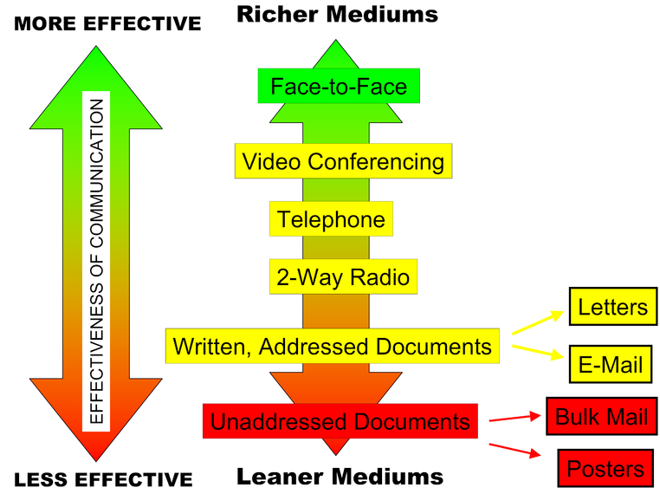
Channels of Communication
The conversation in terms of face to face channels tends to eliminate the goal of having frequent interruptions.
Interactive blogs when used within Walmart tend to be an effective channel of communication that expresses the requirement for carrying significant information to the employees.
Emails are a professional channel of communication where transparency is fully maintained to spread faster information and data among all and this is the most common method of communication used by Walmart.
Notes:
The channels of communication tend to be efficient to develop a transparent medium of communication among the individuals associated with the business. The platform mainly helps the employees to interact with one another in terms of different channels of communication thus eliminating the interruptions related to noise. Also, e-mail is generally considered to be an efficient channel of communication thus raising the transparency to spread significant information without any disruption of noise (Suh et al., 2018). The presence of different interactive blogs mostly carries the data information for educating the employees having the goal of adapting to cooperative processes that are observed to be applied within Walmart.

Slide 7
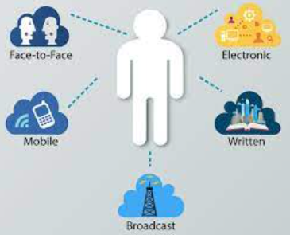
Communication Channels Used to Improve Communication
Exchanging the ideas, opinions and messages by using the ‘right channel’ of communication is needed by the business organisation.
Face-to-Face communication
Video Conferencing
Phone-calls
E-mails
Social Media
Notes:
The right channel of communication is important in the workplace to share real time information flow. Firstly, ‘face-to-face’ communication is effective to remove the misunderstandings. In the workplace, the team meetings are conducted once in a week or month to track the progress and also to share important information. Moreover, direct interaction with the team members in the workplace can also resolve the conflicts if exist. The sensitive topics can be discussed efficiently with the ‘face-to-face’ communication. Secondly, in the remote working perspective, ‘video conferencing’ helps to assess the facial expressions by increasing the flexibility. The large team can be connected efficiently with the video conferencing that can support the verbal communication. The reduction of the travel time and quick real time-sharing options are the benefits of the video conferencing. Thirdly, the ‘phone calls’ are efficient to connect quickly with the individuals and considered to be the most convenient way. During the urgency, one can communicate quickly with the individuals with the help of the phone calls. The lengthy discussion can be executed quickly with the phone calls. In case of the ‘email’, the formal communication method can be implemented. The e-mail will support the documentation process of the organisation. The formal announcement of the company in a structured way can be executed with the help of the e-mail. Lastly, the ‘social media’ is a latest communication channel that can enhance the reach of the message. Currently, the companies are implementing social media platforms to create awareness or inform the customers regarding their new product/services. The active social media users in the UK have reached 52 million in the year 2021. Therefore, social media tools are also considered to be an effective channel for communication for the business organisation.

Slide 8
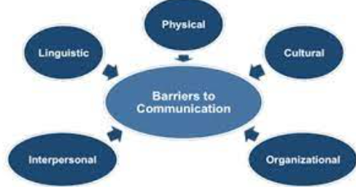
Barriers of Communication
Barriers are the ‘obstacles’ that hinder the communication process in the workplace.
Perceptual and language differences of the employees can influence the communication process.
Information overload creates issue in decoding the exact information from the message.
Rigid organisation structure restrict the free flow of information in the organisation.
Unstructured communication process in the organisation creates misunderstandings.
Notes:
The barriers are the obstacles that influences the communication process of the organisation. Hence, it is important to analyse and examine the barriers to undertake measures. In the workplace, the common barrier is the language differences of the employees. The teams are consisting of the members from diverse backgrounds like race, religion, ethnicity, gender etc. Therefore, the differences among the members can arise while working in the team. The problem in understanding the voice tone or language are the common issues. Secondly, if the message consists of excess information, it will be problematic for the receiver to decode the exact information. Therefore, sharing the exact message is needed to reduce the information overload. Thirdly, the rigid organisation structure can prevent the free flow of information and thereby reduces the chances of creativity in the workplace. Lastly, the unstructured communication process can create misunderstandings and conflicts. Therefore, a specific process of sharing the message or information is required in the workplace.

Slide 9

Impact of Effective Communication in Business
Communication plays a vital role in exchanging the information in the workplace of Walmart.
The communication is a key activity within Walmart that encompasses conveying the business goals, reinforcing the business values, discussions, following-up, interaction with the customers and third parties, stakeholder engagement etc.
The communication helps to build relationships, encourages the innovation, creation of the team, managing employees, etc. within the business premises of Walmart
Notes:
It has been observed that an effective communication process is important in the workplace that encompasses conveying the business goals, reinforcing the business values, discussions, following-up, interaction with the customers and third parties, stakeholder engagement etc. The stakeholders are related to the business affairs directly or indirectly. The stakeholders like investors and shareholders must be updated with the financial information of the organisation. Moreover, the employees are also the stakeholders that requires effective communication flow to make them updated about the organisational policies and decisions. Moreover, the stakeholders like the customers must be engaged with the organisation through promotional campaigns. Therefore, communication plays an important role in driving the business success.

Slide 10
Conclusion
The process of communication acts as a certain medium to transfer key messages among individuals associated with Walmart
Different communication models have been presented measuring the standards of proper communication within the work premises of Walmart
An effective method of communication also measures the nature of adjustability in terms of developing a cohesive working place within Walmart
Inclusion of listening skills and linguistic responses could be understood as the main barriers to communication of Walmart’s employees.
Notes:
The aspect of communication is viewed as the main vehicle of moving compelling data without zeroing in on the limitations of confusion. The presence of various models of correspondence makes minimal development of further developing the data-sharing organization by preferring various people about the thoughts of various correspondence ways. The absence of expert listening abilities and the accessibility of phonetic varieties hampered the development of straightforward correspondence channels among various representatives of Sainsbury. The fruitful translation of compelling specialized strategies makes a firm working group for understanding the significance of sending proficient messages with next to no limitations.

Slide 11
References
Hänninen, N. & Karjaluoto, H., 2017. The effect of marketing communication on business relationship loyalty. Marketing Intelligence & Planning.
Kristjánsson, H. et al., 2020. Resource theories of communication. New Journal of Physics, 22(7), p.073014.
Srivastava, P. et al., 2020. Models of communication and control for brain networks: distinctions, convergence, and future outlook. Network Neuroscience, 4(4), pp.1122-59.
Suh, J., Harrington, J. & Goodman, D., 2018. Understanding the link between organizational communication and innovation: An examination of public, nonprofit, and for-profit organizations. Public Personnel Management, 47(2), pp.217-44.

